Slide 1
Windows shortcuts
W+alt+R – Recrd
W+G – Rcrdfiles
w+d - hide the windows

Slide 2
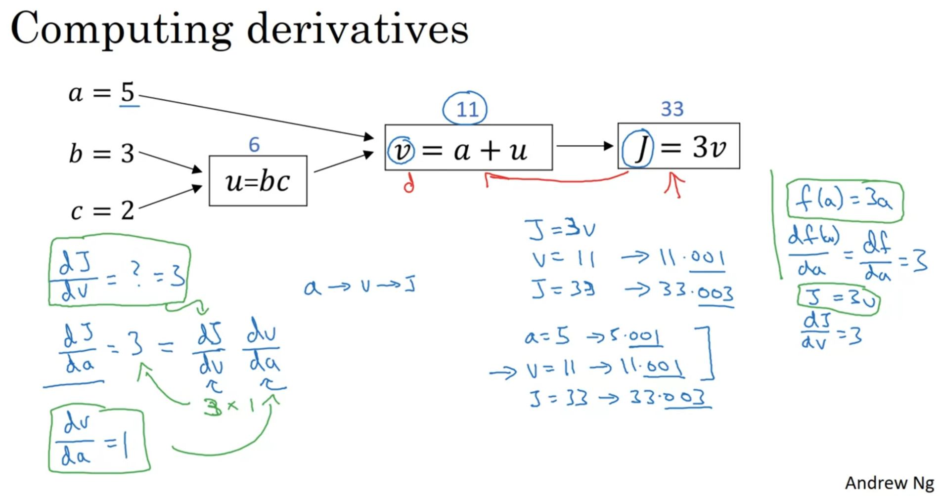

Slide 3
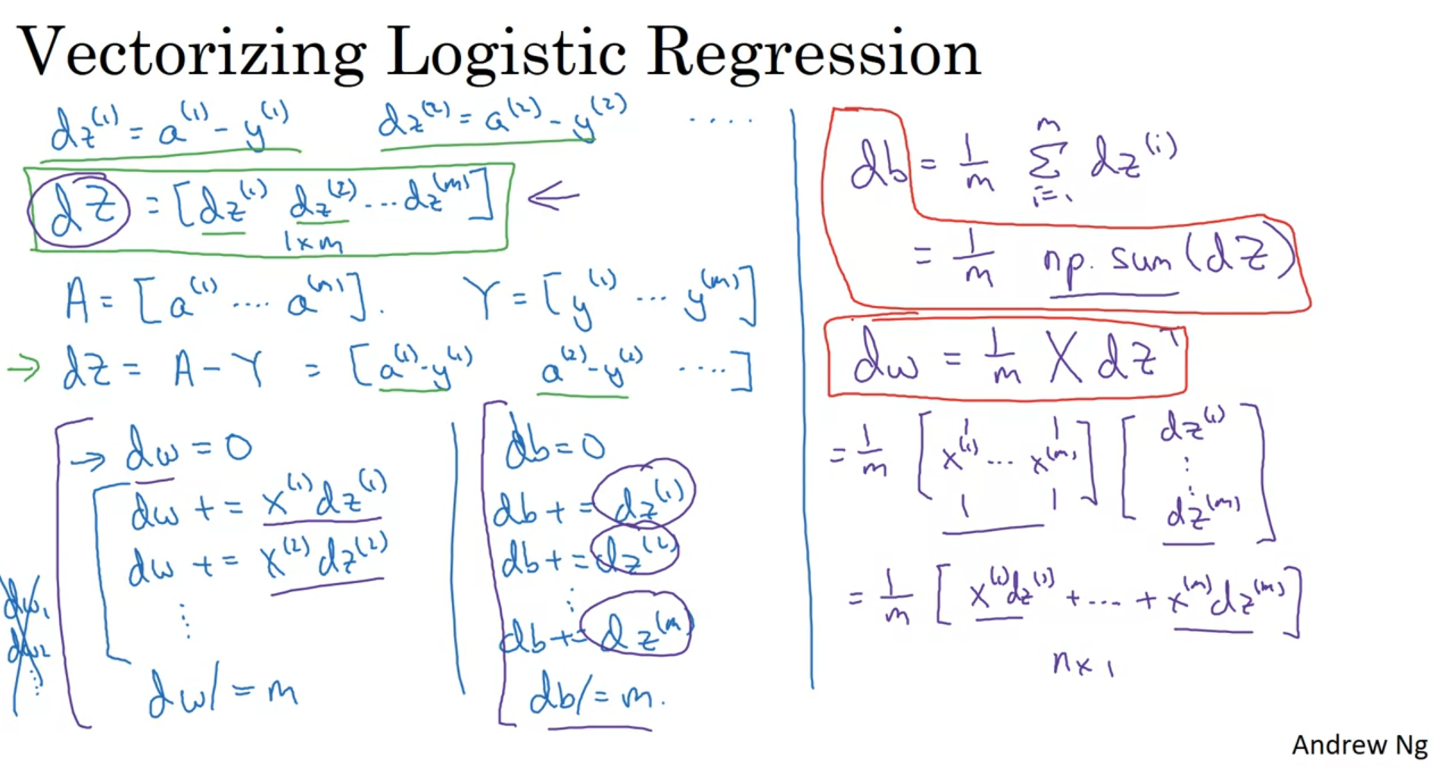

Slide 4
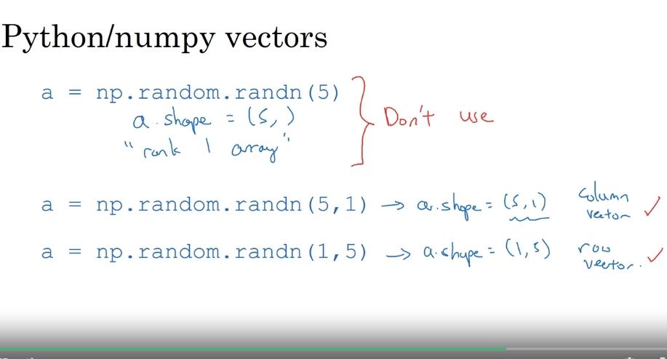

Slide 5
Implementation of function using the numpy
What you need to remember:
np.exp(x) works for any np.array x and applies the exponential function to every coordinate
the sigmoid function and its gradient
image2vector is commonly used in deep learning
np.reshape is widely used. In the future, you'll see that keeping your matrix/vector dimensions straight will go toward eliminating a lot of bugs.
numpy has efficient built-in functions
broadcasting is extremely useful

Slide 6
Key points
Cost function
Loss function
Vectorization

