Slide 1
ATOMS
PRESENTATION
About
Atoms
PRESENTED BY KIRAN

Slide 2
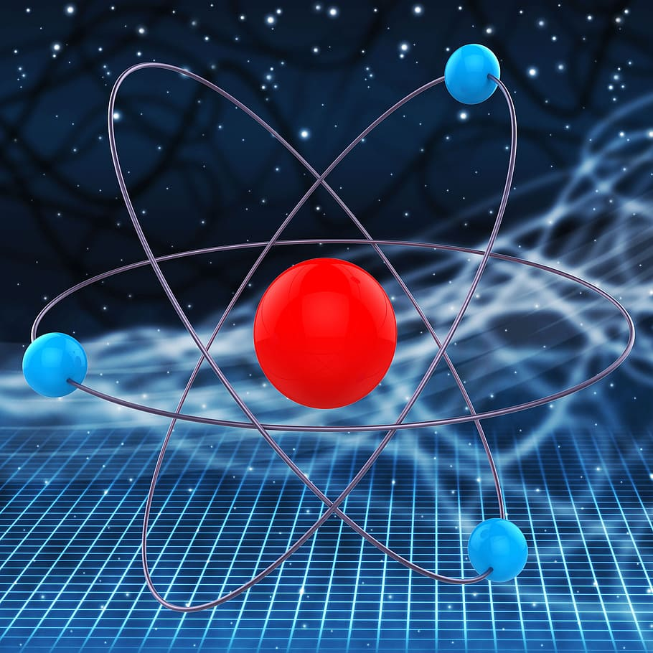
atoms
Atoms are the fundamental building block of all matter. They are smallest particle that are constantly in motion and interact with each other to form large structures.

Slide 3
Atom contain three subatomic particle. They are:
Subatomic particle
ELECTRONS:
Negatively charged particle that revolve around the fixed path called shell.
PROTONS:
Posotively charged particle that found in center of an atoms is known as proton.
Neutrons:
Chargeless particle that found in nucleus in known as neutron.

Slide 4
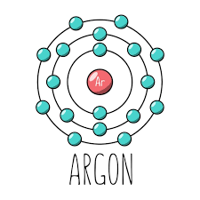

The rules which have eight electron in outer most shell is called octet rule.
OCTET RULE:

Slide 5
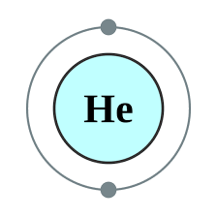
The rules which have two electron in first shell is called DUPLET rule.
DUPLET rule:

Slide 6
THE END

