Slide 1
Creating multiple instance with different names

Slide 2
Step 1: Configure AWS Credentials To allow Terraform to interact with your AWS account, you need to configure your AWS access credentials.
Follow these steps to set up your credentials:
Open the AWS Management Console and navigate to the IAM service.
Create a new IAM user or use an existing one. Assign the necessary permissions for creating EC2 instances and related resources. Note down the Access Key ID and Secret Access Key associated with the IAM user.
On your local machine, open a terminal or command prompt, and execute the following command to configure the AWS credentials: $ aws configure
Enter your Access Key ID, Secret Access Key, default region (e.g., us-east-1), and preferred output format (e.g., json) when prompted.

Slide 3
Step 2: Create a Variables File Create a new file named variables.tf in your Terraform project directory. This file will contain the variable definitions for the EC2 instance configurations.
variables.tf content:
variable “configuration” {
description = “The total configuration, List of Objects/Dictionary”
default = [{}]
}
We define a variable named instance_configs of type map(object ({})) to hold the configurations of our instances. Each configuration includes the ami (Amazon Machine Image), instance_type, and key_name values.

Slide 4
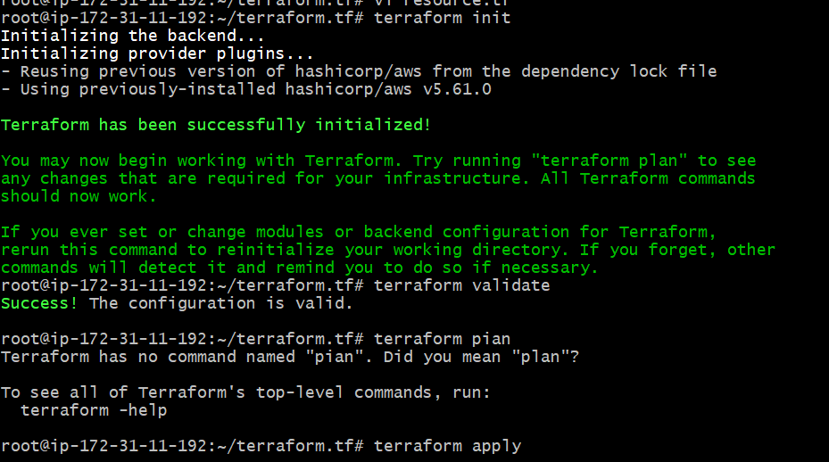
terraform init

Slide 5
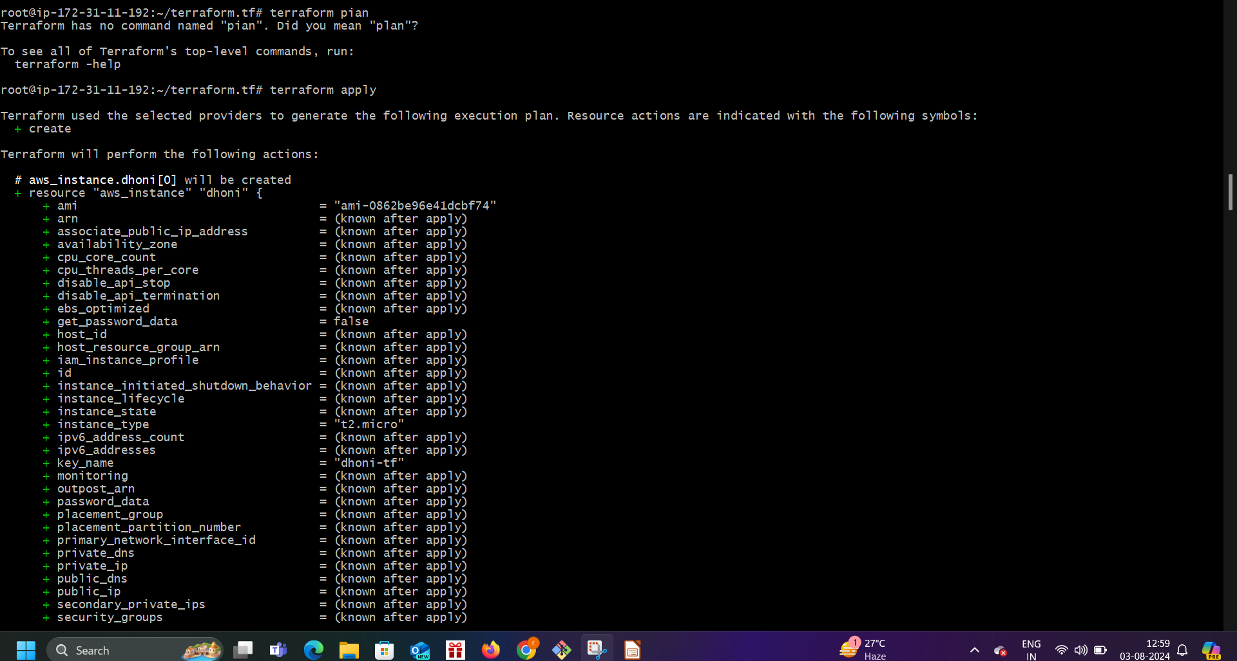
Terraform plan

Slide 6
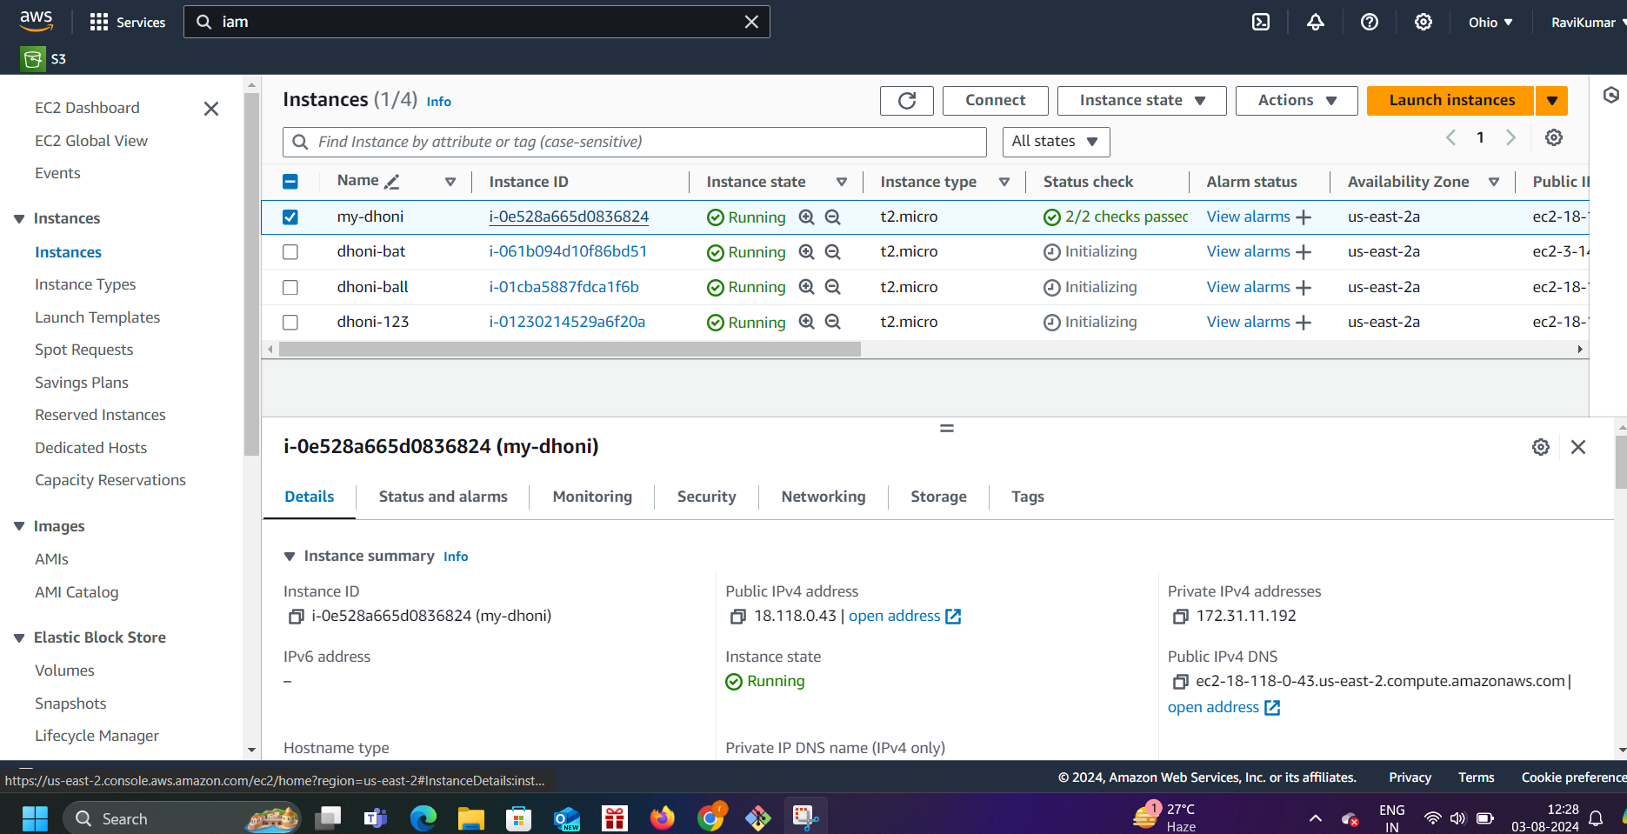

Slide 7
Congratulations! You have successfully created multiple EC2 instances with different configurations using Terraform’s count and for_each feature. By separating the configurations into a variables file (variables.tf) and a configuration file (dev.tfvars), and using the main.tf file for defining resources, you can achieve better organization and flexibility in managing your infrastructure.
Cleanup: To avoid incurring unnecessary costs, consider cleaning up the resources created by Terraform after you have finished using them. Execute the following command to destroy the created resources:

Slide 8
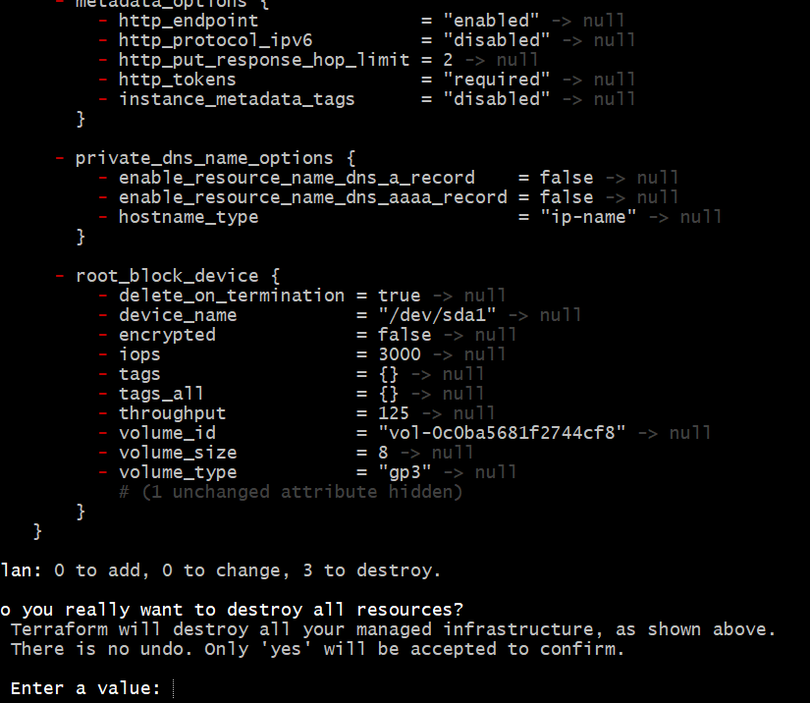
destory

Slide 9
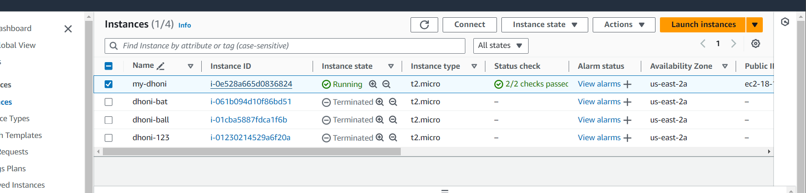

Slide 10
success

