Slide 1
Conditional Identity-Based Broadcast Proxy Re-Encryption and Its Application to Cloud Email

Slide 2
ABSTRACT:
We propose an efficient CIBPRE scheme with provable security. In the instantiated scheme, the initial ciphertext, the re-encrypted ciphertext and the re-encryption key are all in constant size, and the parameters to generate a re-encryption key are independent of the original receivers of any initial ciphertext. Finally, we show an application of our CIBPRE to secure cloud email system advantageous over existing secure email systems based on Pretty Good Privacy protocol or identity-based encryption.

Slide 3
EXISTING SYSTEM:
PRE and IPRE allows a single receiver. If there are more receivers, the system needs to invoke PRE or IPRE multiple times. To address this issue, the concept of broadcast PRE (BPRE) has been proposed. BPRE works in a similar way as PRE and IPRE but more versatile.
In contrast, BPRE allows a sender to generate an initial ciphertext to a receiver set, instead of a single receiver. Further, the sender can delegate a re-encryption key associated with another receiver set so that the proxy can re-encrypt to.

Slide 4
DISADVANTAGES OF EXISTING SYSTEM:
The early PRE was proposed in the traditional public-key infrastructure setting which incurs complicated certificate management.
The PRE schemes only allow data sharing in a coarse-grained manner. That is, if the user delegates a reencryption key to the proxy, all ciphertexts can be reencrypted and then be accessible to the intended users; else none of the ciphertexts can be re-encrypted or accessed by others.
PGP and IBE, system is less efficient in the aspect of communication and not more practical in user experience.
Users are not able to share the encrypted data to others lot of issue are occurring.
No Identity provided for public keys to encrypt data.

Slide 5
PROPOSED SYSTEM:
In this paper, we refine PRE by incorporating the advantages of IPRE, CPRE and BPRE for more flexible applications and propose a new concept of conditional identity based broadcast PRE (CIBPRE). In a CIBPRE system, a trusted key generation center (KGC) initializes the system parameters of CIBPRE, and generates private keys for users.
To securely share files to multiple receivers, a sender can encrypt the files with the receivers’ identities and file-sharing conditions. If later the sender would also like to share some files associated with the same condition with other receivers, the sender can delegate a re-encryption key labeled with the condition to the proxy, and the parameters to generate the re-encryption key is independent of the original receivers of these files. Then the proxy can re-encrypt the initial ciphertexts matching the condition to the resulting receiver set.

Slide 6
ADVANTAGES OF PROPOSED SYSTEM:
The sender does not need to download and re-encrypt repetitively, but delegates a single key matching condition to the proxy. These features make CIBPRE a versatile tool to secure remotely stored files, especially when there are different receivers to share the files as time passes.
We define a practical security notion for CIBPRE systems. Intuitively, without the corresponding private keys, one can learn nothing about the plaintext hidden in the initial or re-encrypted CIBPRE ciphertext; an initial ciphertext can not be correctly re-encrypted by a re-encryption key if the ciphertext and the key are associated with different conditions.

Slide 7
SYSTEM ARCHITECTURE:

Slide 8
HARDWARE REQUIREMENTS:
System : Pentium Dual Core.
Hard Disk : 120 GB.
Monitor : 15’’ LED
Input Devices : Keyboard, Mouse
Ram : 1GB.

Slide 9
SOFTWARE REQUIREMENTS:
Operating system : Windows 7.
Coding Language : JAVA/J2EE
Tool : Netbeans 7.2.1
Database : MYSQL

Slide 10
MODULES:
System Construction Module
Proxy Re-encryption Module
Trusted Key Generation Center (KGC)
Cloud Email

Slide 11
System Construction Module:
In this module a user can upload and send datas to other users in cloud mail and other users can recive the data in cloud mail with a secure way. CIBPRE system, an trusted key generation center (KGC) initializes the system parameters of CIBPRE, and generates private keys for users.
A sender can encrypt the files with the receivers’ identities and file-sharing conditions. If later the sender would also like to share some files associated with the same condition with other receivers, the sender can delegate a reencryption key labeled with the condition to the proxy, and the parameters to generate the re-encryption key is independent of the original receivers of these files

Slide 12
Proxy Re-encryption Module:
In Proxy re-encryption a User may encrypt his file with his own public key and then store the ciphertext in an honest-but-curious server. When the receiver is decided, the sender can delegate a re-encryption key associated with the receiver to the server as a proxy.
Then the proxy re-encrypts the initial ciphertext to the intended receiver. Finally, the receiver can decrypt the resulting ciphertext with her private key.

Slide 13
Trusted Key Generation Center (KGC):
In this module Key generation is the process of generating keys in cryptography. A key is used to encrypt and decrypt whatever data is being encrypted/decrypted by user.The trusted key generation is used for initializes the system parameters of CIBPRE, and generates private keys for users.
The KGC generates the system parameters to initialize the CIBPRE based cloud email system. It chooses a security parameter 2 N and a value N 2 N (the maximal number of receivers of an email), and runs algorithm Setup to generate a pair of master public and secret keys PKPRE and MKPRE.

Slide 14
Cloud Email:
In this module CIBPRE-based cloud email system, the enterprise administrator only needs to initialize the system and generate the private key for the newly joined user. In other words, the enterprise administrator can be offline if no new user joins the system. It is a useful paradigm for the enterprise administrator to resist the outside attacks in practice.
It is a useful paradigm for the enterprise administrator to resist the outside attacks in practice. The cloud server provides efficient services to send, store and forward users’ encrypted emails.

Slide 15
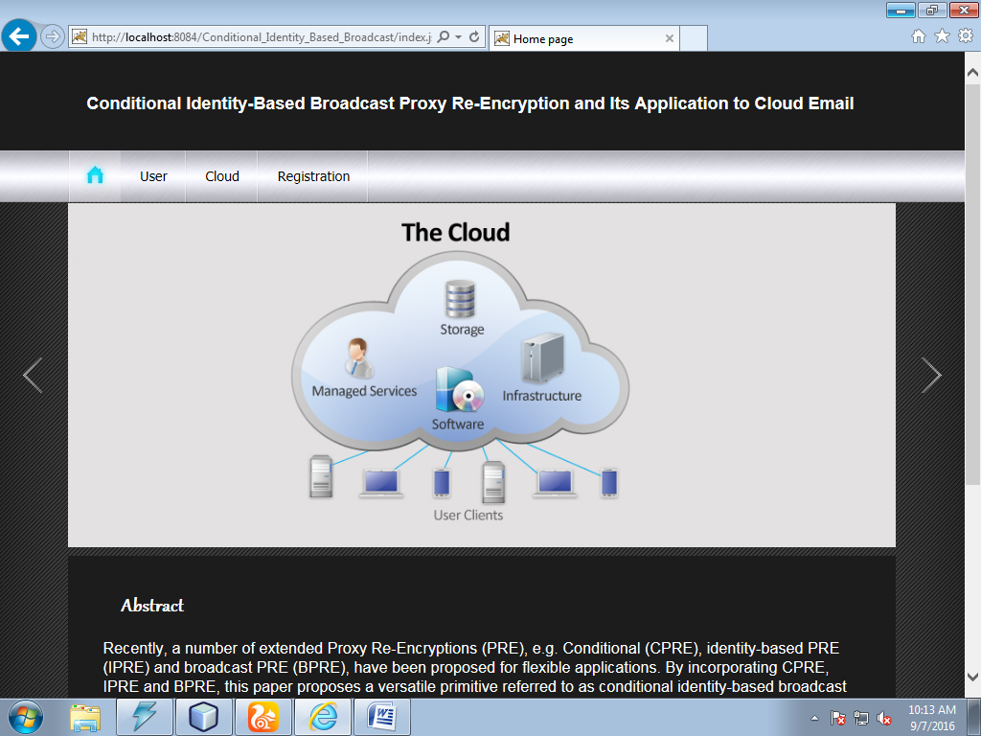

Slide 16
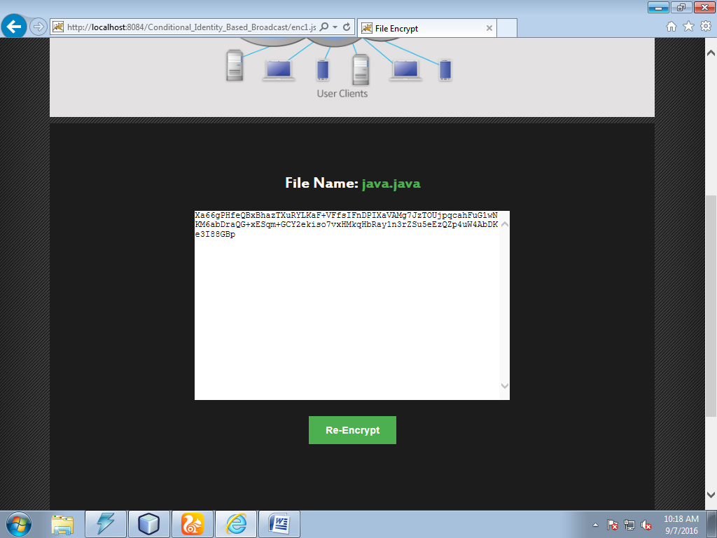

Slide 17
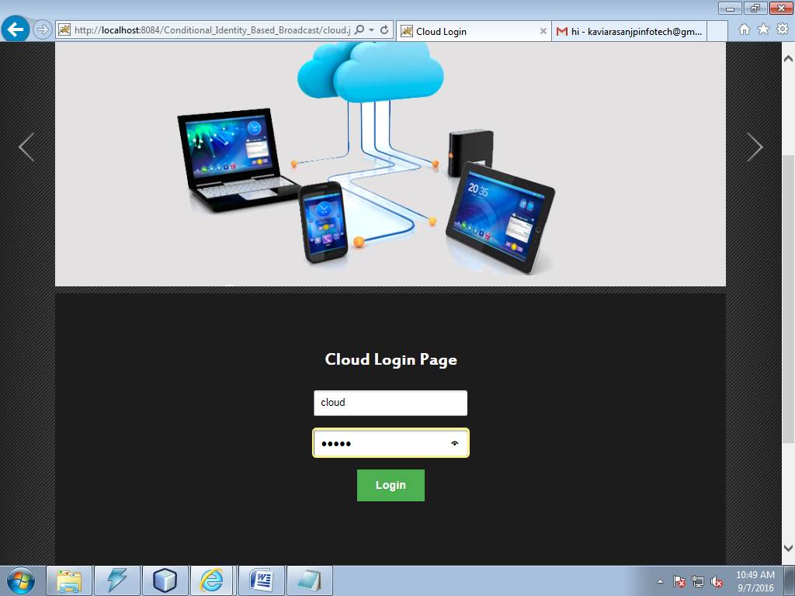

Slide 18
REFERENCE:
Peng Xu, Member, IEEE, Tengfei Jiao, Qianhong Wu, Member, IEEE, Wei Wang, Member, IEEE, and Hai Jin, Senior Member, IEEE, “Conditional Identity-Based Broadcast Proxy Re-Encryption and Its Application to Cloud Email”, IEEE TRANSACTIONS ON COMPUTERS, VOL. 65, NO. 1, JANUARY 2016.

