Slide 1
Syntax Trees
Syntax-Tree
  an intermediate representation of the compiler’s input.
  A condensed form of the parse tree.
  Syntax tree shows the syntactic structure of the program while omitting irrelevant details.
  Operators and keywords are associated with the interior nodes.
  Chains of simple productions are collapsed.
Syntax directed translation can be based on syntax tree as well as parse tree.

Slide 2
Syntax Tree-Examples
Expression:
+
5 *
3 4
Leaves: identifiers or constants
Internal nodes: labelled with operations
Children: of a node are its operands
if B then S1 else S2
  if - then - else
Statement:
Node’s label indicates what kind of a statement it is
Children of a node correspond to the components of the statement
B S1 S2

Slide 3
Constructing Syntax Tree for Expressions
Each node can be implemented as a record with several fields.
Operator node: one field identifies the operator (called label of the node) and remaining fields contain pointers to operands.
The nodes may also contain fields to hold the values (pointers to values) of attributes attached to the nodes.
Functions used to create nodes of syntax tree for expressions with binary operator are given below.
  mknode(op,left,right)
  mkleaf(id,entry)
  mkleaf(num,val)
  Each function returns a pointer to a newly created node.

Slide 4
Constructing Syntax Tree for Expressions-
Example: a-4+c
p1:=mkleaf(id,entrya);
p2:=mkleaf(num,4);
3. p3:=mknode(-,p1,p2)
p4:=mkleaf(id,entryc);
p5:= mknode(+,p3,p4);
The tree is constructed bottom up.
+
-
id
to entry for c
id
num | 4
to entry for a

Slide 5
A syntax Directed Definition for Constructing Syntax Tree
It uses underlying productions of the grammar to schedule the calls of the functions mkleaf and mknode to construct the syntax tree
Employment of the synthesized attribute nptr (pointer) for E and T to keep track of the pointers returned by the function calls.
PRODUCTION SEMANTIC RULE
E → E₁ + T E.nptr = mknode(“+”,E₁.nptr ,T.nptr)
E → E₁ - T E.nptr = mknode(“-”,E₁.nptr ,T.nptr)
E → T E.nptr = T.nptr
T → (E) T.nptr = E.nptr
T → id T.nptr = mkleaf(id, id.lexval)
T → num T.nptr = mkleaf(num, num.val)

Slide 6
Annotated parse tree depicting construction of syntax tree for the expression a-4+c
E.nptr
E.nptr + T.nptr
E.nptr - T.nptr
id
+
T.nptr num
-
id
id
Entry for c
id
num
Entry for a

Slide 7
Why intermediate code ?
Details of the source language are confined to the front_x0002_end (analysis phase) of a compiler, while details of the target machine are confined to the back-end (synthesis) part.
This saves a considerable amount of effort since with m front-ends and n back-ends we have m*n compilers
Intermediate representations
Syntax Trees : Code is represented in the form of a tree where nodes represent constructs in the source program; the children of a node represent the meaningful components of a construct.
Three-Address Code: Made up of instructions of the general form x=y op z .
X, y and z are the three addresses.

Slide 8
Three Address Code (TAC)
An alternative form of intermediate (lower level) representation.
x+y*x becomes t 1 = y * z , t 2 = x + t1
For expressions TAC is very similar to syntax trees.
For statements it would produce labels and jumps in a similar fashion to machine code

Slide 9
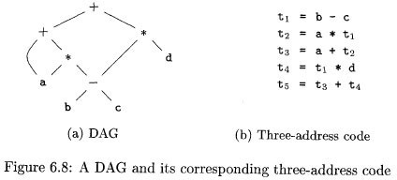
TAC for a+a*(b-c)+(b-c)*d

Slide 10

Directed Acyclic Graphs
Nodes in a syntax tree represent constructs in the source program
A DAG is used to identify common sub_x0002_expressions. e.g. a+a*(b-c)+(b-c)*d
By doing so it gives the compiler important hints on how to generate efficient code to evaluate the expressions

Slide 11
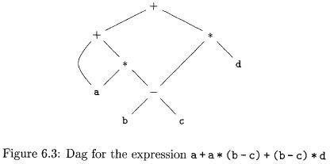
DAG for a+a*(b-c)+(b-c)*d

Slide 12
Quadruples and Triples
Data structures to hold three address code instructions.
A Quadruple has four fields ( x = y+z)
  Op (+)
  Arg1 (y)
  Arg2 (z)
  Result (x)

Slide 13
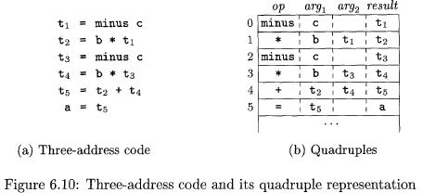
An example ...

Slide 14
Triples
Omit result field.
Instead of a result field we can use pointers to the triple structure itself.
This makes DAG and triple representation practically identical, since we are pointing to a node.
In next example (n) indicates position n in the triple structure

Slide 15
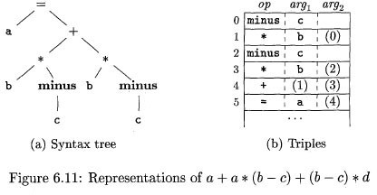
An example ...

Slide 16
Control Flow
A directed graph where
  Each node represents a statement
  Edges represent control flow
Statements may be
  Assignments x = y op z or x = op z
  Copy statements x = y
  Branches goto L or if relop y goto L
  etc

Slide 17
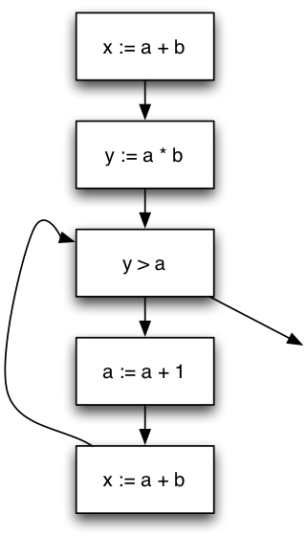
Control-flow Graph Example
x := a + b;
y := a * b
While (y > a){
a := a +1;
x := a + b
}

Slide 18
Back-patching
The problem in generating three address codes in a single pass is that we may not know the labels that control must go to at the time jump statements are generated.So to get around this problem a series of branching statements with the targets of the jumps temporarily left unspecified is generated.
Back Patching is putting the address instead of labels when the proper label is determined.
Back patching Algorithms perform three types of operations
1) makelist (i) – creates a new list containing only i, an index into the array of quadruples and returns a pointer to the list it has made.
2) Merge (i, j) – concatenates the lists pointed to by i and j, and returns a pointer to the concatenated list.
3) Backpatch (p, i) – inserts i as the target label for each of the statements on the list pointed to by p.

