Slide 1
Cryptography and Network Security
UNIT- 1
Computer Security concepts
Security attacks
Security mechanisms
Security services
OSI Security Architecture
A Model for Network security
Classical Encryption Techniques
Substitution Ciphers
Transposition Ciphers

Slide 2
Definitions
  Cryptography- Study of methods in protecting information and communication through the use of codes.
  Cryptanalysis - Study of methods in defeating cryptography.
  Network Security - measures to protect data during their transmission
  Computer Security - generic name for the collection of tools designed to protect data and to thwart hackers
  Internet Security - measures to protect data during their transmission over a collection of interconnected networks

Slide 3
Computer Security concepts
Computer Security -: The protection afforded to an automated information system in order to attain the applicable objectives of preserving the integrity, availability, and confidentiality of information system resources (includes hardware, software, firmware, information/data, and telecommunications).

Slide 4
KEY SECURITY OBJECTIVES
CIA triad
Confidentiality
Data Confidentiality
Privacy
Integrity
Data Integrity
System Integrity
Availability

Slide 5
Aspects of Security
Consider 3 aspects of information security:
  Security Attack: Any action that compromises the security of information.
  Security Mechanism: A mechanism that is designed to detect, prevent, or recover from a security attack.
  Security Service: A service that enhances the security of data processing systems and information transfers. A security service makes use of one or more security mechanisms

Slide 6
Security Attacks
Any action that compromises the security of information owned by an organization.
Information security is about how to prevent attacks, or failing that, to detect attacks on information-based systems
Types of attacks
  passive
  active

Slide 7

Passive Attack - Interception
Notes:
A useful means of classifying security attacks, used both in X.800 and RFC 2828, is in terms of passive attacks and active attacks. A passive attack attempts to learn or make use of information from the system but does not affect system resources.
Passive attacks are in the nature of eavesdropping on, or monitoring of, transmissions. The goal of the opponent is to obtain information that is being transmitted. Two types of passive attacks are:
+ release of message contents - as shown above in Stallings Figure 1.2a here
+ traffic analysis - monitor traffic flow to determine location and identity of communicating hosts and could observe the frequency and length of messages being exchanged
These attacks are difficult to detect because they do not involve any alteration of the data.

Slide 8
Passive Attack: Traffic Analysis
Observe traffic pattern

Slide 9
Active Attack: Interruption
(Denial of service)
Block delivery of message

Slide 10
Active Attack: Fabrication
Fabricate message

Slide 11

Active Attack: Replay
Notes:
Active attacks involve some modification of the data stream or the creation of a false stream and can be subdivided into four categories: masquerade, replay, modification of messages, and denial of service:
masquerade of one entity as some other
replay previous messages (as shown above in Stallings Figure 1.3b)
modify/alter (part of) messages in transit to produce an unauthorized effect
denial of service - prevents or inhibits the normal use or management of communications facilities
Active attacks present the opposite characteristics of passive attacks. Whereas passive attacks are difficult to detect, measures are available to prevent their success. On the other hand, it is quite difficult to prevent active attacks absolutely, because of the wide variety of potential physical, software, and network vulnerabilities. Instead, the goal is to detect active attacks and to recover from any disruption or delays caused by them.

Slide 12
Active Attack: Modification
Modify message
Notes:
Active attacks involve some modification of the data stream or the creation of a false stream and can be subdivided into four categories: masquerade, replay, modification of messages, and denial of service:
masquerade of one entity as some other
replay previous messages (as shown above in Stallings Figure 1.3b)
modify/alter (part of) messages in transit to produce an unauthorized effect
denial of service - prevents or inhibits the normal use or management of communications facilities
Active attacks present the opposite characteristics of passive attacks. Whereas passive attacks are difficult to detect, measures are available to prevent their success. On the other hand, it is quite difficult to prevent active attacks absolutely, because of the wide variety of potential physical, software, and network vulnerabilities. Instead, the goal is to detect active attacks and to recover from any disruption or delays caused by them.

Slide 13
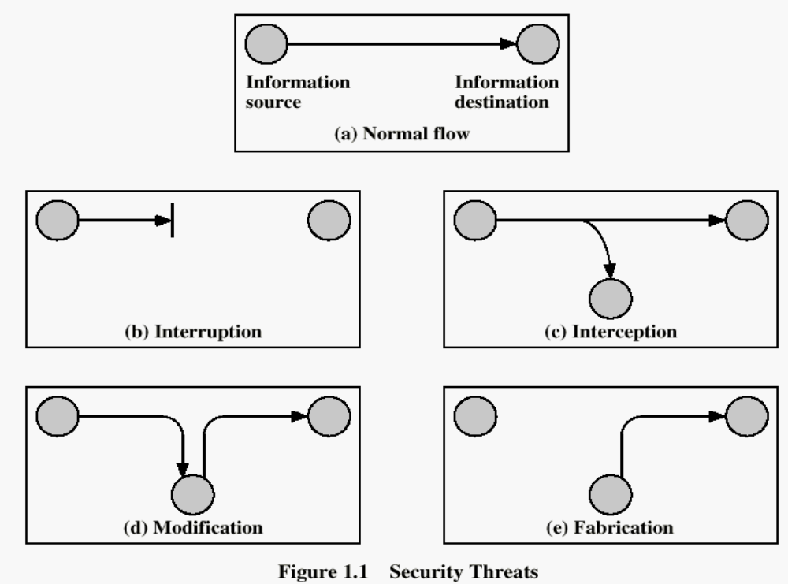
Security Attacks

Slide 14
Security Mechanism
feature designed to detect, prevent, or recover from a security attack
no single mechanism that will support all services required
however one particular element underlies many of the security mechanisms in use:
  cryptographic techniques
Notes:
Now introduce “Security Mechanism” which are the specific means of implementing one or more security services.
Note these mechanisms span a wide range of technical components, but one aspect seen in many is the use of cryptographic techniques.

Slide 15
Security Mechanisms (X.800)
specific security mechanisms:
  encipherment, digital signatures, access controls, data integrity, authentication exchange, traffic padding, routing control, notarization
pervasive security mechanisms:
  trusted functionality, security labels, event detection, security audit trails, security recovery

Slide 16
Security Service
  enhance security of data processing systems and information transfers of an organization
  intended to counter security attacks
  using one or more security mechanisms
  often replicates functions normally associated with physical documents
    which, for example, have signatures, dates; need protection from disclosure, tampering, or destruction; be notarized or witnessed; be recorded or licensed

Slide 17
Security Services
X.800:
  “a service provided by a protocol layer of communicating open systems, which ensures adequate security of the systems or of data transfers”
RFC 2828:
  “a processing or communication service provided by a system to give a specific kind of protection to system resources”
Notes:
Also have a couple of definition of “security services” from relevant standards. X.800 defines a security service as a service provided by a protocol layer of communicating open systems, which ensures adequate security of the systems or of data transfers. Perhaps a clearer definition is found in RFC 2828, which provides the following definition: a processing or communication service that is provided by a system to give a specific kind of protection to system resources; security services implement security policies and are implemented by security mechanisms.

Slide 18
Security Services (X.800)
Authentication - assurance that the communicating entity is the one claimed
Access Control - prevention of the unauthorized use of a resource
Data Confidentiality –protection of data from unauthorized disclosure
Data Integrity - assurance that data received is as sent by an authorized entity
Non-Repudiation - protection against denial by one of the parties in a communication

Slide 19

OSI Security Architecture
ITU-T X.800 “Security Architecture for OSI”
defines a systematic way of defining and providing security requirements
for us it provides a useful, if abstract, overview of concepts we will study

Slide 20
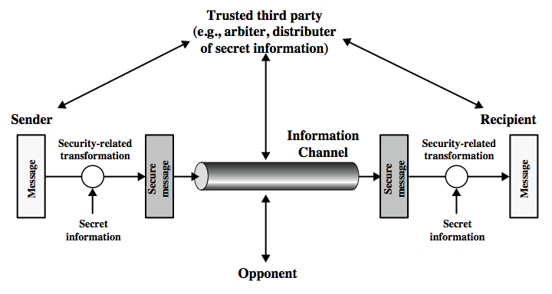
Model for Network Security
Notes:
In considering the place of encryption, its useful to use the following two models
The first, models information being transferred from one party to another over an insecure communications channel, in the presence of possible opponents. The two parties, who are the principals in this transaction, must cooperate for the exchange to take place. They can use an appropriate security transform (encryption algorithm), with suitable keys, possibly negotiated using the presence of a trusted third party.

Slide 21
Model for Network Security
using this model requires us to:
  design a suitable algorithm for the security transformation
  generate the secret information (keys) used by the algorithm
  develop methods to distribute and share the secret information
  specify a protocol enabling the principals to use the transformation and secret information for a security service
Notes:
This general model shows that there are four basic tasks in designing a particular security service, as listed.

Slide 22
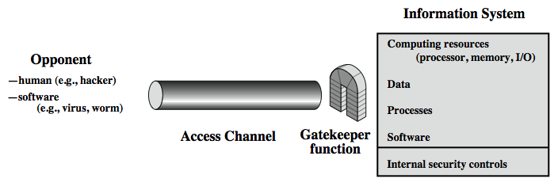
Model for Network Access Security
Notes:
The second, model is concerned with controlled access to information or resources on a computer system, in the presence of possible opponents. Here appropriate controls are needed on the access to and within the system, to provide suitable security.
The security mechanisms needed to cope with unwanted access fall into two broad categories (as shown in this figure). The first category might be termed a gatekeeper function. It includes password-based login procedures that are designed to deny access to all but authorized users and screening logic that is designed to detect and reject worms, viruses, and other similar attacks. Once either an unwanted user or unwanted software gains access, the second line of defense consists of a variety of internal controls that monitor activity and analyze stored information in an attempt to detect the presence of unwanted intruders.

Slide 23
Model for Network Access Security
using this model requires us to:
  select appropriate gatekeeper functions to identify users
  implement security controls to ensure only authorised users access designated information or resources
note that model does not include:
  monitoring of system for successful penetration
  monitoring of authorized users for misuse
  audit logging for forensic uses, etc.
Notes:
Detail here the tasks needed to use this model.

Slide 24
Classical Encryption
Techniques
Symmetric Encryption
or conventional / private-key / single-key
sender and recipient share a common key
all classical encryption algorithms are private-key
was only type prior to invention of public-key in 1970’s
and by far most widely used
Notes:
Symmetric encryption, also referred to as conventional encryption or single-key encryption, was the only type of encryption in use prior to the development of public-key encryption in the 1970s. It remains by far the most widely used of the two types of encryption. All traditional schemes are symmetric / single key / private-key encryption algorithms, with a single key, used for both encryption and decryption. Since both sender and receiver are equivalent, either can encrypt or decrypt messages using that common key.

Slide 25
Some Basic Terminology
plaintext - original message
ciphertext - coded message
cipher - algorithm for transforming plaintext to ciphertext
key - info used in cipher known only to sender/receiver
encipher (encrypt) - converting plaintext to ciphertext
decipher (decrypt) - recovering ciphertext from plaintext
cryptography - study of encryption principles/methods
cryptanalysis (codebreaking) - study of principles/ methods of deciphering ciphertext without knowing key
cryptology - field of both cryptography and cryptanalysis

Slide 26

Symmetric Cipher Model
Notes:
Detail the five ingredients of the symmetric cipher model, shown in Stallings Figure 2.1:
plaintext - original message
encryption algorithm – performs substitutions/transformations on plaintext
secret key – control exact substitutions/transformations used in encryption algorithm
ciphertext - scrambled message
decryption algorithm – inverse of encryption algorithm

Slide 27
Requirements
two requirements for secure use of symmetric encryption:
  a strong encryption algorithm
  a secret key known only to sender / receiver
mathematically have:
  Y = E_{K}(X)
  X = D_{K}(Y)
assume encryption algorithm is known
implies a secure channel to distribute key

Slide 28
Cryptography
characterize cryptographic system by:
  type of encryption operations used
    substitution / transposition / product
  number of keys used
    single-key or private / two-key or public
  way in which plaintext is processed
    block / stream

Slide 29
Cryptanalysis
objective to recover key not just message
general approaches:
  cryptanalytic attack
  brute-force attack

Slide 30
Cryptanalytic Attacks
ciphertext only
  only know algorithm & ciphertext, is statistical, know or can identify plaintext
known plaintext
  know/suspect plaintext & ciphertext
chosen plaintext
  select plaintext and obtain ciphertext
chosen ciphertext
  select ciphertext and obtain plaintext
chosen text
  select plaintext or ciphertext to en/decrypt

Slide 31
Brute Force Search
always possible to simply try every key
most basic attack, proportional to key size
assume either know / recognise plaintext
Key Size (bits) | Number of Alternative Keys | Time required at 1 decryption/µs | Time required at 10⁶ decryptions/µs
32 | 2³² = 4.3 × 10⁹ | 2³¹ µs = 35.8 minutes | 2.15 milliseconds
56 | 2⁵⁶ = 7.2 × 10¹⁶ | 2⁵⁵ µs = 1142 years | 10.01 hours
128 | 2¹²⁸ = 3.4 × 10³⁸ | 2¹²⁷ µs = 5.4 × 10²⁴ years | 5.4 × 10¹⁸ years
168 | 2¹⁶⁸ = 3.7 × 10⁵⁰ | 2¹⁶⁷ µs = 5.9 × 10³⁶ years | 5.9 × 10³⁰ years
26 characters (permutation) | 26! = 4 × 10²⁶ | 2 × 10²⁶ µs = 6.4 × 10¹² years | 6.4 × 10⁶ years

Slide 32
Classical Substitution Ciphers
where letters of plaintext are replaced by other letters or by numbers or symbols
or if plaintext is viewed as a sequence of bits, then substitution involves replacing plaintext bit patterns with ciphertext bit patterns

Slide 33
Caesar Cipher
earliest known substitution cipher
by Julius Caesar
first attested use in military affairs
replaces each letter by 3rd letter on
example:
  meet me after the toga party
  PHHW PH DIWHU WKH WRJD SDUWB

Slide 34
Caesar Cipher
can define transformation as:
  a b c d e f g h i j k l m n o p q r s t u v w x y z
  D E F G H I J K L M N O P Q R S T U V W X Y Z A B C
mathematically give each letter a number
  a b c d e f g h i j k l m n o p q r s t u v w x y z
  0 1 2 3 4 5 6 7 8 9 10 11 12 13 14 15 16 17 18 19 20 21 22 23 24 25
then have Caesar cipher as:
  C = E(k ,p) = (p + k) mod (26)
  p = D(k ,C) = (C – k) mod (26)
Notes:
This mathematical description uses modulo (clock) arithmetic. Here, when you reach Z you go back to A and start again. Mod 26 implies that when you reach 26, you use 0 instead (ie the letter after Z, or 25 + 1 goes to A or 0).
Example: howdy (7,14,22,3,24) encrypted using key f (ie a shift of 5) is MTBID

Slide 35
Cryptanalysis of Caesar Cipher
only have 26 possible ciphers
  A maps to A,B,..Z
could simply try each in turn
a brute force search
given ciphertext, just try all shifts of letters
do need to recognize when have plaintext
eg. break ciphertext "GCUA VQ DTGCM"
Notes:
Example "GCUA VQ DTGCM" when broken gives "easy to break", with a shift of 2 (key C).

Slide 36
Monoalphabetic Cipher
rather than just shifting the alphabet
could shuffle (jumble) the letters arbitrarily
each plaintext letter maps to a different random ciphertext letter
hence key is 26 letters long
  Plain: abcdefghijklmnopqrstuvwxyz
  Cipher: DKVQFIBJWPESCXHTMYAUOLRGZN
  Plaintext: ifwewishtoreplaceletters
  Ciphertext: WIRFRWAJUHYFTSDVFSFUUFYA
Notes:
With only 25 possible keys, the Caesar cipher is far from secure. A dramatic increase in the key space can be achieved by allowing an arbitrary substitution, where the translation alphabet can be any permutation of the 26 alphabetic characters.
See example translation alphabet, and an encrypted message using it.

Slide 37
Monoalphabetic Cipher Security
now have a total of 26! = 4 x 1026 keys
with so many keys, might think is secure
but would be !!!WRONG!!!
problem is language characteristics
Notes:
Note that even given the very large number of keys, being 10 orders of magnitude greater than the key space for DES, the monoalphabetic substitution cipher is not secure, because it does not sufficiently obscure the underlying language characteristics.

Slide 38
Language Redundancy and Cryptanalysis
human languages are redundant
eg "th lrd s m shphrd shll nt wnt"
letters are not equally commonly used
in English E is by far the most common letter
  followed by T,R,N,I,O,A,S
other letters like Z,J,K,Q,X are fairly rare
have tables of single, double & triple letter frequencies for various languages
Notes:
As the example shows, we don't actually need all the letters in order to understand written English text. Here vowels were removed, but they're not the only redundancy. cf written Hebrew has no vowels for same reason. Are usually familiar with "party conversations", can hear one person speaking out of hubbub of many, again because of redundancy in aural language also. This redundancy is also the reason we can compress text files, the computer can derive a more compact encoding without losing any information. Basic idea is to count the relative frequencies of letters, and note the resulting pattern.

Slide 39

English Letter Frequencies
Notes:
Note that all human languages have varying letter frequencies, though the number of letters and their frequencies varies. Stallings Figure 2.5 shows English letter frequencies. Seberry & Pieprzyk, "Cryptography - An Introduction to Computer Security", Prentice-Hall 1989, Appendix A has letter frequency graphs for 20 languages (most European & Japanese & Malay).

Slide 40
Use in Cryptanalysis
key concept - monoalphabetic substitution ciphers do not change relative letter frequencies
discovered by Arabian scientists in 9th century
calculate letter frequencies for ciphertext
compare counts/plots against known values
if caesar cipher look for common peaks/troughs
  peaks at: A-E-I triple, NO pair, RST triple
  troughs at: JK, X-Z
for monoalphabetic must identify each letter
  tables of common double/triple letters help
Notes:
The simplicity and strength of the monoalphabetic substitution cipher meant it dominated cryptographic use for the first millenium AD. It was broken by Arabic scientists. The earliest known description is in Abu al-Kindi's "A Manuscript on Deciphering Cryptographic Messages", published in the 9th century but only rediscovered in 1987 in Istanbul, but other later works also attest to their knowledge of the field. Monoalphabetic ciphers are easy to break because they reflect the frequency data of the original alphabet. The cryptanalyst looks for a mapping between the observed pattern in the ciphertext, and the known source language letter frequencies. If English, look for peaks at: A-E-I triple, NO pair, RST triple, and troughs at: JK, X-Z.

Slide 41
Example Cryptanalysis
given ciphertext:
  UZQSOVUOHXMOPVGPOZPEVSGZWSZOPFPESXUDBMETSXAIZ
  VUEPHZHMDZSHZOWSFPAPPDTSVPQUZWYMXUZUHSX
  EPYEPOPDZSZUFPOMBZWPFUPZHMDJUDTMOHMQ
count relative letter frequencies (see text)
guess P & Z are e and t
guess ZW is th and hence ZWP is the
proceeding with trial and error finally get:
  it was disclosed yesterday that several informal but
  direct contacts have been made with political
  representatives of the viet cong in moscow

Slide 42
Playfair Cipher
not even the large number of keys in a monoalphabetic cipher provides security
one approach to improving security was to encrypt multiple letters
the Playfair Cipher is an example
invented by Charles Wheatstone in 1854, but named after his friend Baron Playfair
Notes:
Consider ways to reduce the "spikyness" of natural language text, since if just map one letter always to another, the frequency distribution is just shuffled. One approach is to encrypt more than one letter at once. The Playfair cipher is an example of doing this.

Slide 43
Playfair Key Matrix
a 5X5 matrix of letters based on a keyword
fill in letters of keyword (sans duplicates)
fill rest of matrix with other letters
eg. using the keyword MONARCHY
M | O | N | A | R
C | H | Y | B | D
E | F | G | I/J | K
L | P | Q | S | T
U | V | W | X | Z
Notes:
The best-known multiple-letter encryption cipher is the Playfair, which treats digrams in the plaintext as single units and translates these units into ciphertext digrams. The Playfair algorithm is based on the use of a 5x5 matrix of letters constructed using a keyword. The rules for filling in this 5x5 matrix are: L to R, top to bottom, first with keyword after duplicate letters have been removed, and then with the remain letters, with I/J used as a single letter. This example comes from Dorothy Sayer's book "Have His Carcase", in which Lord Peter Wimsey solves it, and describes the use of a probably word attack.

Slide 44
Encrypting and Decrypting
plaintext is encrypted two letters at a time
  if a pair is a repeated letter, insert filler like 'X’
  if both letters fall in the same row, replace each with letter to right (wrapping back to start from end)
  if both letters fall in the same column, replace each with the letter below it (again wrapping to top from bottom)
  otherwise each letter is replaced by the letter in the same row and in the column of the other letter of the pair
Notes:
Plaintext is encrypted two letters at a time,according to the rules as shown. Note how you wrap from right side back to left, or from bottom back to top.
if a pair is a repeated letter, insert a filler like 'X', eg. "balloon" encrypts as "ba lx lo on"
if both letters fall in the same row, replace each with letter to right (wrapping back to start from end), eg. “ar" encrypts as "RM"
if both letters fall in the same column, replace each with the letter below it (again wrapping to top from bottom), eg. “mu" encrypts to "CM"
otherwise each letter is replaced by the one in its row in the column of the other letter of the pair, eg. “hs" encrypts to "BP", and “ea" to "IM" or "JM" (as desired)
Decrypting of course works exactly in reverse. Can see this by working the example pairs shown, backwards.

Slide 45
Security of Playfair Cipher
security much improved over monoalphabetic
since have 26 x 26 = 676 digrams
would need a 676 entry frequency table to analyse (verses 26 for a monoalphabetic)
and correspondingly more ciphertext
was widely used for many years
  eg. by US & British military in WW1
it can be broken, given a few hundred letters
since still has much of plaintext structure
Notes:
The Playfair cipher is a great advance over simple monoalphabetic ciphers, since there are 26*26=676 digrams (vs 26 letters), so that identification of individual digrams is more difficult. Also,the relative frequencies of individual letters exhibit a much greater range than that of digrams, making frequency analysis much more difficult. The Playfair cipher was for a long time considered unbreakable. It was used as the standard field system by the British Army in World War I and still enjoyed considerable use by the U.S.Army and other Allied forces during World War II. Despite this level of confidence in its security,the Playfair cipher is relatively easy to break because it still leaves much of the structure of the plaintext language intact

Slide 46
Polyalphabetic Ciphers
polyalphabetic substitution ciphers
improve security using multiple cipher alphabets
make cryptanalysis harder with more alphabets to guess and flatter frequency distribution
use a key to select which alphabet is used for each letter of the message
use each alphabet in turn
repeat from start after end of key is reached
Notes:
One approach to reducing the "spikyness" of natural language text is used the Playfair cipher which encrypts more than one letter at once. We now consider the other alternative, using multiple cipher alphabets in turn. This gives the attacker more work, since many alphabets need to be guessed, and because the frequency distribution is more complex, since the same plaintext letter could be replaced by several ciphertext letters, depending on which alphabet is used. The general name for this approach is a polyalphabetic substitution cipher. All these techniques have the following features in common:
A set of related monoalphabetic substitution rules is used.
2. A key determines which particular rule is chosen for a given transformation.

Slide 47
Vigenère Cipher
simplest polyalphabetic substitution cipher
effectively multiple caesar ciphers
key is multiple letters long K = k₁ k₂ ... k_{d}
i^{th} letter specifies i^{th} alphabet to use
use each alphabet in turn
repeat from start after d letters in message
decryption simply works in reverse
Notes:
The best known, and one of the simplest, such algorithms is referred to as the Vigenère cipher, where the set of related monoalphabetic substitution rules consists of the 26 Caesar ciphers, with shifts of 0 through 25. Each cipher is denoted by a key letter, which is the ciphertext letter that substitutes for the plaintext letter ‘a’, and which are each used in turn, as shown next.

Slide 48
Example of Vigenère Cipher
write the plaintext out
write the keyword repeated above it
use each key letter as a caesar cipher key
encrypt the corresponding plaintext letter
eg using keyword deceptive
  key: deceptivedeceptivedeceptive
  plaintext: wearediscoveredsaveyourself
  ciphertext:ZICVTWQNGRZGVTWAVZHCQYGLMGJ
Notes:
Discuss this simple example from text Stallings section 2.2.

Slide 49
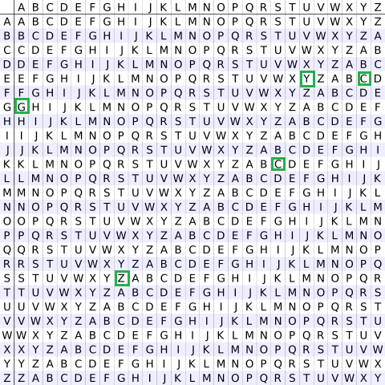
Vigenère square or Vigenère table.

Slide 50
Security of Vigenère Ciphers
have multiple ciphertext letters for each plaintext letter
hence letter frequencies are obscured
but not totally lost
start with letter frequencies
  see if look monoalphabetic or not
if not, then need to determine number of alphabets, since then can attach each
Notes:
The Vigenère & related polyalphabetic ciphers still do not completely obscure the underlying language characteristics.
The key to breaking them was to identify the number of translation alphabets, and then attack each separately.
Encryption The plaintext(P) and key(K) are added modulo 26. E_{i} = (P_{i} + K_{i}) mod 26
Decryption D_{i} = (E_{i} - K_{i} + 26) mod 26

Slide 51
One-Time Pad
if a truly random key as long as the message is used, the cipher will be secure
called a One-Time pad
is unbreakable since ciphertext bears no statistical relationship to the plaintext
since for any plaintext & any ciphertext there exists a key mapping one to other
can only use the key once though
problems in generation & safe distribution of key
Notes:
The One-Time Pad is an evolution of the Vernham cipher, which was invented by Gilbert Vernham in 1918, and used a long tape of random letters to encrypt the message. An Army Signal Corp officer, Joseph Mauborgne, proposed an improvement using a random key that was truly as long as the message, with no repetitions, which thus totally obscures the original message. It produces random output that bears no statistical relationship to the plaintext. Because the ciphertext contains no information whatsoever about the plaintext, there is simply no way to break the code, since any plaintext can be mapped to any ciphertext given some key.
The one-time pad offers complete security but, in practice, has two fundamental difficulties:
There is the practical problem of making large quantities of random keys.
2. And the problem of key distribution and protection, where for every message to be sent, a key of equal length is needed by both sender and receiver.
Because of these difficulties, the one-time pad is of limited utility, and is useful primarily for low-bandwidth channels requiring very high security.

Slide 52
Transposition Ciphers
now consider classical transposition or permutation ciphers
these hide the message by rearranging the letter order
without altering the actual letters used
can recognise these since have the same frequency distribution as the original text
Notes:
All the techniques examined so far involve the substitution of a ciphertext symbol for a plaintext symbol. A very different kind of mapping is achieved by performing some sort of permutation on the plaintext letters. This technique is referred to as a transposition cipher, and form the second basic building block of ciphers. The core idea is to rearrange the order of basic units (letters/bytes/bits) without altering their actual values.

Slide 53
Rail Fence cipher
write message letters out diagonally over a number of rows
then read off cipher row by row
eg. write message out as:
  m e m a t r h t g p r y
  e t e f e t e o a a t
giving ciphertext
  MEMATRHTGPRYETEFETEOAAT
Notes:
The simplest such cipher is the rail fence technique, in which the plaintext is written down as a sequence of diagonals and then read off as a sequence of rows.
The example message is: "meet me after the toga party" with a rail fence of depth 2.
This sort of thing would be trivial to cryptanalyze.

Slide 54
Row Transposition Ciphers
a more complex transposition
write letters of message out in rows over a specified number of columns
then reorder the columns according to some key before reading off the rows
  Key: 4 3 1 2 5 6 7
  Plaintext: a t t a c k p
  o s t p o n e
  d u n t i l t
  w o a m x y z
  Ciphertext: TTNAAPTMTSUOAODWCOIXKNLYPETZ
Notes:
A more complex transposition cipher is to write the message in a rectangle, row by row, and read the message off shuffling the order of the columns in each row.
A pure transposition cipher is easily recognized because it has the same letter frequencies as the original plaintext. For the type of columnar transposition just shown, cryptanalysis is fairly straightforward and involves laying out the ciphertext in a matrix and playing around with column positions. Digram and trigram frequency tables can be useful.

Slide 55
Product Ciphers
ciphers using substitutions or transpositions are not secure because of language characteristics
hence consider using several ciphers in succession to make harder, but:
  two substitutions make a more complex substitution
  two transpositions make more complex transposition
  but a substitution followed by a transposition makes a new much harder cipher
this is bridge from classical to modern ciphers
Notes:
Have seen that ciphers based on just substitutions or transpositions are not secure, and can be attacked because they do not sufficient obscure the underlying language structure
So consider using several ciphers in succession to make harder.
A substitution followed by a transposition is known as a Product Cipher, and makes a new much more secure cipher, and forms the bridge to modern ciphers.

