Slide 1

CAR PRICE PREDICTION
Presented by:
KIRAN KUMAR T

Slide 2
Problem Statement
With the covid 19 impact in the market, we have seen lot of changes in the car market. Now some cars are in demand hence making them costly and some are not in demand hence cheaper. One of our clients works with small traders, who sell used cars. With the change in market due to covid 19 impact, our client is facing problems with their previous car price valuation machine learning models. So, they are looking for new machine learning models from new data. We have to make car price valuation model. This project contains two phase:
1.Data Collection Phase
2.Model Building Phase
…Continued…

Slide 3
1.Data Collection Phase:
You have to scrape at least 5000 used cars data. You can scrape more data as well, it’s up to you.
more the data better the model.
In this section You need to scrape the data of used cars from websites (Olx, cardekho, Cars24
etc.) You need web scraping for this. You have to fetch data for different locations. The number of
columns for data doesn’t have limit, it’s up to you and your creativity. Generally, these columns are
Brand, model, variant, manufacturing year, driven kilometers, fuel, number of owners, location and
at last target variable Price of the car. This data is to give you a hint about important variables in
used car model. You can make changes to it, you can add or you can remove some columns, it
completely depends on the website from which you are fetching the data.
Try to include all types of cars in your data for example- SUV, Sedans, Coupe, minivan,
Hatchback.
Note – The data which you are collecting is important to us. Kindly don’t share it on any public platforms.
…Continued…

Slide 4
2.Model Building Phase:
After collecting the data, you need to build a machine learning model. Before model building do all
data pre-processing steps. Try different models with different hyper parameters and select the best
model.
Follow the complete life cycle of data science. Include all the steps like.
1. Data Cleaning
2. Exploratory Data Analysis
3. Data Pre-processing
4. Model Building
5. Model Evaluation
6. Selecting the best model.

Slide 5
EDA(Exploratory Data Analysis)

Slide 6
Data Description
The dataset contains 18865 records (rows) and 9 features (columns).
Here, we will provide a brief description of dataset features. Since the
number of features is 9, we will attach the data description i.e.,
'Model', 'Brand', 'Variant', 'Manufacturing_year', 'Driven_km’,
'Fuel_type', 'Transmission', 'Selling_Price', 'location'.

Slide 7
Target Variable
Price(Selling Price): It’s continuous type of data, so the model approach is carried out for Regression analysis.
Regression:
It’s an analysis is used when you want to predict a continuous dependent variable from a number of independent variables.
Independent variables with more than two levels can also be used in regression analysis.

Slide 8
Visualization

Slide 9
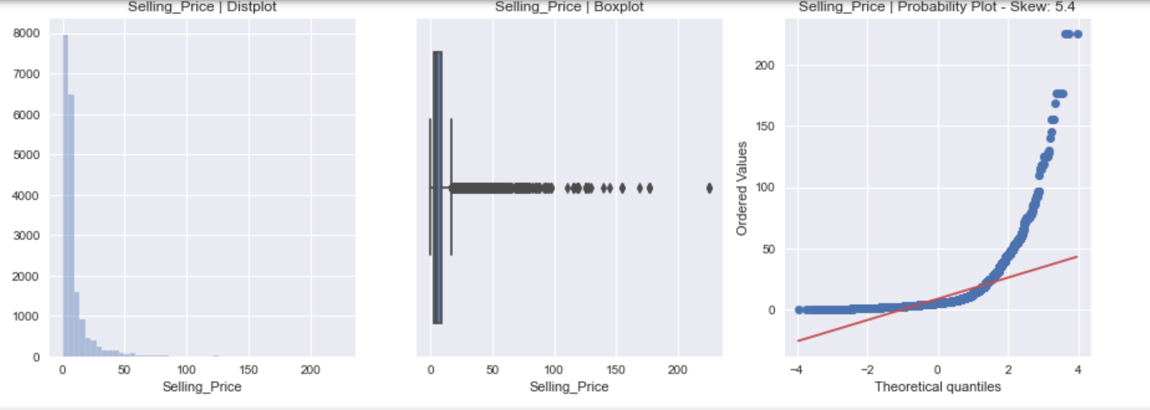
Target Variable (Selling Price)

Slide 10
Data Pre-processing

Slide 11
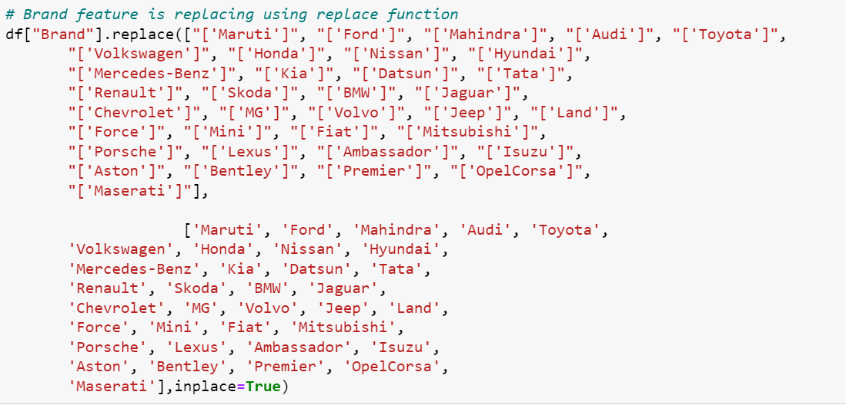
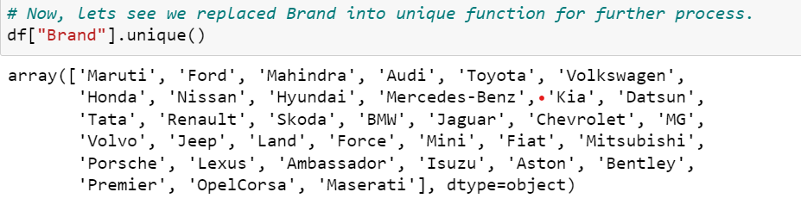
Unique function for dataset

Slide 12
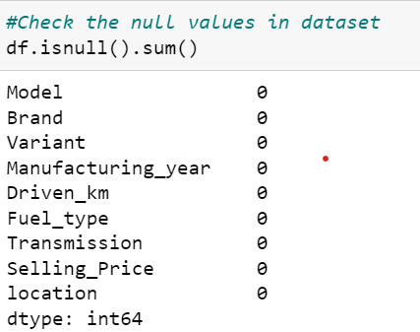
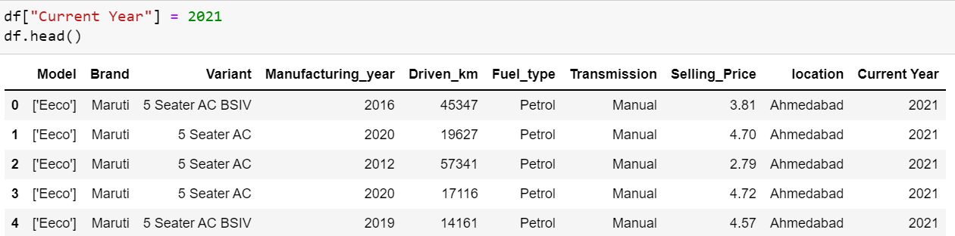
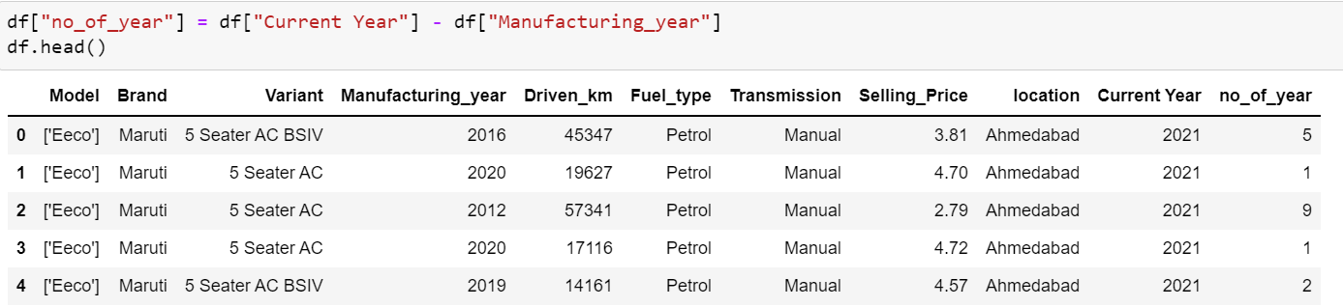
No Null values in Dataset
Adding Features in Datasets
Adding Current year in data frame
Created number of year by subtracting current year and manufacturing year
Dropped Features
Manufacturing Year
Current Year
Model
Variants

Slide 13
Data Cleaning

Slide 14
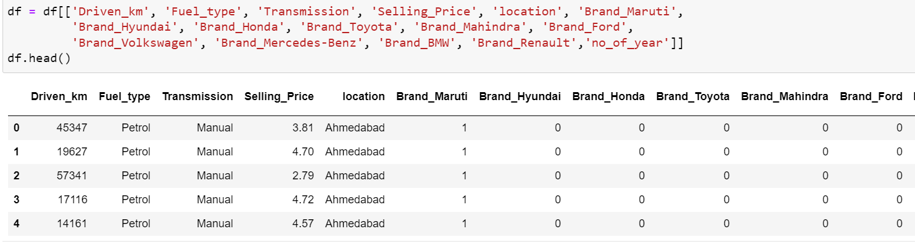
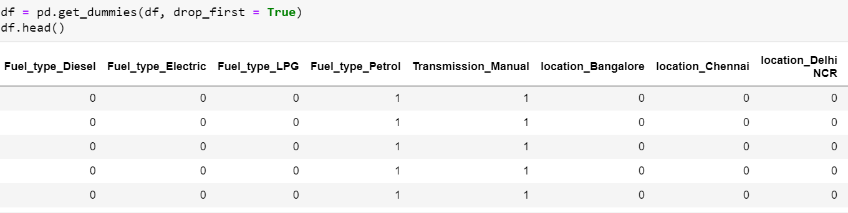
Encoding of Data Frame:
The Encoding Technique is used for this problem:
One hot encoding technique with multiple variables.
One hot encoding technique.
Firstly, proceed with One hot encoding technique with multiple variables for particular features i.e., Brand
The new data frame is created using one hot encoding technique with multiple variables.
Secondly, proceed with One hot encoding technique i.e., transmission, location and fuel types.
Now, let’s we can see all features is converted into numerical one after proceeding with encoding technique.

Slide 15
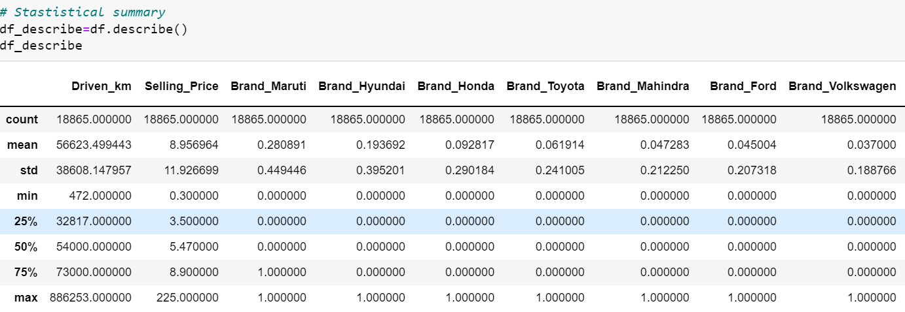
Statistical Summary
To see statistical information about the non-numerical columns in our dataset:

Slide 16
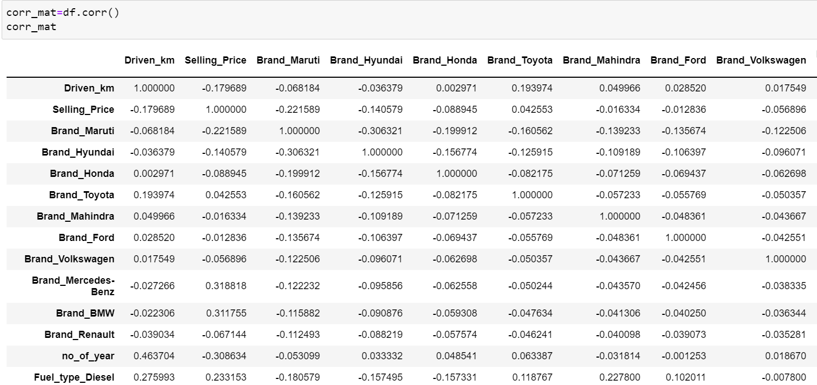
Correlation matrix:
A correlation matrix is simply a table which displays the correlation. The measure is best used in variables that demonstrate a linear relationship between each other. The fit of the data can be visually represented in a heatmap.

Slide 17
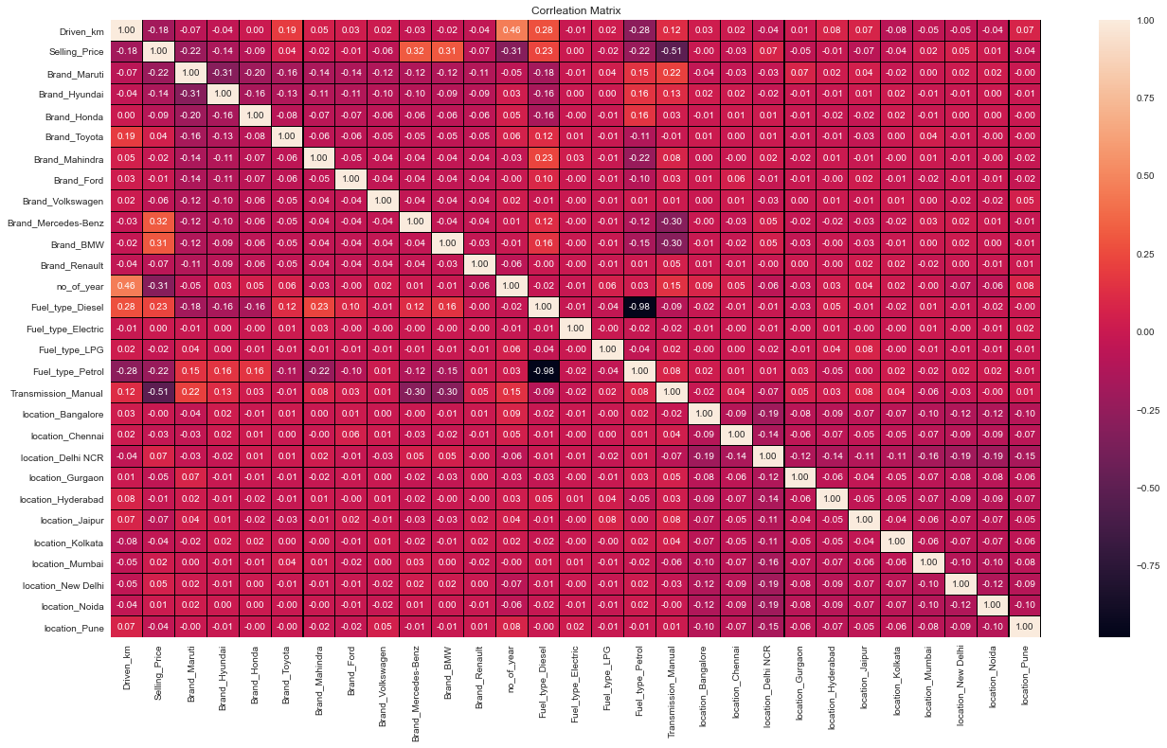

Slide 18
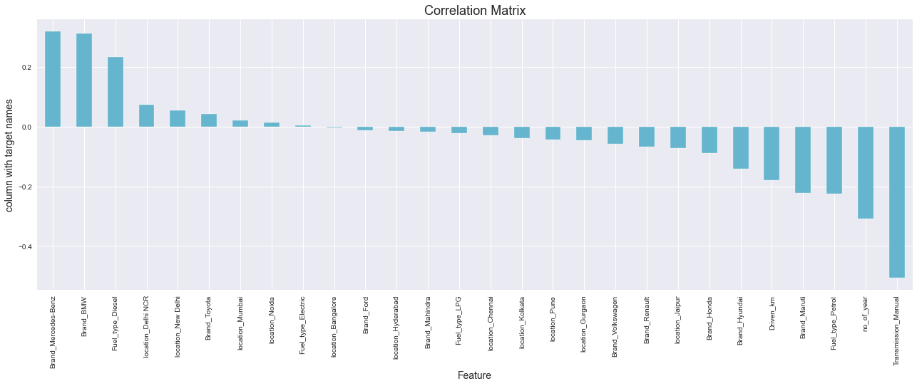
Checking the columns which are positively and negative correlated with the target columns:

Slide 19
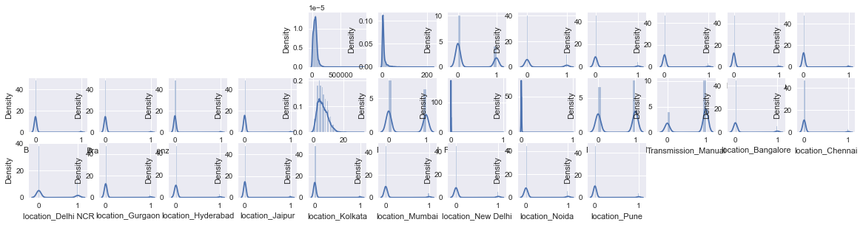
Checking the data distribution among all the columns.

Slide 20
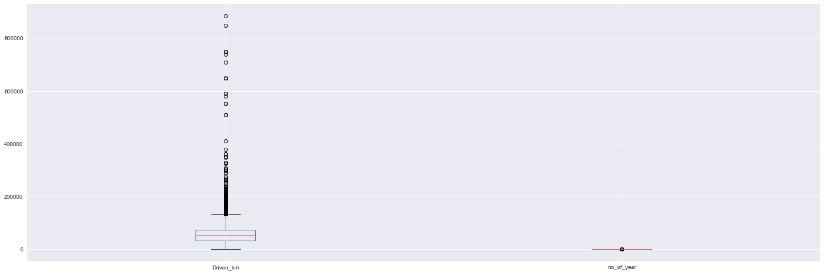
Outliers Check:
In this dataset, we applied one hot encoding method to categorical features. so, we check outlies for nominal features i.e., Diven_Km, no_of_years and Selling Price. Only Driven_km and no_of_years is considered because Selling Price is our target variable.
We can see outliers in Driven km due to various kilometers driven for different cars. so, we proceed with further steps.

Slide 21
Checking Skewness: Now here, we are going to use Power transform function to handle skewness in dataset
Before handling Skewness
After handling Skewness
Columns Skewness | Columns Skewness
Driven_km 4.840692 | Fuel_type_LPG 25.448414
Selling_Price 5.401628 | Fuel_type_Petrol -0.143181
Brand_Maruti 0.975123 | Transmission_Manual -0.994505
Brand_Hyundai 1.550303 | location_Bangalore 2.501900
Brand_Honda 2.806672 | location_Chennai 3.626443
Brand_Toyota 3.635883 | location_Delhi NCR 1.256471
Brand_Mahindra 4.266337 | location_Gurgaon 4.217141
Brand_Ford 4.389812 | location_Hyderabad 3.643476
Brand_Volkswagen 4.906065 | location_Jaipur 4.957997
Brand_Mercedes-Benz 4.917924 | location_Kolkata 4.700873
Brand_BMW 5.208302 | location_Mumbai 3.164728
Brand_Renault 5.376202 | location_New Delhi 2.640141
no_of_year 0.742327 | location_Noida 2.526506
Fuel_type_Diesel 0.185166 | location_Pune 3.354289
Fuel_type_Electric 68.658574
Columns Skewness | Columns Skewness
Driven_km 0.122132 | Fuel_type_LPG 25.448414
Brand_Maruti 0.975123 | Fuel_type_Petrol -0.143181
Brand_Hyundai 1.550303 | Transmission_Manual -0.994505
Brand_Honda 2.806672 | location_Bangalore 2.501900
Brand_Toyota 3.635883 | location_Chennai 3.626443
Brand_Mahindra 4.266337 | location_Delhi NCR 1.256471
Brand_Ford 4.389812 | location_Gurgaon 4.217141
Brand_Volkswagen 4.906065 | location_Hyderabad 3.643476
Brand_Mercedes-Benz 4.917924 | location_Jaipur 4.957997
Brand_BMW 5.208302 | location_Kolkata 4.700873
Brand_Renault 5.376202 | location_Mumbai 3.164728
no_of_year -0.017734 | location_New Delhi 2.640141
Fuel_type_Diesel 0.185166 | location_Noida 2.526506
Fuel_type_Electric 68.658574 | location_Pune 3.354289

Slide 22
Model Building and Evaluation
These are modelling approach made to build an model :
Linear
k-nearest neighbors (KNN)
Random Forest
Decision Tree
XGBoost

Slide 23
Performance Metric
Model Building | R2 score | MAE | MSE | RMSE
Linear | 53.63 | 4.21 | 56.70 | 7.53
KNeighbors | 65.71 | 2.67 | 41.92 | 6.47
Random | 77.45 | 1.97 | 27.56 | 5.25
Decision | 61.21 | 1.98 | 47.38 | 6.88
XGBoost | 72.02 | 2.35 | 34.22 | 5.85
According to performance metric, the random forest has higher R2 score, So this is our best model.

Slide 24
Comparison:
Performance Metric | Cross -Validation Score
53.63 | -4.16
65.71 | 53.89
77.45 | 69.19
61.21 | 54.18
72.02 | 65.62
Comparing the performance model and cross-validation score the minimum difference is for xgboost. so finally, this is our best model.

Slide 25
Hyper Parameter Tuning
The Hyper parameter tuning is carried out for XGBoost Regressor model.
Because performance metric score is 72.02.

Slide 26
Hyper Parameter Tuning Performance
XGBoost Regressor:
R2 Score : 78.18
Cross validation Score : 69.29

Slide 27
Best Model
Hyper parameter Tuning performance is carried out for XGBoost Regressor:
Hyper parameter Tuning i.e.,R2 score and Cross validation score = 78.18% and 69.29% respectively. Finally, XGBoost is best model for these dataset.

Slide 28
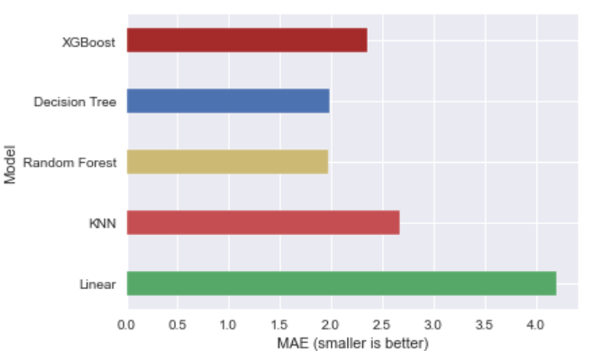
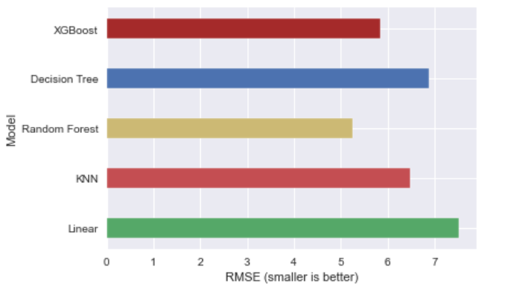
Performance Interpretation:
MAE (Mean Absolute Error)
RMSE (Root Mean Squared Error)

Slide 29
Feature Importance’s:
Some of the models we used provide the ability to see the importance of each feature in the dataset after fitting the model. We will look at the feature importance’s provided by XGBoost models. We have 29 features in our data which is a big number, so we will take a look at the 15 most important features.

Slide 30
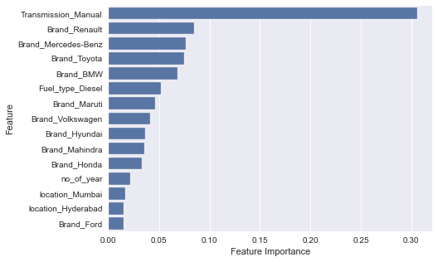
Feature Importance’s:
Notice here in feature importance of XGBoost, the transmission manual feature plays a prominent role for target variable.

Slide 31
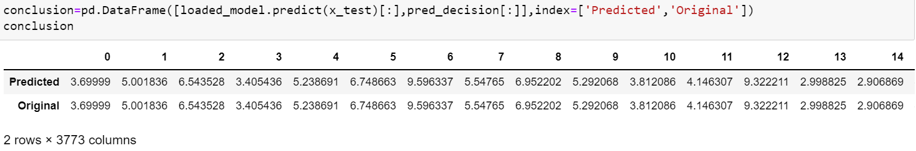
Conclusion:
In this paper, we built several regression models to predict the selling price of cars by given some of the cars features. We evaluated and compared each model to determine the one with highest performance. We also looked at how some models rank the features according to their importance. In this paper, we followed the data science process starting with getting the data, then cleaning and pre-processing the data, followed by exploring the data and building models, then evaluating the results.
As a recommendation, we advise to use this model (or a version of it trained with more recent data) by car market who want to get an idea about car price. The model can be used also with datasets that covered areas provided that they contain the same features. We also suggest that people take into consideration the features that were deemed as most important as seen in the previous section; this might help them estimate the car price is better.

Slide 32
Thank you

