Slide 1
NESTED STATE DIAGRAM AND SIGNAL GENRALISATION

Slide 2
NESTED STATE
A nested state diagram is used to model the complex system as the regular state diagram is inadequate in describing the large and complex problem. The nested state diagram is the concept of advanced state modelling.
Conventionally a complex system has much redundancy. This redundancy can be resolved by restructuring the complex system. One method to restructure complex system is to expand the state that has certain sub states. A state diagram are sufficient for describing simple system but need additional power to handle large problems.

Slide 3
Figure 6.4 simpliﬁes the phone line model from Chapter 5; a single transition from Active to Idle replaces the transitions from each state to Idle. All the original states except Idle are nested states of Active. The occurrence of event onHook in any nested state causes a transition to state Idle.
The composite state name labels the outer contour that entirely encloses the nested states. Thus Active is a composite state with regard to nested states DialTone, Timeout, Dial- ing, and so forth. You may nest states to an arbitrary depth. A nested state receives the out- going transitions of its composite state. (By necessity, only ingoing transitions with a speciﬁed nested state can be shared, or there would be ambiguity.)
Figure 6.5 shows a state diagram for an automobile automatic transmission. The trans- mission can be in reverse, neutral, or forward; if it is in forward, it can be in ﬁrst, second, or third gear. States First, Second, and Third are nested states of state Forward.
Each of the nested states receives the outgoing transitions of its composite state. Selecting “N” in any forward gear shifts a transition to neutral. The transition from Forward to Neutral implies three transitions, one from each forward gear to neutral. Selecting “F” in neutral causes a transition to forward. Within state Forward, nested state First is the default initial state, shown by the unlabeled transition from the solid circle within the Forward con- tour. Forward is just an abstract state; control must be in a real state, such as First.

Slide 4
All three nested states share the transition on event stop from the Forward contour to state First. In any forward gear, stopping the car causes a transition to First.
It is possible to represent more complicated situations, such as an explicit transition from a nested state to a state outside the contour, or an explicit transition into the contour. In such cases, all the states must appear on one diagram. In simpler cases where there is no interaction except for initiation and termination, you can draw the nested states as separate diagrams and reference them by including a submachine, as in the vending machine example of Figure 6.2.
For simple problems you can implement nested states by degradation into “ﬂat” state diagrams. Another option is to promote each state to a class, but then you must take special care to avoid loss of object identity. The becomes operation of Smalltalk lets an object change class without a loss of identity, facilitating promotion of a state to a class. However, the performance overhead of the becomes operation may become an issue with many state changes. Promotion of a state to a class is impractical with C++, unless you use advanced techniques, such as those discussed in [Coplien-92]. Java is similar to C++ in this regard.
Entry and exit activities are particularly useful in nested state diagrams because they permit a state (possibly an entire subdiagram) to be expressed in terms of matched entry-exit activities without regard for what happens before or after the state is active. Transitioning into or out of a nested state can cause execution of several entry or exit activities, if the transition reaches across several levels of nesting. The entry activities are executed from the out- side in and the exit activities from the inside out. This permits behavior similar to nested subroutine calls.

Slide 5
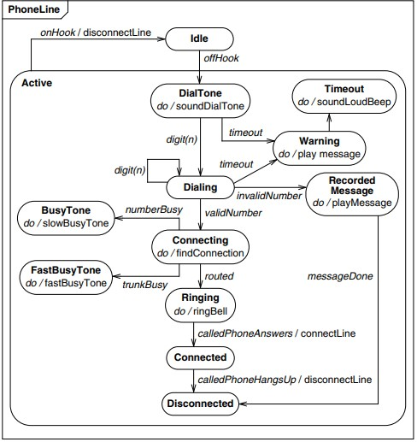

Slide 6
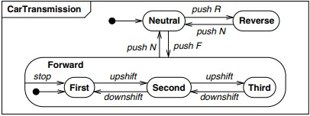

Slide 7
Signal Generalization
You can organize signals into a generalization hierarchy with inheritance of signal attributes. Figure 6.6 shows part of a tree of input signals for a workstation. Signals MouseButton and KeyboardCharacter are two kinds of user input. Both signals inherit attribute device from signal UserInput (the root of the hierarchy). MouseButtonDown and MouseButtonUp inherit location from MouseButton. KeyboardCharacters can be divided into Control and Graphic characters. Ultimately you can view every actual signal as a leaf on a generalization tree of signals. In a state diagram, a received signal triggers transitions that are deﬁned for any an- cestor signal type. For example, typing an ‘a’ would trigger a transition on signal Alphanu- meric as well as signal KeyboardCharacter. Analogous to generalization of classes, we recommend that all supersignals be abstract.
A signal hierarchy permits different levels of abstraction to be used in a model. For ex- ample, some states might handle all input characters the same; other states might treat con- trol characters differently from printing characters; still others might have different activities on individual characters.

Slide 8
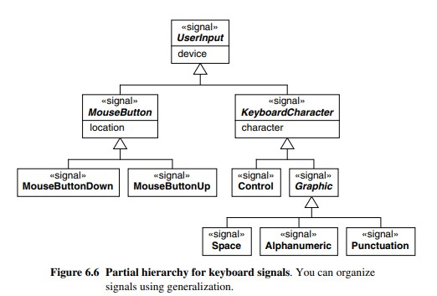

Slide 9
THANK YOU

