Slide 1


Heart Disease Risk Prediction in India
M: -Driven Preventive Healthcare & Clinical Analysis
By : Kiran Aralapuram

Slide 2

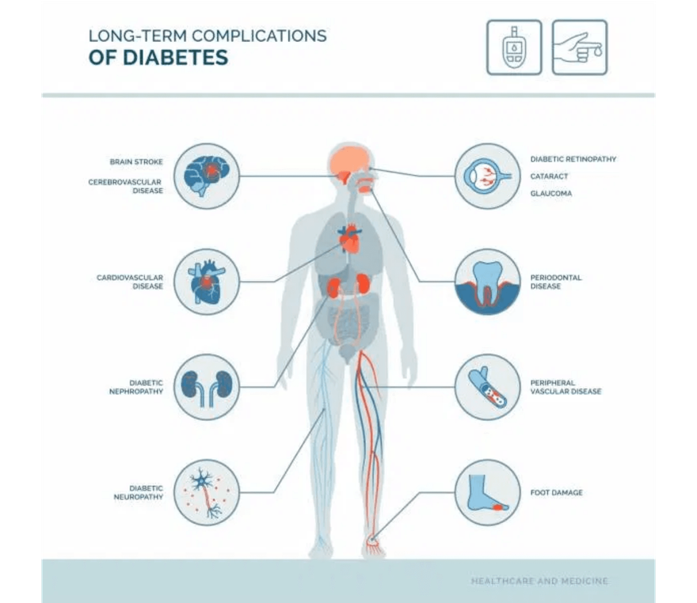
The Dual Crisis: Diabetes & Heart Disease in India
India faces a critical health challenge as Type 2 Diabetes and cardiovascular diseases surge in tandem. Clinical evidence highlights poor blood sugar control as a primary driver of heart attack risk.
"How accurately can we use Machine learning in creating a suitable model to predict heart attack risk for people in India? And when we look at all the health factors, just how much bigger of a red flag is diabetes compared to everything else?"

Slide 3

Data Insights: Sourcing & Exploratory Analysis
Dataset: Sourced from Kaggle, curated for the Indian demographic to ensure regional relevance.
EDA Findings: Individual clinical features (Cholesterol, BP, Smoking) can mask complex risk patterns when viewed alone.
Key Insight: Cumulative risk factors provide a more accurate prediction than any single clinical variable.

Slide 4

Feature Engineering & Model Selection
Feature Transformation
Clinical variables were categorized into risk tiers (Normal, Borderline, High). Lifestyle factors were aggregated into a composite risk score to capture interactions.
Models Evaluated
Tested a spectrum of algorithms: Decision Trees (Baseline), Logistic Regression (Linear), and Ensemble methods including Random Forest, Gradient Boosting, and XGBoost.
Ensemble models demonstrated superior handling of non-linear clinical data.

Slide 5

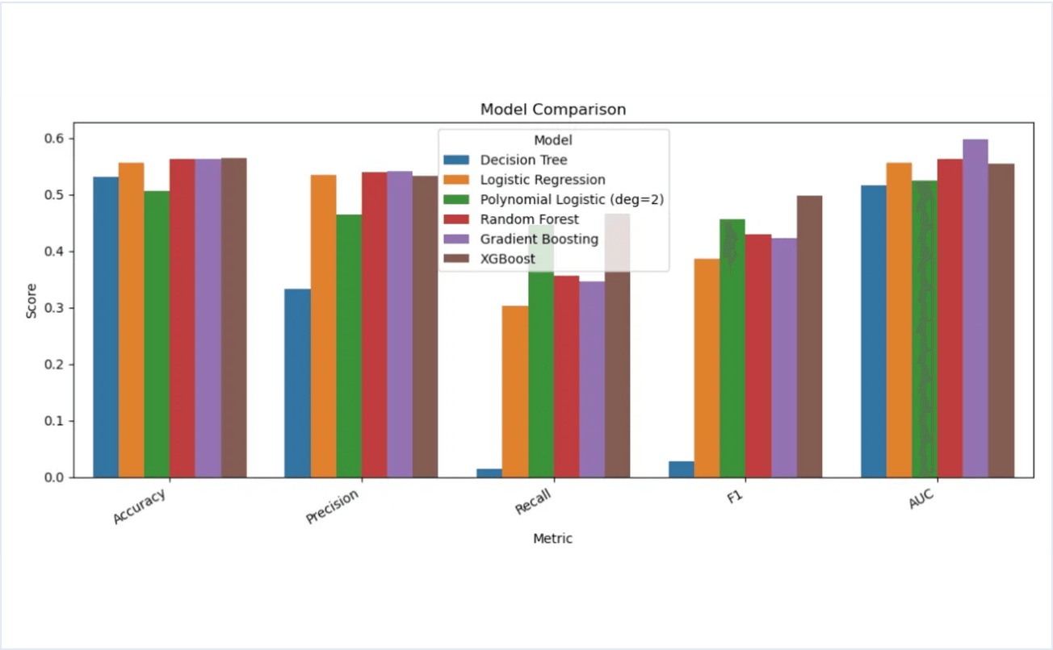
Model Performance: Metrics Comparison
Ensemble models (Random Forest, Gradient Boosting, XGBoost) significantly outperform the baseline Decision Tree.
Key Observation: XGBoost achieves the highest Recall and F1-score, making it the most reliable for risk detection.
Figure: Performance Metrics Across Evaluated Models

Slide 6
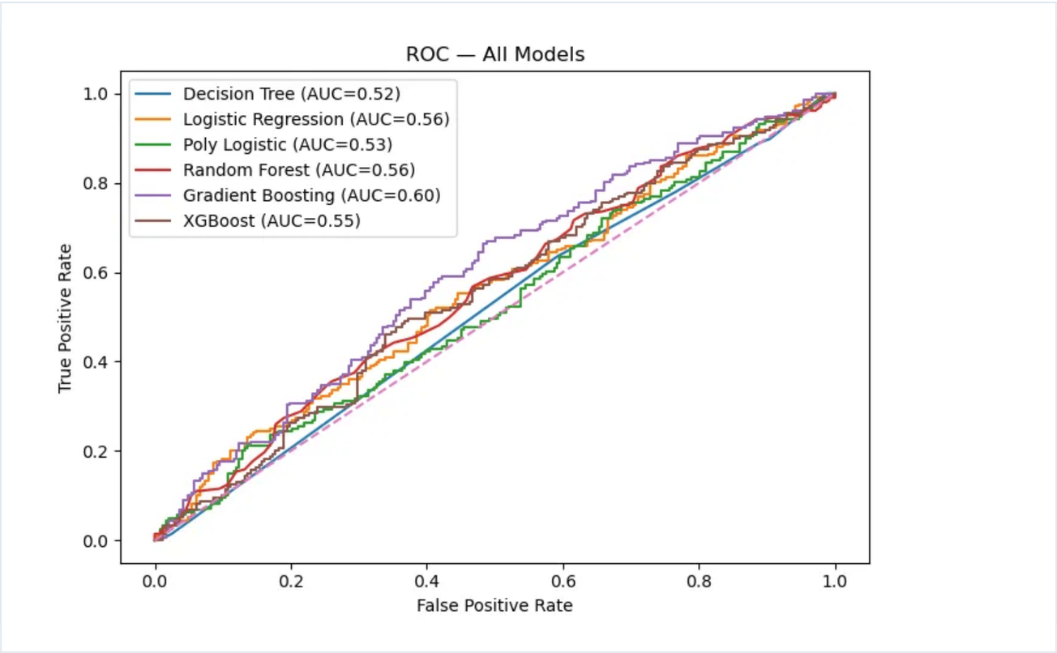
ROC Analysis: Class Separation
The ROC curve visualizes the trade-off between sensitivity (Recall) and specificity across all thresholds.
Observation: Gradient Boosting shows the highest AUC (~0.60), indicating the strongest overall discrimination ability.
Figure: ROC Curves for Evaluated Models

Slide 7
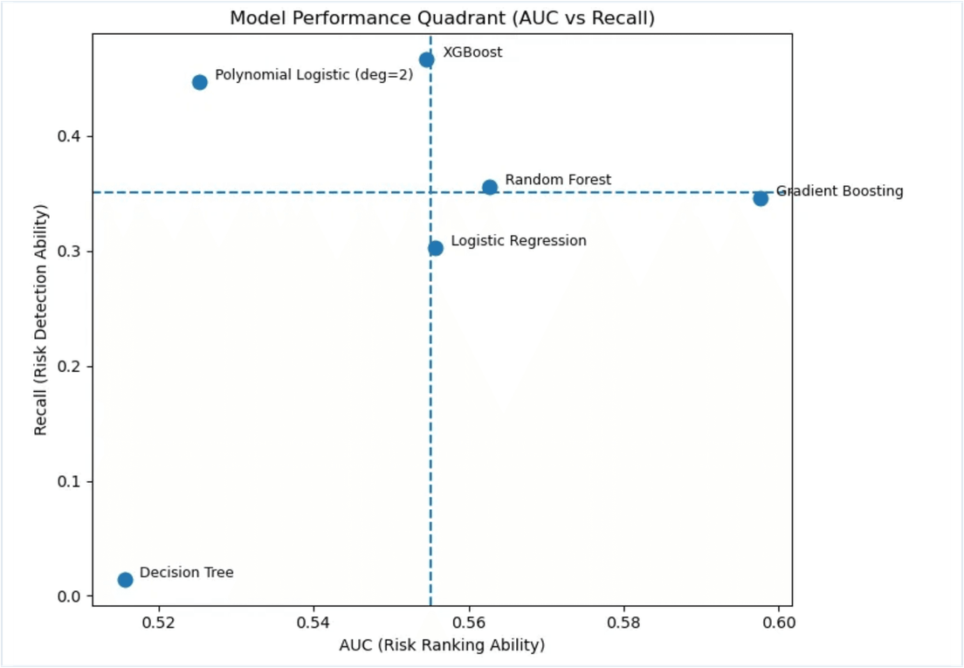
Clinical Priority: The Power of Recall
In preventive medicine, the primary goal is to ensure no high-risk patient is overlooked. This makes Recall the most critical metric for our model.
The Cost of Missing a Case
A "False Negative" means a patient at risk of a heart attack is sent home without intervention. In healthcare, we prioritize sensitivity to ensure early detection and life-saving care.
XGBoost's Position: Located in the upper region of the quadrant, demonstrating the highest Recall performance among all tested models.
Figure: Magic Quadrant - Risk Detection vs Risk Ranking

Slide 8
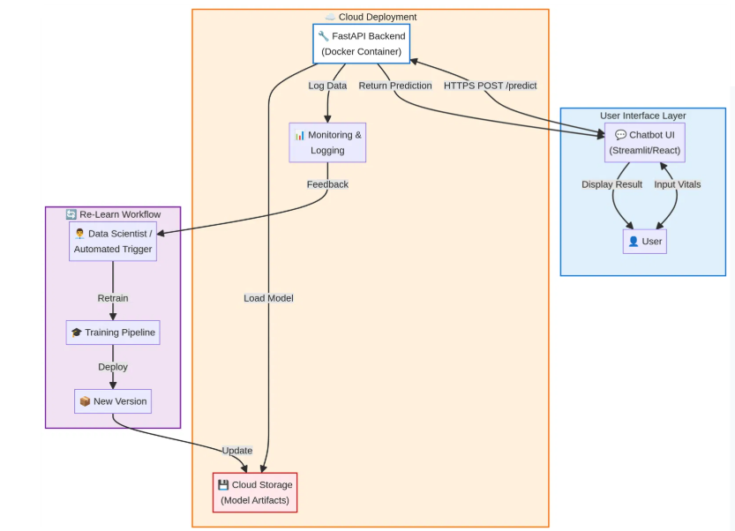
Cloud Deployment & Re-Learn Workflow
Cloud Deployment
Inference: Fast API backend hosted on scalable cloud containers (Docker).
Storage: Versioned model artifacts stored in secure cloud buckets.
Re-Learn Workflow
Feedback Loop: Monitoring logs capture performance data → Automated triggers or Data Scientists initiate retraining → New model versions are pushed to storage.
Note: The system ensures continuous improvement through a closed-loop training pipeline.
Figure: Cloud-Based Inference & Re-Learn Architecture

Slide 9

Conclusion & Future Roadmap
Final Conclusion: XGBoost is the optimal model for clinical deployment due to its superior Recall. Diabetes remains the most significant "red flag" for heart attack risk in the Indian demographic.
Future Roadmap
Perform hyperparameter tuning on the selected XGBoost model to further improve Recall and AUC by adjusting parameters such as learning rate, max depth, and number of trees.
Explore additional feature engineering- including interaction features (e.g., combined clinical risk scores) to better capture relationships between cholesterol, blood pressure, and lifestyle factors.
Optimize the classification threshold to prioritize Recall, since detecting high-risk patients is more important than maximizing overall accuracy in healthcare settings.
Test the model on external datasets - to evaluate generalizability and robustness.
Incorporate additional variables - such as medication history or genetic factors, to improve predictive performance and clinical relevance.

