Slide 1
DBMS
Introduction

Slide 2
Basic Concepts
Data: raw facts and figure
Information: Refined data (processed, organized or summarized data)
Database: Collection of information or persistent data
Collection of logically related data
Database are organized by fields, records and files.

Slide 3
Fields: Smallest unit of data.
Also called data item or data element
Records: Collection of logically related fields.
File: A file is a collection of related records

Slide 4
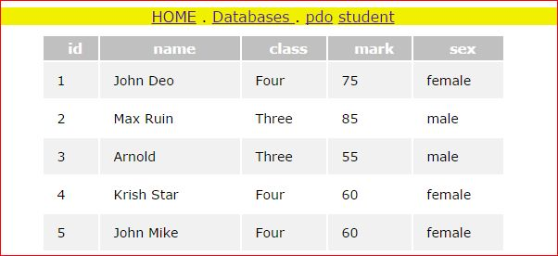

Slide 5
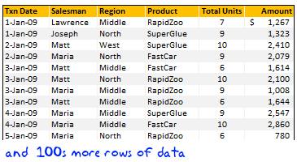

Slide 6
DBMS
DBMS: Database Management system is a set of software used to
Create
process
store
Retrieve
control and manage data.
Computerized record keeping system that store information and allow user to add, delete, modify, retrieve and update that information.
General purpose software that facilitate the process of defining, constructing ,manipulating and sharing databases among various users and application

Slide 7
Five primary functions of DBMS
  Define, create and organize database
  Input data
  Process data
  Maintain data integrity and security
  Query database
E.g.
  Oracle
  MySQL
  Microsoft SQL Server
  Sybase

Slide 8
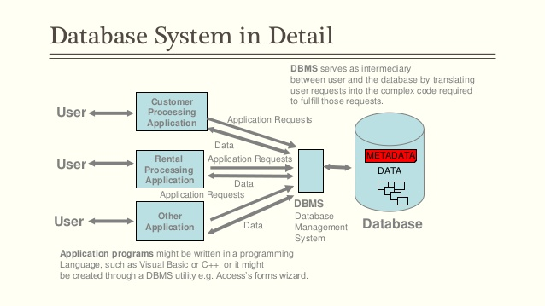

Slide 9
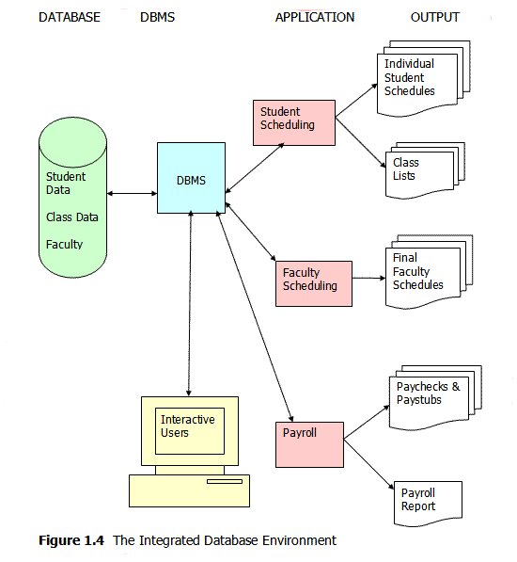

Slide 10
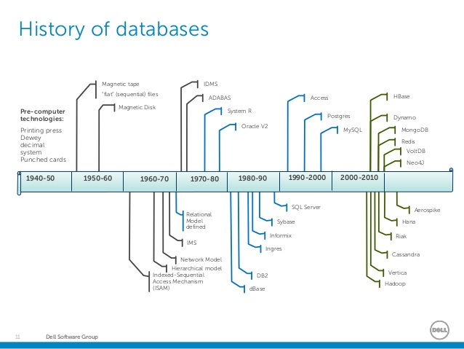
History of Database system

Slide 11
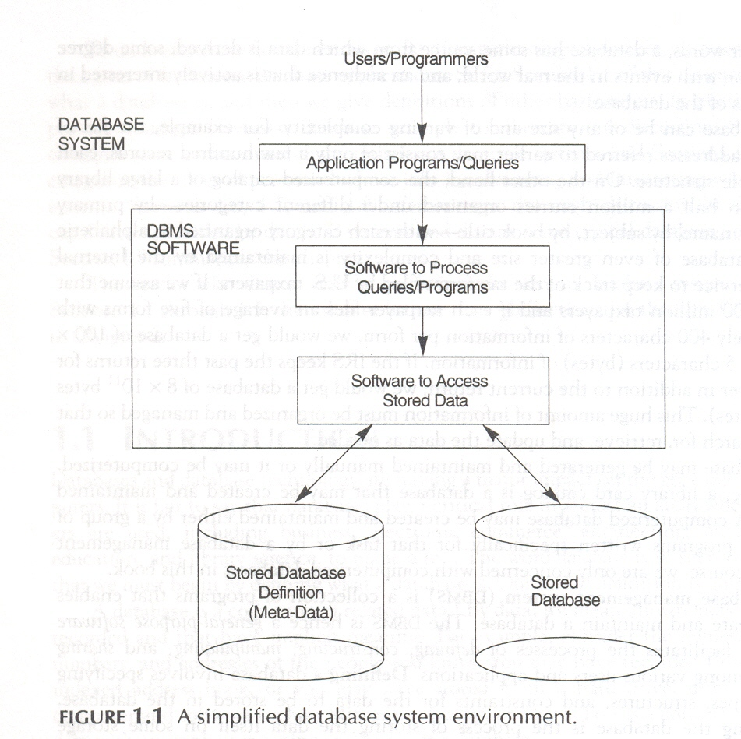

Slide 12
Purpose of Database system
Single repository of storage
Free from redundancy compared to file processing approach
  Easy to manage
  No wastage of storage space
  Maintain upto date data

Slide 13
Main characteristics of database approach
  Self describing nature of database system
    Meta data in DBMS catalog
  Insulation between program and data(data abstraction)
    Structure not embedded in application program
    Change the structure without changing program accessing it.
      Property called program data independence
      Characteristics that allow program data independence is called data abstraction

Slide 14
  Support of multiple views of data
    View is a subset of database
  Sharing of data and multiple user transaction processing
    Must include concurrency control
    E.g Railway ticket reservation

Slide 15
Advantages of DBMS
Controlling redundancy
Restricting Unauthorized access
Providing storage structure for efficient query processing
  Specialized data structure-index
  Buffering module
  Query processing and optimization module
Providing backup and Recovery-restoring to a consistent state
Providing Multiple user interface
  Programming Language interface
  Menu driven interface
  Nature language interface
Representing complex relationship among data
Enforcing integrity constraints-(e.g. unique constraints)
Permitting inferencing and actions using rule.
  Deductive database

Slide 16
Schemas versus Instances
Database Schema: The description of a database. Includes descriptions of the database structure and the constraints that should hold on the database.
Schema Diagram: A diagrammatic display of (some aspects of) a database schema.
Schema Construct: A component of the schema or an object within the schema, e.g., STUDENT, COURSE.
Database Instance: The actual data stored in a database at a particular moment in time. Also called database state (or occurrence).

Slide 17
Database Schema Vs. Database State
Database State: Refers to the content of a database at a moment in time.
Initial Database State: Refers to the database when it is loaded
Valid State: A state that satisfies the structure and constraints of the database.
Distinction
  The database schema changes very infrequently. The database state changes every time the database is updated.
  Schema is also called intension, whereas state is called extension

Slide 18

Example of a Database Schema

Slide 19

Example of a database state

Slide 20

The three-schema architecture

Slide 21
Goal: Separate user application and physical database
3 schema architecture helps to achieve:
  Program-data independence.
  Support of multiple views of the data.
Not explicitly used in commercial DBMS products, but has been useful in explaining database system organization

Slide 22
Defines DBMS schemas at three levels:
  Internal schema at the internal level to describe physical storage structures and access paths (e.g indexes).
  Conceptual schema at the conceptual level/logical level
    Describe the structure and constraints for the whole database for a community of users.
    Describe logical structure of database-concentrates on relational model of database
  External schemas at the external level to describe the various user views.
    Describes part of the database that a particular user group is interested in
    Actual view of data seen by individual users.
    User can only access that part of database for which he is authorized

Slide 23
Mappings among schema levels are needed to transform requests and data.
  Programs refer to an external schema, and are mapped by the DBMS to the internal schema for execution.
  Data extracted from the internal DBMS level is reformatted to match the user’s external view (e.g. formatting the results of an SQL query for display in a Web page)

Slide 24
DBMS must transform a request specified on an external schema into a request against the conceptual schema and then into a request on the internal schema for processing over stored database.
The process of transforming requests and results between levels are called mapping.
There are two mappings:
  The conceptual/Internal Mapping
  The external/Conceptual Mapping

Slide 25
The conceptual/Internal Mapping
  Defines the correspondence or operation between conceptual view and the physical view
  It specifies how data is retrieved from physical storage and shown at conceptual level
  It specifies how conceptual records and fields are represented at the internal level
The External/conceptual Mapping
  Defines the correspondence between conceptual view and external view
  Specifies how data is retrieved from conceptual level and shown at external level

Slide 26
Data Independence
Defined as characteristics of the database system to change the schema at one level without having to change the schema at the next level.
Logical Data Independence:
  The capacity to change the conceptual schema without having to change the external schemas and their associated application programs.
Physical Data Independence:
  The capacity to change the internal schema without having to change the conceptual schema.
  For example, the internal schema may be changed when certain file structures are reorganized or new indexes are created to improve database performance.

Slide 27
When a schema at a lower level is changed, only the mappings between this schema and higher-level schemas need to be changed in a DBMS that fully supports data independence.
The higher-level schemas themselves are unchanged.
  Hence, the application programs need not be changed since they refer to the external schemas

Slide 28
Data Models
Data Model:
  A set of concepts to describe the structure of a database, the operations for manipulating these structures, and certain constraints that the database should obey.
  Process of creating logical representation of the structure of database
  Plan for building database
  Provides a way to describe the design of a database at the physical , logical and view level.
  Data models are represented graphically using E-R diagram

Slide 29
Data Model Structure and Constraints:
  Constructs are used to define the database structure
  Constructs typically include elements (and their data types) as well as groups of elements (e.g. entity, record, table), and relationships among such groups
  Constraints specify some restrictions on valid data; these constraints must be enforced at all times.

Slide 30
Data Model Operations:
  These operations are used for specifying database retrievals and updates by referring to the constructs of the data model.
  Operations on the data model may include basic model operations (e.g. generic insert, delete, update) and user-definedoperations(e.g.compute_student_gpa, update_inventory

Slide 31
Categories of Data Models
Conceptual (high-level, semantic) data models:
  Provide concepts that are close to the way many users perceive data.
    Use concepts like entities, attributes and relationship
    (Also called entity-based or object-based data models.)
Physical (low-level, internal) data models:
  Provide concepts that describe details of how data is stored in the computer by representing information such as record format, record ordering and access path.
  These are usually specified in an ad-hoc manner through DBMS design and administration manuals
Implementation (representational) data models:
  Provide concepts that may be understood by end users hiding details about data storage (e.g. relational data models used in many commercial systems, Network, hierarchical).
    Represent data using record structure and hence are called record based data model

Slide 32
Entities and Attributes
Entities are specific objects or things in the mini-world that has independent exsistence(physical/conceptual); for example the EMPLOYEE John Smith, the Research DEPARTMENT, the ProductX PROJECT.
Attributes are properties used to describe an entity; for example an EMPLOYEE entity may have a Name, SSN, Address, Sex, BirthDate.
A specific entity will have a value for each of its attributes; for example a specific employee entity may have Name='John Smith', SSN='123456789', Address='731 Fondren, Houston, TX', Sex='M', BirthDate='09-JAN-55'.

Slide 33
Types of attribute
  Simple or Composite
  Single valued and multivalued
  Derived and stored
    Derived from another known attribute
    E.g. Age derived from D.O.B
  Null value (if value not known or not applicable)
  Complex attribute (composite+multivalued)

Slide 34
Simple: Each entity has a single atomic value for the attribute; for example SSN or Sex.
Composite: The attribute may be composed of several components; for example Address(Apt#, House#, Street, City, State, ZipCode, Country) or Name(FirstName, MiddleName, LastName).
Composition may form a hierarchy where some components are themselves composite.
Multi-valued: An entity may have multiple values for that attribute; for example Color of a CAR or PreviousDegrees of a STUDENT. Denoted as {Color} or {PreviousDegrees

Slide 35
In general, composite and multi-valued attributes may be nested arbitrarily to any number of levels although this is rare.
For example, PreviousDegrees of a STUDENT is a composite multi-valued attribute denoted by {PreviousDegrees(College, Year, Degree, Field)}.

Slide 36
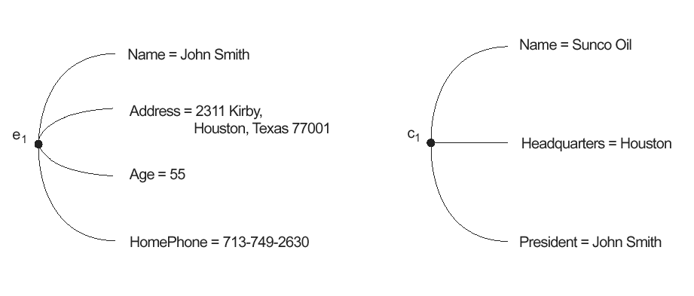
Two entities, an employee e₁ and a company c₁, and their attribute values

Slide 37
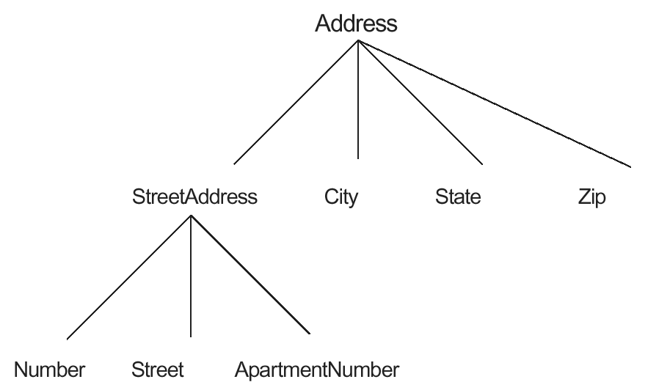
3.4 A hierarchy of composite attributes; the Street Address component of an Address is further composed of Number, Street, and Apartment Number.

Slide 38
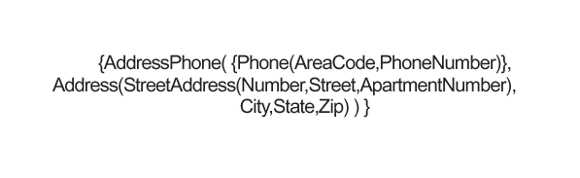
A complex attribute AddressPhone with multivalued and composite components

Slide 39
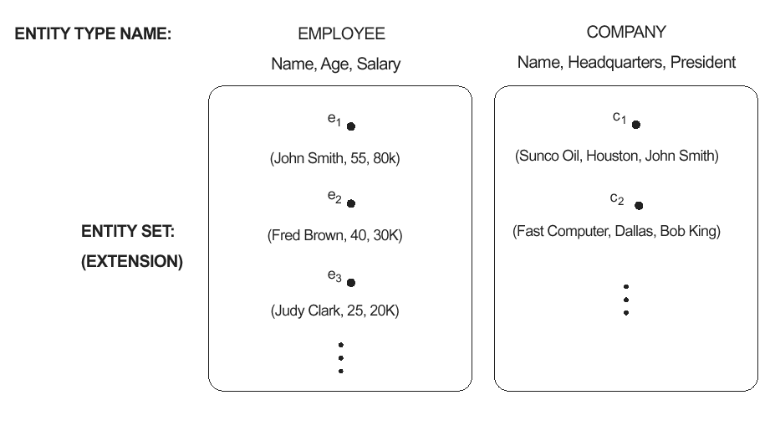
Two entity types named EMPLOYEE and COMPANY, and some of the member entities in the collection of entities (or entity set) of each type.

Slide 40
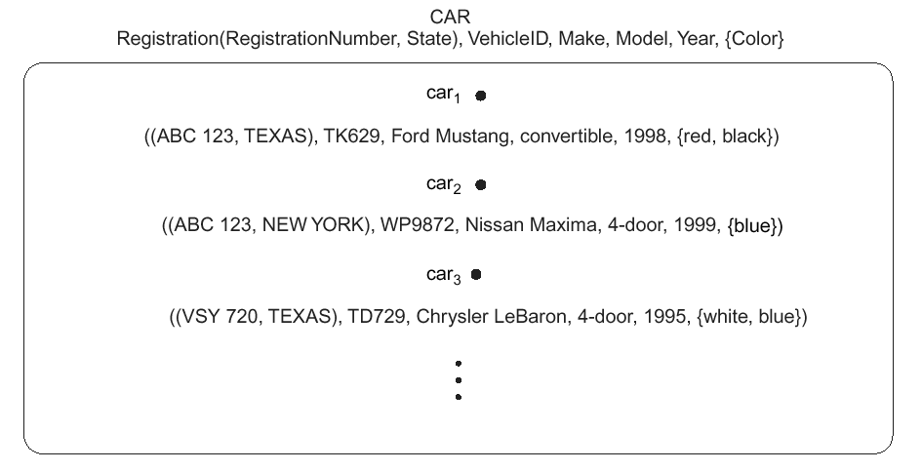
The CAR entity type, with two key attributes Registration and VehicleID. Multivalued attributes are shown between set braces {}. Components of a composite attribute are shown between parentheses ().

Slide 41
Entity Types and Key Attributes
Entities with the same basic attributes are grouped or typed into an entity type.
For example, the EMPLOYEE entity type or the PROJECT entity type.
An attribute of an entity type for which each entity must have a unique value is called a key attribute of the entity type.
  Used to identify individual entities in a entity set.
For example SSN of EMPLOYEE.

Slide 42
A key attribute may be composite. For example, vehicle Registration Number is a key of the CAR entity type with components (Number, State).
An entity type may have more than one key. For example, the CAR entity type may have two keys: VehicleIdentificationNumber and
VehicleRegistrationNumber(Number, State).

Slide 43
Types of Keys
  Super key
    Set of collection of one or more than one attribute
    Entity may have more than one super key
  Candidate key
    Minimal super key
  Primary Key
    Identify data uniquely(not null and unique)
    Only one primary key
  Alternate keys
    All candidate keys other than primary key
  Foreign key
    An attribute in an entity which is also a primary key in any another entity

Slide 44
Relationships and Relationship Types
A relationship relates two or more distinct entities with a specific meaning
For example, EMPLOYEE John Smith works on the ProductX PROJECT or EMPLOYEE Franklin Wong manages the Research DEPARTMENT.
- Relationships of the same type are grouped or typed into a relationship type.
For example, the WORKS_ON relationship type in which EMPLOYEEs and PROJECTs participate, or the MANAGES relationship type in which EMPLOYEEs and DEPARTMENTs participate.
Relationship types can have attributes

Slide 45
The degree of a relationship type is the number of participating entity types.
  Both MANAGES and WORKS_ON are binary relationships.
More than one relationship type can exist with the same participating entity types
For example, MANAGES and WORKS_FOR are distinct relationships between EMPLOYEE and DEPARTMENT participate.

Slide 46
Degree of relationship set
  Total number of entity sets participating in a relationship set
    Binary Relationship set-only 2 entity set involved
    Ternary Relationship set-Only 3 entity set involved.
Role and Recursive Relationship set
  Role:
    The function of any entity which it plays in relationship set is called that entities role
    E.g. Employee play the role of worker in the department
  Recursive Relationship set
    When the same entity sets participate in same relationship set more than once with different roles each time, this type of relationship set is known as recursive relationship set.
    E.g. Student plays role of (student, faculty) in relationship set Workfor between student and college

Slide 47
Constraints on Relationship Type (Mapping Constraints)
  Constraints acts as rules to which the content of database must conforms. There are two types of mapping constraint
    Mapping Cardinalities (Cardinality Ratios)
    Participation Constraints
  Mapping Cardinalities (cardinality Ratio)
    Number of entities of an entity set that are associated with entities of another entity set through a relationship set
    Two entity sets X and Y having binary relationship set R must have one of the following mapping cardinalities.
    One to One (1:1) – Entity in X associated with atmost one entity in Y and Vise versa
    One to many (1:N) – An entity in X associated with any number of entities in Y
    Many to one (N:1) – An entity in X Associated with atmost 1 entity in Y
    Many to Many (M:N)- An entity in X associated with any number of entities in Y

Slide 48
  Participation Constraints
  It tells the participation of entity set in relationship set
  Specifies minimum number of relationship instance that each entities can participate in.
  Sometimes called minimum cardinality ratio
  2 types:
  Partial Participation
  Total Participation
  Partial:
  If some entities from entity set E is participated in set R
  Total:
  If every entity from entity set E is participated with atleast one relation in relationship set R
Entity Types
  Weak entity type---Entity type that do not have a key attribute
  Identifying entity set---Weak entity set is always associated with a another entity set to make it meaningfull.
  Strong Entity Type----Entity type that do have a key attribute

Slide 49
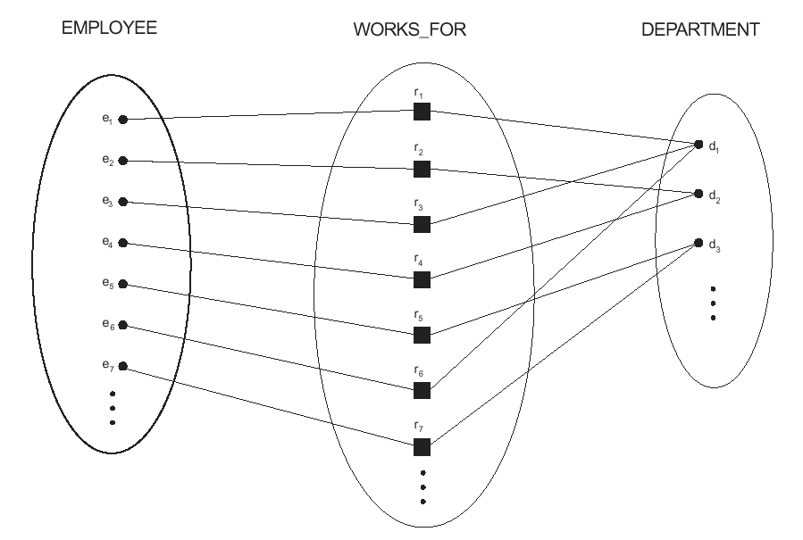
Some instances of the WORKS_FOR relationship between EMPLOYEE and DEPARTMENT

Slide 50
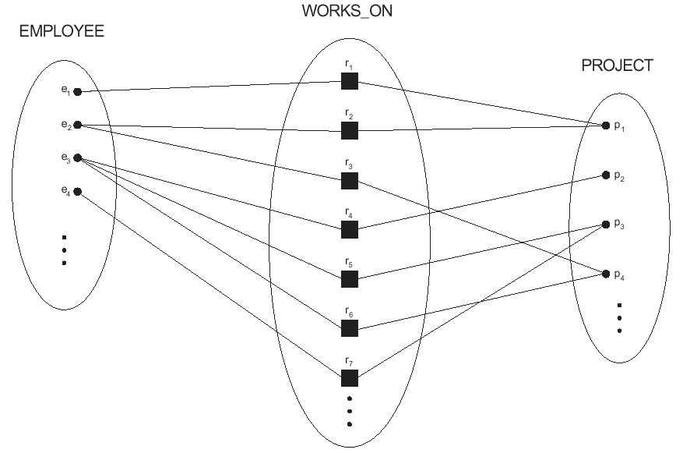
Example relationship instances of the WORKS_ON relationship between EMPLOYEE and PROJECT

Slide 51
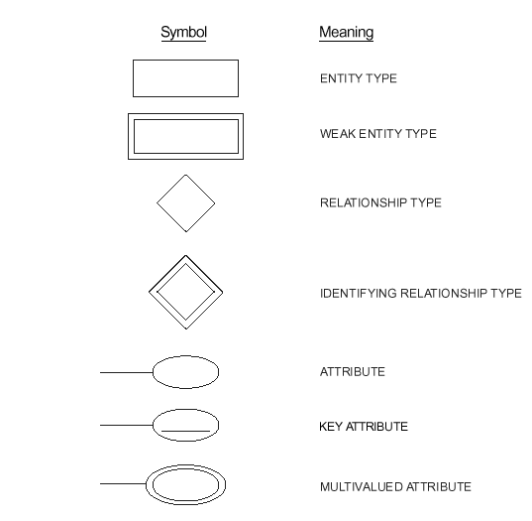
Summary of ER diagram notation

Slide 52
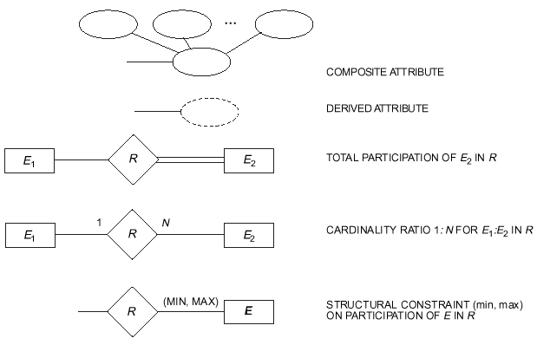

Slide 53
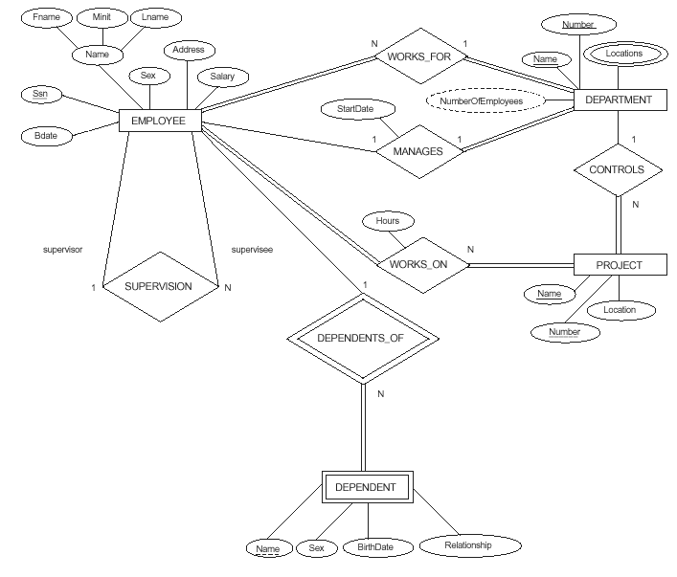
ER schema diagram for the company database

Slide 54
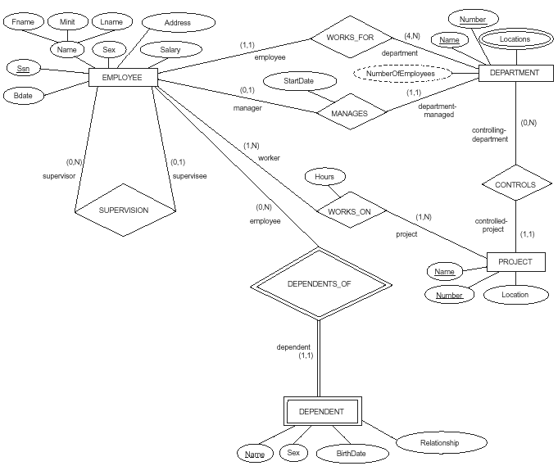
ER diagram for the COMPANY schema, with all role names included and with structural constraints on relationships specified using the alternate notation (min, max).

Slide 55
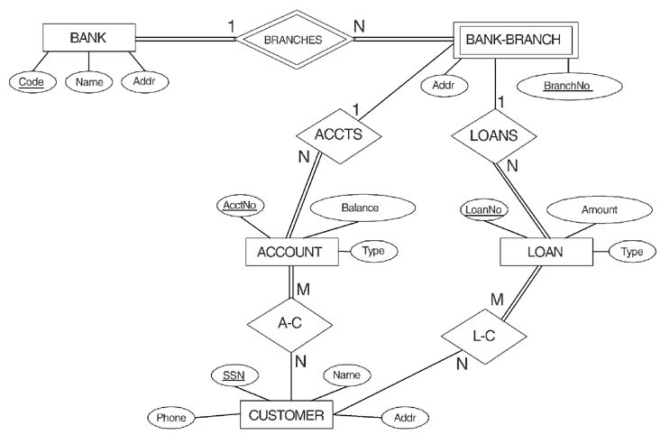

Slide 56
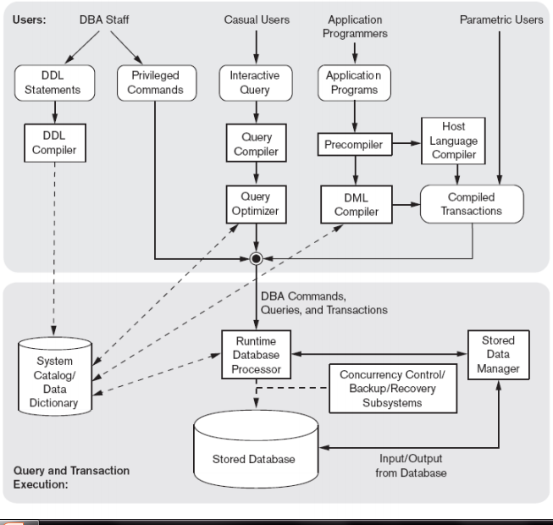
Components of DBMS

Slide 57
Major software components are:
  Data Manager
  Buffer Manager
  DDL Compiler & DML Compiler
  Database Processor
  Query Compiler
  Precompiler
  Client Program, Database server and Application Server

Slide 58
Data manager control access to database information or catalog information stored on disk
  Use OS services for data transfer between disk and main memory
  In a multi user environment, DBMS disk access request are scheduled by OS
Buffer Manager module handle the buffering of disk pages
DDL compiler processes DDL queries and store schema descriptions in DBMS catalog
  DBMS software module lookup the catalog as and when needed

Slide 59
The Precompiler extracts DML commands from an application programs written in host programming language and these commands are sent to the DML compiler
The DML compiler compile DML queries into object code for database access.
The rest of program is sent to host language compiler
The runtime database processor processes retrieval and update queries
  handles database access at runtime with the help of data manager.

Slide 60
The object codes for the DML commands and rest of the program are linked forming a canned transactions whose executable codes include calls to the runtime database processor.
The client program access the DBMS running at remote site(database server)
  Client access application server which access the database server

