Slide 1
DATA TRANSFER SCHEMES

Slide 2
Parallel and Serial
Parallel classified as:
Programmed I/O
Synchronous
Asynchronous
Interrupt driven
Direct Memory Access
Burst mode
Cycle stealing mode
Serial classified as:
Using hardware
Using software

Slide 3
DMA Operation

Slide 4
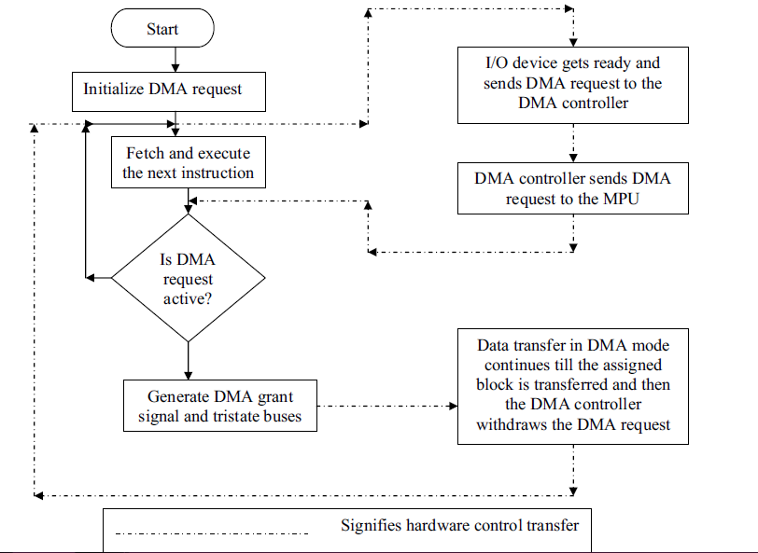

Slide 5
8257
DMA CONTROLLER

Slide 6
It is a 4-channel DMA.
So 4 I/O devices can be interfaced to DMA
It is designed by Intel
Each channel have a 16-bit address and a counter register.
It provides chip priority resolver that resolves priority of channels in fixed or rotating mode.
It provide on-chip channel inhibit logic.

Slide 7
It requires single phase clock.
The maximum frequency is 3Mhz and minimum frequency is 250 Hz.
40 pin DIP.
Primary function is generate a sequential memory address which allows the peripheral to read or write data directly to or from the memory.

Slide 8
It execute 3 types of DMA cycles
1.DMA read
2.DMA write
3.DMA verify.
It is operate in two modes.
1.Master Mode
2.Slave Mode

Slide 9
Modes of operation:
Fixed Priority Rotating Mode
Rotating priority Mode

Slide 10
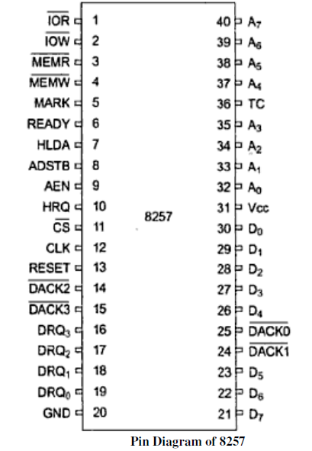

Slide 11
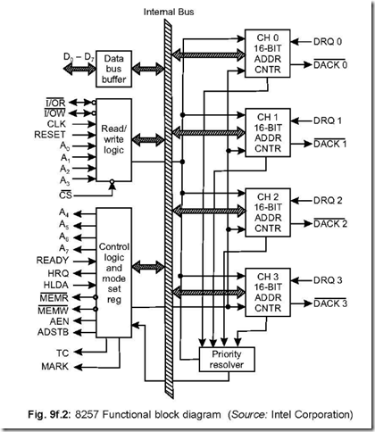

Slide 12
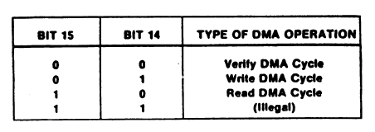

Slide 13
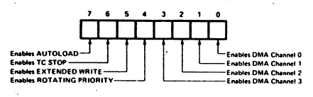
Mode set register

Slide 14
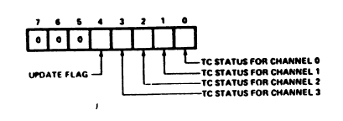
Status register

Slide 15
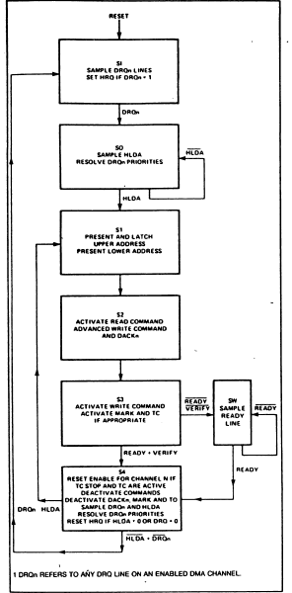
State diagram

Slide 16
S_{I} State
Idle state
DMAC samples the DRQ lines of the 4 channels
If a valid request is detected
Sets HRQ output
Enters S₀ State

Slide 17
S₀ State
Resolves the priorities of the DMA requests
Waits for a valid HLDA signal from CPU
On valid HLDA enters S₁ state

Slide 18
S₁ State
DMA puts the MSB of the DMA address register of the highest priority channel on its D₀ – D₇ pins – 8212 latches the MSB
LSB is put on the A₀ – A₇ pins
Enters S₂ state

Slide 19
S₂ State
Read command is activated
for DMA write and for DMA read
Issues signal to the I/O device being serviced
Activates write command if in extended write mode
Enters state S₃

Slide 20
S₃ State
Write command is activated
for DMA read and for DMA write
Sets the TC and MARK o/p if appropriate conditions are met
Samples the READY i/p
If not READY enters a wait state
On READY, enters state S₄

Slide 21
S₄ State
Disables the channel
If TC stop is set in mode set register
If TC o/p is high
Deactivates TC, MARK and
Samples DRQ lines
If any line is high, resolves priority an enters state S₁ – if HLDA is still active
If HLDA is not active, enters state S_{I}
If no requests, resets HRQ o/p and enters state S_{I}

