Slide 1
Object Oriented Programming
By Gopika S

Slide 2
Software Crisis
After the introduction of the language C , the developments in software technology was dynamic. This has forced the software engineers and industry to continuously look for new approaches to software design and development
The following issued need to be addressed to face the crisis:
• How to represent real-life entities of problems in system design?
• How to design system with open interfaces?
• How to ensure reusability and extensibility of modules?
• How to develop modules that are tolerant of any changes in future?
• How to improve software productivity and decrease software cost?
• How to improve the quality of software?
• How to manage time schedules?

Slide 3
Many software projects are either not finished , or not used , or else are delivered with major change. Only 2% are used as delivered.
Requests for changes are unavoidable and hence systems must be adaptable and tolerant to changes.

Slide 4
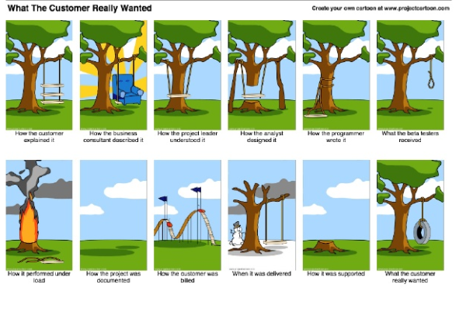

Slide 5
Software products must be evaluated for the following quality checks before they are delivered and implemented.
1. correctness
2. Maintainability
3. Reusability
4. interoperability
5.Portability
6.Security
7.Integrity
8.User friendliness.

Slide 6
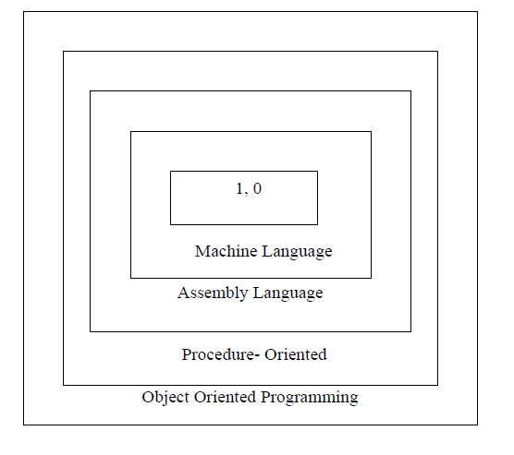
Software Evolution

Slide 7
Evolution..
With the advent of languages such as C, structured programming became very popular.
It enabled programmers to write moderately complex programs fairly easily.
As the programs grew larger, structured approach failed to show the desired result in terms of bug-free, reusable, easy-to-maintain programs.
Object Oriented Programming (OOP) is an approach to program organization and development that attempts to eliminate some of the pitfalls of conventional programming methods

Slide 8
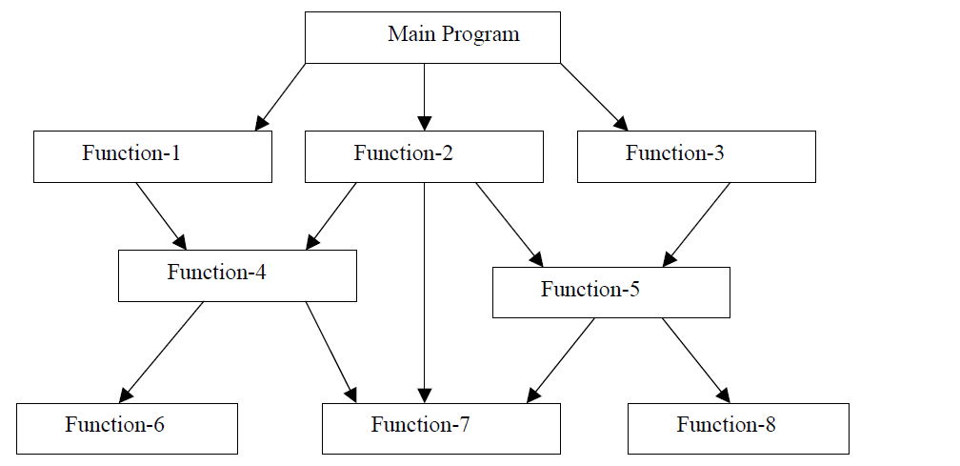
Procedure Oriented Programming
In the procedure oriented approach, the problem is viewed as the sequence of things to be done such as reading, calculating and printing. The primary focus is on functions.

Slide 9
Characteristics of procedure-oriented programming
• Emphasis is on doing things (algorithms).
• Large programs are divided into smaller programs known as functions.
• Most of the functions share global data.
• Data move openly around the system from function to function.
• Functions transform data from one form to another.
• Employs top-down approach in program design.

Slide 10
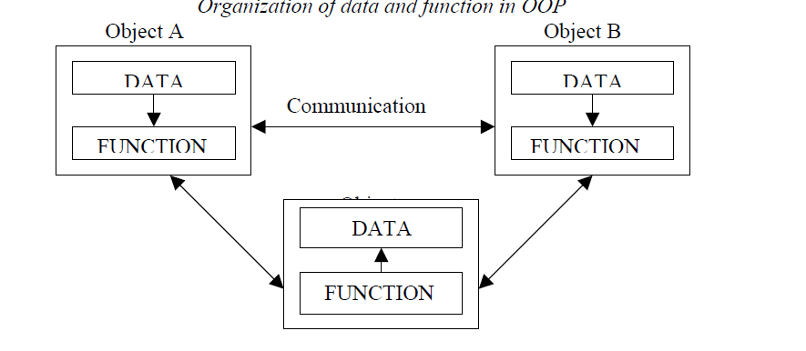
OOP methodology

Slide 11
Object Oriented Paradigm
OOP treats data as a critical element in the program development and does not allow it to flow freely around the system.
It ties data more closely to the function that operate on it, and protects it from accidental modification from outside function.
OOP allows decomposition of a problem into a number of entities called objects and then builds data and function around these objects.
The data of an object can be accessed only by the function associated with that object.
However, function of one object can access the function of other objects.

Slide 12
Features of OOP
Some of the features of object oriented programming are:
• Emphasis is on data rather than procedure.
• Programs are divided into what are known as objects.
• Data structures are designed such that they characterize the objects.
• Functions that operate on the data of an object are tied together in the data structure.
• Data is hidden and cannot be accessed by external function.
• Objects may communicate with each other through function.
• New data and functions can be easily added whenever necessary.
• Follows bottom up approach in program design.

Slide 13
Definition of OOP
“Object Oriented Programming is an approach that provides a way of modularizing programs by creating partitioned memory area for both data and functions that can be used as templates for creating copies of such modules on demand”.
-- Since memory partitions are independent, the objects can be used in a variety of different programs without modifications.

Slide 14
Basic Concepts of Object Oriented Programming
It is necessary to understand some of the concepts used extensively in object-oriented programming. These include:
• Objects
• Classes
• Data abstraction and encapsulation
• Inheritance
• Polymorphism
• Dynamic binding
• Message passing

Slide 15
Objects
Objects are the basic run time entities in an object-oriented system. They may represent a person, a place, a bank account, a table of data or any item that the program has to handle.

Slide 16
Objects
For example, if “customer” and “account” are two objects in a program, then the customer object may send a message to the account object requesting for the bank balance.
Each object contain data, and code to manipulate data.
Objects can interact without having to know details of each other’s data or code. It is a sufficient to know the type of message accepted, and the type of response returned by the objects.

Slide 17
Class
The entire set of data and code of an object can be made a user-defined data type with the help of class.
Objects are variables of the type class. Once a class has been defined, we can create any number of objects belonging to that class.
For examples, Mango, Apple and orange are members of class fruit.
Classes are user-defined that types and behave like the built-in types of a programming language
Fruit Mango;
Will create an object Mango belonging to the class fruit.

Slide 18
Data Abstraction and Encapsulation
The wrapping up of data and function into a single unit (called class) is known as encapsulation.
The data is not accessible to the outside world, and only those functions which are wrapped in the class can access it.
These functions provide the interface between the object’s data and the program. This insulation of the data from direct access by the program is called data hiding or information hiding.
Abstraction refers to the act of representing essential features without including the background details or explanation.
Through the process of abstraction, a programmer hides all but the relevant data about an object in order to reduce complexity and increase efficiency

Slide 19
Inheritance
Inheritance is the process by which objects of one class acquired the properties of objects of another classes.
In OOP, the concept of inheritance provides the idea of reusability.
This means that we can add additional features to an existing class without modifying it. This is possible by deriving a new class from the existing one. The new class will have the combined feature of both the classes.

Slide 20
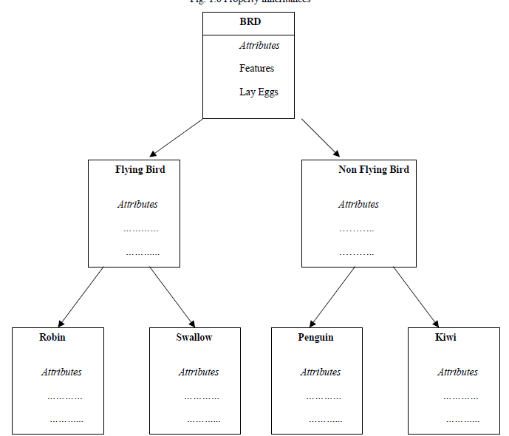

Slide 21
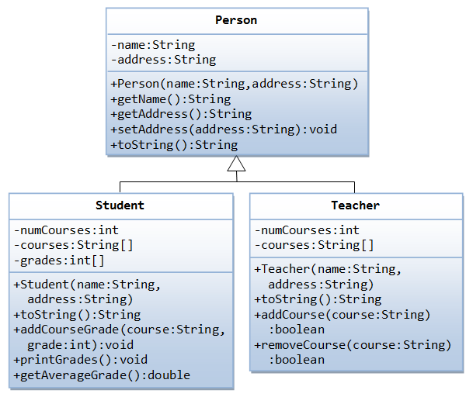
Example

Slide 22
Polymorphism
Polymorphism is another important OOP concept. Polymorphism, a Greek term, means the ability to take more than one form.
An operation may exhibit different behavior is different instances. The behavior depends upon the types of data used in the operation.
The process of making an operator to exhibit different behaviors in different instances is known as operator overloading.
Using a single function name to perform different type of task is known as function overloading.

Slide 23
Eg:-
Function overloading
Void add(int a ,int b);
Int add(int a,int b);
Int add(inta,int b,int c);
Int add(int a , float b); etc
Operator overloading
3+ 7
4.5 + 7.5
“Hello “ + “ Morning”
- All functions are different , even though their name is same.

Slide 24
Dynamic Binding
Binding refers to the linking of a procedure call to the code to be executed in response to the call.
Dynamic binding means that the code associated with a given procedure call is not known until the time of the call at run time.
It is associated with polymorphism and inheritance.

Slide 25
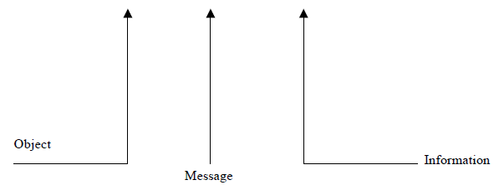
Message Passing
An object-oriented program consists of a set of objects that communicate with each other. The process of programming in an object-oriented language, involves the following basic steps:
1. Creating classes that define object and their behavior,
2. Creating objects from class definitions, and
3. Establishing communication among objects.
A Message for an object is a request for execution of a procedure, and therefore will invoke a function (procedure) in the receiving object that generates the desired results. Message passing involves specifying the name of object, the name of the function (message) and the information to be sent.
Example:
Employee. Salary (name);

Slide 26
Benefits of OOP
1. Through inheritance, we can eliminate redundant code extend the use of existing Classes.
2. We can build programs from the standard working modules that communicate with one another, rather than having to start writing the code from scratch. This leads to saving of development time and higher productivity.
3.The principle of data hiding helps the programmer to build secure programs that can not be invaded by code in other parts of the programs.
4. It is possible to have multiple instances of an object to co-exist without any interference.
5.It is possible to map object in the problem domain to those in the program.
6. It is easy to partition the work in a project based on objects.
7. Object-oriented system can be easily upgraded from small to large system.
8. Software complexity can be easily managed.

Slide 27
CHAPTER II (MODULE I)

Slide 28
Classes and Objects
The classes are the most important feature of C++ that leads to Object Oriented programming.
A class in C++ combines related data and functions together. It makes a data type which is used for creating objects of this type.
Classes represent real world entities that have both data type properties (characteristics) and associated operations (behavior).
The syntax of a class definition is shown below :
Class name_of _class
{
private : variable declaration; // data member
Function declaration; // Member Function (Method)
protected: Variable declaration;
Function declaration;
public : variable declaration;
Function declaration;
};

Slide 29
Class - contd..
For example : Class of birds, all birds can fly and they all have wings and beaks. So here flying is a behavior and wings and beaks are part of their characteristics. And there are many different birds in this class with different names but they all posses this behavior and characteristics.
i.e. class is just a blue print or template.
Eg: -
class Abc {
int x;
void display(){} //empty function
};
int main()
{
Abc obj; // Object of class Abc created
}

Slide 30
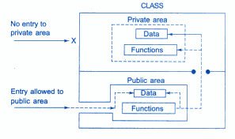
Data hiding in class

Slide 31
Access Control in Classes :Public
Access specifiers in C++ class defines the access control rules. C++ has 3 new keywords introduced, namely, public , private and protected.
These access specifiers are used to set boundaries for availability of members of class be it data members or member functions
Public, means all the class members declared under public will be available outside the class. The data members and member functions declared public can be accessed by other classes too. Hence there are chances that they might change them. So the key members must not be declared public.
class PublicAccess
{
public: // public access specifier
int x; // Data Member Declaration
void display(); // Member Function declaration
};

Slide 32
Private
Private keyword, means that it is not possible to access the class members declared as private outside that class.
By default class variables and member functions are private.
class PrivateAccess
{
private: // private access specifier
int x; // Data Member Declaration
void display(); // Member Function declaration
}

Slide 33
Protected
Protected, is the last access specifier, and it is similar to private, it makes class member inaccessible outside the class. But they can be accessed by any subclass of that class.
(If class A is inherited by class B, then class B is subclass of class A, and B can access protected members of A.)
class ProtectedAccess
{
protected: // protected access specifier
int x; // Data Member Declaration
void display(); // Member Function declaration
};

Slide 34
Objects
Objects of class holds separate copies of data members. We can create as many objects of a class as we need.
Class is mere a blueprint or a template.
No storage is assigned when we define a class. Objects are instances of class, which holds the data variables declared in class and the member functions work on these class objects.
Each object has different data variables. Objects are initialized using special class functions called Constructors.
And whenever the object is out of its scope, another special class member function called Destructor is called, to release the memory reserved by the object. C++ doesn't have Automatic Garbage Collector like in JAVA, in C++ Destructor performs this task.

Slide 35
Examples of object creation :-
class Student
{
public: int rollno;
string name;
}A,B; // this practice is seldom followed.
Here A and B are the objects of class Student, declared with the class definition. We can also declare objects separately, like we declare variable of primitive data types. In this case the data type is the class name, and variable is the object.
int main()
{
Student A;
Student B;
} Both A and B will have their own copies of data members.

Slide 36
Accessing Data Members of Class
Accessing a data member depends solely on the access control of that data member.
If its public, then the data member can be easily accessed using the direct member access (.) operator with the object of that class.
Private and Protected members can be accessed through public member functions.
Following is an example to show you how to initialize and use the public data members using the dot (.) operator and the respective object of class.

Slide 37
class Student
{
public:
int rollno;
string name;
};
int main()
{
Student A;
Student B;
A.rollno=1;
A.name="Adam";
B.rollno=2;
B.name="Bella";
cout <<"Name and Roll no of A is :"<< A.name << A.rollno;
cout <<"\n Name and Roll no of B is :"<< B.name << B.rollno;
}

Slide 38
Accessing Private Data Members
To access, use and initialize the private data member you need to create getter and setter functions, to get and set the value of the data member.
The setter function will set the value passed as argument to the private data member, and the getter function will return the value of the private data member to be used. Both getter and setter function must be defined public.

Slide 39
Example :
class Student
{
private: // private data member
int rollno;
public: int getRollno()
{
return rollno;
}
void setRollno(int i)
{
rollno=i;
}
};
int main()
{
Student A;
A.rollno=1; //Compile time error
cout<< A.rollno; //Compile time error
A.setRollno(1); //Rollno initialized to 1
cout<< A.getRollno(); //Output will be 1
}

Slide 40
Member Functions in Classes
Member functions are the functions, which have their declaration inside the class definition and works on the data members of the class.
The definition of member functions can be inside or outside the definition of class.
If the member function is defined inside the class definition, it can be defined directly, but if its defined outside the class, then we have to use the scope resolution operator ( :: )along with the class name and function name.
Example :
class Cube
{
public: int side;
int getVolume(); //Declaring function getVolume with no argument and return type int.
}; If we define the function inside class then we don't not need to declare it first, we can directly define the function.

Slide 41
class Cube
{
public: int side;
int getVolume()
{
return side*side*side; //returns volume of cube
} };
One of the objective of OOP is to separate the details of implementation from the class definition.
So, its better to define the member function outside the class definition .
We must declare the function inside class definition and then define it outside.

Slide 42
class Cube
{
public: int side;
int getVolume();
};
int Cube :: getVolume() // defined outside class definition
{
return side*side*side;
}

Slide 43
int main()
{
Cube C1;
C1.side=4; // setting side value
cout<< "Volume of cube C1 ="<< C1.getVolume();
}

Slide 44
Types of Member Functions
Following are different types of Member functions,
Simple functions
Inline functions
Static functions
Friend function
Const functions

Slide 45
Simple Member functions
These are the basic member function, which dont have any special keyword like static etc as prefix.
All the general member functions, which are seen so far in this subject , are termed as simple and basic member functions.
return_type functionName(parameter_list)
{
function body;
}

Slide 46
Inline functions
These are the functions designed to speed up program execution. An inline function is expanded (i.e. the function code is replaced when a call to the inline function is made) in the line where it is invoked.
So execution time taken is more in case of normal functions. There is a memory penalty in the case of an inline function.
The system of inline function is as follows :
inline function_header
{
body of the function
}
For example,
//function definition min()
inline void min (int x, int y)
{
cout<< (x < Y? x : y);
}

Slide 47
Void main()
{
int num1, num2;
cout<<”\Enter the two intergers\n”;
cin>>num1>>num2;
min (num1,num2; //function code inserted here
------------------
------------------
}
An inline function definition must be defined before being invoked as shown in the above example. Here min ( ) being inline will not be called during execution, but its code would be inserted into main ( ) as shown and then it would be compiled.
If the size of the inline function is large then heavy memory penalty makes it not so useful and in that case normal function use is better.

Slide 48
Static Member functions
Static is something that holds its position.
Static is a keyword which can be used with data members , member functions as well as with objects.
A function is made static by using static keyword with function name. These functions work for the class as a whole rather than for a particular object of a class.
It can be called using class name and scope resolution :: operator.

Slide 49
Static Data Member
Static Data Member: It is generally used to store value common to the whole class. The static data member differs from an ordinary data member in the following ways :
(i) Only a single copy of the static data member is used by all the objects.
(ii) It can be used within the class but its lifetime is the whole program.
For making a data member static, we require :
(a) Declare it within the class.
(b) Define it outside the class.

Slide 50
example
Class student
{
Static int count; //declaration within class
-----------------
-----------------
-----------------
};
The static data member is defined outside the class as :
int student :: count; //definition outside class
The definition outside the class is a must.

Slide 51
Static function
Static Member Function: A static member function can access only the static members of a class. We can do so by putting the keyword static before the name of the function while declaring it.
for example,
Class student
{
Static int count;
-----------------
public :
-----------------
-----------------
static void showcount (void) //static member function
{
Cout<<”count=”<<count<<”\n”;
}
};
int student ::count=0;

Slide 52
In C++, a static member function differs from the other member functions in the following ways:
(i) Only static members (functions or variables) of the same class can be accessed by a static member function.
(ii) It is called by using the name of the class rather than an object as given below:
Name_of_the_class :: function_name
For example,
student::showcount();

Slide 53
Example for static
class X
{
public: static void f()
{
}
};
int main()
{
X::f(); // calling member function directly with class name
}
These functions cannot access ordinary data members and member functions, but only static data members and static member functions.

Slide 54
a. Static variables inside Functions
Static variables when used inside function are initialized only once, and then they hold their value even through function calls.
void counter()
{
static int count=0;
cout << count++;
}
int main()
{
for(int i=0;i<5;i++)
{
counter();
} }

Slide 55
Let's see the same program's output without using static variable.
Output of previous program is
0 1 2 3 4
___________________________________________________
void counter()
{
int count=0;
cout << count++;
}
int main()
{
for(int i=0;i<5;i++)
{
counter();
} }
Output : 0 0 0 0

Slide 56
Eg:- of static members and functions
class stat
{
int code;
static int count;
public:
stat()
{
code=++count;
}
void showcode()
{
cout<<"\n\tObject number is :"<<code;
}
static void showcount()
{ cout<<"\n\tCount Objects :"<<count;
} };
int stat::count;
main()
{
stat obj1,obj2;
obj1.showcount();
obj1.showcode();
obj2.showcount();
obj2.showcode();
}

Slide 57
Output:
Count Objects: 2
Object Number is: 1
Count Objects: 2
Object Number is: 2

Slide 58
Const - Member function
A const member function never modifies data members in an object.
Syntax : return_type function_name() const;
class Test {
int value;
public:
Test(int v )
{ value = v; }
int getValue() const
{ return value;
} // We get compiler error if we add a statement like "value = 100;“ in this function.
};
int main() {
Test t(20);
cout<<t.getValue();
return 0;
}

Slide 59
Friend Function
A mechanism built in C++ programming to access private or protected data from non-member function , which is a friend function.
A friend function of a class is defined outside that class' scope but it has the right to access all private and protected members of the class.
class class_name
{
...... .... ........
friend return_type function_name(argument/s);
...... .... ........
}

Slide 60
Example program - 1
class Box { double width; public: friend void printWidth( Box box ); void setWidth( double wid ); }; void Box::setWidth( double wid ) { width = wid; } void printWidth( Box box ) // Note: printWidth() is not a member function of any class. { /* Because printWidth() is a friend of Box, it can directly access any member of this class */ cout << "Width of box : " << box.width <<endl; } int main( ) { Box box; box.setWidth(10.0); // Use friend function to print the width. printWidth( box ); return 0; }

Slide 61
Example program-2
class sample
{
int a ;
int b;
public: void setvalue()
{
a=25;
b = 40;
}
friend float mean(sample s);
};
float mean(sample s)
{
return (s.a+s.b)/2.0;
}
int main()
{
sample x;
x.setvalue();
cout<<mean(x);
return 0;
}

Slide 62
program to add two complex numbers using friend function- Example 3
#include<iostream>
using namespace std;
class complex
{
int real,imag;
public:
complex()
{
real =0;
imag =0;
}
complex(int a,int b)
{
real =a;
imag = b;
}
friend complex sum(complex,complex);
void display();
};
void complex::display()
{
cout<<"the sum of complex num is"<<real<<"+i"<<imag;
}
complex sum(complex a,complex b)
{
complex t;
t.real=a.real+b.real;
t.imag=a.imag+b.imag;
return t;
}
int main()
{
complex a(2,3),b(3,4),c;
c=sum(a,b);
c.display();
return(0);
}

Slide 63
Function friendly to two classes – Example 4
class ABC; //forward declaration
class XYZ{
int x;
public :
setvalue(int i)
{ x = i; }
friend void max(XYZ,ABC);
};
class ABC{
int a;
public: void setvalue(int i)
{ a = i;
}friend void max(XYZ,ABC);
};
void max(XYZ m, ABC n)
{
if (m.x>=n.a)
cout<<m.x;
else cout<<n.a;
}
int main()
{
ABC abc;
abc.setvalue(10);
XYZ xyz;
xyz.setvalue(20);
max(xyz,abc);
return 0;
}

Slide 64
Constructors
Constructor (having the same name as that of the class) is a special member function whose task is to initialize the objects of its class.
Constructors are invoked whenever an object of its associated class is created.
Destructors are the functions that are complimentary to constructors and are used to de-initialize objects when they are destroyed.
Declaration and Definition of a Constructor:-
It is defined like other member functions of the class, i.e., either inside the class definition or outside the class definition.

Slide 65
Parameterized constructor
Are used to initialize the data members with different values when they are created.
Constructors that can take arguments are called parameterized constructors. The parameter of a constructor can be of any type except that of the class to which it belongs.
public : A(A); ------- Is illegal
However, a constructor can accept a reference to its own type
public: A(A&) ; ------- Is valid ( Copy Constructor)
Arguments are passed to constructors in two ways
- Implicitly and explicitly
Example e1 = Example(2,4);//explicit call
Example e3(1,1); //implicit call

Slide 66
Example
class Example {
int x, y;
public:
Example();
Example(int a, int b); // Parameterized constructor
void display()
{
cout <<"x= "<<x <<endl<<"y="<<y<<endl;
}
};
Example :: Example()
{
x=5;
y= 5;
}
Example :: Example(int a, int b)
{
x = a; y = b;
}
int main()
{
Example e1 = Example(2,4);//explicit call
Example e2;
Example e3(1,1); //implicit call
cout<<"object 1\n";
e1.display();
cout<<"object 2\n";
e2.display();
cout<<"object 3\n";
e3.display();
}

Slide 67
Properties of constructors
(i) These are called automatically when the objects are created.
(ii) These should be declared in the public section.
(iii) constructors cannot be virtual.
(iv) Return type (not even void) cannot be specified for constructors.
(v) They cannot be inherited, but a derived class can call the base class constructor.
(vi) These cannot be static.
(vii) These can have default arguments as other C++ functions.
(Viii) A constructor can call member functions of its class.
(ix) They make ‘implicit call’ to the operators new and delete when memory allocation is needed.

Slide 68
Constructors with default arguments Eg:1
include<iostream>
using namespace std;
class student
{
public: int roll,uid;
student(int r, int u=1) ;//default argument constructor
void display()
{
cout <<"roll= "<<roll <endl<<"uid="<<uid<<endl;
} };
student:: student(int r,int u)
{
roll =r;
uid = u;
}
int main()
{
student s1(1) ; // Assigns the value of 1 to roll and 1 to uid
student s2(2,2);
student s3(3); // Assigns the value of 3 to roll and 1 to uid
s1.display() ;
s2.display() ;
s3.display() ;
}

Slide 69
Example 2:-
class student
{
public: int roll,uid;
student(int r, int u=1) ;//default argument constructor
student(int r);
void display()
{
cout <<"roll= "<<roll <<endl<<"uid="<<uid<<endl;
} };
student:: student(int r)
{
roll =uid = r;
}
student:: student(int r,int u)
{
roll =r;
uid = u;
}
int main()
{
student s1(1) ; // Assigns the value of 1 to roll and 1 to uid
student s2(2,2);
student s3(3);
s1.display() ;
s2.display() ;
s3.display() ; // Assigns the value of 3 to roll and 1 to uid
}

Slide 70
Default Constructor → No argument Constructor
Default argument Constructor→ Can be called with any number of arguments or no argument, provided values are provided in the function declaration/definition.
When called with no arguments, it becomes a default constructor.
It causes ambiguity /compilation error for such statements – Whether to call ,
student(int r, int u=1) //default argument constructor
or student(int r)
for the function call , student s3(10);

Slide 71
Copy Constructor
A copy constructor is used to declare and initialize an object from another object.
Example: - Integer I2(I1);
Integer I2 =I1;
The process of initializing through a copy constructor is called as copy initialization.
The statement , I2= I1 ; Simply copies the member values, its not a copy constructor.

Slide 72
Example for copy constructor
// Let us access values assigned by constructors
cout << "p1.x = " << p1.getX() << ", p1.y = " << p1.getY();
cout << "\np2.x = " << p2.getX() << ", p2.y = " << p2.getY();
cout << "\np3.x = " << p3.getX() << ", p3.y = " << p3.getY();
p1.x++;
p1.y++;
p3=p1; // simply copying values .Not a copy constructor
cout << "\n\np1.x = " << p1.getX() << ", p1.y = " << p1.getY();
cout << "\np2.x = " << p2.getX() << ", p2.y = " << p2.getY();
cout << "\np3.x = " << p3.getX() << ", p3.y = " << p3.getY();
return 0;
}
class Point
{
private:
int x, y;
public:
Point(int x1, int y1) { x = x1; y = y1; }
// Copy constructor
Point(Point &p3)
{x = p3.x;
y = p3.y;
}
int getX() { return x; }
int getY() { return y; }
};
int main()
{
Point p1(10, 10),p3(1,1); // Normal constructor is called here
Point p2 = p1; // Copy constructor is called here

Slide 73
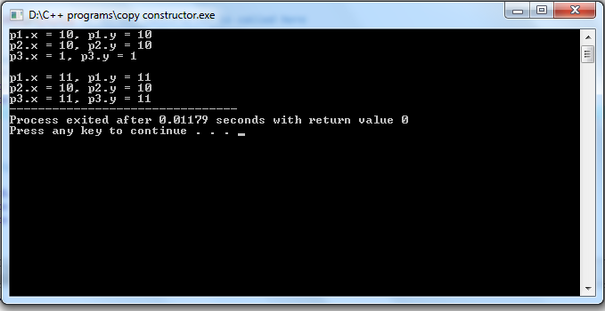

Slide 74
Destructor
A destructor is a special member function of a class that is executed whenever an object of it's class goes out of scope.
It never takes any argument nor does it return any value.
It is called implicitly by the compiler upon exit from the program /block/function to clean up storage that is no longer accessible.
It’s a good programming practice.

Slide 75
Destructor
class Line
{
private: double length;
public: void setLength( double len );
double getLength( void );
Line(); // This is the constructor declaration
~Line(); // This is the destructor: declaration
};
Line::Line(void)
{
cout << "Object is being created" << endl;
}
Line::~Line(void)
{
cout << "Object is being deleted" << endl;
}
void Line::setLength( double len )
{
length = len;
}
double Line::getLength( void )
{
return length;
}
// Main function for the program
int main( )
{
Line line;
line.setLength(6.0);
cout << "Length of line : " << line.getLength() <<endl;
return 0;
}

Slide 76
When the above code is compiled and executed, it produces the following result:
Object is being created
Length of line : 6
Object is being deleted

Slide 77
Review ..
Class , Objects, Abstraction, Encapsulation, Polymorphism , Inheritance.
Private , Protected, Public.
Static(variables and functions), Inline, const, friend.
:: - scope resolution , . - dot operator .
Constructor, destructor .
default constructor, default argument function

