Slide 1
8259A
PROGRAMMABLE INTERRUPT CONTROLLER

Slide 2
Introduction
Handle eight interrupt inputs.
Vector an interrupt request anywhere in the memory map.
Resolve eight levels of interrupt priorities in a variety of modes.
Mask each interrupt request individually.
Read the status of pending interrupts, in service interrupts, and masked interrupts.

Slide 3
Be set up to accept either the level triggered or edge triggered interrupt request.
8259 can be cascade in a master slave configuration to handle 64 interrupt inputs.

Slide 4
It is packaged in a 28-pin DIP
NMOS technology
Requires a single a +5V supply.
Circuitry is static, requiring no clock input.
The 8259A is designed to minimize the software and real time overhead in handling multi-level priority interrupts.

Slide 5
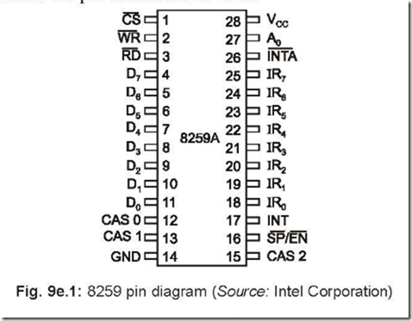

Slide 6
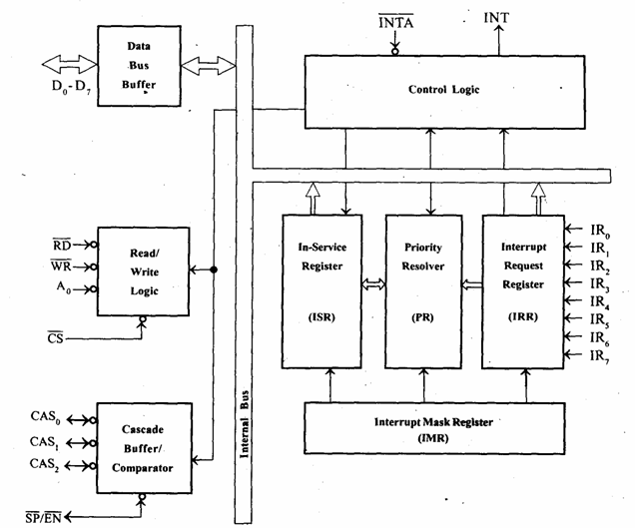

Slide 7
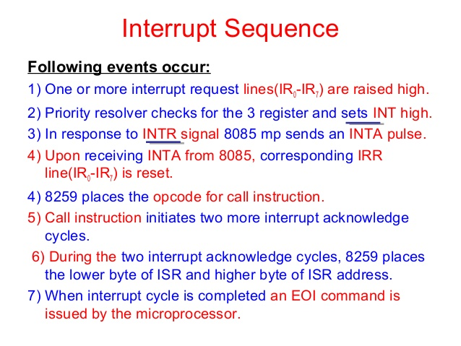

Slide 8
Priority modes
Fully nested mode
Automatic rotation mode
Specific rotation mode
Special mask mode

Slide 9
Programming 8259
Initialization command word (ICW) – before starting the functioning of 8259
To load starting address of ISS
Whether edge or level triggered
Whether in single or cascaded mode
Whether ICW4 is required or not
Operation command word (OCW) – during operation of 8259.
Mask or unmask the interrupt lines
Change priorities of interrupt lines
To send EOI signals.

Slide 10
Four types of ICW:
ICW1
ICW2
ICW3
ICW4
Three types of OCW:
OCW1
OCW2
OCW3

Slide 11
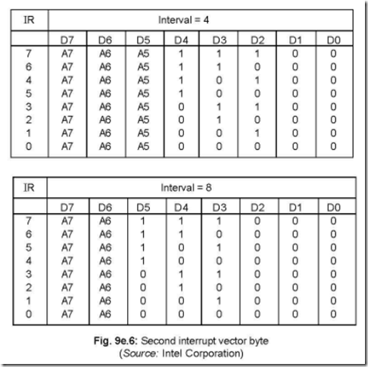
Address calculation for IR lines

Slide 12
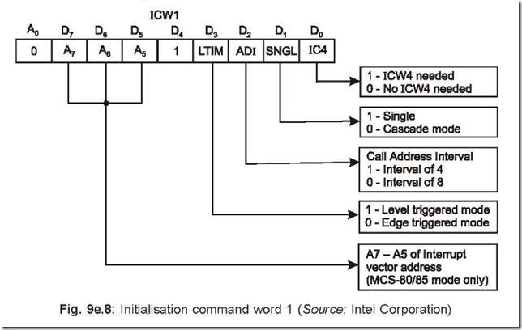
ICW1

Slide 13
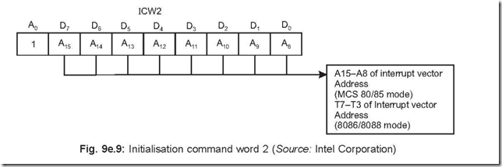
ICW2

Slide 14
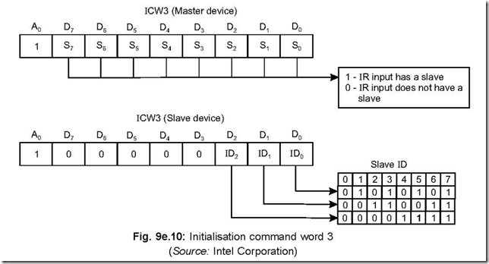
ICW3

Slide 15
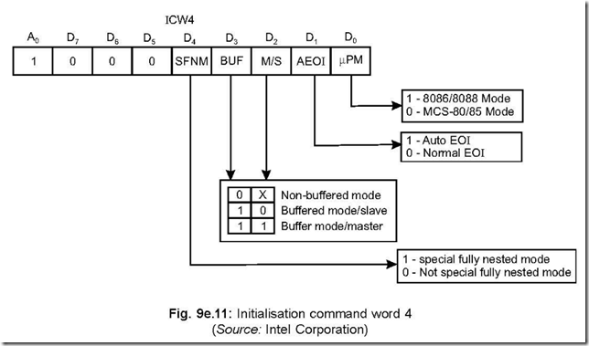
ICW4

Slide 16
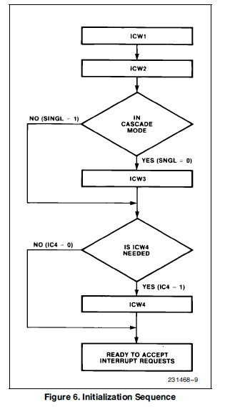

Slide 17
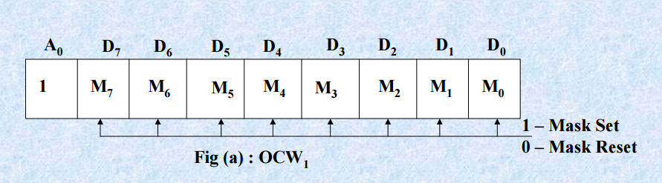
OCW1

Slide 18
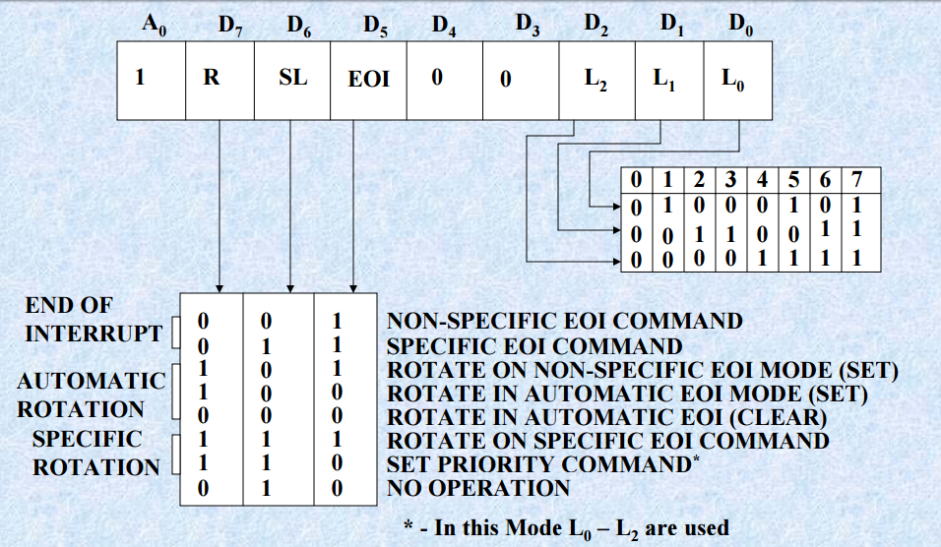
OCW2

Slide 19
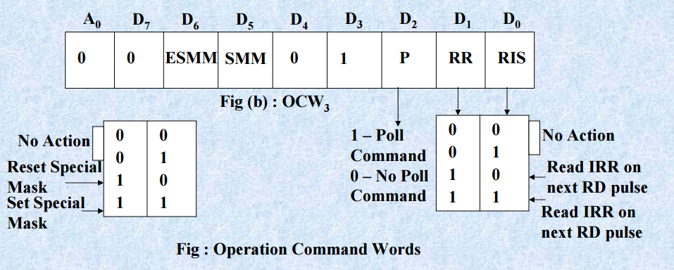
OCW3

Slide 20
Poll command
In polled mode of operation, the INT output of 8259A is neglected.
The 8259A treats the next RD pulse to the 8259A as an interrupt acknowledge.
An appropriate ISR bit is set, if there is a request. The priority level is read and a data word is placed on to data bus, after RD is activated.
A poll command may give the option of more than 64 priority levels.

Slide 21
