Slide 1
OPCODE FETCH MACHINE CYCLE

Slide 2
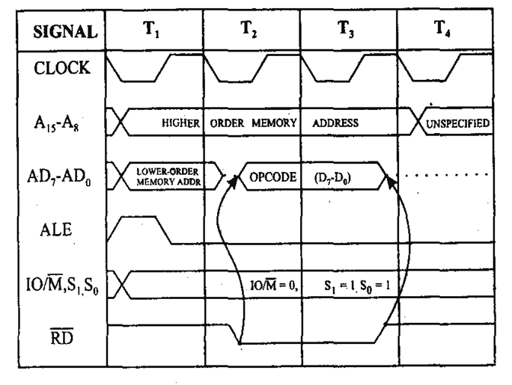

Slide 3
MEMORY READ MACHINE CYCLE

Slide 4
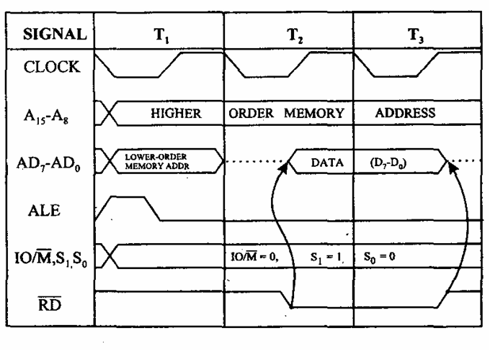

Slide 5
MEMORY WRITE MACHINE CYCLE

Slide 6
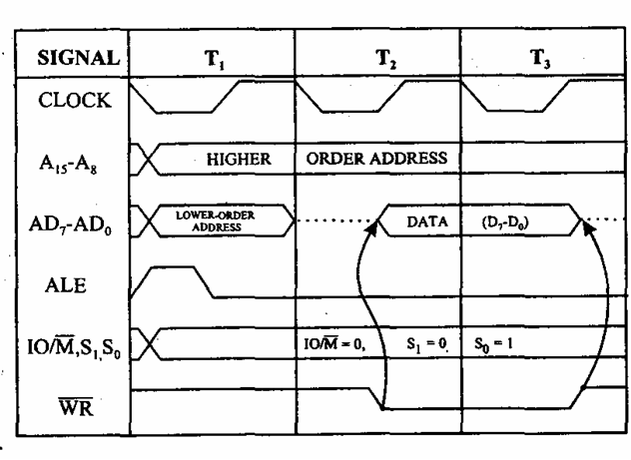

Slide 7
MOV C,A
1 byte instruction
1 machine cycle- opcode fetch
Opcode : 4F
Location: 2005H

Slide 8
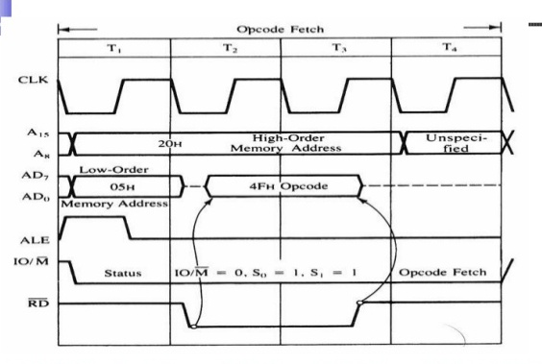

Slide 9
MVI A, 32 H
2 byte instruction
2 machine cycles: opcode fetch, memory read
Opcode: 3E, operand: 32 H
Location: 2000H and 2001H

Slide 10
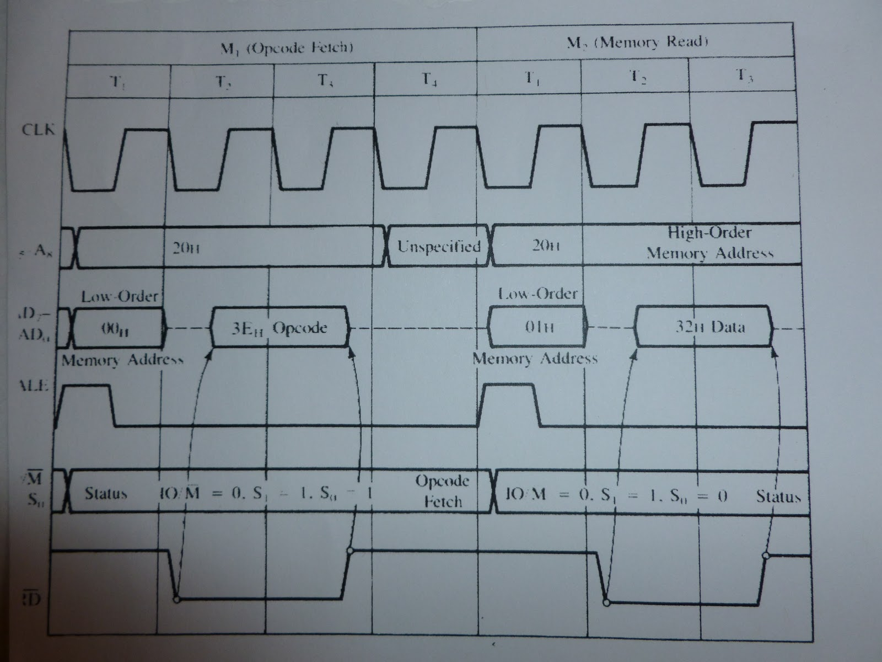

Slide 11
STA 526A H
3 byte instruction
4 machine cycles: opcode fetch, memory read,
memory read, memory write
Opcode: 32, operand: 52H and 6A H
Location: 41FF H, 4200H, 4201 H

Slide 12
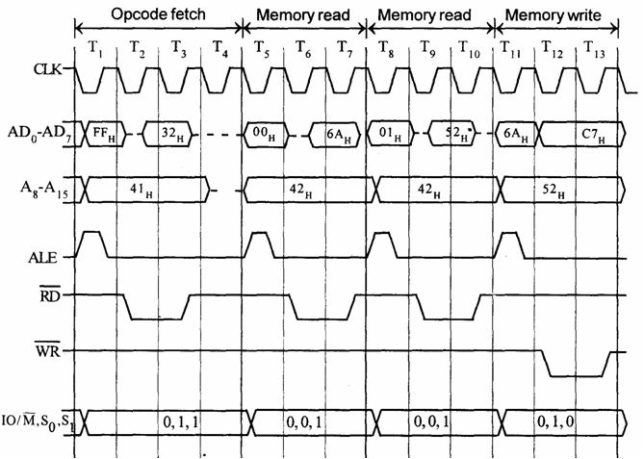

Slide 13
I/O READ MACHINE CYCLE

Slide 14
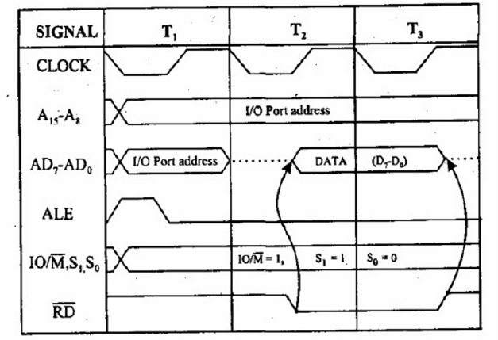

Slide 15
I/O WRITE MACHINE CYCLE

Slide 16
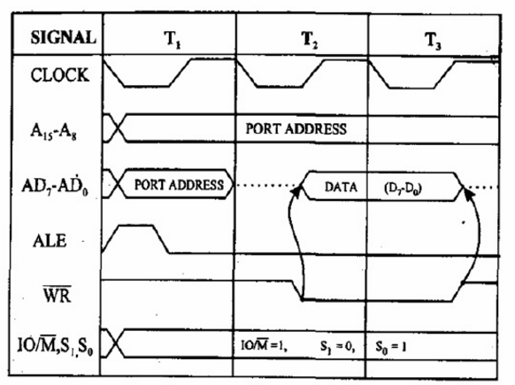

Slide 17
IN 84 H
2 byte instruction
3 machine cycle: opcode fetch, memory read, I/O read
Opcode: DB H, operand: 84 H
Location: 2065H and 2066H

Slide 18
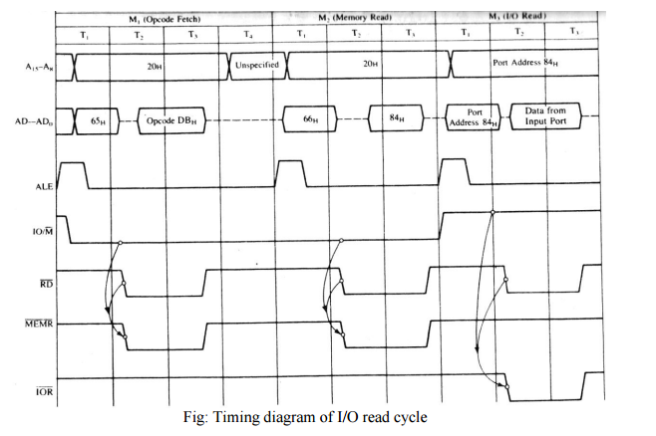

Slide 19
OUT 01 H
2 byte instruction
3 machine cycle: opcode fetch, memory read, I/O write
Opcode: D3 H, operand: 01 H
Location: 2050H and 2051H

Slide 20
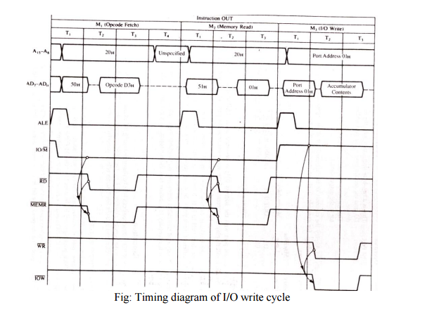

Slide 21
Interrupt ack machine cycle & RST instruction

Slide 22
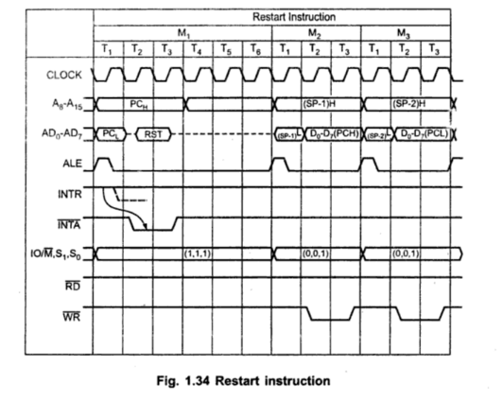

Slide 23
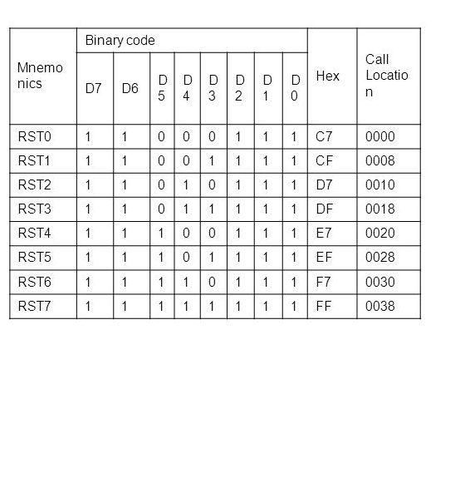

Slide 24
