Slide 1
MODULE II
INHERITANCE

Slide 2
Inheritance
It is the capability of one class to acquire properties and characteristics from another class. The class whose properties are inherited by other class is called the Parent or Base or Super class. And, the class which inherits properties of other class is called Child or Derived or Sub class.
In C++ , classes are reused by the concept called inheritance .
When we inherit an existing class, all its methods and fields become available in the new class, hence code is reused.
NOTE : All members of a class except Private, are inherited

Slide 3
Purpose of inheritance..(Advantages)
Reduces code redundancy.
Provides code reusability.
Reduces source code size and improves code readability.
Code is easy to manage and divided into parent and child classes.
Supports code extensibility by overriding the base class functionality within child classes.

Slide 4
Disadvantages
In Inheritance, base class and child classes are tightly coupled. Hence If you change the code of parent class, it will get affected in all the child classes.
In class hierarchy many data members remain unused and the memory allocated to them is not utilized. Hence this concept affects the performance of program if inheritance is not applied correctly.

Slide 5
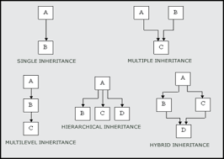
Types of inheritance

Slide 6
Syntax:-
class Subclass_name : access_mode Superclass_name
{
…..
……
…… // Members of derived class
};
While defining a subclass like this, the super class must be already defined or at-least declared before the subclass declaration.
Access Mode is used to specify, the mode in which the properties of superclass will be inherited into subclass, public, privtate or protected.
Eg: - Class PQR: public/private/protected ABC

Slide 7
Inheritance Visibility Mode
Depending on Access modifier used while inheritance, the availability of class members of Super class in the sub class changes. It can either be private, protected or public.
1) Public Inheritance
This is the most used inheritance mode. In this the protected member of super class becomes protected members of sub class and public becomes public.
class Subclass : public Superclass
2) Private Inheritance
In private mode, the protected and public members of super class become private members of derived class.
class Subclass : Superclass // By default its private inheritance.
Note: Private members are not inherited and hence private members of a base class will never become members of its derived class.

Slide 8
3) Protected Inheritance
In protected mode, the public and protected members of Super class becomes protected members of Sub class.
class subclass : protected Superclass
In inheritance, some of the base class data elements and member functions are inherited in to the derived class. We can add our own data and member functions and thus extend the functionality of base class.
Inheritance, thus becomes a powerful tool for incremental program development.

Slide 9
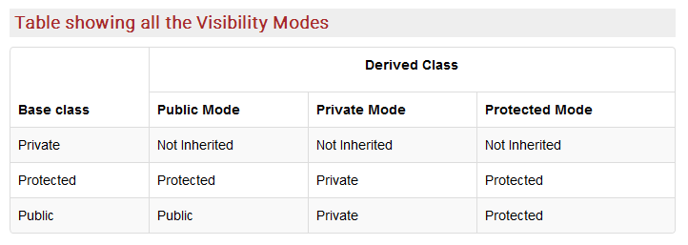

Slide 10
Single Inheritance
In this type of inheritance one derived class inherits from only one base class. It is the most simplest form of Inheritance.
Super Class
Sub Class

Slide 11
Single Inheritance - Example
class B
{
int a;
public:
int b;
void get_ab();
int get_a();
void show_a();
};
class D: public B
{
int c;
public:
void mul();
void display();
};
void B :: get_ab()
{
a=5;b=10;
}
int B :: get_a()
{ return a;}
void B :: show_a()
{
cout<<"a="<<a<< "\n" ;
}
void D :: mul()
{
c=b* get_a();
}
void D :: display()
{
cout<<"a="<<get_a()<<"\n";
cout<<"b="<<b<<"\n";
cout<<"c="<<c<<"\n";
}
int main()
{
D d;
d.get_ab();
d.mul();
d.show_a();
d.display();
d.b=20;
d.mul();
d.display();
return 0;
}

Slide 12
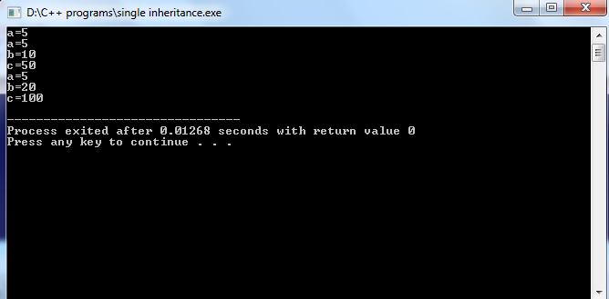
Output ..

Slide 13
Class D: Public B
Inherited from B
Private section
c
Public section
b
get_ab()
Inherited from B
get_a()
show_a()
mul()
display()

Slide 14
Class D: Private B
c
Inherited from B
Private section
b
get_ab()
get_a()
show_a()
Public section
mul()
display()

Slide 15
For the declaration class D: private B
int main()
{
D d;
d.get_ab();
d.mul();
d.show_a();
d.display();
d.b=20;
d.mul();
d.display();
return 0;
}

Slide 16
For the declaration class D: private B
int main()
{
D d;
d.get_ab(); //wont work
d.mul();
d.show_a(); //wont work
d.display();
d.b=20; // wont work . B is now private
d.mul();
d.display();
return 0;
}

Slide 17
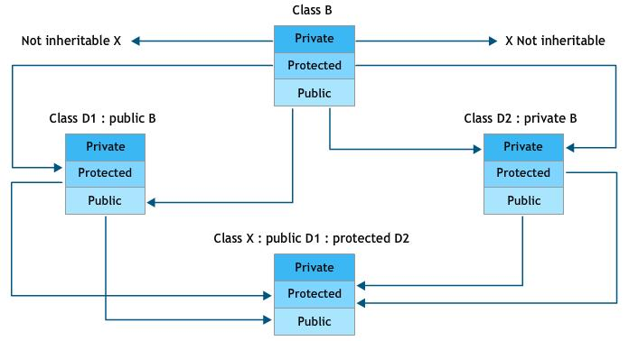
Effect of inheritance in visibility of members

Slide 18
Friend Class
Similarly like, friend function, A class can be made a friend of another class using keyword friend.
For example:
class A{
........
..... ........
friend class B; // class B is a friend class
..... ..... .....
};
class B
{
..... ...
.. .....
};
All member functions of class B will be friend functions of class A.
Thus, any member function of class B can access the private and protected data of class A.
If B is declared friend class of A then, all member functions of class B can access private data and protected data of class A. But, member functions of class A cannot access private and protected data of class B.

Slide 19
Example pgm
class beta;
class alpha {
private:
int alpha_data;
public:
alpha()
{
alpha_data=0;
}
alpha(int d)
{
alpha_data=d;
}
void show()
{
cout<<"\n Value of alpha_data = "<<alpha_data<<endl;
}
friend beta;
};
class beta
{
private:
int beta_data;
public:
beta()
{
beta_data=0;
}
void show(alpha a)
{
cout<<" Value of beta_data = "<<a.alpha_data<<endl;
} };
main()
{
alpha a(786);
beta b;
a.show();
b.show(a1);
}

Slide 20
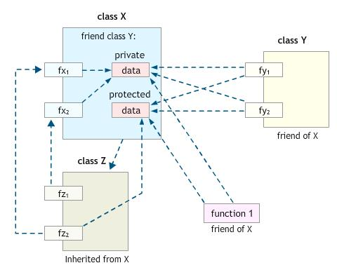
Access mechanism in classes

Slide 21
Some useful points..
Friendships are not symmetric – If class A is a friend of class B, class B is not automatically a friend of class A.
Friendships are not transitive – If class A is a friend of class B, and class B is a friend of class C, class A is not automatically a friend of class C.
Friendships are not inherited – A friend of class Base is not automatically a friend of class Derived and vice versa; equally if Base is a friend of another class, Derived is not automatically a friend and vice versa.
Access due to friendship is inherited – A friend of Derived can access the restricted members of Derived that were inherited from Base. A friend of Derived only has access to members inherited from Base to which Derived has access itself, e.g. if Derived inherits publicly from Base, Derived only has access to the protected (and public) members inherited from Base, not the private members, so neither does a friend.

Slide 22
View of access control to the members of class
All users
Public
Protected
Private
Own Member functions , friend classes and friend functions
Derived class member functions

Slide 23
Example 2:-
class first
{
public:
int a,b;
void getdata()
{
cout<<"\nEnter Number :::\t";
cin>>a>>b;
}
void putdata()
{
cout<<"\nNumber Is :::\t"<<a<<"\t"<<b;
}
};
class second :public first
{
public :
int c;
void add()
{
getdata();
putdata();
c=a+b;
cout<<"\n\nAnswer :::\t"<<c;
}
};
int main()
{
second s1;
s1.add();
}

Slide 24
Constructor and inheritance
The derived class constructor is mandatory if base class has it.
The compiler automatically calls a base class constructor before executing the derived class constructor.
This is done by specifying the arguments to the selected base class constructor in the definition of the derived class constructor.

Slide 25
Example:-
class Rectangle {
private :
float length;
float width;
public: Rectangle ()
{
length = 1; width = 1;
}
Rectangle (float len, float wid)
{
length = len; width = wid;
}
float area()
{
return length * width ;
} };
class Box : public Rectangle {
private : float height;
public: Box ()
{ height = 2;
}
Box (float len, float wid, float ht) : Rectangle(len, wid)
{
height = ht;
}
float volume()
{
return area() * height;
} };
int main ()
{
Box bx;
Box cx(4,8,5);
cout << bx.volume() << endl;
cout << cx.volume() << endl;
return 0; }

Slide 26
Why is Base class Constructor called inside Derived class ?
Constructors have a special job of initializing the object properly. A Derived class constructor has access only to its own class members, but a Derived class object also have inherited property of Base class, and only base class constructor can properly initialize base class members. Hence all the constructors are called, else object wouldn't be constructed properly.

Slide 27
Function Overriding
A derived class can override a member function of its base class by defining a derived class member function with the same name and parameter list.
It is often useful for a derived class to define its own version of a member function inherited from its base class.
class base {
public: void display ()
{
cout << "base: display function\n";
} };
class derivd : public base
{
public: void display ()
{
cout << "derivd: display function\n\n";
} };
int main ()
{
derivd r;
r.display();
return 0;
}

Slide 28
Modifying the display() function:
class derivd : public base
{
public: void display ()
{
cout << "derivd: display function\n\n";
base::display();
}
};
output:
derivd: display function
base: display function

Slide 29
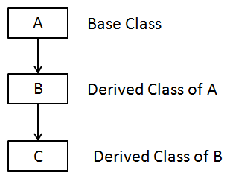
Multilevel Inheritance
Class B is called the intermediate base class, since it provides a link
for the inheritance between A and C. The chain ABC is known as inheritance path.
Class A{….};
Class B: public A{…….};
Class C:public B{……};
This can be extended to any number of levels.

Slide 30
Sample program
class A
{
public: void display()
{
cout<<"Base class content.";
} };
class B : public A
{
};
class C : public B
{
};
int main()
{
C c;
c.display();
}

Slide 31
Example 2:-
class base1 { public: base1() { cout<<"In constructor of base1"<<endl; } ~base1() { cout<<"In destructor of base1"<<endl; } }; class base2:public base1 { public: base2() { cout<<"In constructor of base2"<<endl; } ~base2() { cout<<"In destructor of base2"<<endl; } };
class derived :public base2 { public: derived() { cout<<"In constructor of derived"<<endl; } ~derived() { cout<<"In destructor of derived"<<endl; } }; int main() { base1 b1; base2 b2; derived d1; }

Slide 32
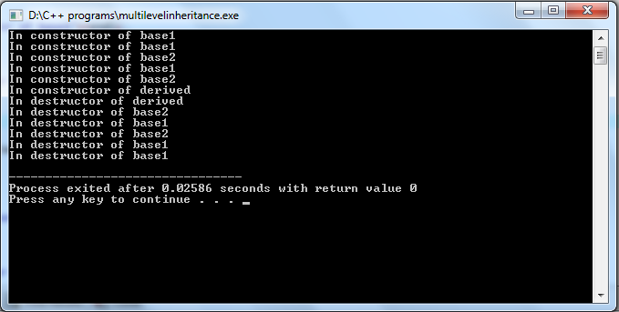
Constructors are always executed from the parent to child and destructors are executed in the opposite order.

Slide 33
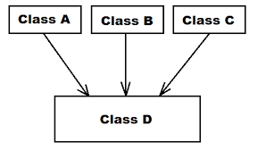
Multiple inheritance
A class inherits the attributes/properties of more than one class
i.e A class can have more than one direct base classes.
Consider the following classes:
Class A {/* .....*/};
Class B {/* .....*/};
Class C : public A, public B
{ /*
.
.
.
.
*/
};
This is called Multiple Inheritance.

Slide 34
Example program
class student
{
protected:
int rno,m1,m2;
public:
void get()
{ cout<<"Enter the Roll no :";
cin>>rno;
cout<<"Enter the two marks :";
cin>>m1>>m2;
} };
class sports
{
protected:
int sm; // sm = Sports mark
public:
void getsm()
{
cout<<"\nEnter the sports mark :";
cin>>sm;
} };
class statement:public student,public sports
{
int tot,avg;
public:
void display()
{
tot=(m1+m2+sm);
avg=tot/3;
cout<<"\n\n\tRoll No : "<<rno<<"\n\tTotal : "<<tot;
cout<<"\n\tAverage : "<<avg;
}
};
main()
{
statement obj;
obj.get();
obj.getsm();
obj.display();
}

Slide 35
Constructor call in Multiple Inheritance
All the Base class's constructors are called inside derived class's constructor, in the same order in which they are inherited.
Eg: -
class A : public B, public C
In this case, first class B constructor will be executed, then class C constructor and then class A constructor.

Slide 36
Example
class A
{
public:
A() { cout << "A's constructor called" << endl; }
};
class B
{
public:
B() { cout << "B's constructor called" << endl; }
};
class C: public B, public A // Note the order
{
public:
C() { cout << "C's constructor called" << endl; }
};
A
B
C
int main()
{
C c;
return 0;
}

Slide 37
Output:
B's constructor called
A's constructor called
C's constructor called
The destructors are called in reverse order of constructors.

Slide 38
Ambiguity in multiple inheritances
Consider an example of multiple inheritances in which there are two base classes having functions with the same name and a class derived from both these base classes having no function with this name.
Class A
{
Public:
Void show ()
{
Cout<<”\n class A”;
}
};
Class B
{
Public:
Void show ()
{
Cout<<”\n class B”;
}
};

Slide 39
Contd…
Class C: public A, public B
{
};
int main ()
{
C obj;
Obj. Show ();
}
The members are ambiguous without scope resolution operator .
When the member function show () is accessed by the derived class object, naturally, the compiler can’t distinguish between member function of the class A and B.
The problem is resolved using scope-resolution operator to specify the class in which the function lies. Thus,
Obj.y:: show ();
Refers to the function in the B class. Thus, the scope – resolution operator resolves the ambiguity.

Slide 40
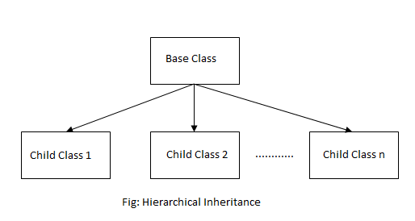
Hierarchical Inheritance

Slide 41
Syntax of Hierarchical Inheritance
class base_classname
{
properties;
methods;
};
class derived_class1 :visibility_mode base_classname {
properties;
methods;
};
class derived_class2 :visibility_mode base_classname {
properties;
methods;
};
... ... ... ... ... ...
class derived_classN: visibility_mode base_classname {
properties;
methods;
};

Slide 42
Example program
class person
{
char name[100],gender[10];
int age;
public:
void getdata()
{
cout<<"Name: ";
gets(name);
cout<<"Age: ";
cin>>age;
cout<<"Gender: ";
cin>>gender;
}
void display()
{
cout<<"Name: "<<name<<endl;
cout<<"Age: "<<age<<endl;
cout<<"Gender: "<<gender<<endl;
}
};
class student: public person
{
char institute[100], level[20];
public:
void getdata()
{
person::getdata();
cout<<"Name of College/School: ";
gets(institute);
cout<<"Level: ";
cin>>level;
}
void display()
{
person::display();
cout<<"Name of College/School: "<<institute<<endl;
cout<<"Level: "<<level<<endl;
}
};

Slide 43
Pgm continued..
class employee: public person
{
char company[100];
float salary;
public:
void getdata()
{
person::getdata();
cout<<"Name of Company: ";
gets(company);
cout<<"Salary: Rs.";
cin>>salary;
}
void display()
{
person::display();
cout<<"Name of Company: "<<company<<endl;
cout<<"Salary: Rs."<<salary<<endl;
} };
int main()
{
student s;
employee e;
cout<<"Student"<<endl;
cout<<"Enter data"<<endl;
s.getdata();
cout<<endl<<"Displaying data"<<endl;
s.display();
cout<<endl<<"Employee"<<endl;
cout<<"Enter data"<<endl;
e.getdata();
cout<<endl<<"Displaying data"<<endl;
e.display();
return 0;
}

Slide 44
Hybrid inheritance
Hybrid inheritance is combination of two or more inheritances such as single, multiple, multilevel or Hierarchical inheritances.
In the diagram, class B inherits property(member function) of class A which is base class and class D inherits property from class B and class C
A
C
B
D

Slide 45
Sample pgm
class A //Base class
{
public:
int l;
void len()
{
cout<<"\n\nLength :::\t";
cin>>l;
} };
class B :public A //Inherits property of class A
{
public:
int b,c;
void l_into_b()
{
len();
cout<<"\n\nBreadth :::\t";
cin>>b;
c=b*l;
} };
class C
{
public:
int h;
void height()
{
cout<<"\n\nHeight :::\t";
cin>>h;
} };
//Hybrid Inheritance Level
class D:public B,public C
{
public:
int res;
void result()
{
l_into_b();
height();
res=h*c;
cout<<"\n\nResult (l*b*h) :::\t"<<res;
} };
int main()
{
D d1;
d1.result();
}

Slide 46
Sample pgm 2 - Hybrid
class base1
{
public:
base1()
{
cout<<"In constructor of base1"<<endl;
}
~base1()
{
cout<<"In destructor of base1"<<endl;
} };
class base2:public base1
{
public:
base2()
{
cout<<"In constructor of base2"<<endl;
}
~base2()
{
cout<<"In destructor of base2"<<endl;
} };
class derived :public base2,public base1
{
public:
derived()
{
cout<<"In constructor of derived"<<endl;
}
~derived()
{
cout<<"In destructor of derived"<<endl;
}
};
main()
{
derived d1;
}
base1
base1
base2
Derived

Slide 47
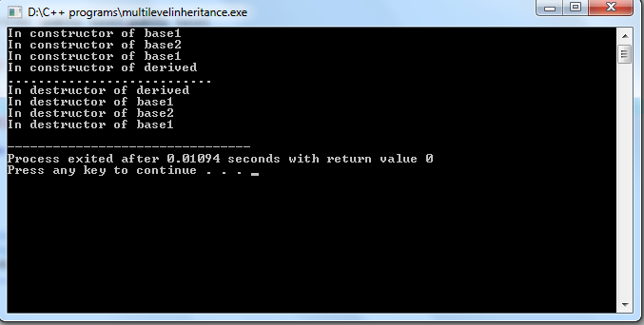
[Warning] direct base 'base1' inaccessible in 'derived' due to ambiguity

Slide 48
Virtual Base Class
A
B
C
D

Slide 49
Virtual Base Class
Derived class D class gets duplicate
copy of properties inherited
from base class A.
This introduces ambiguity
and must be avoided.
A
B
C
D

Slide 50
class A
{
public: int i;
};
class B : virtual public A
{
public: int j;
};
class C: virtual public A
{
public: int k;
};
class D: public B, public C
{
public: int sum;
};
int main()
{
D ob;
ob. i = 10; //unambiguous since only one copy of i is inherited.
ob.j = 20;
ob.k = 30;
ob.sum = ob.i + ob.j + ob.k;
cout << "Value of i is : "<< ob.i<<"\n";
cout << "Value of j is : "<< ob.j<<"\n"; cout << "Value of k is :"<< ob.k<<"\n";
cout << "Sum is : "<< ob.sum <<"\n";
return 0;
}

Slide 51
When a class is made virtual, C++ takes necessary care to see that only one copy of that class is inherited regardless of multiple inheritance paths.

Slide 52
Nesting of classes
Another way of inheriting properties of one class in another class.
This gives a view that an object can be a collection of many objects.
Ie. A class can contain objects of other classes as its members.
Eg: - class alpha { ……};
class beta{…….};
class gamma
{
alpha a;
beta b ;
………..
};
All objects of gamma will contain the objects a and b.
This relationship is called containership or nesting

Slide 53
Creation of a nested objects:-
In two stage , first the member objects are created using their respective constructors and then other ‘ordinary’ members are created.
I.e. constructors of all member objects must be called before calling its own constructor.
Eg: - class gamma
{
…..
alpha a;
beta b;
public: gamma(arglist):a(arglist1),b(arglist2)
{
// Constructor body
} };

Slide 54
Nesting of classes .. Contd..
arglist is the list of arguments that is to be supplied when gamma object is defined.
arglist1 is the arguments for constructor of a and
arglist2 is the arguments for constructor of b

Slide 55
Example pgm
class A
{ public: int i;
A( int a )
{
i = a;
}
void display()
{
cout<<"i="<<i;
} };
class B
{
public: int j;
B(int b)
{ j =b;
}
void display()
{
cout<<"j="<<j;
} };
class C
{
public: int k;
A a1;
B b1;
C(int a,int b,int c):a1(a),b1(b)
{
k =c;
}
void display()
{
a1.display();
b1.display();
cout<<"k="<<k;
} };
int main()
{
C c(3,4,5);
c.display();
c.a1.display();
c.b1.display();
}

Slide 56
Review ..
Base class , derived class , inheritance path, inheritance types , modes of inheritance.
Reusability , indirect base class , intermediate base class .
Containership , friend class.
Virtual base class
Order of constructor call in inheritance
Nesting of classes

