Slide 1
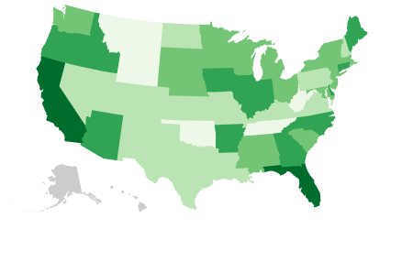
D3.js - Maps and Projections
VENKAT BANDI
Debajyoti Mondal
University of Saskatchewan

Slide 2
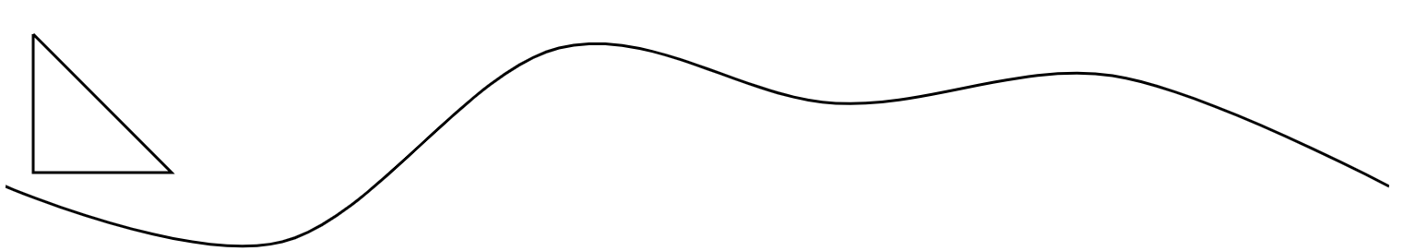
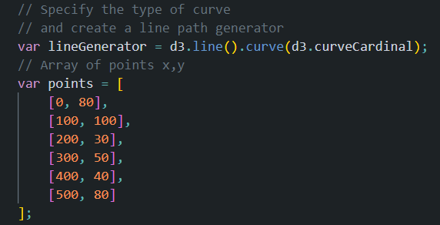
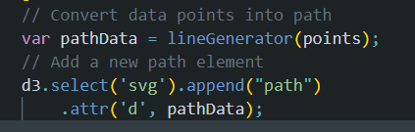
SVG Paths
TRIANGLE PATH
CURVED LINE PATH

Slide 3
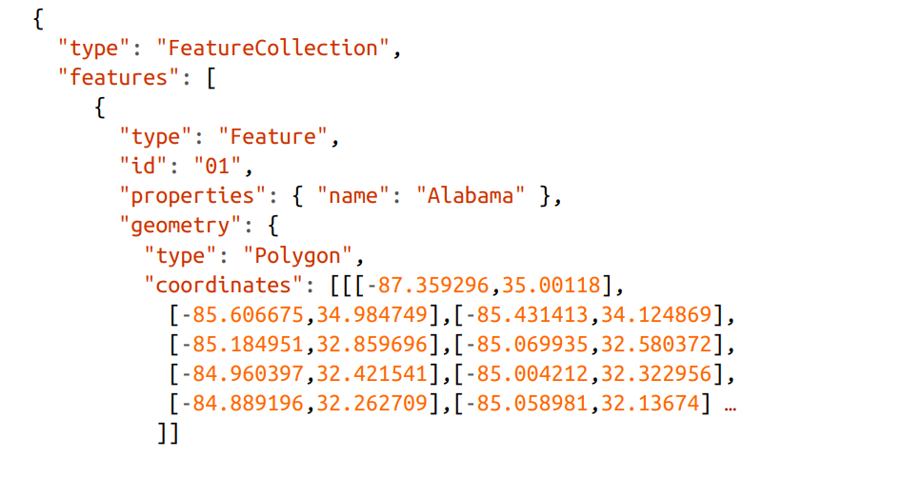
D3 Maps – GEO JSON

Slide 4
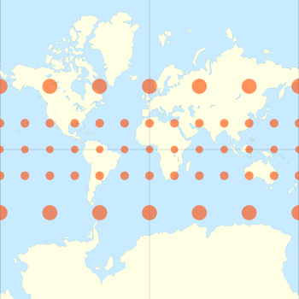
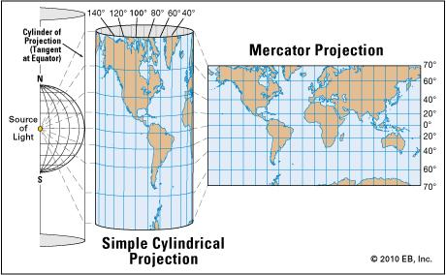
Projections - Mercator

Slide 5
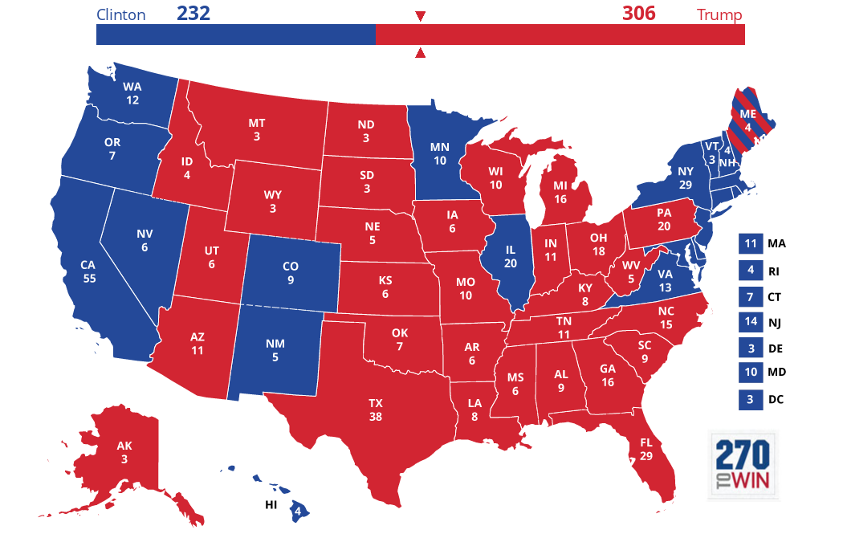
Choropleth Maps

