Slide 1
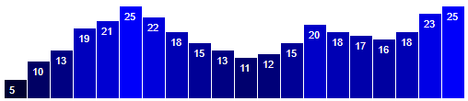
D3.js
var dataset = [ 5, 10, 13, 19, 21, 25, 22, 18, 15, 13, 11, 12, 15, 20, 18, 17, 16, 18, 23, 25 ];
Debajyoti Mondal
VENKAT BANDI – TA
venkat.bandi@usask.ca
G72 Thorvaldson GROUND FLOOR
University of Saskatchewan

Slide 2
Start the Server
Microsoft Windows [Version 10.0.15063]
(c) 2017 Microsoft Corporation. All rights reserved.
C:\> python -m SimpleHTTPServer 8888
C:\Users\jyoti\AppData\Local\Programs\Python\Python37-32\python.exe: No module named SimpleHTTPServer
C:\> python -m http.server 8888
Serving HTTP on 0.0.0.0 port 8888 (http://0.0.0.0:8888/) ...

Slide 3
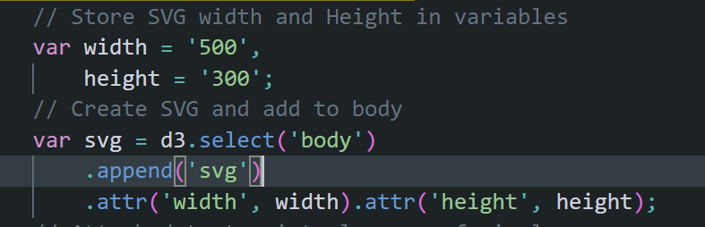
Example 1 - Creating a SVG
Store width and height values in variables
Get the body and attach a new SVG element to it
Set the width and height attributes
Store the SVG element in a variable

Slide 4
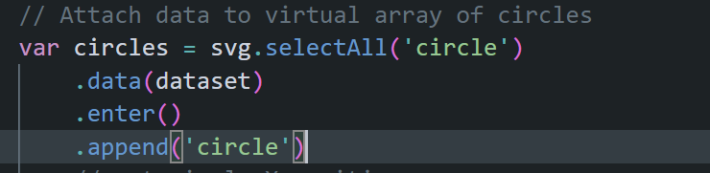
Example 1 - Creating a Set of Circles
selectAll function gets all the circles on the page
However, if there aren’t any it creates an empty virtual array
data function then binds the elements to the provided data array
So each value in the array dataset is now bound to one virtual element after the enter function
Then for each virtual element add an actual circle

Slide 5
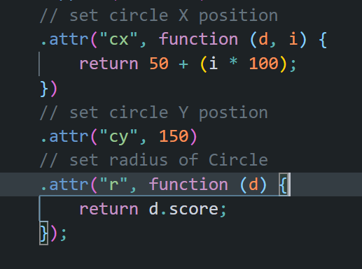
Creating a Set of Circles
For each circle
Set the X position based on the array index since circles are laid horizontally
Set the Y position constant so all circles are in the same level vertically
Set the radius based on the score, the d variable has an object which has both team name and score values, pick only score.

Slide 6
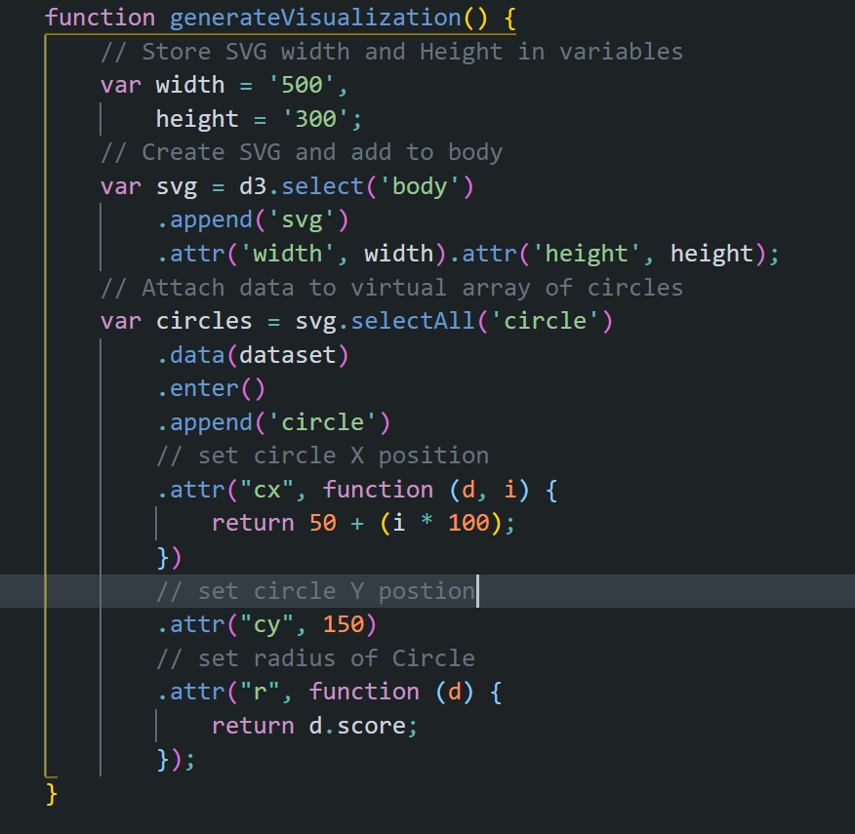
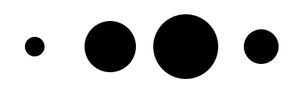
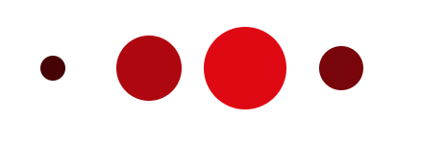
Example 1
Input.csv
team,score
A,13
B,34
C,43
D,23
Try to get the image below using the attribute “fill” with the same code sample
hint : red is rgb(255,0,0)

Slide 7
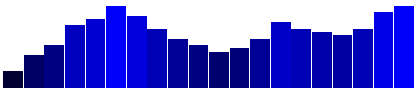
Example 2 - Display Static Data
var w = 500; var h = 100; var barPadding = 1;
var dataset = [ 5, 10, 13, 19, 21, 25, 22, 18, 15, 13, 11, 12, 15, 20, 18, 17, 16, 18, 23, 25 ];
//Create SVG element
var svg = d3.select("body") .append("svg")
.attr("width", w).attr("height", h);

Slide 8
Example 2 - Bar Chart
svg.selectAll("rect")
.data(dataset)
.enter()
.append("rect")
.attr("x", function(d, i) { return i*(w/dataset.length); })
.attr("y", function(d) { return h-(d*4); })
.attr("width", w/dataset.length - barPadding)
.attr("height", function(d) { return d*4; })
.attr("fill", function(d) {
return "rgb(0,0,"+Math.round(d*10) + ")"; });
var w = 500; var h = 100; var barPadding = 1;
var dataset = [ 5, 10, 13, 19, 21, 25, 22, 18, 15, 13, 11, 12, 15, 20, 18, 17, 16, 18, 23, 25 ];
//Create SVG element
var svg = d3.select("body") .append("svg")
.attr("width", w).attr("height", h);

Slide 9
Example 2 - Bar Chart
svg.selectAll("rect")
.data(dataset)
.enter()
.append("rect")
.attr("x", function(d, i) { return i*(w/dataset.length); })
.attr("y", function(d) { return h-(d*4); })
.attr("width", w/dataset.length - barPadding)
.attr("height", function(d) { return d*4; })
.attr("fill", function(d) {
return "rgb(0,0,"+Math.round(d*10) + ")"; });
var w = 500; var h = 100; var barPadding = 1;
var dataset = [ 5, 10, 13, 19, 21, 25, 22, 18, 15, 13, 11, 12, 15, 20, 18, 17, 16, 18, 23, 25 ];
//Create SVG element
var svg = d3.select("body") .append("svg")
.attr("width", w).attr("height", h);

Slide 10
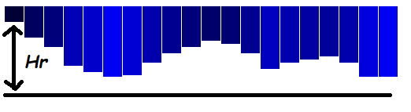
Example 2 - Bar Chart
Figure 1
Figure 2
The origin is in the top left corner in SVG by default so drawing a set of rectangles with different heights would give Figure 2 which is not what we want.
So we change the Y values from 0 to a dynamic value.
Then we invert the plot , we do this by pushing each rectangle downwards by Hr
Hr = h – (d*4)

Slide 11
Example 2 - Bar Chart
svg.selectAll("rect")
.data(dataset)
.enter()
.append("rect")
.attr("x", function(d, i) { return i*(w/dataset.length); })
.attr("y", function(d) { return h-(d*4); })
.attr("width", w/dataset.length - barPadding)
.attr("height", function(d) { return d*4; })
.attr("fill", function(d) {
return "rgb(0,0,"+Math.round(d*10) + ")"; });
var w = 500; var h = 100; var barPadding = 1;
var dataset = [ 5, 10, 13, 19, 21, 25, 22, 18, 15, 13, 11, 12, 15, 20, 18, 17, 16, 18, 23, 25 ];
//Create SVG element
var svg = d3.select("body") .append("svg")
.attr("width", w).attr("height", h);

Slide 12
Example 2 - Bar Chart
svg.selectAll("rect")
.data(dataset)
.enter()
.append("rect")
.attr("x", function(d, i) { return i*(w/dataset.length); })
.attr("y", function(d) { return h-(d*4); })
.attr("width", w/dataset.length - barPadding)
.attr("height", function(d) { return d*4; })
.attr("fill", function(d) {
return "rgb(0,0,"+ d*10 + ")"; });
var w = 500; var h = 100; var barPadding = 1;
var dataset = [ 5, 10, 13, 19, 21, 25, 22, 18, 15, 13, 11, 12, 15, 20, 18, 17, 16, 18, 23, 25 ];
//Create SVG element
var svg = d3.select("body") .append("svg")
.attr("width", w).attr("height", h);

Slide 13
Example 2 - Bar Chart
svg.selectAll("rect")
.data(dataset)
.enter()
.append("rect")
.attr("x", function(d, i) { return i*(w/dataset.length); })
.attr("y", function(d) { return h-(d*4); })
.attr("width", w/dataset.length - barPadding)
.attr("height", function(d) { return d*4; })
.attr("fill", function(d) {
return "rgb(0,0,"+ d*10 + ")"; });
var w = 500; var h = 100; var barPadding = 1;
var dataset = [ 5, 10, 13, 19, 21, 25, 22, 18, 15, 13, 11, 12, 15, 20, 18, 17, 16, 18, 23, 25 ];
//Create SVG element
var svg = d3.select("body") .append("svg")
.attr("width", w).attr("height", h);

Slide 14
Example 2 - Bar Chart
svg.selectAll("text")
.data(dataset)
.enter()
.append("text")
.text(function(d) { return d; })
.attr("x", function(d,i) {return i*(w/dataset.length)+5; })
.attr("y", function(d) { return h-(d*4)+15; })
.attr("font-family", "sans-serif")
.attr("font-size", "11px")
.attr("fill", "white");
var w = 500; var h = 100; var barPadding = 1;
var dataset = [ 5, 10, 13, 19, 21, 25, 22, 18, 15, 13, 11, 12, 15, 20, 18, 17, 16, 18, 23, 25 ];
//Create SVG element
var svg = d3.select("body") .append("svg")
.attr("width", w).attr("height", h);
svg.selectAll("rect")
.data(dataset)
.enter()
.append("rect")
.attr("x", function(d, i) { return i*(w/dataset.length); })
.attr("y", function(d) { return h-(d*4); })
.attr("width", w/dataset.length - barPadding)
.attr("height", function(d) { return d*4; })
.attr("fill", function(d) {
return "rgb(0,0,"+Math.round(d*10) + ")"; });

Slide 15
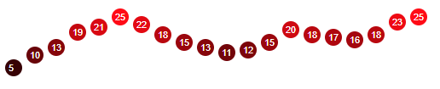
Try to modify the same code to get the graph below
If you cannot figure out the solution yourself , look at example_2_modified.html for help.

