Slide 1
D3.js
Debajyoti Mondal
VENKAT BANDI – TA
venkat.bandi@usask.ca
G72 Thorvaldson GROUND FLOOR
University of Saskatchewan

Slide 2
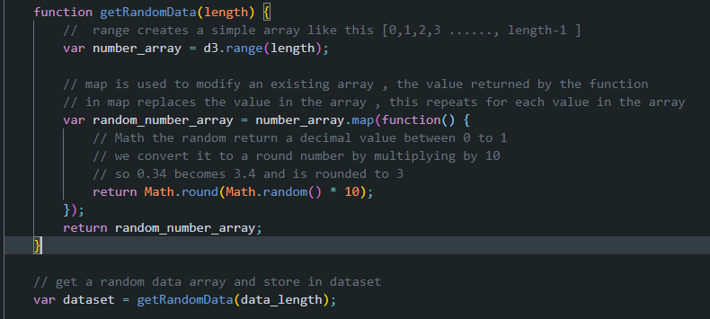
Example 1 – Random Data

Slide 3
Example 1 – Random Data

Slide 4
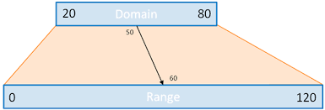
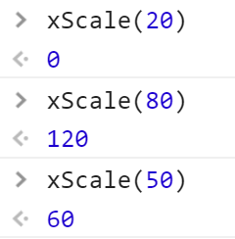
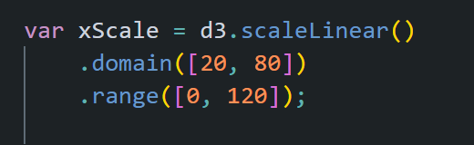
Example 1 – Create a Scale
http://www.jeromecukier.net

Slide 5
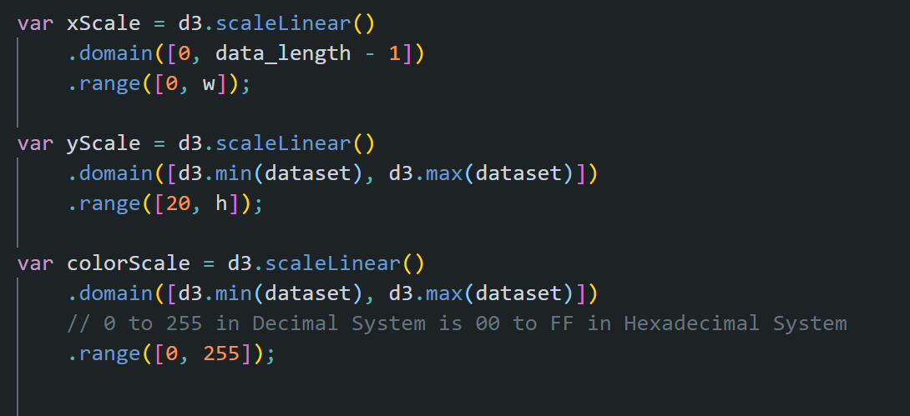
Example 1 – Create 3 Scales

Slide 6
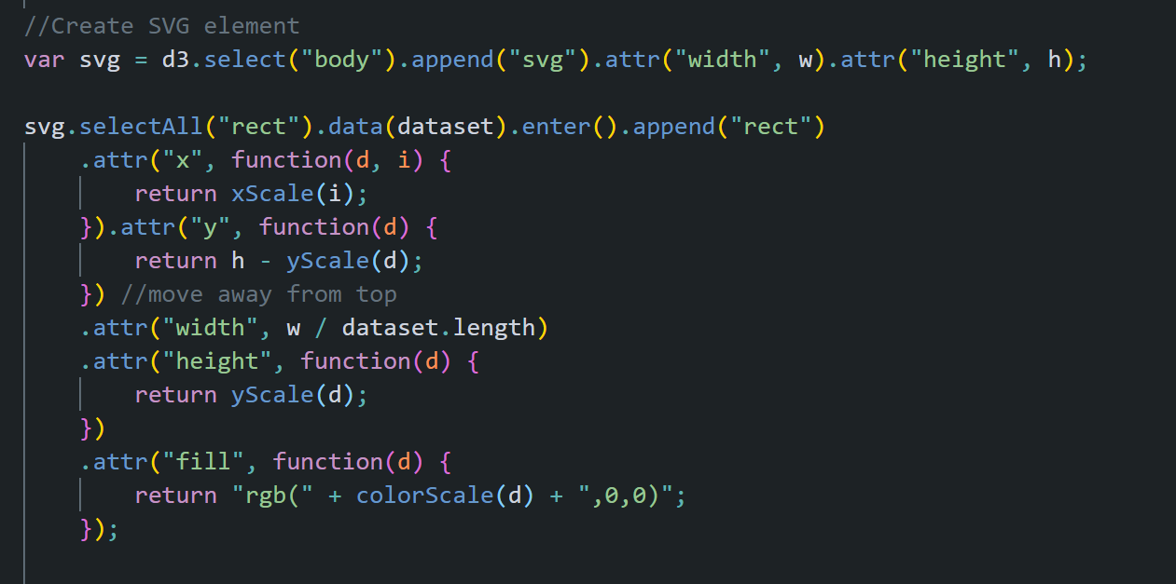
Example 1 -Create Chart using Scales

Slide 7
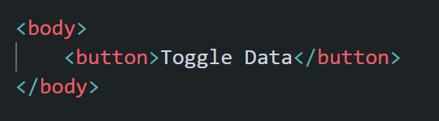
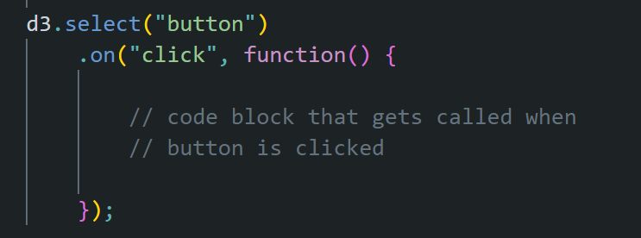
Example 1 – Attach Event
HTML TAG
SCRIPT TO ATTACH EVENT

Slide 8
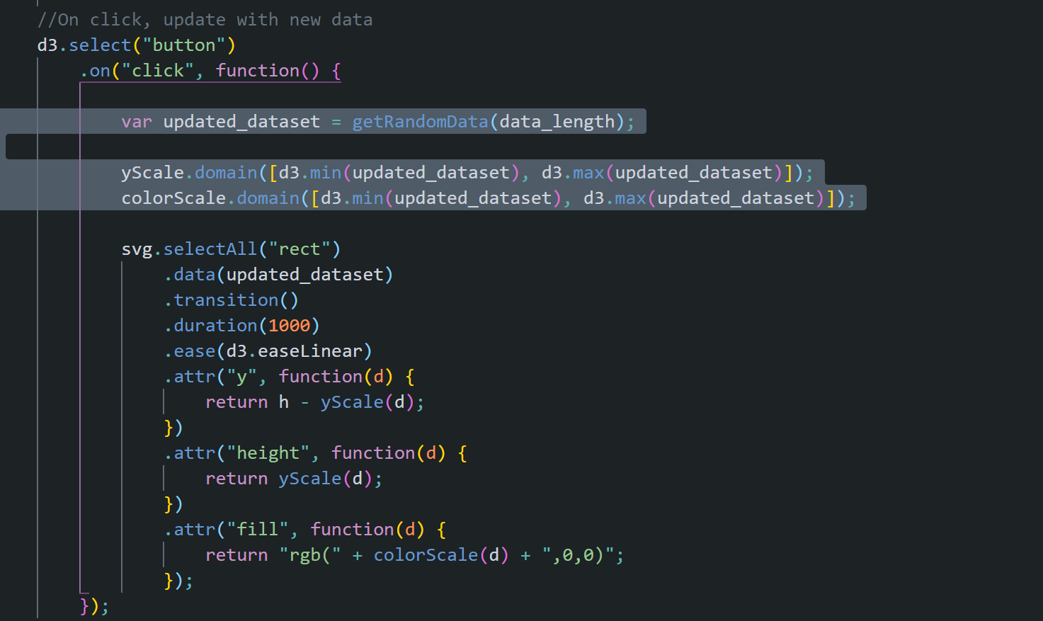
Example 1 – Event Handling

Slide 9
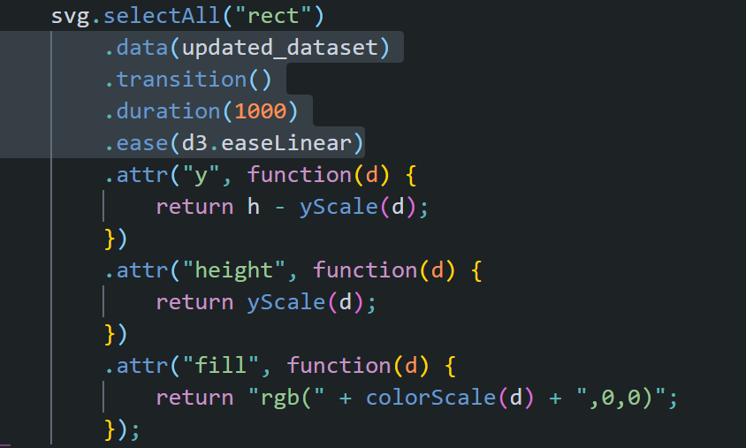
Example 1 – Transition Elements

Slide 10
Try This -

Slide 11
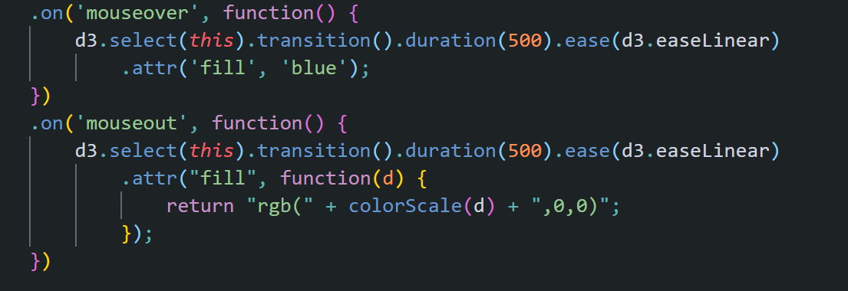
Example 2 – Events on SVG elements

