Slide 1

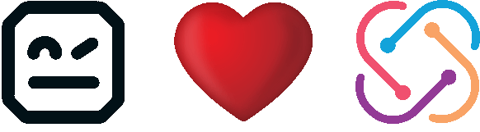
Robot Framework Introduction
Antti Karjalainen
CEO / Founder Robocorp, Member of Board at Robot Framework Foundation

Slide 2
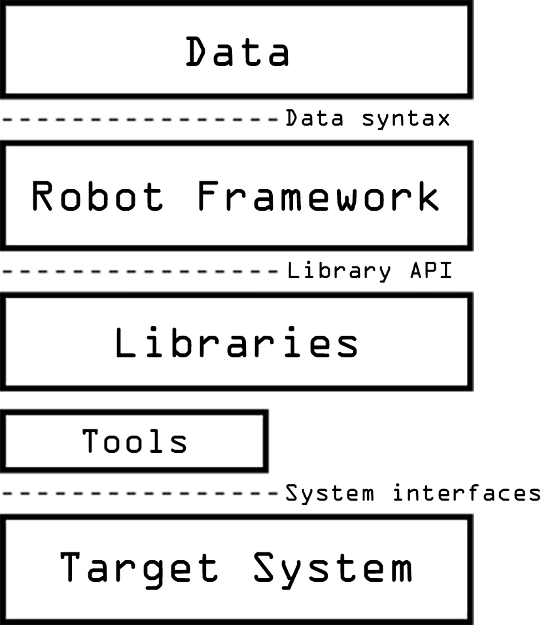
What is Robot Framework?
Python-based open-source test automation and RPA ecosystem.
Robot Framework is a generic open source automation framework. It can be used for test automation and robotic process automation (RPA).

Slide 3
Brief history
Originated from Nokia Networks as a way to unify end-to-end software test automation.
Development started 2005. First published as open-source project in 2008 under Apache 2.0 license.
Robot Framework Foundation established in 2015 by users and core team members.
Robocon conference hosted since 2018.

Slide 4
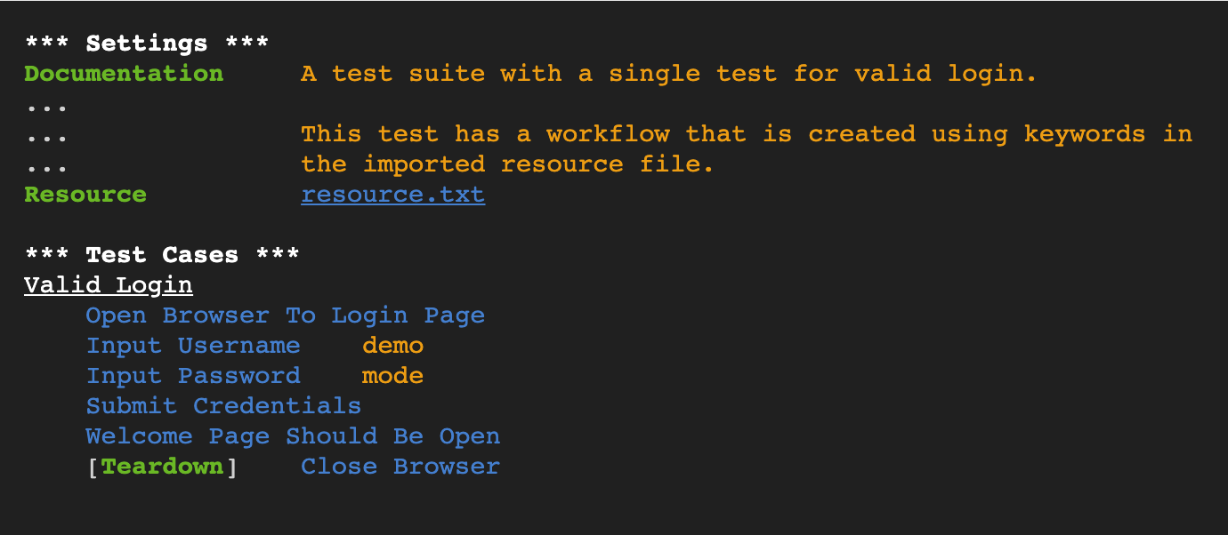
Keyword-driven syntax

Slide 5
A framework for multi-channel testing.
Robot Framework provides a unified way to access target systems with library keywords that are easy to extend.
The same tool can test a website front end and backend in one end-to-end run.
Used to test anything from web apps to mainframes and embedded systems.

Slide 6
What makes Robot Framework work?
Integrations – Hundreds of available integration libraries.
Architecture – Low barrier to entry, but high ceiling for mastery.
Logging – Unified model for test log output.
Community – Active global community of users and developers.
Governance – Controlled by an active foundation with 50+ member companies.

Slide 7

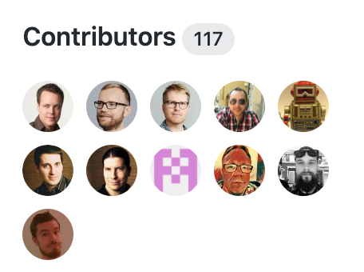
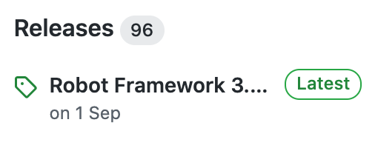
Robot Framework open-source project
5.3k stars on Github
Over 100 contributors
Stable release schedule

Slide 8
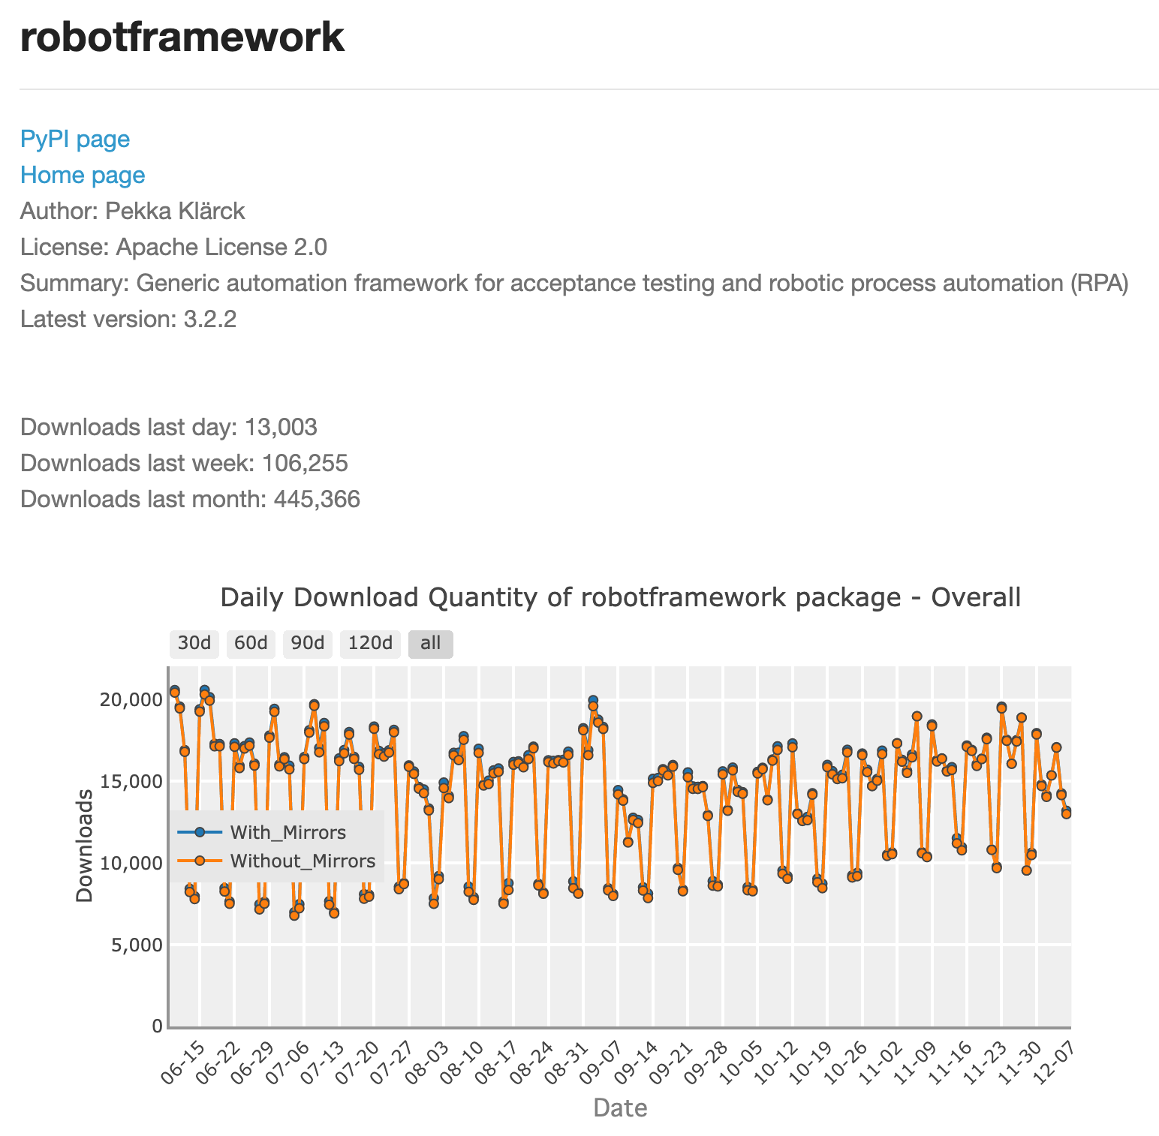
Core Robot Framework downloads
Annually downloaded over 5 million times from pypi.

Slide 9
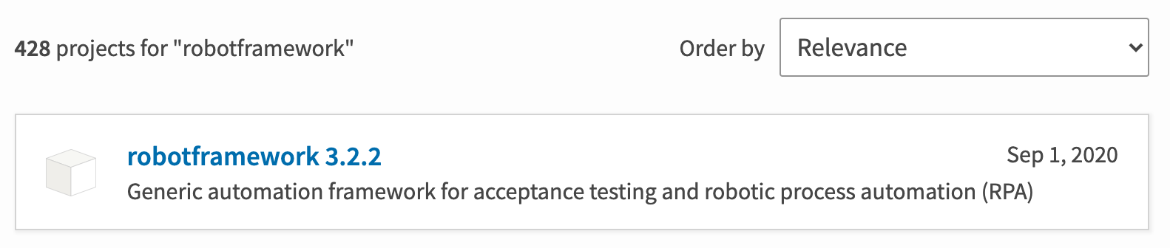
Extended Robot Framework ecosystem
Robot Framework is not just the core project.
There are over 400 pypi packages that reference robotframework.

Slide 10
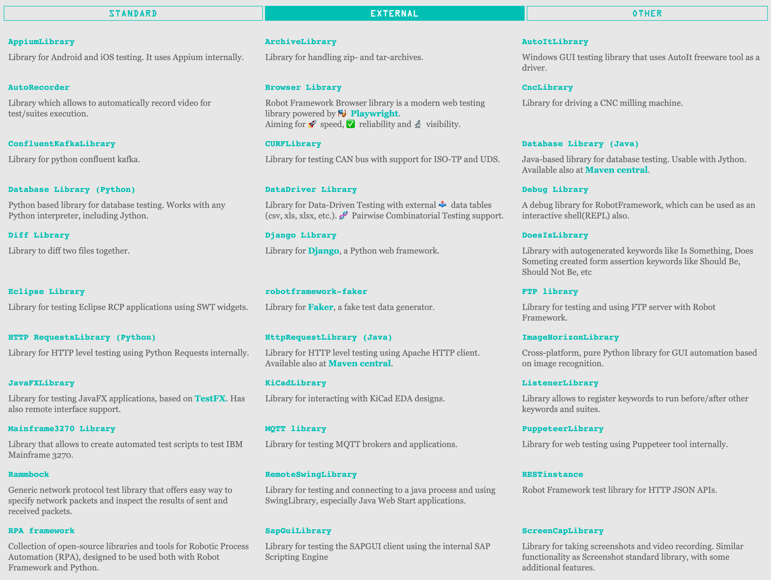

Slide 11
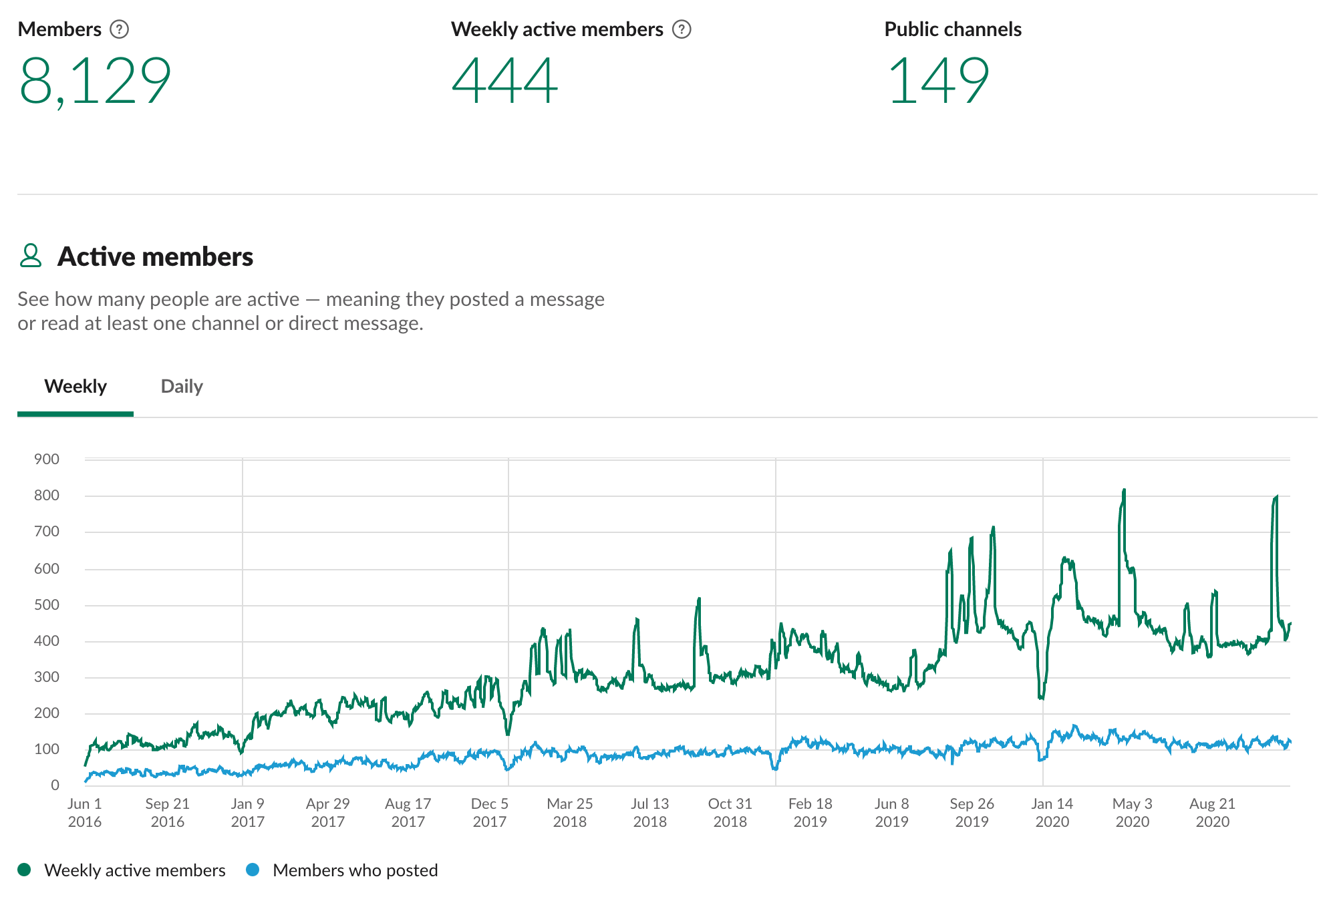
Robot Framework Slack community
>8000 Members on Robot Framework Slack

Slide 12
Robot Framework Roadmap
RF 4.0 release coming late 2020 with control structure updates and improved keyword library documentation.
RF 5.0 scheduled for 2021, adding more control structures, removing Python 2 support.
RPA introduced in 2018, which is growing the community in new areas. Expect the community to grow in this area for the coming years.

Slide 13
Robot Framework Ecosystem additions
Language server protocol support added in 2020 bringing better support for developer tools (VS Code)
Debugger capabilities added through VS Code extension (search Robocorp in marketplace)
New libraries coming up regularly – for example TestProject!

Slide 14

Selenium Library vs. TestProject Library for Robot Framework
Senior Solution Engineer TestProject
Ran Tzur

Slide 15
Selenium Library vs. TestProject Library
Robot Framework Libraries
 | Selenium Library for RF | TestProject Library for RF
Prerequisites | A couple of hours: Setup & Configure Selenium Driver | 5 mins: Download TestProject Agent & get Dev token
How to Install Library | pip install --upgrade robotframework-seleniumlibrary | pip3 install testproject-robot-library
Keyword | Create Webdriver and Open Browser | Init TestProject Driver
HTML reports | Local reports | Cloud distributed (built in permissions)
PDF reports | None | Embedded within a click
Screenshots | Not supported | Included out of the box
Reports accessibility | Local storage | Accessible via Rest API/WEB Dashboard
Automatic Deployment & Execution | None | [Coming Soon] Upload Robot test to TestProject cloud for built-in deployment & execution capabilities

Slide 16
Let The TestProject <> Robot Magic Begin !
Sign up for FREE at testproject.io
Questions? Reach out anytime! support@testproject.io | forum.testproject.io | Built-in platform chat
In just a couple of hours you will all get:
A full recording of the webinar
And those who attended the entire session will also receive a cool badge of participance!
Follow us to stay updated with all our latest releases and upcoming events!
LinkedIn: linkedin.com/company/testproject
Twitter: twitter.com/TestProject_io
YouTube: www.youtube.com/testproject
Telegram: t.me/testproject_io
Antti Karjalainen: linkedin.com/in/aikarjal/
Robot Framework Foundation: linkedin.com/company/robot-framework-foundation/

