Slide 1
Advising Check-in Meeting
July 17, 2024
Larry, Kiran

Slide 2
Topics
Research update on international climate policy packages
Two new scenarios:
1) Benchmark: RICE baseline without any equity considerations, no L&D compensation
2) Ability to pay: RICE baseline with quintile level disaggregation and diminishing marginal utility of income, no L&D compensation (“NICE” model)
Existing scenarios with (crude) re-optimization
3) Scenario (2) + polluter pays L&D compensation
4) Scenario (2) + beneficiary pays L&D compensation

Slide 3
Scenarios summary
 | RICE Baseline | NICE Ability to Pay scenario | NICE + Polluter Pays L&D transfers | NICE + Beneficiary Pays L&D transfers
Ability to pay accounted for? | No* | Yes | Yes | Yes
International transfers instrument? | No | No | Yes | Yes
Transfers magnitude | N/A | N/A | Prospective only | Prospective + Retrospective
Allocation of responsibility | N/A | N/A | Emissions from 1990 | Emissions from 1830

Slide 4
Methodology Summary: Model
MODEL
RICE issues
RICE excel model cannot accommodate my updated code
RICE 2020 GAMS code has a lot of bugs and author has not responded to questions
Using MIMI framework NICE model which is built on RICE for this work
NICE model disaggregates RICE regions into quintiles
Removes Negishi weighting

Slide 5
Methodology Summary: Scenarios (1)
SCENARIOS SUMMARY
1) RICE Baseline
Intragenerational ability to pay ignored, no international transfers
Trying to replicate RICE results in NICE without Negishi weighting
Negishi weighting equalizes the marginal utility of income between regions
Proponents of approach argue that it helps calibrate the model to observed (unequal) distribution of economic outcomes and prevents climate policy becoming a tool of global redistribution
Critics of approach believe this reinforces observed (normatively undesirable) inequalities by ignoring the diminishing value of a $ to countries that are currently poor
I take the NICE model and optimize for utility based on global aggregate consumption
When aggregating quintile and regional consumption I apply no utility weights
Welfare is concave in global per capita consumption
Note that this approach treats across generation inequalities and within generation inequalities asymmetrically (also true of DICE and default RICE model)

Slide 6
Methodology Summary: Scenarios (2)
SCENARIOS SUMMARY
2) NICE Ability to Pay
Intragenerational ability to pay incorporated at the quintile level, no international transfers
Welfare is concave in quintile level consumption, therefore ability to pay is accounted for
Much more defensible in my opinion
Consistent in its treatment of inequalities across time and across (and within) regions
Requires assumption about distribution of climate damages by quintile
I assume damages are proportional to quintile consumption to be conservative

Slide 7
Methodology Summary: Scenarios (3)
SCENARIOS SUMMARY
3) NICE Ability to Pay + Polluter Pays L&D
Intragenerational ability to pay incorporated at the quintile level
Additional instrument of international transfers
Co-optimizing with international transfers does not converge
Tried on Excel RICE as well as multiple MIMI models
I implement international transfers in two stages
Stage 1:
Run NICE ability to pay
Get results on emissions and damages by region
Calculate L&D compensation based on polluter pays algorithm
Stage 2:
Re-run Stage 1 model with L&D transfers
Compare changes to global optimal carbon tax

Slide 8
Methodology Summary: Scenarios (4)
SCENARIOS SUMMARY
4) NICE Ability to Pay + Beneficiary Pays L&D
Same as (3) but different parameters for algorithmic allocation
Includes retrospective damages
Includes emissions starting in 1830 for allocating responsibility for damages

Slide 9
Methodology Summary: Implementing L&D transfers
IMPLEMENTATION OF L&D TRANSFERS
I assume L&D compensation is similar to climate damages and abatement costs in that it reduces gross output
Gross output is a function of labor and capital stock
Net output reduces gross output by climate damages, abatement costs and L&D
25% of net output goes to investment, rest is consumption
Alternative would be to subtract L&D compensation from consumption
Thoughts?
Is there a better economic rationale for one versus the other?

Slide 10
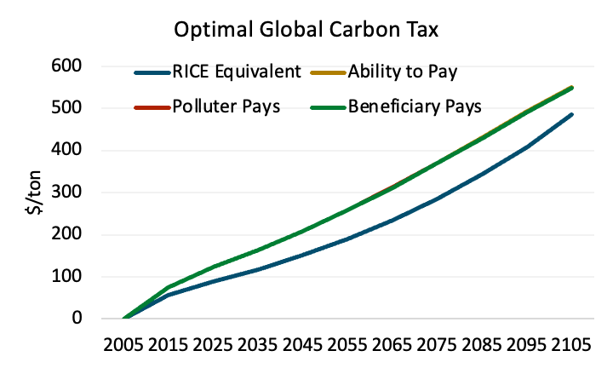
Results: Global optimal carbon tax
Accounting for ability to pay makes more stringent carbon tax optimal
No meaningful difference between Ability to Pay, Polluter Pays and Beneficiary Pays optimal carbon tax
Even though Polluter Pays and Beneficiary Pays have transfers for L&D compensation

Slide 11
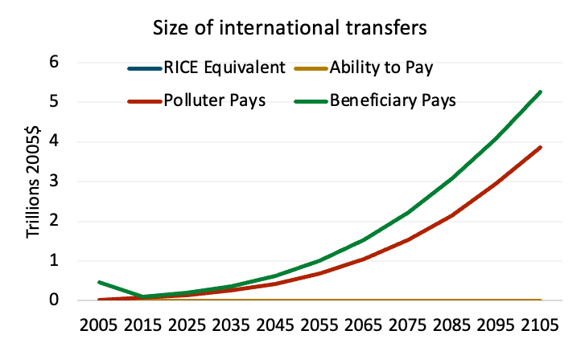
Results: Scale of annual international transfers for L&D
Scenarios with international transfers result in cumulative transfers of $13-18 trillion by 2100 (2005$)
Beneficiary pays scenario has higher transfers because of retrospective damages included, as well as a longer time horizon to calculate responsibility
Larger share of transfers from historical emitters

Slide 12
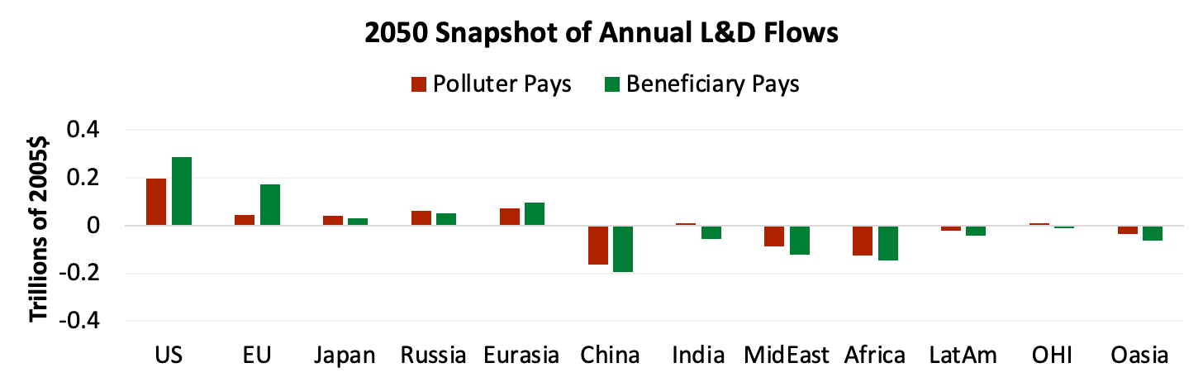
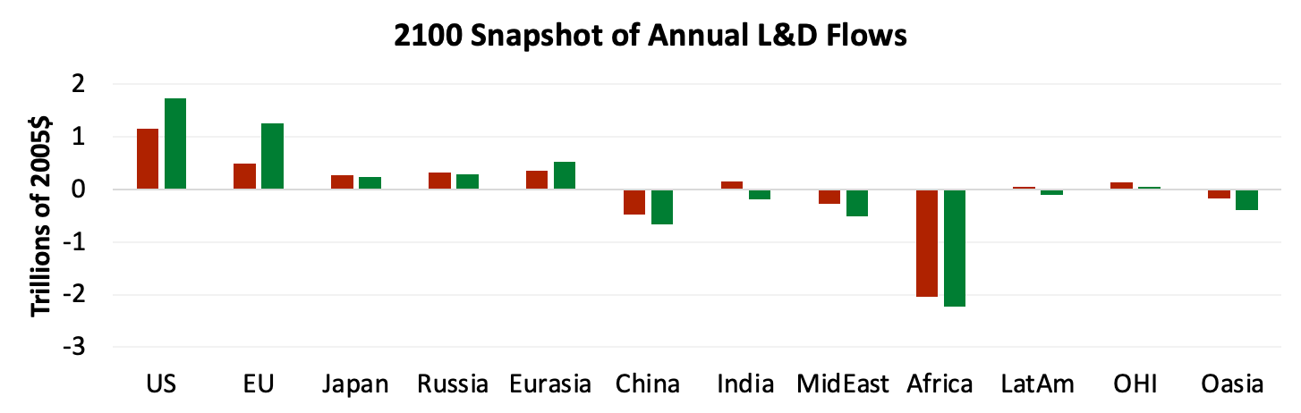
Results: India and Latin America can be payers or beneficiaries depending on the normative assumptions

Slide 13
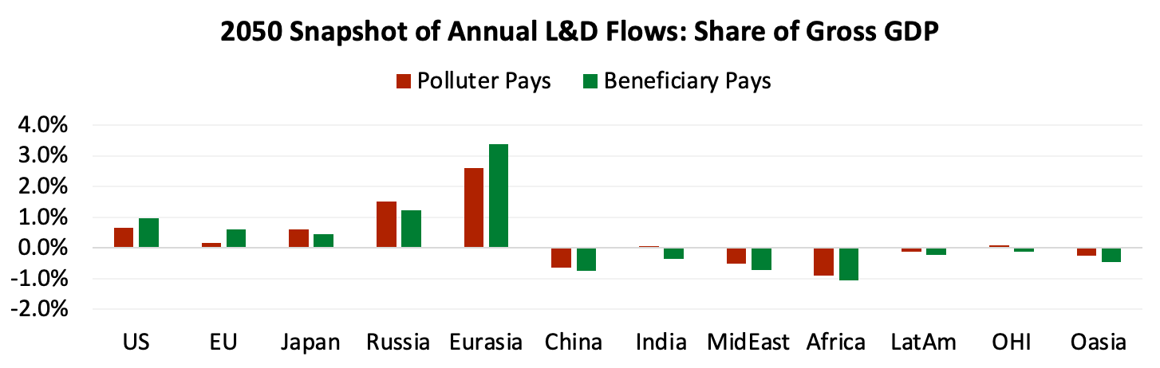
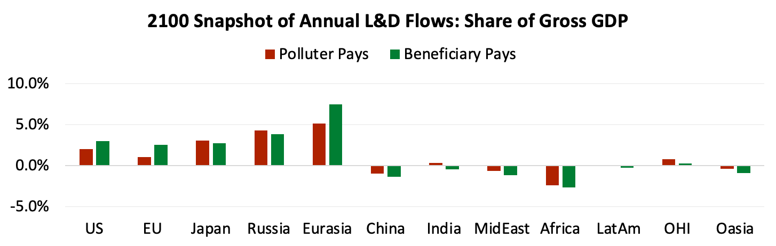

Results: L&D flows as a fraction of gross GDP

Slide 14
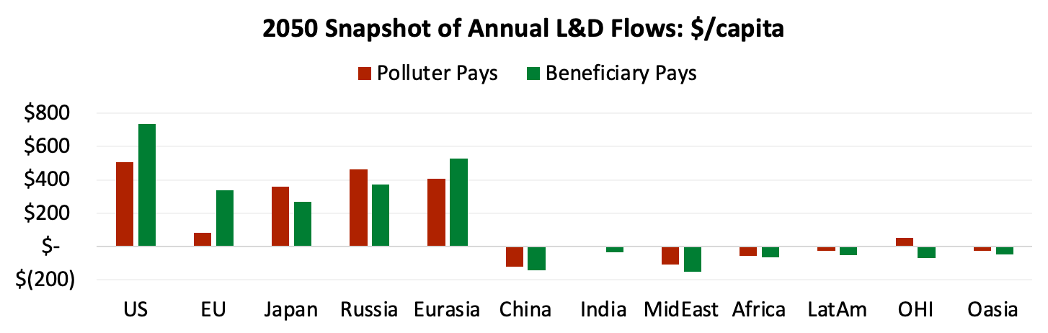
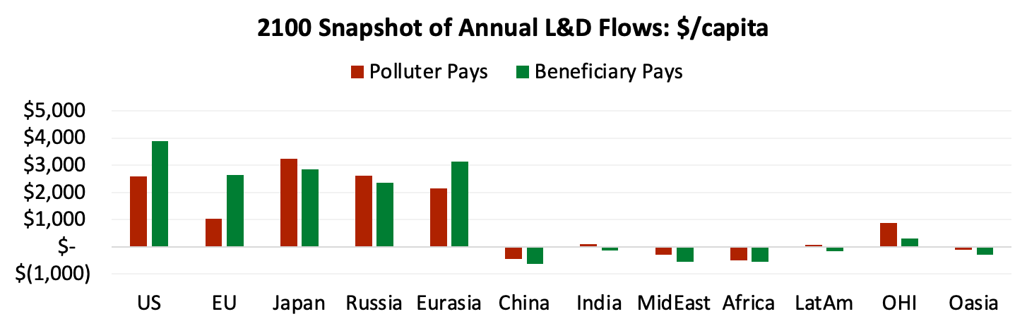
Results: L&D flows in $/capita

Slide 15
Discussion and pending items
Treatment of retrospective damages
Is it a one-time payment in present day?
Convert it to an annualized stream?
Need to compound historic damages
Model goes out till 2500 and numbers become quite big
Should I present NPV results for full model horizon?
Or continue focus through 2100 in annual terms?
Values for L&D lower than latest RICE model (~$15T v $50T cumulative by end of century)
$ yr 2005 vs 2019 (scale up multiplier of 1.64)
UPDATED DAMAGE FUNCTIONS (incorporate or discuss as a limitation?)
Add in revenue recycling?
If every region implemented the globally optimal tax, would tax revenues be enough to cover L&D obligations for payers?
Within region and across region inequality tradeoff?

Slide 16
Thank you!

