Slide 1

Student Details
Name : J Kiran Deepthi
SKILL BUILD ID : kirandeepthijonnalagadda2004@gmail.com
COLLEGE NAME : SRM AP University
COLLEGE STATE : ANDHRA PRADESH
Admission NO : AP22110011301
DOMAIN : AIML
Date of joining : 03.06.2024
END DATE OF INTERNSHIP : 25.07.2024

Slide 2
Project Title: “Employee Burnout Prediction”
Problem Statement: Employee burnout is a critical issue in today's fast-paced work environment, significantly impacting productivity, employee satisfaction, and overall organizational health. The goal of this project is to develop a predictive model that can accurately identify the likelihood of employee burnout based on various factors such as workload, job satisfaction, and work-life balance. By leveraging regression techniques and machine learning algorithms, we aim to provide organizations with a tool that can help in the early detection of burnout risks, allowing for timely interventions and support to enhance employee well-being and maintain high levels of productivity.

Slide 3
AGENDA
Problem Statement
Agenda
Project Overview
Who are end users of this project ?
Your solution and its value proposition
How did you customize the project and make it your own
Modelling
Results and Conclusion
Future Work
Links

Slide 4
PROJECT OVERVIEW
Objective: To predict employee burnout using regression models.
Dataset: "Are Your Employees Burning Out?" dataset.
Methodology:
Data Cleaning and Preparation
Exploratory Data Analysis
Feature Engineering
Model Training and Evaluation

Slide 5
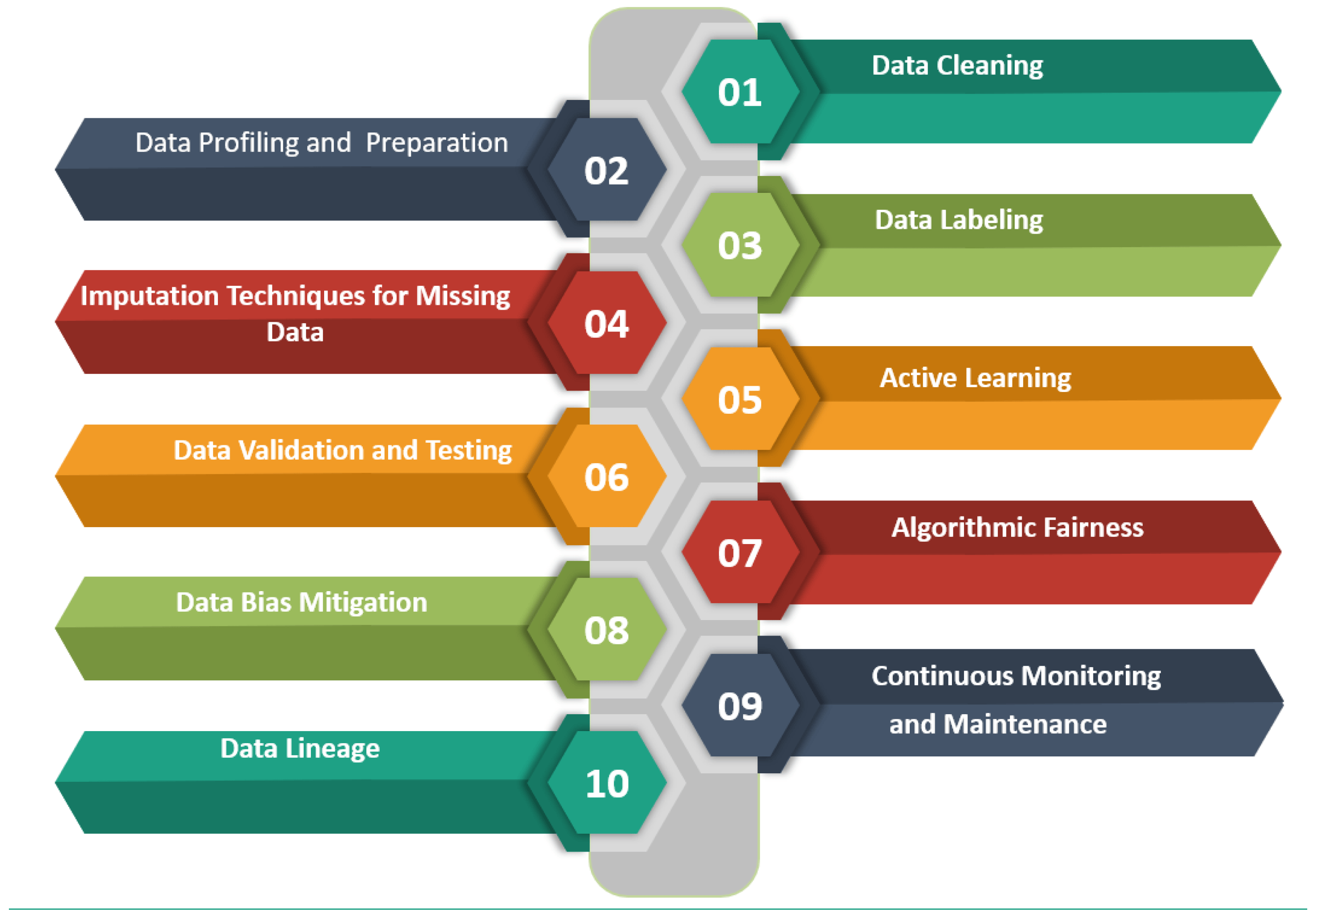
PROJECT OVERVIEW

Slide 6
WHO ARE THE END USERS of this project?
End Users:
HR Departments
Organizational Psychologists
Management Teams
Employee Wellness Programs
Benefits:
Early identification of burnout risks.
Proactive measures to improve employee well-being.
Enhanced productivity and job satisfaction.

Slide 7

YOUR SOLUTION AND ITS VALUE PROPOSITION
Solution: A predictive model to identify employees at risk of burnout.
Value Proposition:
Early detection of burnout signs.
Helps in taking preventive actions.
Reduces employee turnover and improves job satisfaction.

Slide 8
How did you customize the project and make it your own
Dataset Selection and Feature Engineering:
Selected a tailored dataset and engineered unique features like a composite stress index.
Exploratory Data Analysis (EDA) and Model Selection:
Conducted in-depth EDA and chose linear regression, fine-tuning it for optimal results.
Handling Missing Data and Performance Evaluation:
Employed strategic methods to handle missing data and validated the model with cross-validation techniques.
Visualization, Interpretation, and Deployment:
Created detailed visualizations and prepared the model for practical deployment, integrating it into a system for early detection of burnout risks.

Slide 9
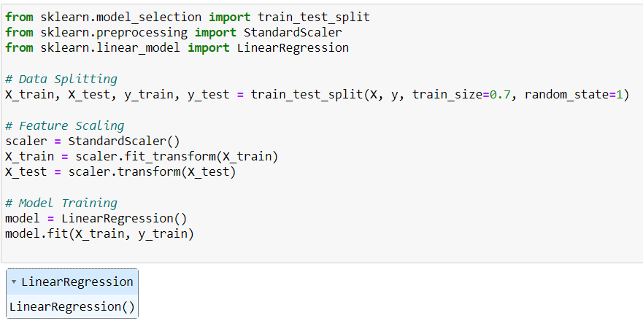
MODELLING
Libraries Used:
NumPy, pandas, Matplotlib, Seaborn, scikit-learn
Steps:
Data Splitting: Training and testing sets (70:30 ratio).
Feature Scaling: Standardization of features.
Model Training: Linear Regression.

Slide 10
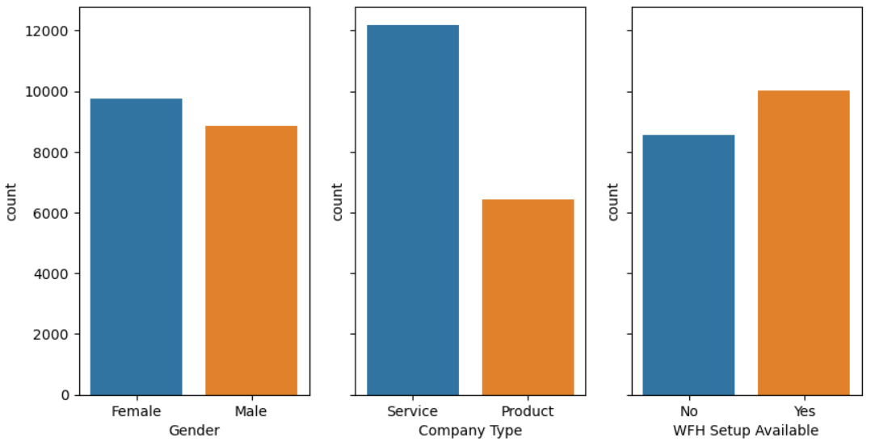
Results
Performance Metrics:
Mean Squared Error: 0.0032
Root Mean Squared Error: 0.0562
Mean Absolute Error: 0.0460
R-squared Score: 0.9188
Conclusion:
The Linear Regression model is effective in predicting burnout.
High R-squared score indicates a good fit to the data.
Model can be deployed for practical use in organizations.

Slide 11
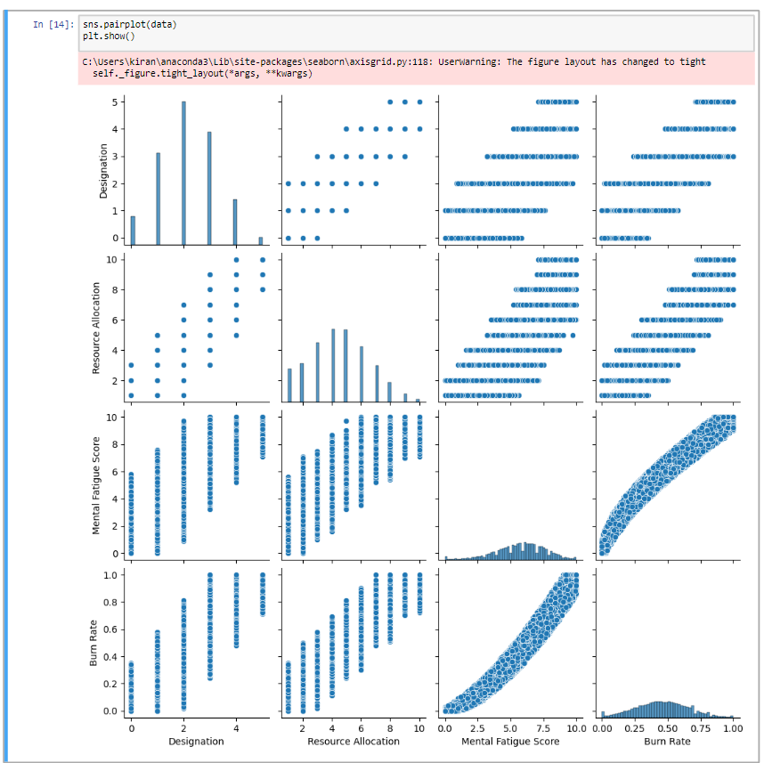
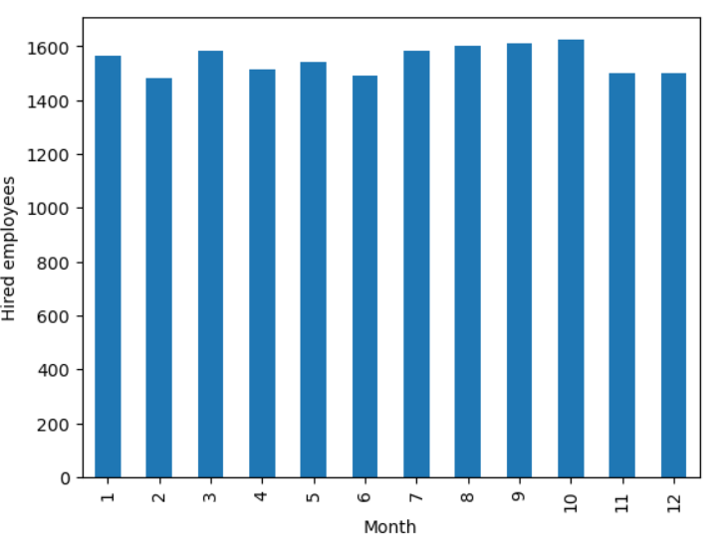
Results

Slide 12
Future work
Enhanced Feature Engineering:
Incorporate additional features such as physiological data (e.g., heart rate, sleep patterns) to improve prediction accuracy.
Advanced Algorithms:
Experiment with advanced machine learning algorithms like neural networks and ensemble methods to further enhance model performance.
Real-Time Monitoring:
Develop a real-time monitoring system to continuously assess employee burnout and provide timely interventions.
Scalability:
Adapt the model for use in diverse organizational settings and industries, ensuring scalability and flexibility.

Slide 13
links
Project link
https://github.com/kirandeepthiJ/Employee-Burnout-Prediction
IBM SkillsBuild Email ID
https://skills.yourlearning.ibm.com/profile/preference
Linkedin Profile
https://www.linkedin.com/in/kirandeepthi-jonnalagadda/

