Slide 1

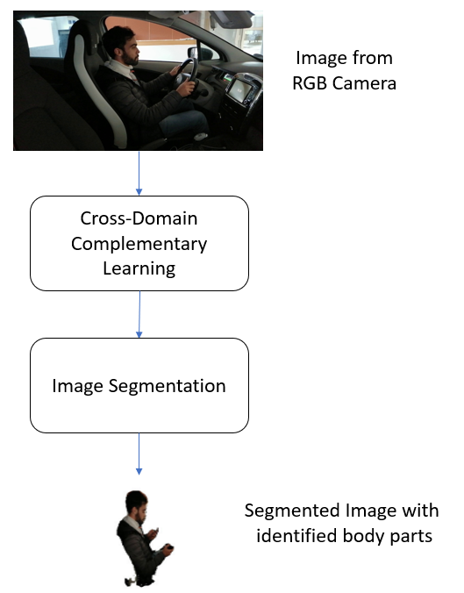
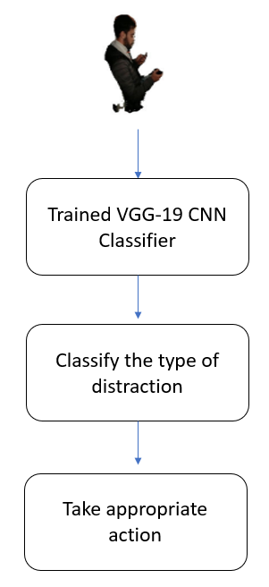
Dayananda Sagar College of Engineering
Department of Computer Science and Engineering
Deep Learning Approach to Detect Distracted Driving Activities
K Sudheevar Reddy (1DS19CS065), Kiran N Deshmukh (1DS19CS070), Lokesh M (1DS19CS081), Prathik Raj RC (1DS19CS117)
ABSTRACT
Guide: Dr. Kavitha K S
FLOWCHART
With increase in the use of advanced systems on vehicle dashboards such as modern infotainment systems and mobile phones, we have come to observe a proportional increase in the distraction of drivers. Distracted driving has proven to be a vital cause for most modern-day road crashes due to lane variation, and inattention on the road. Over the last decade, road crashes have become the tenth leading cause of death in the world, and are predicted to rise to the fifth position by 2030. Hence, efficient mechanisms to tackle this problem have to be studied and developed.
LITERATURE SURVEY
Name | Algorithm/Model | Contributions | Limitations
1. Driver distraction detection and recognition using RGB-D sensor | RGB-D sensor, AdaBoost classifier and Hidden Markov Model. | The proposed model is easy to implement in real car systems. | Aims only to detect inattention or provide a level of inattention.
2. Drive-Net: Convolutional Network for Driver Distraction Detection | Convolutional Neural Network (CNN), Random Decision Forest | The proposed model achieved a better detection accuracy compared to RNN and an MLP algorithm. | Training a CNN model with a large dataset can lead to over-fitting the model.
3. Online Prediction of Driver Distraction Based on Brain Activity Patterns | Electroencephalographic (EEG) signals | The proposed model provides a practical tool to solve the challenging problem of online predicting driver distraction using EEG signals. | The model is too complicated to include in the existing hardware systems.
4. optNet-50: An Optimized Residual Neural Network Architecture of Deep Learning for Driver’s Distraction | OptNet-50: Optimised ResNet-50 | OptNet-50 exhibited a time efficiency comparable to ResNet-50, ResNet-101 and MobileNet. | It could be improvised to further include other factors such as swerving between lanes and driver emotions.
5. A Driver Face Monitoring System for Fatigue and Distraction Detection | Haar-like features and adaptive boosting method, template matching method | Fuzzy logic method is used to efficiently estimate driver fatigue and distraction. . | Since the proposed system is a face tracking method , it is inaccurate and complex to compute
OBJECTIVES
Improve road safety
Enhance driving performance
Support legal compliance
Support vehicle design and development
OUTCOME/CONCLUSION
This robust deep learning approach to monitor driver behaviour can be used to detect distraction and hence mitigate the number of road accidents and alert concerned authorities about unsafe driving. The Inception-v3 and VGG19 models respectively to achieve great accuracy scores of 93.42% and 95.77%.

