Slide 1


Slide 2

DIGITAL LIBRARY MANAGEMENT SYSTEM
ID : BS140401541
PROJECT ID : S2102EB39B

Slide 3

INTRODUCTION OF PROJECT
This beautiful web application consists of three users these are Admin, Librarian and Users.
Admin will manage the complete application. Admin will manage books , add new librarian / delete librarian also can see total books and students. Admin will manage different Books in each category.. Admin will also able to know number of registered users, number of books issued.
Librarian will view different books and number of student registered, librarian and Student will sign up to be a register user or Customer.
user will view all the Books available user will choose a books as his or her own choice. And have to return back before 30 days if not return customer has to pay the fine of that book

Slide 4
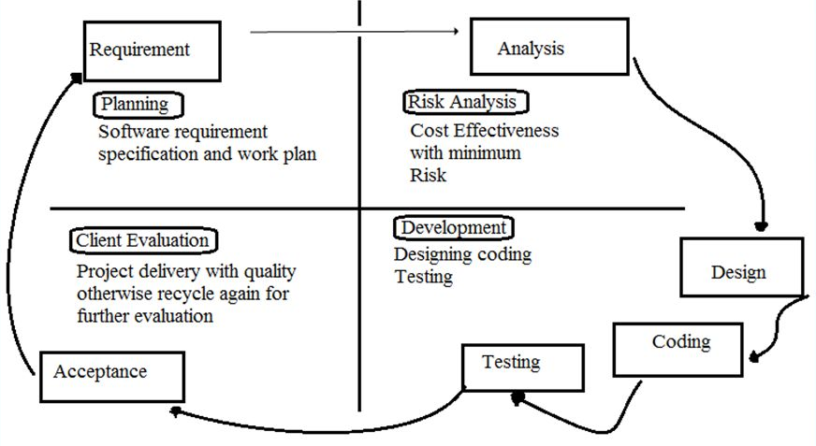
VU PROCESS MODEL

Slide 5
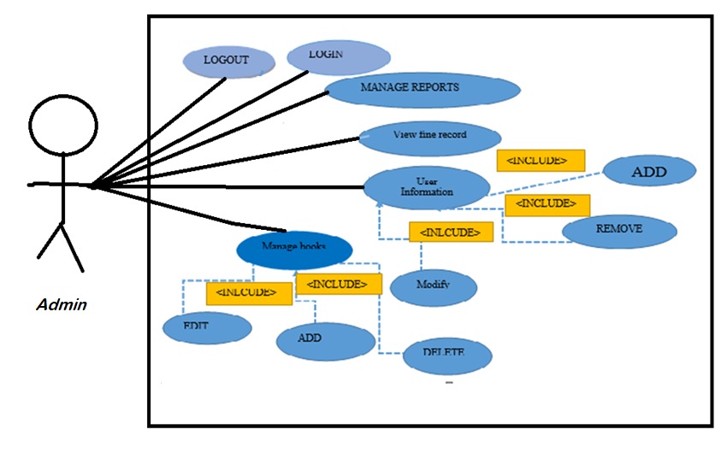
Use Case Diagram

Slide 6
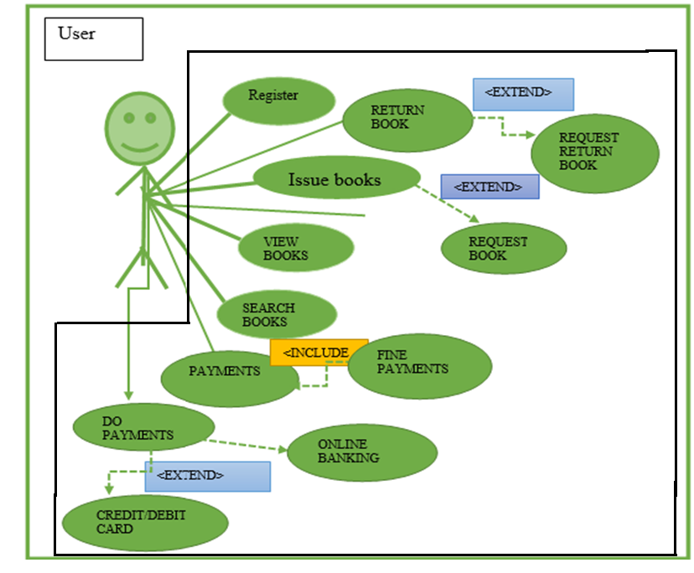

Slide 7
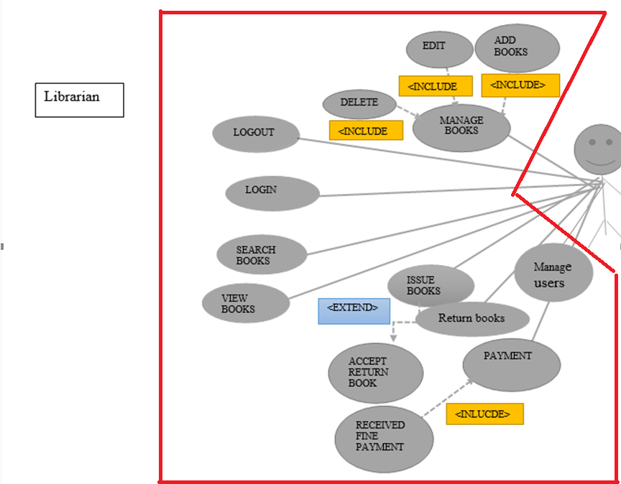

Slide 8
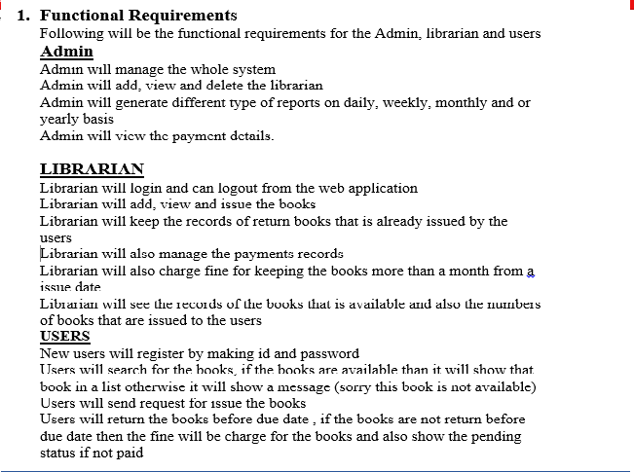
FUNCTIONAL REQUIREMENTS
.

Slide 9
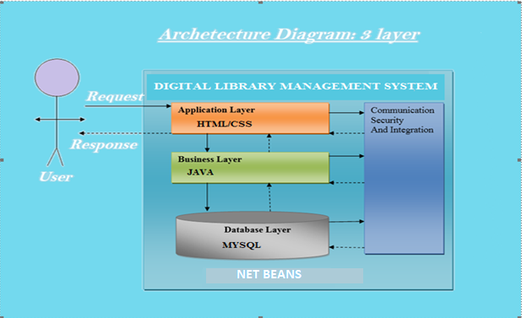
Architectural Design

Slide 10
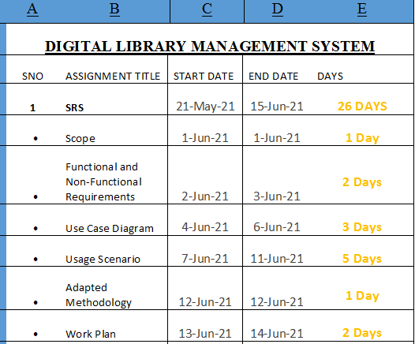
Project Schedule

Slide 11
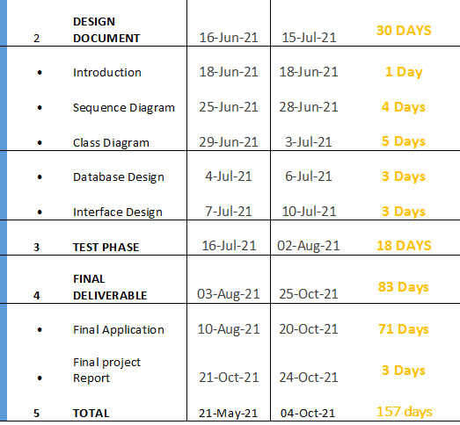

Slide 12
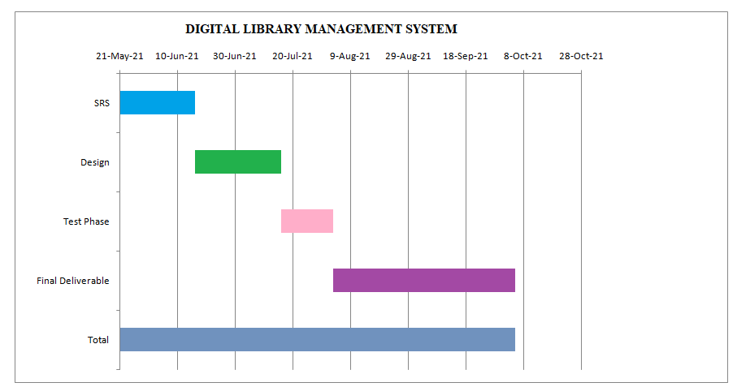

Slide 13
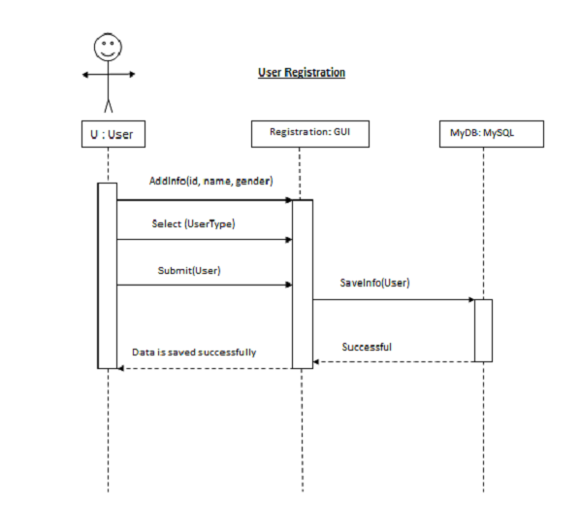
Sequence Diagrams
Provide some core sequence diagrams here. Provide one diagram per slide and give heading at top for each sequence diagram.

Slide 14
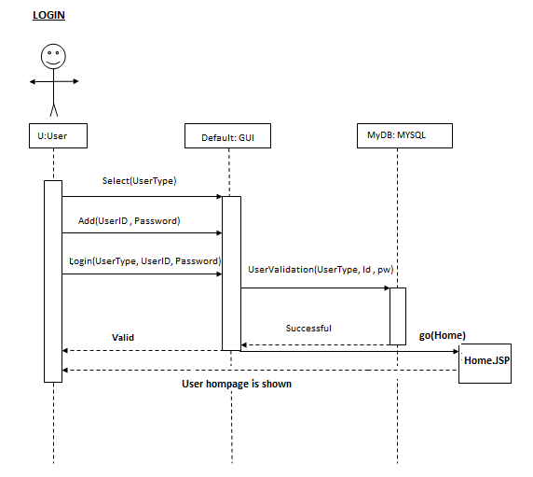

Slide 15
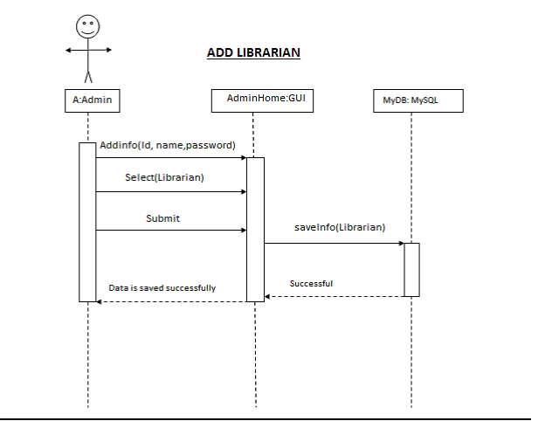

Slide 16
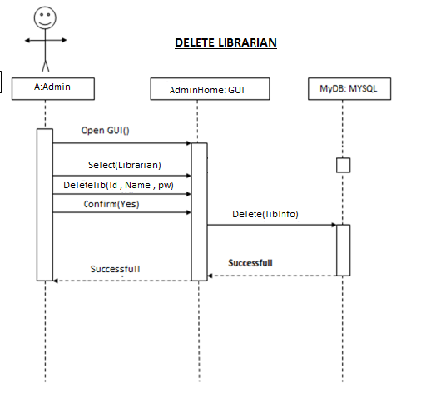

Slide 17
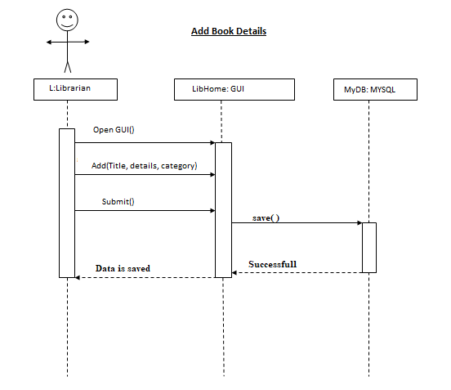

Slide 18
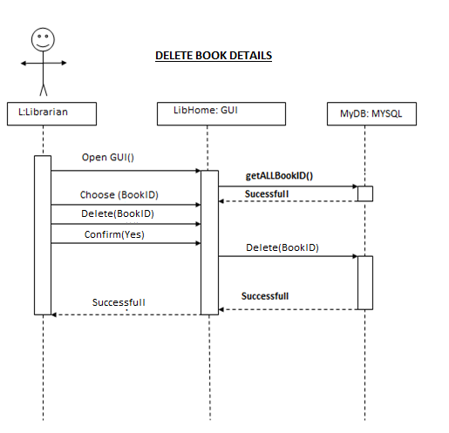

Slide 19
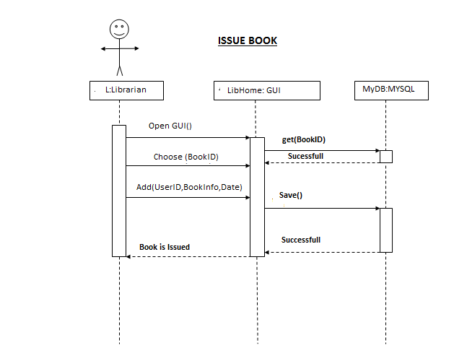

Slide 20
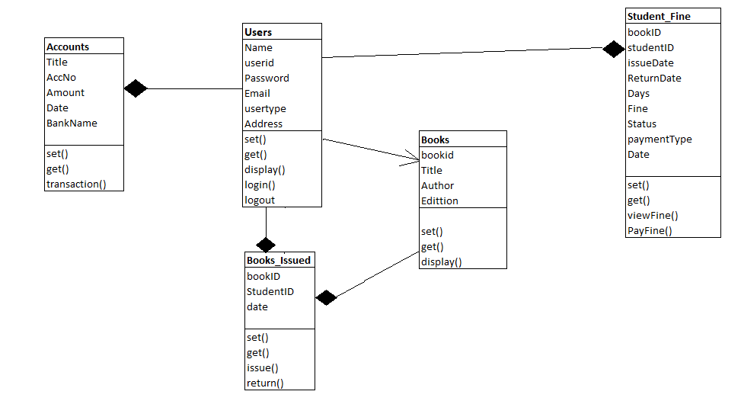
Logical Model/Class Diagram

Slide 21
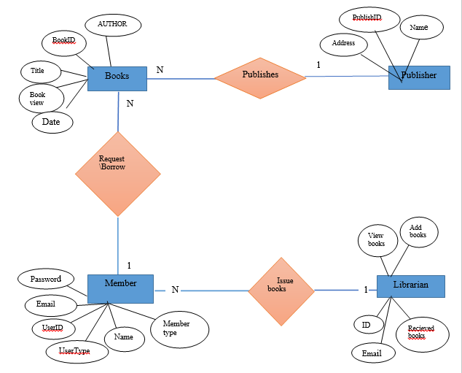
Entity-Relationship Diagram

Slide 22
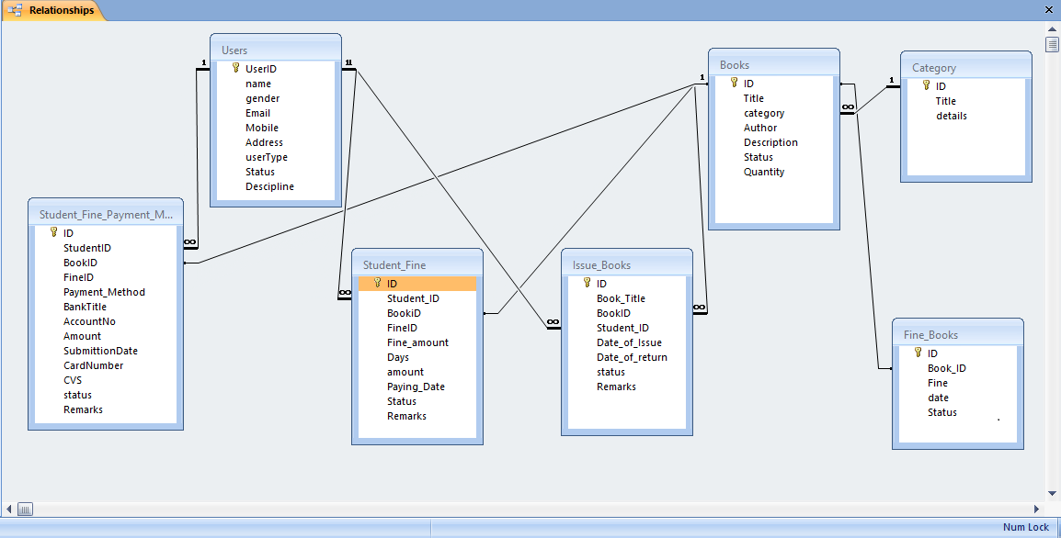
Database Diagram

Slide 23
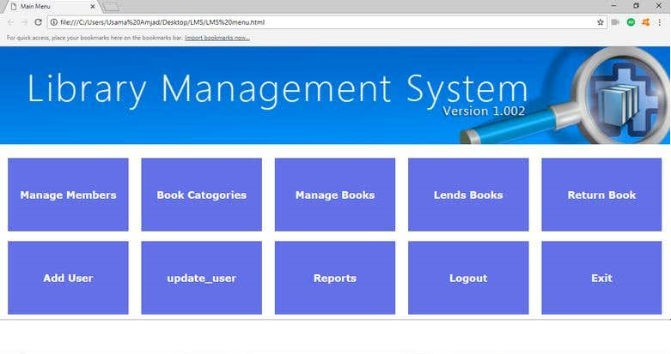
User Interfaces
Provide screen shots of GUI in different slides of your application here

Slide 24
Tools
HTML, CSS, Bootstrap
JAVA AND JSP and TOMCAT/MySQL database

