Slide 1

Kiran Franklin G
Senior Research Associate, Excelra
25th Aug 2023

Slide 2
Outline
Education background and projects
Project discussion
Future scope

Slide 3



Education background and projects
B.E Biotechnology
2017 – 2021
Dayananda Sagar College of Engineering,
Visvesvaraya Technological University
CGPA : 8.99
Bioinformatics Engineer
Boltzmann labs
Mar, 2021 - Jun, 2022
Senior Research Associate
Excelra
Jun 2022 - Present
Intern, Shodhaka Life Sciences
Jun ‘19 - Aug ’19
Research Intern, Bayes Labs
Jun ‘20 - Oct ’20
AI Master Class, Pantech Solutions Pvt Ltd (Pantech ProLabs India) · Apprenticeship
Oct ‘20 - Nov ’20
Insilco study on human delta sarcoglycan protein involved in Limb Girdle Muscular Dystrophy.
Functional impact on G108R mutations in PPT1 causing infantile neuronal ceroid lipofuscinosis: A molecular dynamics Study
Enzymatic and antibiotic degradation of Bacterial biofilm in Ventilator Associated pneumonia.
Skills:
TensorFlow · TensorBoard · Data Science · Machine Learning · Matplotlib · NumPy · Seaborn · Python (Programming Language) · MS Excel
· Bioinformatics · CADD · MMDD
Automated cheminformatics data-scraper-curator and QSAR modelling.
Automated virtual Screening and Validation of Small molecules: ADMET and Molecular docking.
Chemical space exploration and surrogate modelling.
Led a team of 6 in conducting internal and external case studies.
Open Souce contribution MolPro
Skills:
Scikit-Learn · Microsoft Visual Studio Code · Pycaret · Team Management · Data Science · Machine Learning · Matplotlib · NumPy · Bioinformatics · Python (Programming Language) - GCP
· Bioinformatics:
· Libraries – Rdkit, pubchempy, chembl_webcleint, Biopython, PLIP .
· Utilizing traditional and AI CADD tools such as playmolecule, Boltchem. Building similar tools.
SaaS for HTOmics.
Designing SaaS platform for Impurity management and toxicology reports.
Migration of Analytics ready pipeline.
Skills :
PostgreSQL · SQL · GitHub · Docker · Data Engineering · PyTest · Google Cloud Platform (GCP) · Nextflow · Python (Programming Language) · Flask · React.js · pyspark
· Bioinformatics · RNA-Seq Analysis using DESeq2, GAGE, clusterprofiler, David · Learning scRNA-seq - scanpy

Slide 4
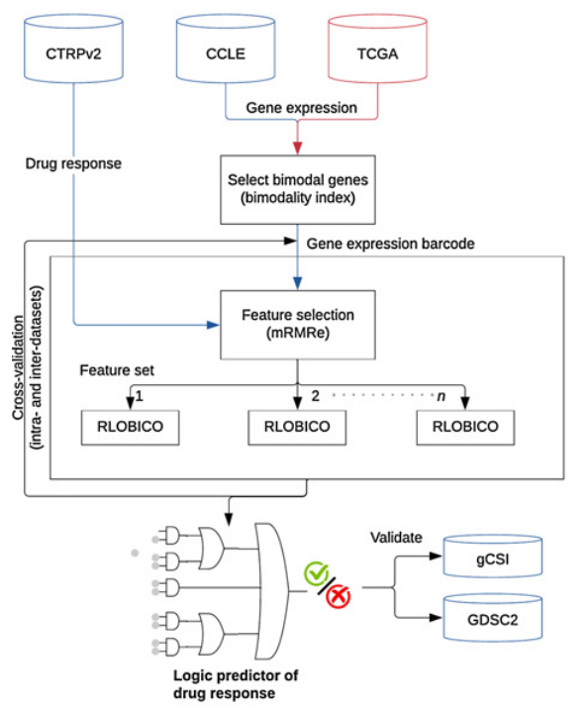
Bimodal Gene Expression in Patients with Cancer Provides Interpretable Biomarkers for Drug Sensitivity
Overview of the pipeline to create logic predictors of drug response
Precision oncology aims to tailor cancer treatment based on individual patient characteristics, including molecular biomarkers.
Genomic biomarkers have been widely studied, but they have limitations in predicting drug response.
This paper focuses on the identification of predictive biomarkers using gene expression, specifically exploring the concept of bimodality in gene expression.
Why Only Gene Expression profile? Why Not Gene Mutation, CNV or tissue of origin?
Robustness
Standardization
Reproducibility
Feature Selection
Ba-Alawi W, Nair SK, Li B, Mammoliti A, Smirnov P, Mer AS, Penn LZ, Haibe-Kains B. Bimodal Gene Expression in Patients with Cancer Provides Interpretable Biomarkers for Drug Sensitivity. Cancer Res. 2022 Jul 5;82(13):2378-2387. doi: 10.1158/0008-5472.CAN-21-2395. PMID: 35536872.

Slide 5
Bimodal Gene Expression in Patients with Cancer Provides Interpretable Biomarkers for Drug Sensitivity
Results:
CTRP data [544 drugs] Activity used is area above the dose–response curve (AAC) metric
21, 903 genes
CCLE – 945 cell lines from 23 tissue types
TCGA –10,534 tumours from 30 tissue types
Excluded drugs for which less than 10% of tested cancer cell lines are sensitive
Binarization of expression matrix and drug effect – AAC <0.2 as resistant and >= 0.2 as sensitive
Continuous values of AAC are used as weights to optimize modelling i.e high penalty for high sensitive sample misclassification
Fit into mixture of 2 Gaussian distribution – plot showing 2 clear distinct expression states
Good Fit Genes – Calculate BI score , considers size of two gps, avg. of their activities and how spread out they are.
mRMRe – “n” features –> Calculate relevance – > find redundancy and filter –> Rank and select best features
Rank the genes – select top 80th percentile
3 feature sets with 5-fold CV used to build model using RLOBICO and Evaluated using Concordance index( CI)
Testing Reproducibility
Able to build models yielding a CI >0.6 in 5- fold CV setting for 39.9% of drugs in CTRP.
CT > 0.6 was chosen as threshold to define robust model-based evaluation of CI scores between 11 drugs of different drug classes and their associated known biomarkers.
In comparison with Univariate models, 87% of multivariate models had a high CI value. Top predictive models are EGFR, ERBB2, VEGFR
2,816 genes of 21,903 genes were selected and also pathway enrichment analysis was done.

Slide 6
Bimodal Gene Expression in Patients with Cancer Provides Interpretable Biomarkers for Drug Sensitivity
Results :
Bimodal Gene Expression vs. Other Data Types:
found that the gene expression of bimodal genes performed much better than other types of data like mutations and CNVs in predicting how cells respond to drugs in about 72% of the drugs they tested.
Bimodal Genes Are Not Tissue Surrogates:
Wanted check if the genes could tell from which tissue they come from/ belong to, but bimodal genes couldn’t.
Tissue Type Predictions vs. Drug Response:
When they compared how well bimodal genes predict drug response with how well tissue types predict drug response, they found that tissue type was the best predictor for about 16% of the drugs. This means that some drugs are linked strongly to specific tissues.
External Datasets for Validation:
used two big datasets, gCSI and GDSC2, which contain information about drug responses in various cancers and found that their models performed well on these independent datasets. The validation rates were around 92% for gCSI and 61% for GDSC2.
In Vivo Validation and translating to Clinical settings :
Took their predictions to the next level by testing them on lung cancer PDX from the Novartis PDXE dataset and also clinical genomics dataset from HMF. Both results from these experiments matched their predictions, providing more confidence in the accuracy of their models.
Future Scope:
Integration of multi-omics data
Development of tissue-specific models
Validation on patient cohorts
Functional validation experiments

Slide 7
Back-up

Slide 8
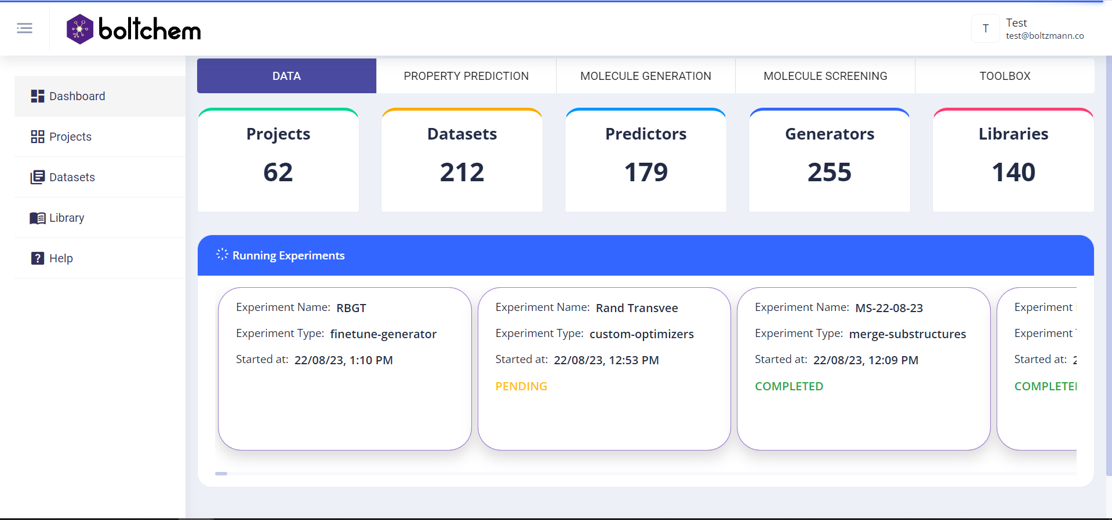
BoltChem : AI powered platform developed with data driven approaches and emphasis on multi objective optimization.

Slide 9
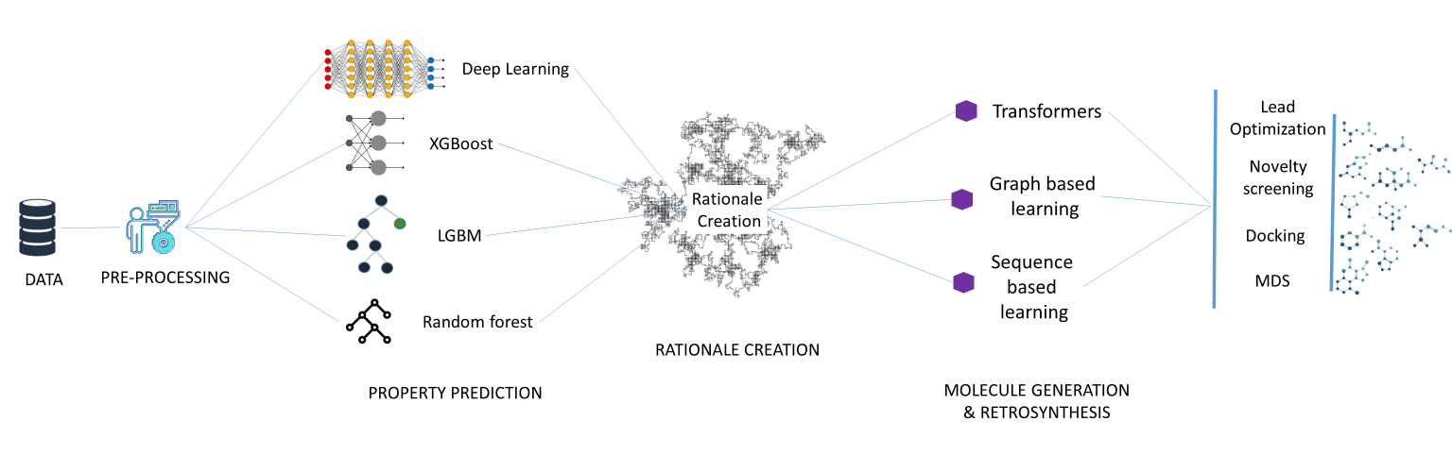
BoltChem : AI powered platform developed with data driven approaches and emphasis on multi objective optimization.

Slide 10
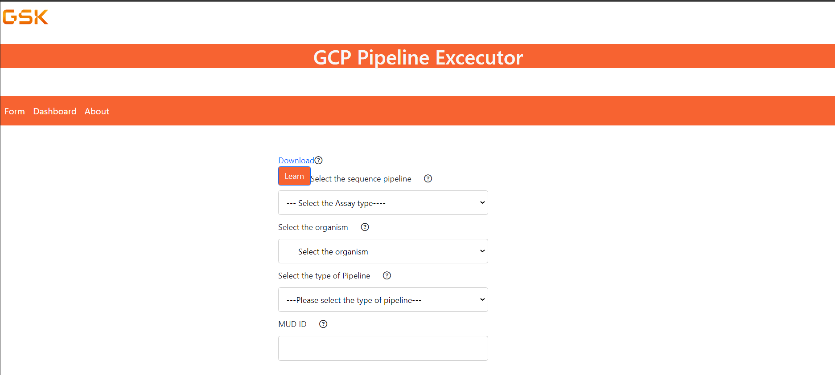
SaaS Omics platform

Slide 11
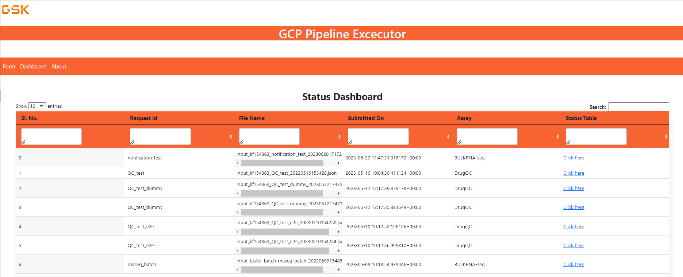
SaaS Omics platform

Slide 12
Bimodal Gene Expression in Patients with Cancer Provides Interpretable Biomarkers for Drug Sensitivity
21, 903 genes
mRMRe feature selection
gCDSI ( 92% validation rate) + GDSC2 ( 61% of validation rate)
CCLE – 945 cell lines + 23 tissue types
TCGA – 30 tissue types
RLOBICO with 5- fold CV
Comparative study:
Gene expression profile vs CNV vs Mutation vs tissue of origin
Bimodalling via two gaussian distribution – 2816 genes
Evaluation is via CI, CI > 0.6
Pathway enrichment
Comparative study:
Gene expression profile Out performs with predicting 72% of drugs sensitivity
CTRP – filter out drugs <= 10%
Pre-processing
Modelling
Validation
The results highlight the advantages of using bimodal gene expression as predictive biomarkers. Bimodal genes provide interpretable associations between gene expression patterns and drug response, facilitating clinical translation.
The logic-based models offer robustness and generalizability, capturing dependencies between genes and improving prediction accuracy. The models' interpretability allows clinicians to make informed treatment decisions based on the identified biomarkers.

Slide 13
Bimodal Gene Expression in Patients with Cancer Provides Interpretable Biomarkers for Drug Sensitivity
Results:
The authors characterize bimodality in gene expression in patient tumors and cancer cell lines.
They identify a subset of genes that exhibit high bimodality and select them as the top bimodal gene feature set.
The logic-based models built using these bimodal genes demonstrate superior performance in predicting drug sensitivity compared to other data types, such as mutations and copy number variations (CNVs).
The models achieve high predictive value and validation rates when tested on independent datasets, including GDSC2 and the Genentech Cell Line Screening Initiative (gCSI).
Discussion:
The results highlight the advantages of using bimodal gene expression as predictive biomarkers. Bimodal genes provide interpretable associations between gene expression patterns and drug response, facilitating clinical translation.
The logic-based models offer robustness and generalizability, capturing dependencies between genes and improving prediction accuracy. The models' interpretability allows clinicians to make informed treatment decisions based on the identified biomarkers.

Slide 14
Bimodal Gene Expression in Patients with Cancer Provides Interpretable Biomarkers for Drug Sensitivity
Future Scope:
Integration of multi-omics data: Investigate the integration of additional omics data, such as epigenomics, proteomics, or metabolomics, to enhance the predictive power of the models. This can provide a more comprehensive understanding of the molecular mechanisms underlying drug response.
Development of tissue-specific models: Explore the development of tissue-specific models to improve the accuracy of drug response prediction. This can involve identifying tissue-specific bimodal genes and incorporating tissue-specific features into the logic-based models.
Validation on patient cohorts: Collaborate with clinical partners to validate the predictive models on patient cohorts. This can involve analyzing gene expression data from patient samples and assessing the performance of the models in predicting drug response in a real-world clinical setting.
Functional validation experiments: Conduct functional validation experiments to understand the biological mechanisms underlying the identified bimodal gene expression patterns. This can involve perturbing the expression of specific bimodal genes in cell lines or animal models and assessing the impact on drug response.

