Slide 1
Neoantigen: A new breakthrough in tumor immunotherapy
summarized the latest advances in the classification of immunotherapy and the process of classification, identification and synthesis of tumor-specific neoantigens, as well as their role in current cancer immunotherapy.
Introduction:
Cancer and how they escape the immune system:
Cancer occurs when normal cells change and begin to lose control. Since cancer cells are derived from normal cells and are indistinguishable from normal cells, the immune system’s ability to recognize cancer cells is minimal . Cancer cells can avoid being attacked by the immune system when the immune system mistakenly thinks tumor cells are self-components. The surveillance of the immune system is also progressively weakened by mutations in the tumor. Tumor cells that activate the immune system are gradually screened out until they produce tumor molecules that are not recognized by the immune system. This process is also known as immunoediting of tumor.
Coz of this strategy of tumor cells and side effects of chemotherapy [ lack of specificity to target cell], surgery [ probability of removing all tumor less is not 1] and radiotherapy, Immunotherapy came to picture and sounded better.
wide application of high-throughput omics and the development of neoantigen prediction technology, immunotherapy based on neoantigen has become a new research hotspot.
Immunotherapy enhances the immune system’s ability to recognize, target, and eliminate cancer cells in the body, making it a potentially universal cancer solution

Slide 2
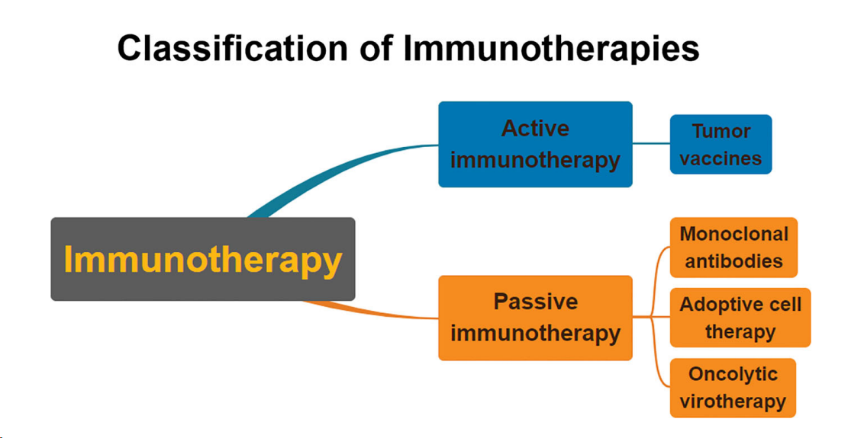

Slide 3
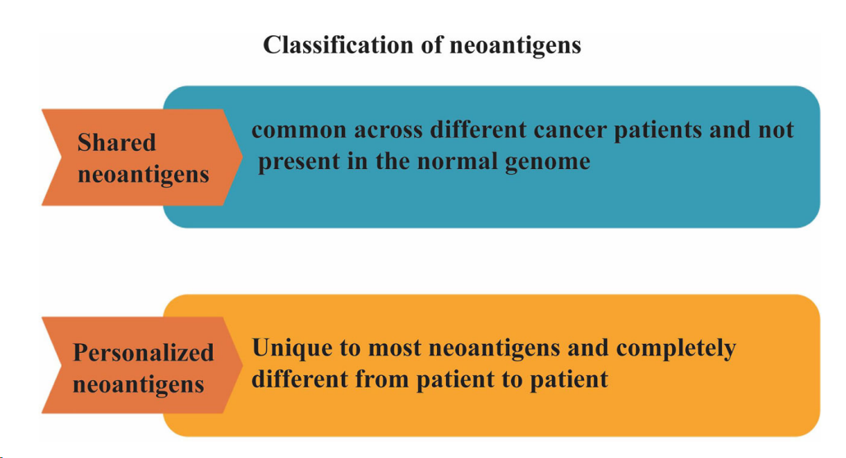
What is neoantigen?
Gene mutations caused by genetic instability @ coding / non-coding -> carcinogenesis -> the amino acid sequence changes caused by mutations in the coding region can produce proteins that are not found in normal cells -> this protein activate immune system -> make system to attack tumoar cells ->this protein present only in tumor cells by MHC molecules and get recognized by T-cells ->neoantigens
Tumor antigens are divided into tumor associated antigens (TAA) and tumor specific antigen (TSA)
TAA is a protein expressed by unmutated genes and appears to be significantly over-expressed in tumor cells but rarely expressed in normal cells. Because TAAs are normal host proteins, they are subject to both central and peripheral tolerance mechanisms. Targeting TAAs may also lead to autoimmune toxicity .
tumor specific antigen (TSA) is a neoantigen resulting from somatic mutations and is expressed only in tumor cells but not in normal cells (66). Because normal cells do not express TSA, they are considered non-self by the immune system, neoantigen specific immune responses are not affected by tolerance. Furthermore, targeting TSAs does not easily induce autoimmunity

Slide 4
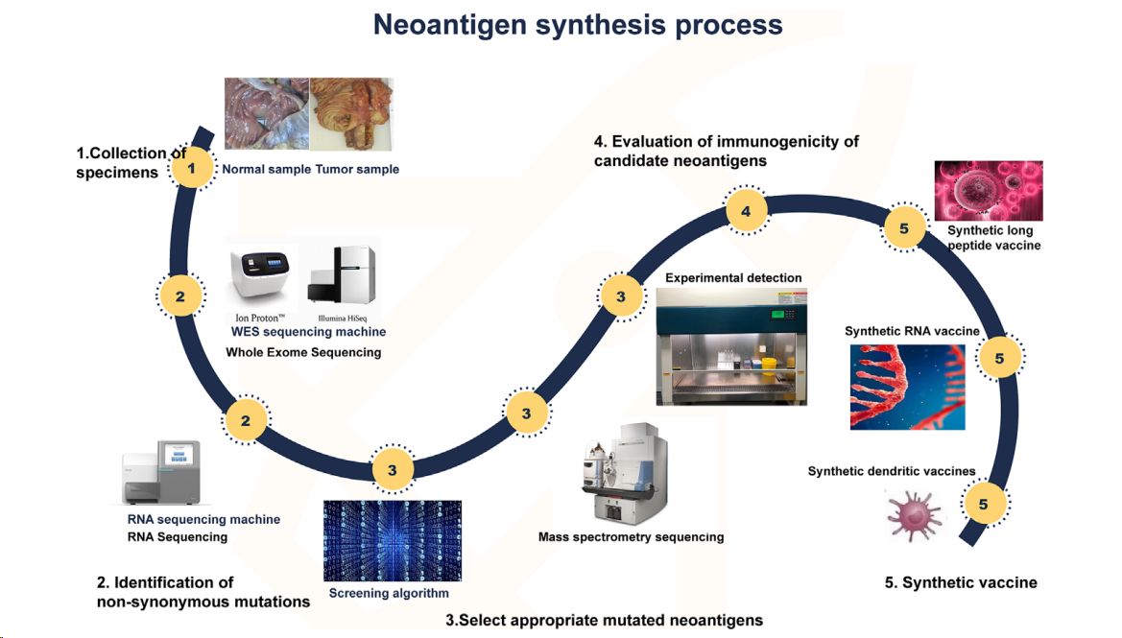
IDENTIFICATION OF NEOANTIGENS
the number of neoantigens with immunogenicity is small, and the prediction comparison is difficult . Therefore, the neoantigen field needs more optimized algorithms and validated methods for accurate prediction in order to select more reliable neoepitopes of high immunogenicity.
actors to be considered for prediction algorithms:
HLA typing, expression, mutation analysis, prediction peptide processing, TCR binding force, MHC affinity, PMHC stability, tumor neoantigen source.
T cell recognition, TCR analysis, and immune cell analysis to assess T cell response
NEOANTIGEN SYNTHESIS PROCESS
First, tumor and normal tissue samples were obtained. Then, by comparing the sequencing results of the two groups of samples, the mutated gene of the tumor was identified. Using computer, mass spectrometry or experimental methods to screen the gene sequences that are most likely to become tumor neoantigens, and finally these mutated genes can be designed into vaccines, which can take many forms, such as peptide vaccines, dendritic cell vaccines, RNA vaccines, etc.

Slide 5
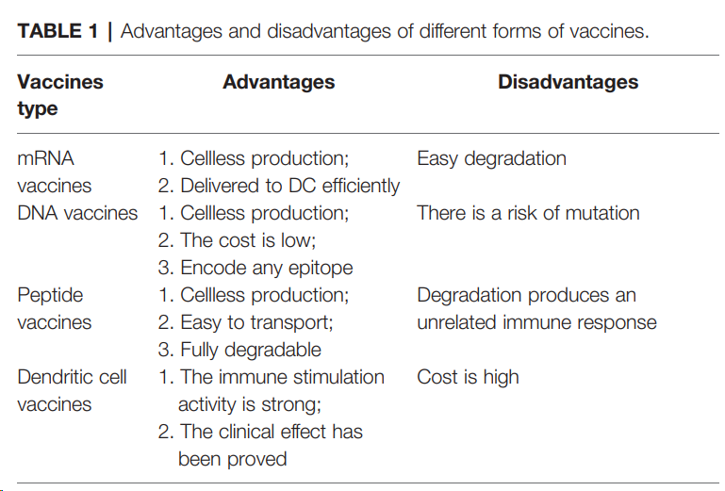

Slide 6
PROSPECTS AND CHALLENGES
Scarce amount of antigens. Finding more effective antigens is a problem that needs to be solved. Studies have shown that most specific antigens tend to be distributed in non-coding regions. The development of non-coding research in recent years will also provide assistance for the discovery of new antigens.
Screening methods for predicting neoantigens need to be improved. Using artificial intelligence and machine learning.
development cycle of neoantigen vaccine is too long
Preparation and delivery of vaccines.
The heterogeneity of the tumor is difficult to resolve.
Expensive. Therapies based on neoantigens are mostly personalized, and from initial gene sequencing to validation and production, the cost of treatment can be very high. Cost remains the biggest challenge

Slide 7
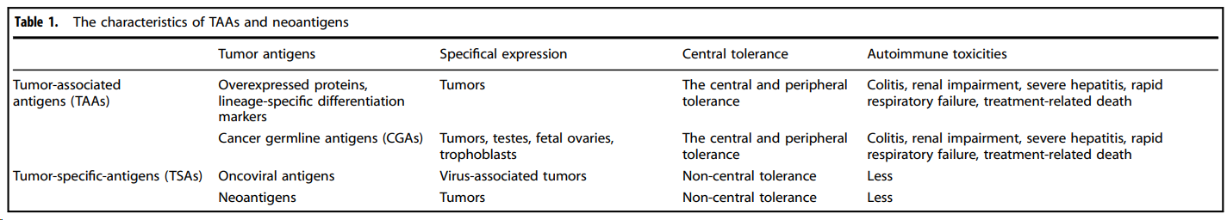
Neoantigens: promising targets for cancer therapy
overview on the identification and characterization of neoantigens and outlines the clinical applications of prospective immunotherapeutic strategies based on neoantigens. We also explore their current status, inherent challenges, and clinical translation potential
Neoantigens are self-antigens generated by tumor cells because of genomic mutations. Besides, neoantigens can also derive from unique proteins or peptides produced by dysregulated RNA splicing and disordered post-translational protein modification in non-virus-associated malignancies. For cancers with a viral infection, such as HPV-positive cervical cancer and EBV associated nasopharyngeal carcinoma, neoantigens can also be created by virally encoded open reading frames (ORFs). Compared with other types of tumor antigens, such as cancer testis antigens (CTAs) and TAAs, neoantigens offer a distinct advantage in their unique tumor-specific and absence in normal tissues, presenting ideal targets for effectively personalized treatment of tumors.
Furthermore, the capacity of immunotherapy-enhanced neoantigen-specific T cell responses in enduring and giving posttreatment immunological memory offers hope for long-term protection against disease recurrence.
Advanced techniques, including tumor gene sequencing, neoantigen discovery, and neoantigen-based immune therapeutic product preparation →algorithms for predicting MHC molecules binding epitopes → development of personalized cancer vaccines (PCVs) and adoptive cell therapy (ACT).
Limitations →costs and time, no ideal platform for e2e neoantigen prediction

Slide 8
The source of Neoantigens:
Genomic variants:
SNVs:
Most prevalent type -> yield most distinct peptides from wild type -> hence present by MHC-I as antigen.
100s of somatic mutation in patients have led to form avg 150 potential neoantigens peptides / individuals.
the SNV neoantigens landscape is highly variable between different cancer types and different stages of the same cancer type. Also, mtDNA mutation leads to neoantigens.
INDELS:
mainly caused by the insertion or deletion of base pairs in the genome → frameshift mutation
Generated more types of neoantigens with increase in MHC BA → increase in immunotherapy mutation type compared to SNVs.
frameshift INDEL neoantigen burden is also a novel biomarker for ICB response. INDEL frameshift mutations are supposed to produce more immunogenic neoantigens, hence improving response to ICBs
Gene Fusions:
Generated by mesenchymal deletion, chromosomal translocation or chromosomal inversion.
Even in some tumors with low TMB and limited immune infiltration, neoantigens generated by gene fusion are still able to activate cytotoxic T cells. The fusion neoantigens are more likely to induce stronger immune response than the neoantigens produced by SNVs and INDELs, and the neoantigen produced by frameshift fusion has better immunogenicity than the in-frame fusion neoantigen
The fusion neoantigens, such as BCR-ABL, SYT-SSX1/SSX2, PAX3-FOXO1, TPM3/TPM4-ALK, and EWS-FLI1, showed immunogenic potential
Structural Variations:
SVs generally refer to genetic variants that are larger than 50 base pairs, such as insertions, deletions, inversions, translocations, duplications/amplifications, and chromosomal additions and deletions, as well as chromosomal rearrangements. Among them, chromosomal rearrangement is the most complex (such as chromothripsis and chromoplexy), which is a prominent feature of tumors and plays a crucial role in the occurrence and immune recognition of various malignant tumors.
This re-arrangement is not detected by traditional DNA-seq hence WES methods like mate pair sequencing (MPseq). Potential neoantigens generated by chromosomal rearrangements have been identified by a combination of MPseq and RNA sequencing (RNA-seq)

Slide 9
The source of Neoantigens:
2. Transcriptomic variants:
Transcript alternative splicing:
Mutation during RNA splicing due to Cis or trans acting factors
Cis-acting mutations:
Mutation at cis-acting elements generates potential neoantigens through altered splicing, including alternative 5’ and 3’ splice site determination, intron retention, exon skipping and mutually exclusive exons
Trans-acting alterations in splicing factors:
Trans-acting alterations, in which a somatic mutation in a splicing factor results in an altered splicing variant, induce the production of neoantigens throughout the genome.
Nonsense-mediated RNA decay (NMD):
In cells with normal NMD function, a pioneer round of translation is required for initiating the NMD-mediated degradation of aberrant transcripts, which can lead to the production of small amounts of neoantigens. Moreover, the NMD regulatory mechanism is frequently impaired in tumor cells, enabling aberrant transcripts to avoid degradation and potentially produce large amounts of neoantigens.
Polyadenylation (pA) and RNA editing:
Polyadenylation is adding poly-A at 3` for mRNA maturation →,]some APA events occur in the intronic region upstream of the last exon, which is called intronic polyadenylation (IPA).→production of truncated or non-coding transcripts that have the potential to generate tumor-specific immunotherapeutic targets.
By comparing RNA-seq data between tumor and normal tissue samples from various cancers, more neoantigens created by IPA might be identified, providing prospective targets for cancer immunotherapy
Allegedly non-coding regions: previously tagged as non-coding regions now has coding knowledge and mutation in them leads to neoantigen formation -> MS is used for this identification

Slide 10
The source of Neoantigens:
3. Proteomic variants:
proteomic variants also come from the aberrant function of PTMs, proteasome processing, and transporter associated with antigen processing (TAP).
4. Viral-derived tumor antigens (Viral ORFs):
viral genes with oncogenic properties can integrate into the cellular genome, promoting the continuous expression of viral genes and leading to tumorigenesis
Current studies mainly focus on SNVs and INDELs → clinical application of neoantigens produced from SNVs and INDELs is limited by their patient specificity and poor immunogenicity, which results in less clinical benefit for cancer patients.
gene fusions, alternative splicing variants and PTMs, may be attractive novel targets for immunotherapy. The neoantigens produced by gene fusion, particularly the frameshift fusion, have better immunogenicity than the SNVand INDEL-neoantigens, which were included in numerous clinical trials.

Slide 11
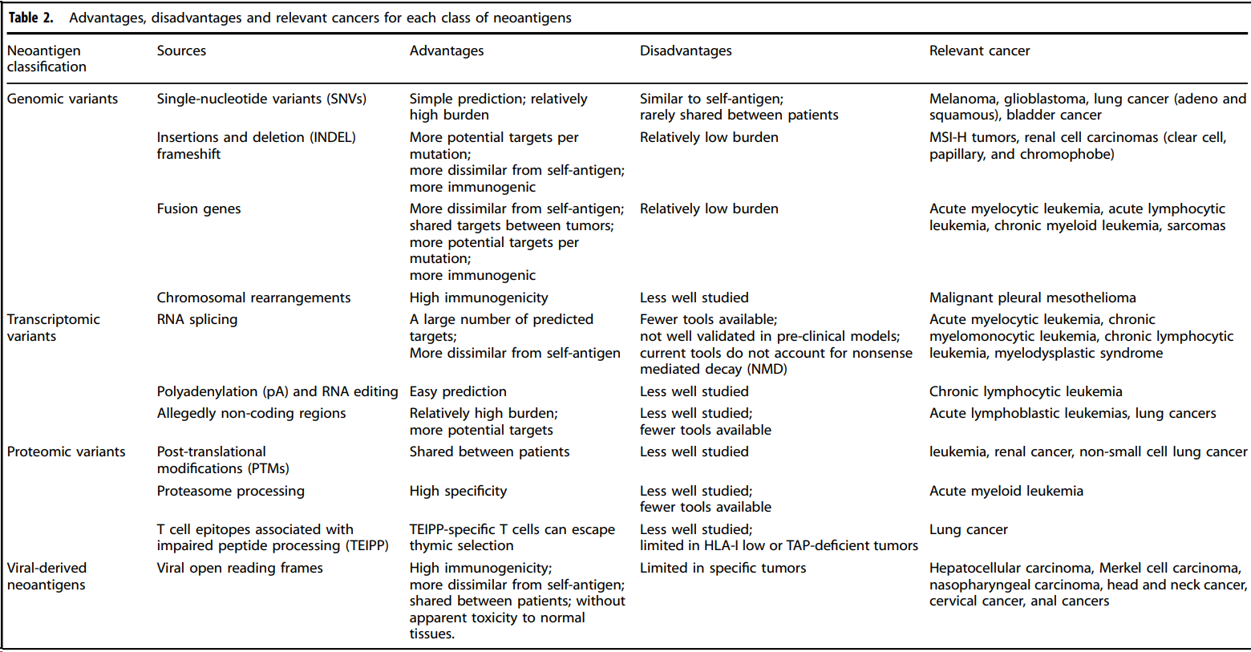

Slide 12
IDENTIFICATION, PREDICTION, AND VALIDATION OF IMMUNOGENIC NEOANTIGENS
Neoantigens may now be thoroughly screened across the entire cancer spectrum thanks to the convergence of whole-exome sequencing (WES), RNA-seq, and proteomic data from TCGA → tumor types, tumor lesions, and patients, customized immune treatments necessitate the detection and prediction of neoantigens based on distinct patient and tumor characteristics
Two main strategies for identifying neoantigen epitopes are developed: the immunogenomic approach can create virtual peptidomes by in silico methods based on NGS, and the immunopeptidomic strategy use MS to analyze the MHC loaded peptides.
Identification of somatic mutations
the initial stage in the process of detecting possible neoantigens from NGS data is mapping tumor-specific genetic abnormalities using WES of the tumor and normal DNA. RNA-seq data may be combined with WES to determine whether a mutant gene is expressed in the tumor. In addition, more hidden biological information, such as information about copy number changes, microbial contamination, transposable elements, cell type, and the existence of neoantigens, can be found in RNA-seq.
neoantigens arising from aberrant DNA sequence or RNA expression, MS-based proteomics provide the "gold standard" for neoantigen detection at the protein level, which cannot be discovered from DNA and RNA studies.

Slide 13
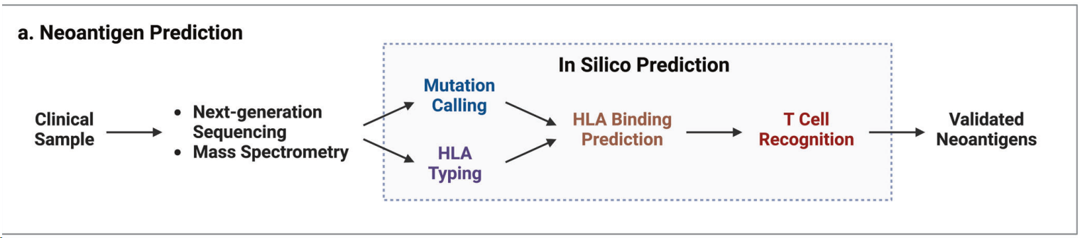
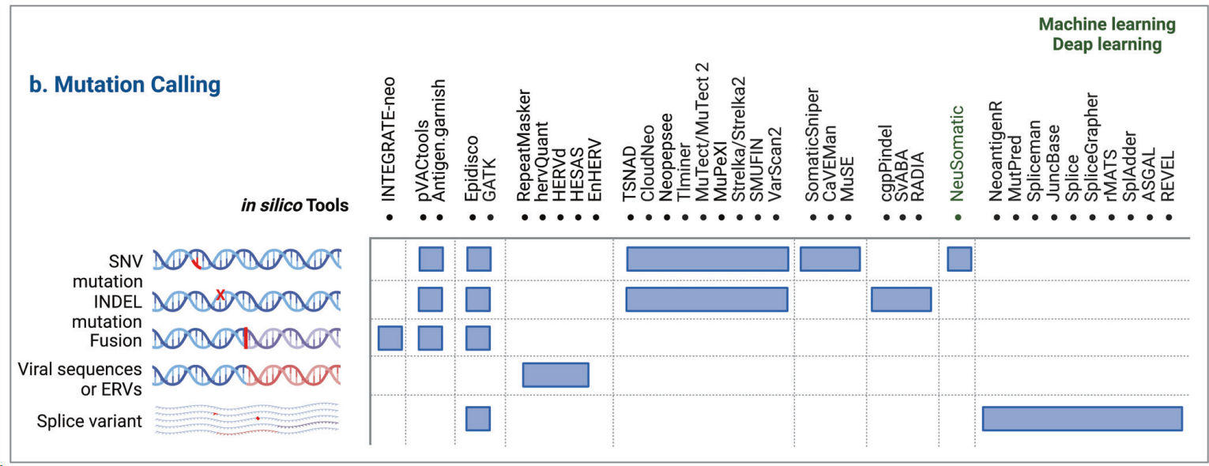
IDENTIFICATION, PREDICTION, AND VALIDATION OF IMMUNOGENIC NEOANTIGENS
In silico neoantigen prediction

Slide 14
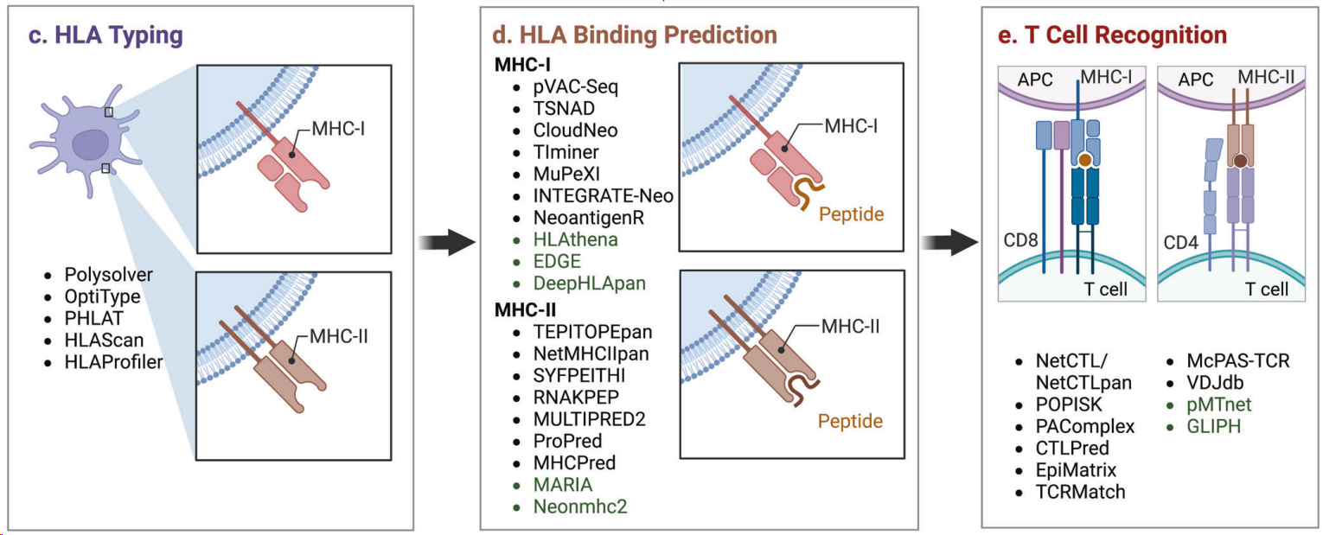
IDENTIFICATION, PREDICTION, AND VALIDATION OF IMMUNOGENIC NEOANTIGENS
In silico neoantigen prediction

Slide 15
IDENTIFICATION, PREDICTION, AND VALIDATION OF IMMUNOGENIC NEOANTIGENS
Evaluation and validation of candidate neoantigens’ immunogenicity
immunogenic neoantigen must satisfy two or more requirements, the main bottlenecks are appropriate MHC molecule presentation and effective TCR recognition
crucial to take the TCR recognition of pMHC complexes into account.
most used method is NetCTL/NetCTLpan, which generates a composite score rather than predicting T cell binding directly by combining MHC binding, C-terminal cleavage affinity and TAP transport.
Integrating single-cell RNA sequencing (scRNA-seq) with TCR sequencing of responsive cell groups may be used to boost the sensitivity of detection.

Slide 16
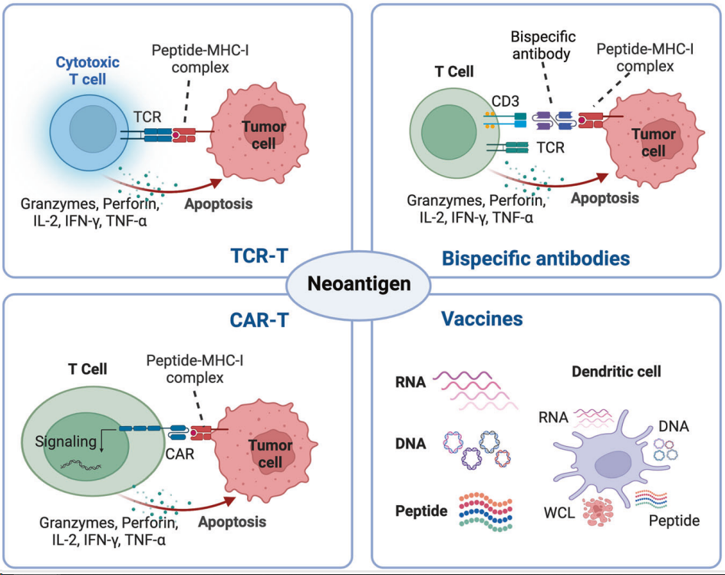
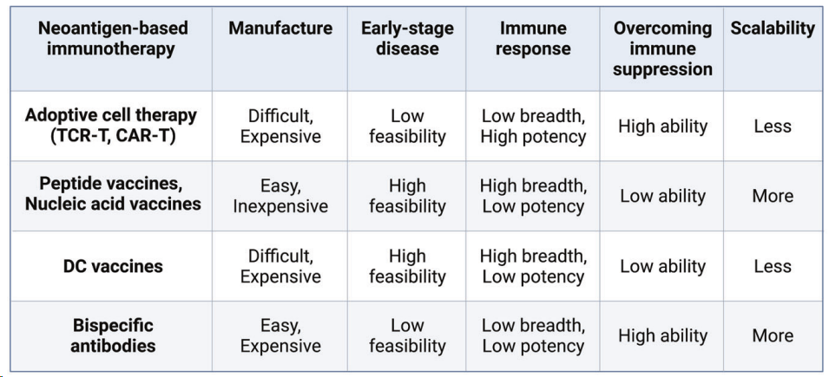
NEOANTIGENS-BASED THERAPEUTIC STRATEGIES

Slide 17
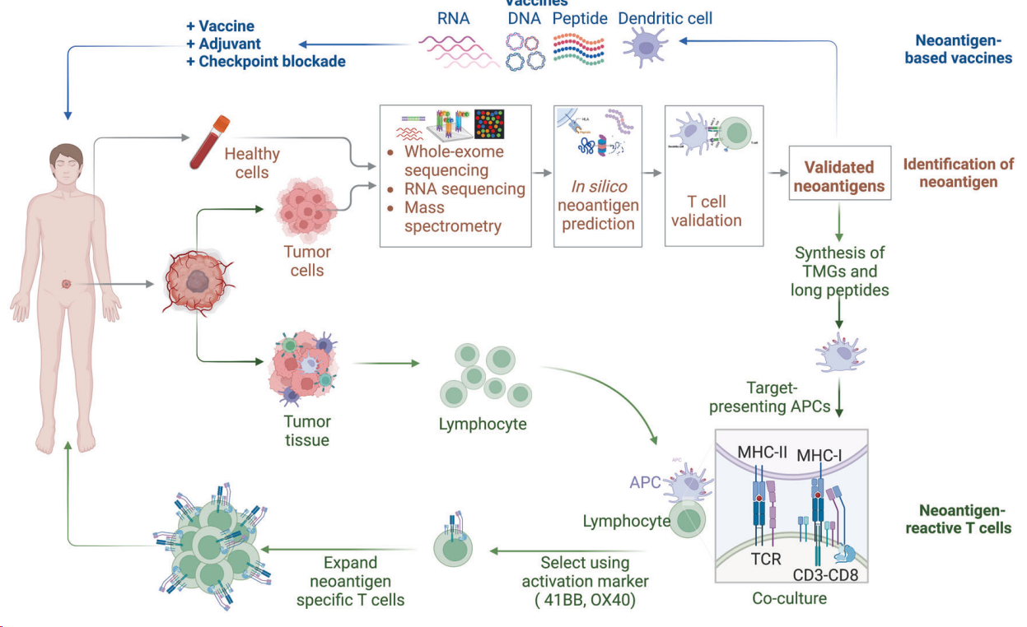
NEOANTIGENS-BASED THERAPEUTIC STRATEGIES
Schematic illustration of neoantigen-based cancer immunotherapy production. The individualized neoantigens are identified using blood cells and tumor tissues from patient. These patient-specific neoantigens are used to develop immunotherapies, such as cancer vaccines and ACTs. Cancer vaccines in the form of peptides, DNA or mRNA, and dendritic cells are generated and administered to the same patient. For ACTs, T cells are extracted from the peripheral blood or tumor tissues of a patient and then induced to proliferate by cytokines, monoclonal antibodies against CD3 and CD28, and other reagents. The development of neoantigen-specific T lymphocytes with neoantigen-specific targeting requires co-culturing T cells with primed APCs and genetic engineering of immune cells with TCRs or CARs. After sufficient T cell expansion, T cell products are injected into lymphodepleted patients with the hope of eliciting an immune response that attacks the tumors

Slide 18
CHALLENGES AND OPPORTUNITIES FOR CLINICAL APPLICATION
1. Limited accuracy of neoantigen prediction
2. Escape from immunological surveillance: loss of neoantigens, modification of antigen peptide presentation, and immunosuppressive TME
3. Loss of neoantigens: The loss of tumor-specific neoantigens may be a significant immune escape strategy for tumors
4. Disrupted presentation of neoantigen peptides: Tumors may evolve mutations that change not just neoantigen expression but also HLA heterozygosity and MHC stability in response to anti-tumor immune pressure.
5. Immunosuppressive TME: recognition of neoantigens and activation of T cells can also be compromised by immunosuppressive TME processes, including the suppression of immunological checkpoints, the immunosuppressive effects of various TME cells, and the release of ions or proteins from within tumor cells following necrosis. ICBs are combined with neoantigen vaccines to prevent immune escape
6. Insufficient production of neoantigen-specific T cells
7.Limited neoantigen-reactive T cell repertoire
8. Determination and monitoring of neoantigen-specific T cell responses

