Slide 1
Day 1 – Afternoon Session
Preparation

Slide 2
Slack
Installing Ruby
Git
Github
Codewars

Slide 3
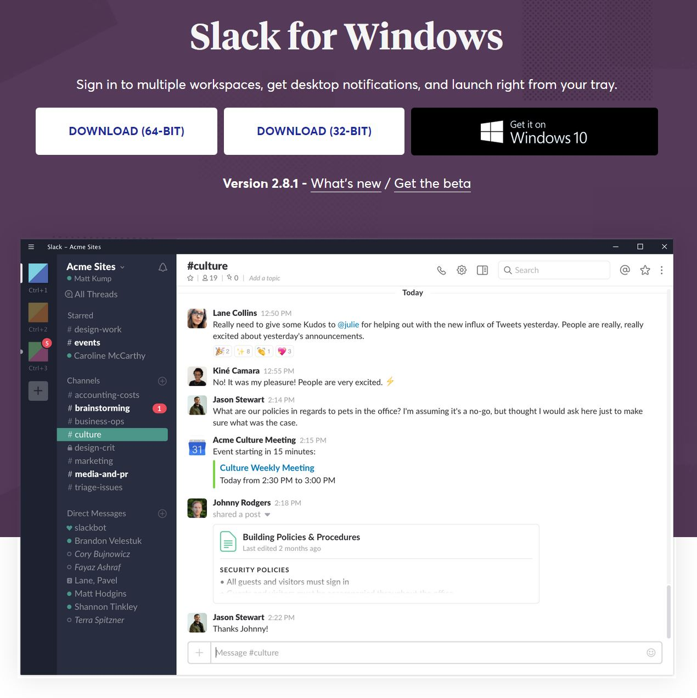
slack.com/downloads

Slide 4
ruby.id/slack
/join #kollaedu-goscholar
/join #tech-question

Slide 5
Installing ruby

Slide 6
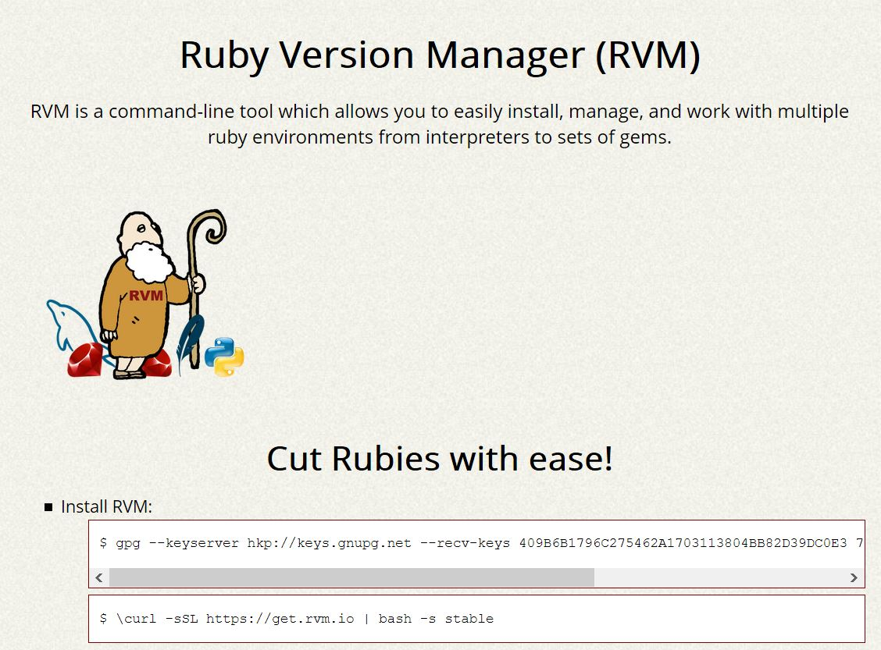
rvm.io

Slide 7
rvm list
rvm install 2.4.2
rvm use 2.4.2 --default
# test
ruby --version
which ruby

Slide 8
Git

Slide 9
# test
which git
# only install if git isn’t available
sudo apt-get install git-core

Slide 10
# check current directory status for git
git status

Slide 11
# initialize current directory as new git repository
git init .

Slide 12
# add file(s) to staged index
git add <filenames or directories>

Slide 13
Local repository
committed
staged
unstaged
# add file(s) to staged index
git add <filenames or directories>

Slide 14
Local repository
committed
committed
unstaged
# commit staged index
git commit -m <message>

Slide 15
Local repository
committed
committed
unstaged
# check remote repository
git remote -v

Slide 16
Local repository
Remote repository
committed
committed
committed
unstaged
# set remote repository (https)
# first time use ‘add’ instead of set-url
git remote set-url origin https://github.com/username/repo.git
# set remote repository (ssh)
git remote set-url origin git@github.com:username/repo.git

Slide 17
Local repository
Remote repository
committed
committed
committed
# pull from remote repository
git pull
# pull for first time
git pull origin <remote-branch-name>

Slide 18
Local repository
Remote repository
committed
committed
committed
committed
unstaged
# push to remote repository
git push
# push to remote repository (first time)
git push –u origin <remote-branch-name>

Slide 19
Local repository
committed
Branch feature-1
committed
# list all branches
git branch –a
# create new branch
git branch <branch-name>
# move to new branch (careful when using this command)
git checkout <branch-name>

Slide 20
Local repository
committed
Branch feature-1
committed
# list all branches
git branch –a
# create new branch
git branch <branch-name>
# move to new branch (careful when using this command)
git checkout <branch-name

Slide 21
Local repository
committed
Branch feature-1
committed
committed
# merge branch
git checkout <dest-branch-name>
git merge --no-ff <src-branch-name>

Slide 22
Local repository
committed
unstaged
# remove file(s) from staged index
git reset

Slide 23
Github

Slide 24
Codewars
codewars.com/r/VoqzPQ

