Slide 1
P30: Koopman/EDMD Forecasting of MRSA Spread
on a Hospital Contact Network
CMDS Course Project · M.Tech Data Science · Amrita Vishwa Vidyapeetham
Topic P30 · First review: October 6, 2026

Slide 2
Motivation
• Hospital-acquired MRSA spreads through person-to-person contact
• Infection-control resources (isolation, cohorting, screening) are finite
• Which ward, if any, is disproportionately responsible for spread?
• Would intervening there actually help more than a blanket or random policy?

Slide 3
Research Questions
• RQ1: Does lifting ward-level MRSA prevalence into a Koopman/EDMD
- framework forecast outbreak trajectories better than simple baselines?
• RQ2: Do the resulting Koopman eigenmodes identify “superspreader”
- wards better than plain network centrality?
• Answered honestly against a SIMULATED GROUND TRUTH, not just in-sample fit

Slide 4
Data: the I-Bird Hospital Contact Network
• 200-bed long-term/rehabilitation hospital, Berck-sur-Mer, France, 2009
• Obadia et al. 2015 (PLOS Comput Biol); Duval et al. 2018 (Sci Rep)
• admission.csv: 795 people (452 patients, 343 staff), 6 ward groups
• mat.day.csv: 124,924 contact records, 589 people, 19,974 unique pairs
• microbio.csv: 6,728 MRSA swabs, 295 people MRSA-positive at least once
• P1 data audit: all 19 reference numbers independently re-verified exactly

Slide 5
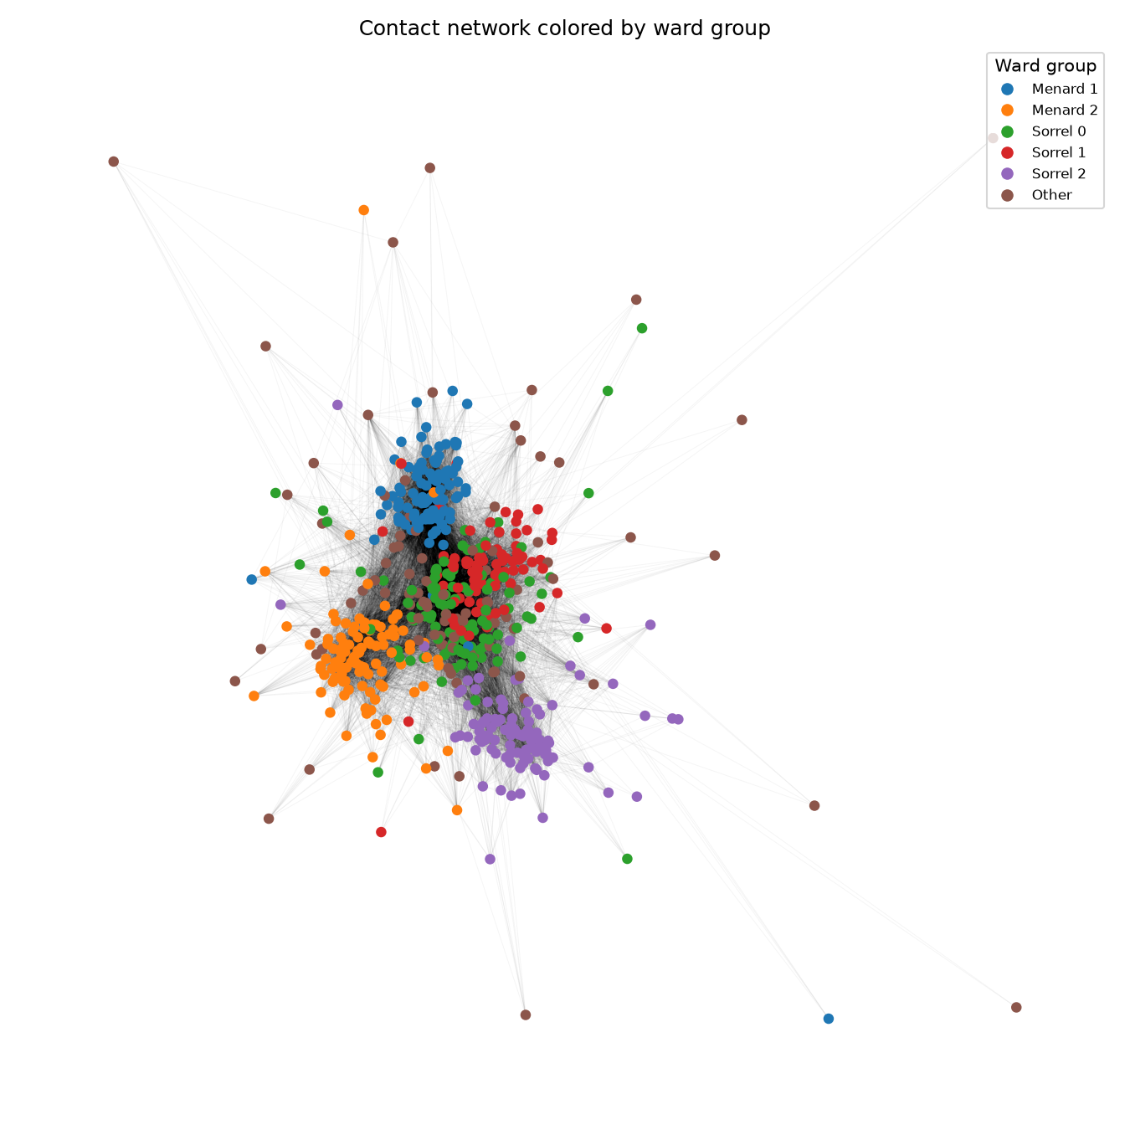
The Contact Network, Colored by Ward
• Clear within-ward clustering
• “Other” (staff, brown) bridges wards
• 90.3% of contact-seconds are within-ward
• Ward contact matrix W built from raw bidirectional contact records
Figure: 589-person contact network, node color = ward group.

Slide 6
Pipeline Overview
• P1 Data audit → P2 Contact network + ward matrix W
• P3 Real weekly prevalence → P4 Individual-level SIS simulation + calibration
• P5 EDMD dictionaries (D1/D2/D3) → P6 Ridge-regularized EDMD fit
• P7 Eigenmode analysis → P8 Real-data forecasting validation
• P9 Superspreader risk score vs. centrality → P10 Intervention simulation
• P11 Robustness experiments E1–E8
• 179 automated tests throughout; every design decision logged and verified

Slide 7
Individual-Level SIS Simulation (P4)
• Daily stochastic SIS on the 589-person contact network
• P(transmit) = 1 − exp(−β·contact hours with infected neighbors)
• Verified analytically: matched a closed-form solution over 20,000 replicates
• Calibrated to real weekly prevalence (weeks 0–11), 320-point grid search
• FINDING: calibration sits on a wide, weakly-identified loss ridge
- — only ~16 real weekly snapshots to calibrate against
• 300 simulated training trajectories generated for EDMD fitting
Best fit: β=6.8×10⁻⁴/hr, γ=1.7×10⁻³/day — 16 of 320 grid points within 10% of best loss

Slide 8
Three EDMD Dictionaries (P5)
• D1 (linear): [1, x] — 7 features
• D2 (degree-2 polynomial): [1, x, x², cross terms] — 28 features
• D3 (contact-weighted): [1, x, x², Wx, x⊙(Wx)] — 25 features
• D3 is the one dictionary meant to inject network structure

Slide 9
Major Finding: D3 Adds No Function Space Beyond D2
• PROVEN ANALYTICALLY, before building anything on top of it:
- Wx is a linear function of x → spans exactly the same subspace as x
- x·(Wx) is a fixed linear combination of D2's own square/cross terms
- → D3's effective rank ceiling: 19 of its 25 raw features
• CONFIRMED EMPIRICALLY: fitted D3 operator has rank(K) = 19 exactly
• D1 (rank 7/7) and D2 (rank 28/28) are both full rank
• Consequence: D3 tests whether a contact-structured PRIOR helps —
- never “injects network information,” since it structurally cannot

Slide 10
EDMD Fit Results (P6)
• Ridge regression, written from scratch in NumPy (no external Koopman library)
• Constant feature excluded from scaling AND the ridge penalty
• λ selected on validation split, mean RMSE over forecast horizons 1–4
• HONEST RESULT: D1, D2, D3 perform almost identically
- Test h=1 RMSE: D1=0.00748, D2=0.00758, D3=0.00747
- All beat persistence by 12–13% at h=1, growing to 25–27% by h=4
• D3 edges out D2 very slightly, despite having less effective capacity

Slide 11
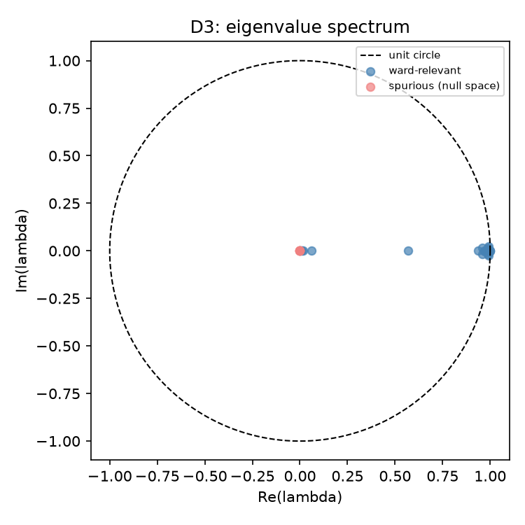
Eigenmode Analysis (P7): a Disagreement Worth Tracking
• Dominant (most persistent) mode's top ward:
• D1 says Menard 1 (45.2% share)
• D2 and D3 agree: Sorrel 1 (~42% share)
• D3's 6 spurious null-space eigenvalues
• (from the proven rank deficiency) sit
• near the origin, cleanly separated
• from the 19 real modes near |λ|=1
• This disagreement is NOT resolved from
• eigenmodes alone — tested next against
• simulated ground truth
Figure: D3's eigenvalue spectrum — real modes (blue) vs. spurious null-space modes (red).

Slide 12
Real-Data Forecasting Validation (P8)
• First time the fitted K touches real data (deliberately held back until now)
• New baselines built: network-exposure linear model, ward-level SIS model
• HONEST RESULT on the holdout period (weeks 12–16):
- D1/D2/D3 statistically indistinguishable from persistence at h=1
- historical_mean overtakes everything by h=3–4 (skill ≈0.20)
• Plausible cause: K trained on simulated trajectories sitting on P4's
- weakly-identified calibration ridge — may not transfer a strong edge

Slide 13
The Central Question:
Koopman Eigenmodes vs. Simple Centrality

Slide 14
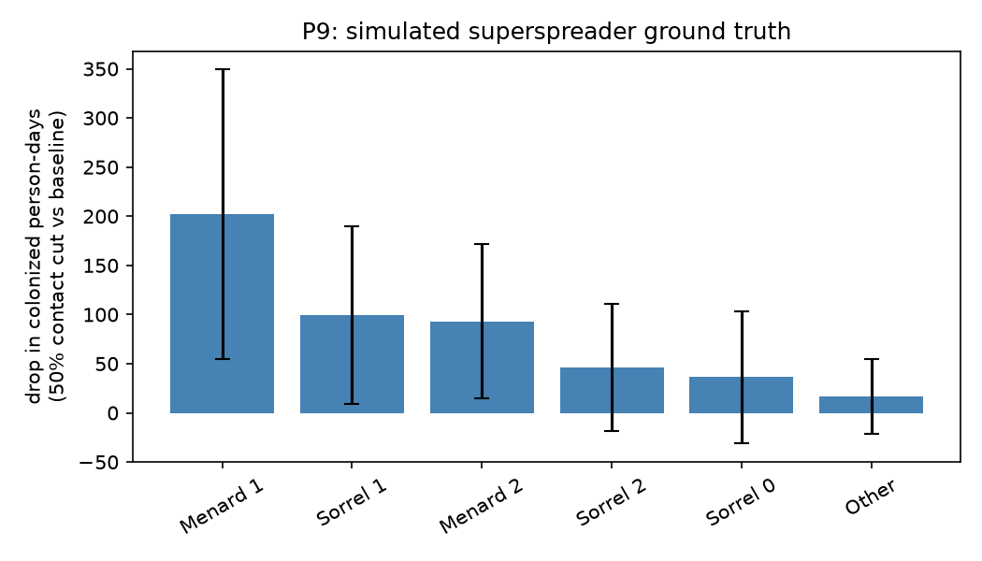
Simulated Superspreader Ground Truth (P9)
• Ground truth: cut each ward's
• contacts 50%, measure the drop
• in colonized person-days
• (100 replicates, common random
• numbers, paired comparison)
•
• Ranking: Menard 1 > Sorrel 1 >
• Menard 2 > Sorrel 2 > Sorrel 0 >
• Other
Figure: drop in colonized person-days per ward, error bars = per-replicate std.

Slide 15
Risk Score vs. Ground Truth: Spearman ρ
Candidate | ρ | p-value
degree_centrality | 0.943 | 0.0048
eigenvector_centrality | 0.714 | 0.111
koopman_D2 | 0.543 | 0.266
koopman_D3 | 0.429 | 0.397
betweenness_centrality | 0.309 | 0.552
koopman_D1 | 0.257 | 0.623
Simple degree centrality (a ward's raw contact volume, no Koopman machinery) predicts the ground
truth far better than any Koopman eigenmode score — the only candidate surviving Bonferroni correction.

Slide 16
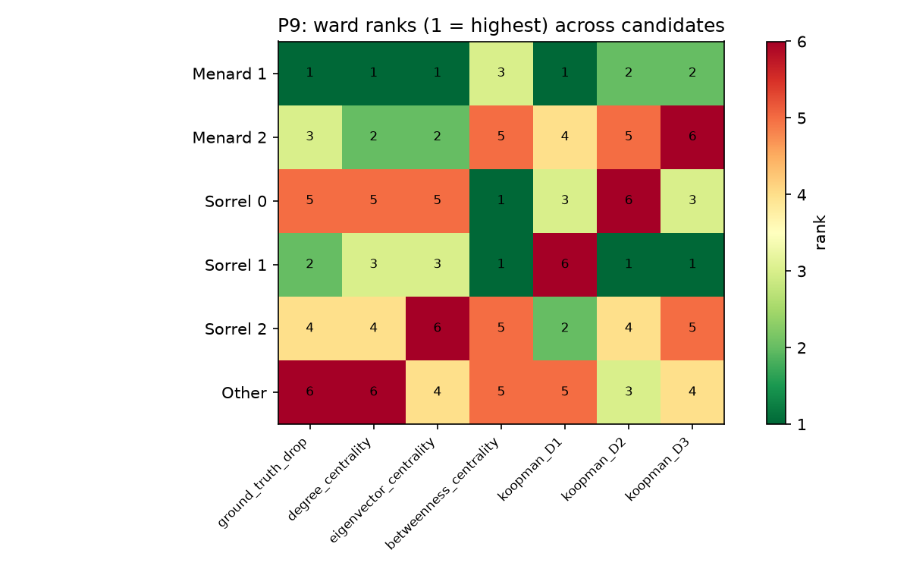
The Same Pattern, Visually
• ground_truth, degree_centrality,
• and eigenvector_centrality
• columns look nearly identical
•
• The three koopman columns
• look comparatively scrambled
•
• Nuance: koopman_D1 DOES pick
• the #1 ward correctly (Menard 1)
• — but has the worst OVERALL
• rank correlation of the three
Figure: ward ranks (1=highest) across all candidates and the ground truth.

Slide 17
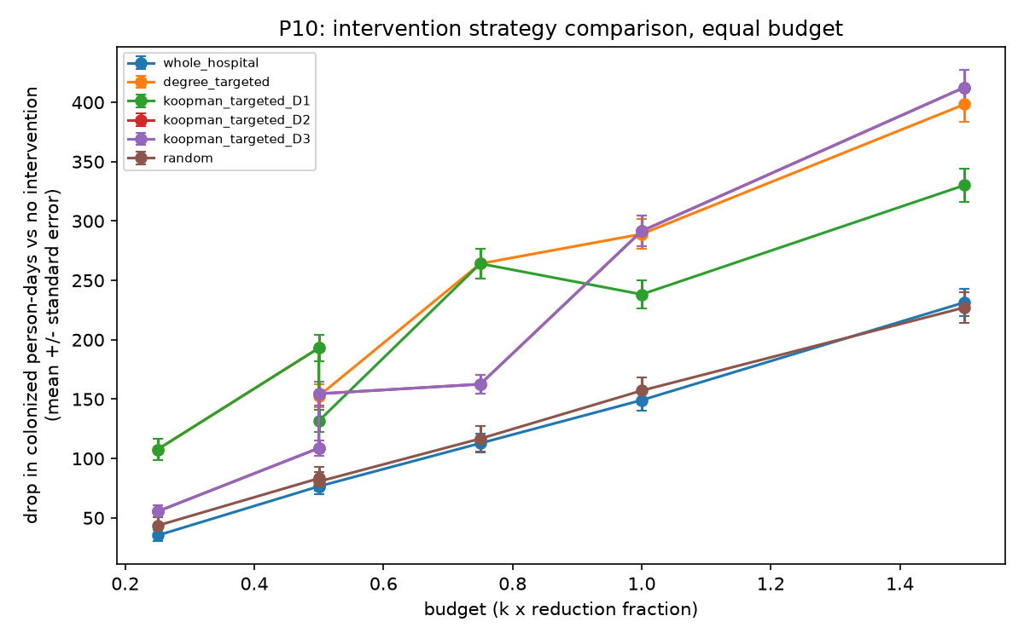
Intervention Simulation (P10): Targeting Matters
• Equal-budget framework:
• budget = k × reduction fraction
•
• Every TARGETED strategy beats
• BOTH untargeted strategies
• (random, whole-hospital) at
• every matching budget
•
• At k=2: koopman_D2/D3 slightly
• beats degree-targeting — a higher
• overall correlation doesn't
• guarantee the better k=2 pick
Figure: drop in colonized person-days vs. budget, by strategy.

Slide 18
Robustness: Experiments E1–E8 (P11)
# | Probes | Result
E1 | Seed sensitivity | ρ=0.943
E2 | λ sensitivity (0.1×/10×) | max ratio dev. 3.3%
E3 | Replicate count (30/300) | ρ=1.000
E4 | Calibration ridge-point | ρ=1.000
E5 | W's time window | ρ=1.000
E6 | Patients-only population | ρ≈1.000
E7 | Missing-data handling | ρ=1.000 (model ranking)
E8 | D3 structural redundancy | ratio=0.998, same dominant ward
Every major conclusion is stable across seed, replicate count, calibration point, network
time-window, population, missing-data handling, and λ choice.

Slide 19
Discussion
• The Koopman/EDMD machinery works and was built/verified rigorously
• (exact recovery on synthetic systems, closed-form agreement, 179 tests)
• On THIS dataset, it does not outperform simpler alternatives — reported
• honestly, with three concrete, verifiable reasons:
- (a) SIS calibration sits on a weakly-identified ridge (~16 real snapshots)
- (b) D3, the “network-aware” dictionary, is PROVABLY no richer than D2
- (c) raw ward contact volume is a strong, nearly-free predictor
• Targeting still matters enormously, independent of which score is used —
• a practically actionable finding that survives every robustness check

Slide 20
Limitations
• About 16 real weekly snapshots only — root cause of the calibration ridge
• Time-invariant K vs. a time-varying contact network
• Only 6 ward groups — rank statistics are inherently weak (n=6)
• No admission/discharge dates, single hospital, single 4-month window
• No transfer records

Slide 21
Conclusion & Future Work
• Built a complete, rigorously-tested pipeline: real network → calibrated
• SIS simulator → EDMD → eigenmodes → validated against simulated ground truth
• Honest answer: network-aware Koopman eigenmodes do not beat simple
• degree centrality for THIS dataset — traced to specific, understood causes
• “Some form of targeting beats none” is robust and practically useful
• FUTURE WORK:
- Genuinely time-varying, network-weighted dictionary (week-specific W_t)
- Larger / multi-site real dataset to better identify the SIS calibration

Slide 22
References
• Obadia, T., Silhol, R., Opatowski, L., Temime, L., Legrand, J.,
• Thiébaut, A.C.M., et al. (2015). Detailed Contact Data and the
• Dissemination of Staphylococcus aureus in Hospitals.
• PLOS Computational Biology, 11(3):e1004170.
•
• Duval, A., Obadia, T., Martinet, L., Boëlle, P.Y., Fleury, E.,
• Guillemot, D., et al. (2018). Measuring dynamic social contacts
• in a rehabilitation hospital: effect of wards, patient and staff
• characteristics. Scientific Reports, 8:1686.

