Slide 1
FACIAL EMOTION AND HAND GESTURE RECOGNITION
Presented by
SHASHANK(4NM17CS163) MADAN A R (4NM17CS095)
SHRIKESH I(4NM17CS177) KIRAN MAHADEV GIRADDI(4NM17CS088)
UNDER THE GUIDANCE OF
Prof. Raju K
Department of CS&E
NMAMIT NITTE

Slide 2
ABSTRACT
Object recognition – a popular task in computer vision
Challenges and fundamental problems in object detection
Convolutional Neural Network (CNN) based architecture to detect objects

Slide 3
INTRODUCTION
Image classification involves activities such as predicting the class of one object in an image
Object localization refers to identifying the location of one or more objects in an image and drawing a bounding box around their extent
Object detection does the work of combining these two tasks and localizes and classifies one or more objects in an image

Slide 4
INTRODUCTION
Object recognition is to describe a collection of related computer vision
tasks that involve activities like identifying objects in digital photographs
Facial emotion recognition is the process of detecting human emotions from facial expressions.
Gesture recognition is a type of perceptual computing user interface that allows computers to capture and interpret human gestures as commands.

Slide 5
PROBLEM STATEMENT
In this project we implement a useful way to detect the basic universal emotions along with neutral expression from frontal facial emotion
We are going to recognize facial emotion and hand gestures from a
video sequence
There are six basic universal emotions for human beings
Our aim is to develop a method of face mood and hand gesture detection that is fast, robust, reasonably simple and accurate

Slide 6
OBJECTIVES
● To develop convolutional neural networks for facial expression recognition
and hand gesture detection.
● To train convolutional neural networks on the input data.
● To classify each facial image into one of the seven facial emotion
Categories.
● To recognise most common hand gestures such as counting of fingers,
thumbs up , thumbs down etc

Slide 7
LITERATURE SURVEY
As per various literature surveys it is found that for implementing Facial Emotion recognition four basic steps are required to be performed
1. Preprocessing
2. Face registration
3. Facial feature extraction
4. Emotion classification

Slide 8
EXISTING SYSTEM
Preprocessing: Preprocessing is a common name for operations with images at the lowest level of abstraction both input and output are intensity images. Most preprocessing steps that are implemented are – reducing the noise, converting the image To binary/grayscale and geometric transformation
Face Registration: Face Registration is a computer technology being used in a variety of applications that identifies human faces in digital images. In this face registration step, faces are first located in the image using some set of landmark points called “face localization” or “face detection”.

Slide 9
EXISTING SYSTEM
Facial Feature Extraction: Facial Features extraction is an important step in face recognition and is defined as the process of locating specific regions, points, landmarks, or curves/contours in a given 2-D image or a 3D range image. In this feature extraction step, a numerical feature vector is generated from the resulting registered image
Emotion Classification: In the final step of classification, the algorithm attempts to classify the given faces portraying one of the seven basic emotions

Slide 10
EXISTING SYSTEM
Implementing hand gesture detection and recognition from a video sequence
involves three simple steps.
1. Background Subtraction
2. Motion Detection and Thresholding
3. Contour Extraction

Slide 11
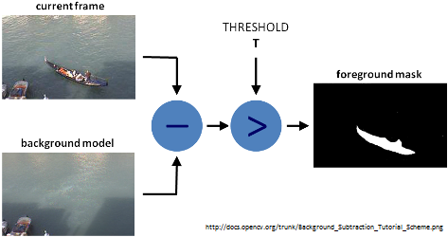
EXISTING SYSTEM
Background Subtraction: Background Subtraction is an efficient method to
separate foreground from background. To do this, we use the concept of running averages. We make our system look over a particular scene for 30 frames. During this period, we compute the running average over the current frame and the previous frames.

Slide 12
EXISTING SYSTEM
Motion Detection and Thresholding: To detect the hand region from this
difference image, we need to threshold the difference image, so that only our
hand region becomes visible and all the other unwanted regions are painted as
black. Thresholding is the assignment of pixel intensities to 0's and 1's based on a particular threshold level so that our object of interest alone is captured from an image.
Contour Extraction: After thresholding the difference image, we find contours in the resulting image. The contour with the largest area is assumed to be our hand. Contour is the outline or boundary of an object located in an image.

Slide 13
EXISTING SYSTEM
Different approaches which are followed for Facial Expression and Hand Gesture Recognition
Neural Network Approach
Principal of Component Analysis
Support Vector Machine

Slide 14
PROPOSED SYSTEM
To Classify facial expression into seven categories and identify hand gestures using algorithm based on Convolution Neural Network.
User is able to provide the input from the webcam and the system based on its trained data is able to correctly predict the output

Slide 15
SYSTEM ANALYSIS AND REQUIREMENTS
Relevance of Platform: OpenCV is a cross-platform library using which we can develop real-time computer vision applications.
Relevance of Programming Language: Python is a powerful and object-oriented high-level programming language. It has very simple easy-to-use syntax.
Scope and Boundary of the project

Slide 16
SYSTEM ANALYSIS AND REQUIREMENTS
Functional Requirements:
Software Requirements: Python, Anaconda, OpenCV, Tensorflow
Hardware Requirements: OS, RAM, Processor, Processor Speed
Non Functional Requirements:
Performance
Flexibility
User-Friendly
Response Time
Understandability

Slide 17
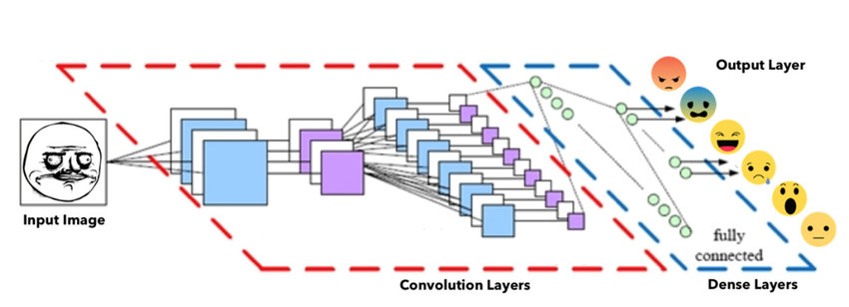
SYSTEM DESIGN
High level design architecture
CNN Architecture

Slide 18
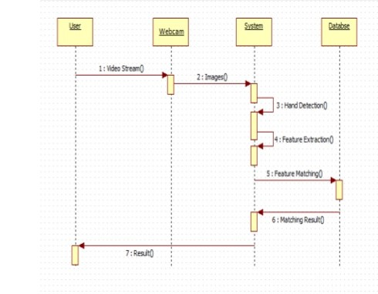
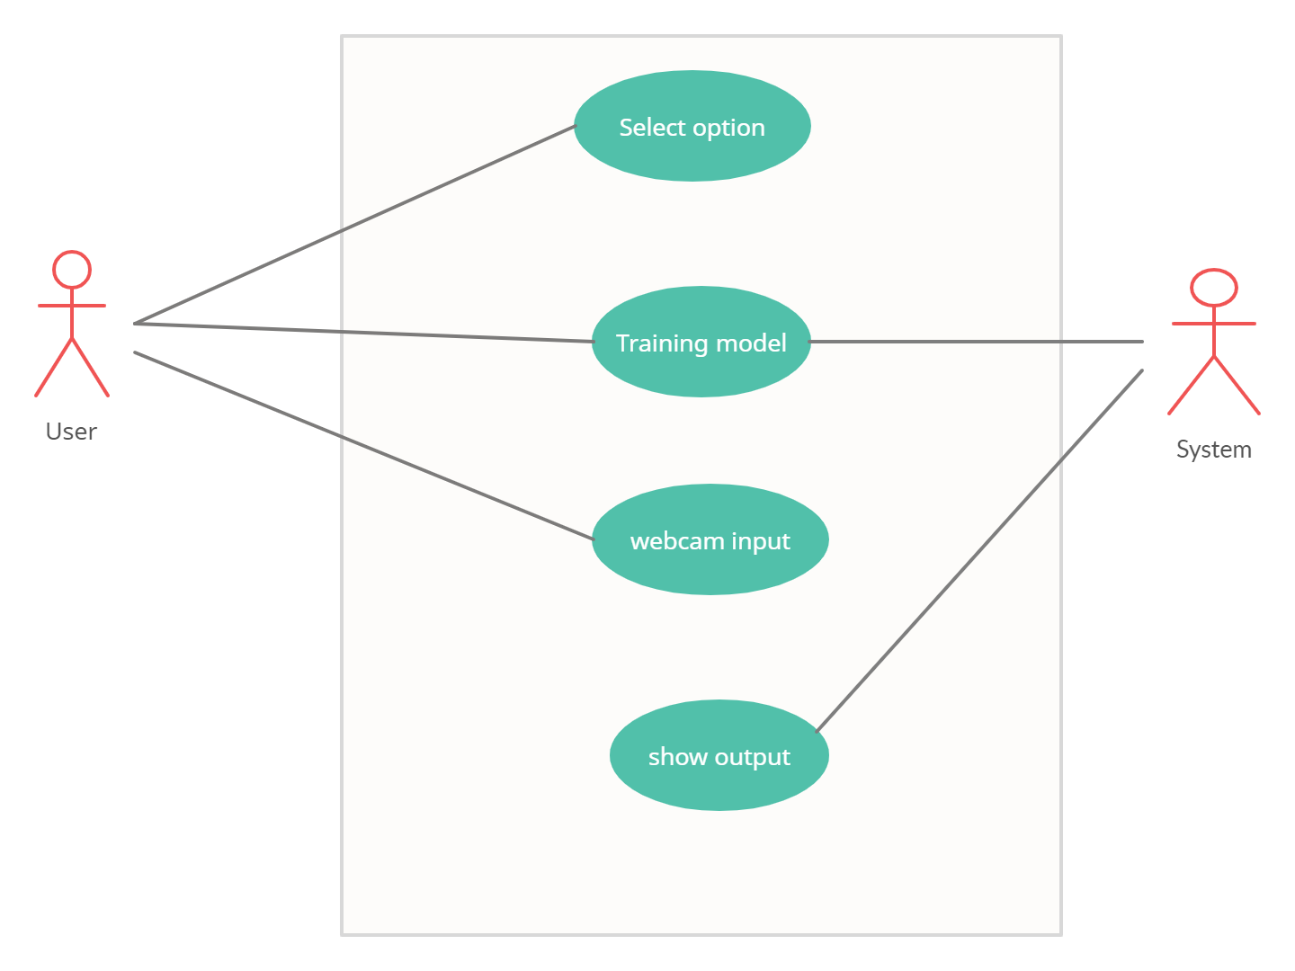
SYSTEM DESIGN
Low level design architecture
Sequence Diagram
Use case Diagram

Slide 19
Thank You

