Slide 1
Capgemini
❄ Snowflake
Unified Enterprise AI Agents Platform
Self-Service Analytics • Document Intelligence • Data Quality Root Cause
All in one conversational AI agent, built natively on Snowflake Cortex
Capgemini × Snowflake Hackathon
Presented by Kiran Kumar Rajoju & Raza Hussain

Slide 2
Agenda
Capgemini
❄ Snowflake
▸ The Problem — three specialists, three tools, too slow
▸ The Solution — one unified conversational agent
▸ Architecture — how it's built, natively on Snowflake
▸ Live Capabilities — Analytics, Document Q&A, Data Quality
▸ Unified Orchestration — one chat box, automatic routing
▸ Dashboards & MCP Integration — usage, trust, and extensibility
▸ Business Value & Judging Criteria
Unified Enterprise AI Agents Platform | Capgemini x Snowflake Hackathon
2

Slide 3
The Problem
Business users at an insurer need answers from three different places — and today,
that means three different specialists.
📊
📄
🛡
SQL / BI Analyst
Document Reviewer
Data Engineer
"What's our average loss ratio
by policy type?"
"Does this policy cover
water damage?"
"Why did this data quality
check fail?"
Structured data: policies,
claims, billing
Unstructured PDFs and
contracts
DQ rules, results,
and logs
Slow, siloed, and dependent on whoever happens to be available.
Unified Enterprise AI Agents Platform | Capgemini x Snowflake Hackathon
3

Slide 4
The Solution
One conversational agent that replaces all three specialists —
built entirely with native Snowflake Cortex features.
📊 Self-Service Analytics
Cortex Analyst turns plain English into governed SQL
against a native SEMANTIC VIEW.
📄 Document Q&A (RAG)
Cortex Search auto-embeds and indexes policy documents
— no external vector database.
🛡 Data Quality Root Cause
A second semantic view lets business users ask “why did
this fail?” and get a real answer.
One chat box. One agent. Automatic routing between all three.

Slide 5
Architecture
Streamlit-in-Snowflake — Chat UI
ENTERPRISE_AI_AGENT
Snowflake Cortex Agent • auto-orchestration
AnalyticsAgent
DocumentQA
DataQualityAgent
Cortex Analyst
(text-to-SQL)
Cortex Search
(RAG)
Cortex Analyst
(text-to-SQL)
ANALYTICS_SEMANTIC_VIEW
POLICY_DOCUMENT_SEARCH_SVC
DQ_SEMANTIC_VIEW
Everything runs natively inside Snowflake — one governance boundary, no data leaves the
account, no external vector DB or orchestration service required.
Unified Enterprise AI Agents Platform | Capgemini x Snowflake Hackathon
5

Slide 6
📊
Agent 1 — Self-Service Analytics
Structured data, answered in plain English
▸ Native SEMANTIC VIEW over 6 operational tables — customers, policies, claims, billing, agents, at-risk policies
▸ Business-friendly metrics: loss ratio, total premium, fraud claim count, revenue at risk, churn probability
▸ Cortex Analyst translates the question into governed SQL — shown inline for full transparency
▸ Relationships declared explicitly, so joins are always correct
Example question
“What's our average loss ratio by policy type?”
Verified live: Life ~57.5%, Health/Home ~55.4%, Auto ~53.1%
— all computed from real generated SQL, not canned data.
Unified Enterprise AI Agents Platform | Capgemini x Snowflake Hackathon
6

Slide 7
📄
Agent 2 — Document Q&A (RAG)
Ask questions of unstructured policy documents
▸ Policy documents chunked with SNOWFLAKE.CORTEX.SPLIT_TEXT_RECURSIVE_CHARACTER
▸ A CORTEX SEARCH SERVICE indexes chunk text with auto-managed embeddings — no external vector DB
▸ Answers cite the source document, so business users can verify, not just trust
▸ Filterable by policy ID, document type, and title
Example question
“What are the exclusion clauses for water damage in the Homeowners policy?”
Verified live: correctly distinguished that flood is excluded,
while general water damage (e.g. burst pipes) is not.
Unified Enterprise AI Agents Platform | Capgemini x Snowflake Hackathon
7

Slide 8
🛡
Agent 3 — Data Quality Root Cause
Conversational root-cause analysis, not a dashboard
▸ A second SEMANTIC VIEW over DQ_RULES, DQ_RESULTS, DQ_COLUMN_HEALTH, and DQ_SCORES
▸ Turns “why did this fail?” into an evidence-backed answer, not a support ticket
▸ Cites the exact rule, pass rate, and threshold that triggered the failure
▸ Replaces manually opening a DQ dashboard and cross-referencing rule logs
Example question
“Why did the DQ check on CUSTOMERS.EMAIL fail?”
Verified live: identified the UNIQUE_CUSTOMER_EMAIL rule,
94% pass rate vs. 99% threshold, root cause = duplicate emails.
Unified Enterprise AI Agents Platform | Capgemini x Snowflake Hackathon
8

Slide 9
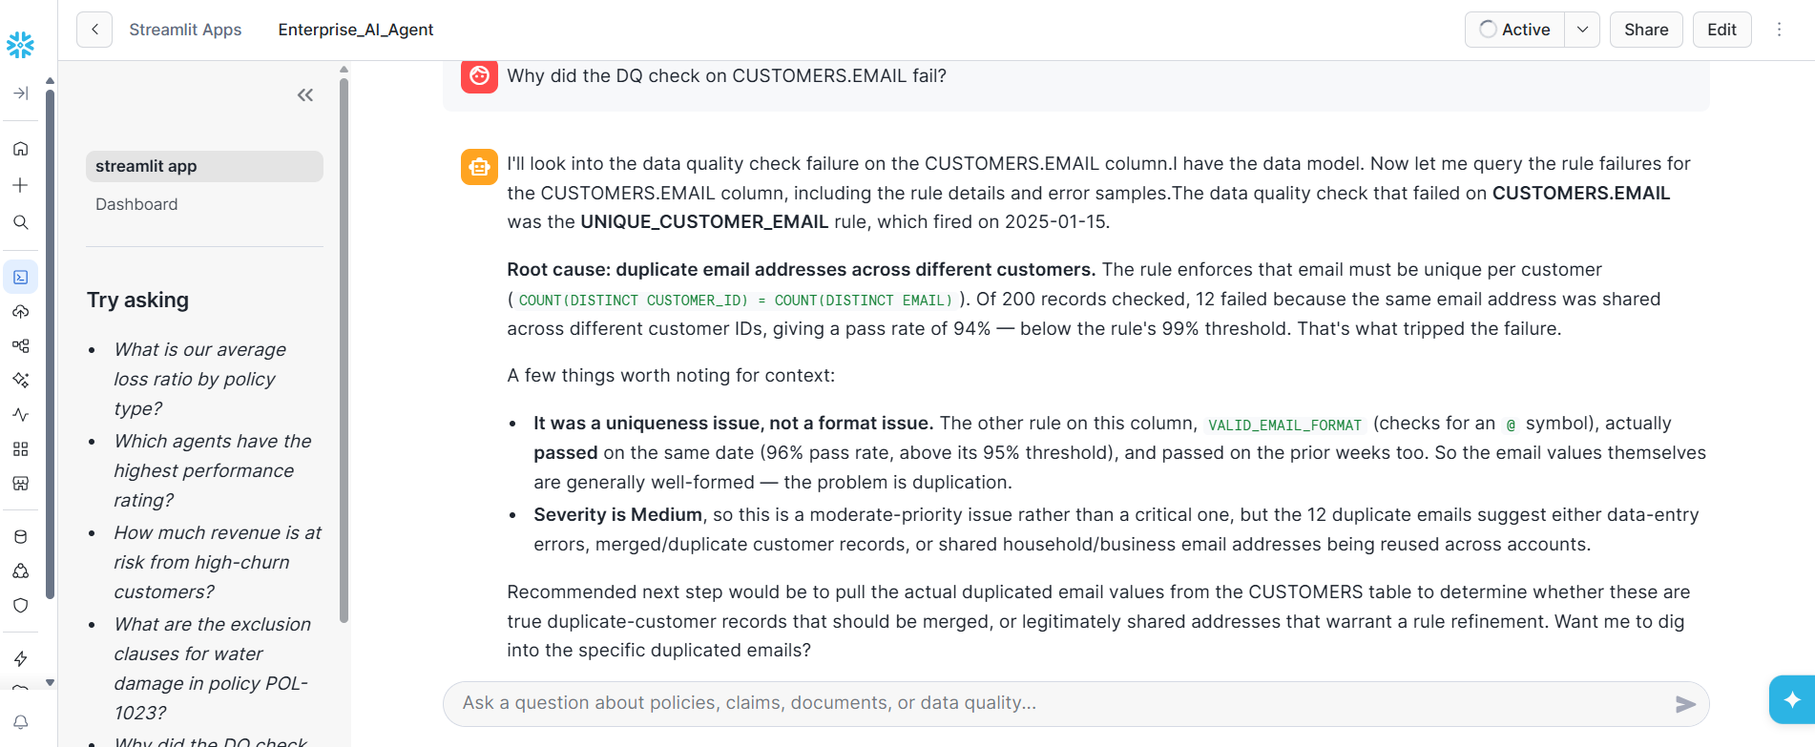
Live Proof — Data Quality Root Cause
Unified Enterprise AI Agents Platform | Capgemini x Snowflake Hackathon
9

Slide 10
Unified Orchestration
This is the “Unified” in the project name — not three separate demos, but one agent
that decides for itself which capability to use.
One chat box.
The user never picks a tool — they just ask a question, in plain English.
Automatic routing.
Cortex Agents' orchestration model decides per-question which tool(s) to invoke.
Full transparency.
Every answer shows a caption — e.g. “via 📊 Self-Service Analytics” — so it's always
clear which capability actually answered.
Auditable by design.
Generated SQL and document citations are shown inline, so every answer can
be independently verified.
Unified Enterprise AI Agents Platform | Capgemini x Snowflake Hackathon
10

Slide 11
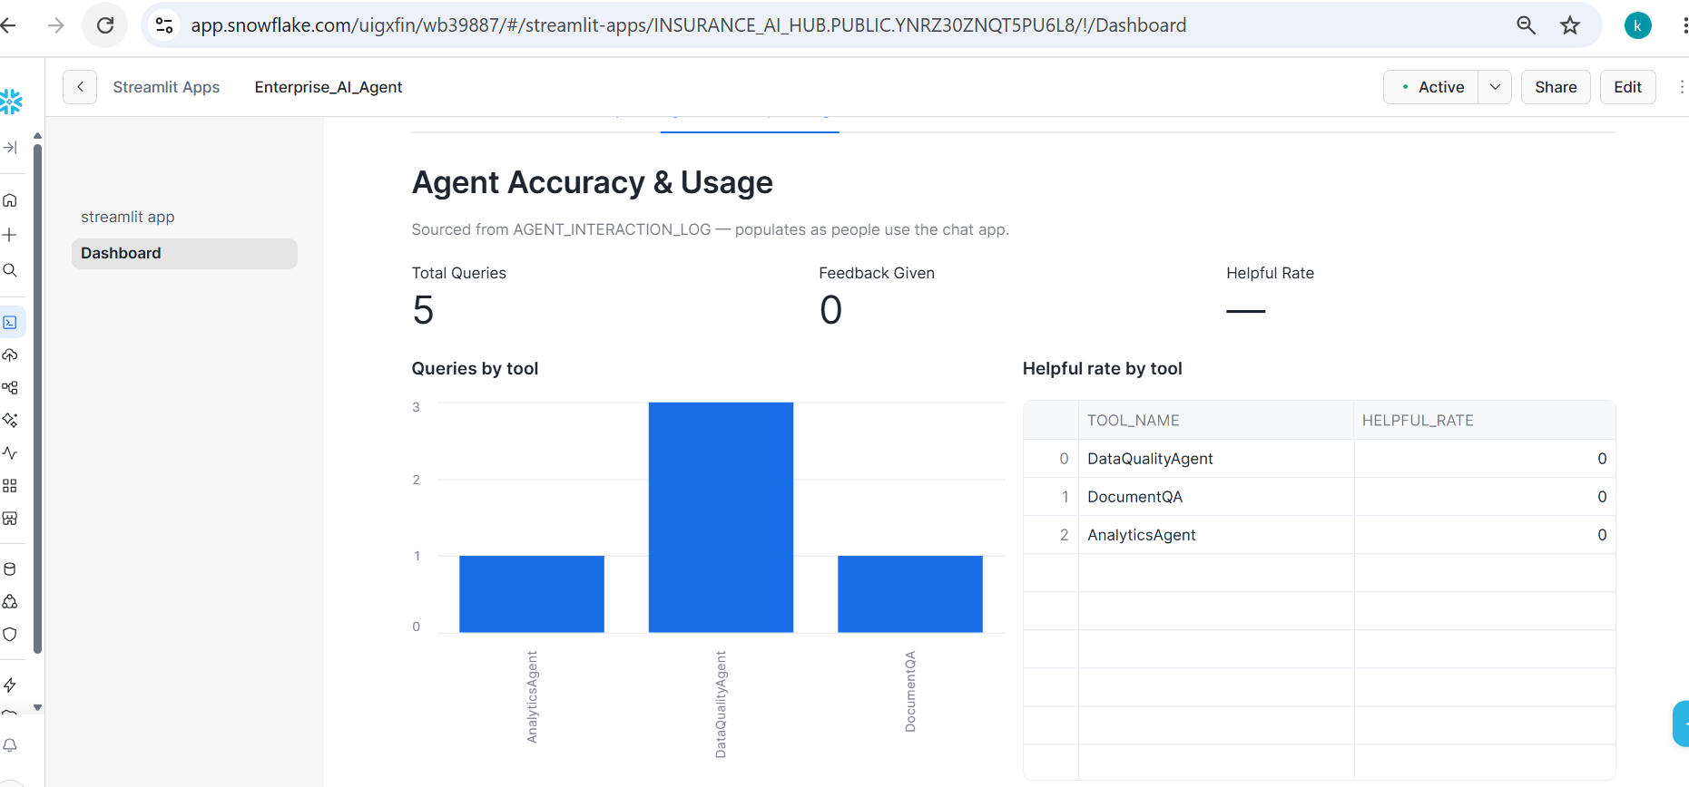
Dashboards & MCP Integration
Snowflake Intelligence Dashboards
▸ Portfolio & Risk — premium, loss ratio, revenue at risk by policy type and region
▸ Trend Analysis — month-over-month claims, fraud, and churn
▸ Agent Accuracy & Usage — query volume and 👍/👎 helpful rate per tool, live from every chat interaction
MCP Integration
▸ ENTERPRISE_AI_AGENT exposed as a Model Context Protocol server — any MCP client (Claude, Cursor, etc.) can query it directly
▸ Tested and verified live end-to-end with Claude's Connectors UI via OAuth — real questions, real executed answers
Unified Enterprise AI Agents Platform | Capgemini x Snowflake Hackathon
11

Slide 12
Business Value & Judging Criteria
Innovation
30%
One governed agent spanning structured, unstructured, and
meta (data-quality) data — not three disconnected demos.
Technical Excellence
25%
Native SEMANTIC VIEW, CORTEX SEARCH SERVICE, and AGENT
objects — no hand-rolled RAG or orchestration code.
Business Value
25%
Collapses three specialist workflows (SQL analyst, document
reviewer, DQ engineer) into one self-service chat experience.
User Experience
20%
One chat box; every answer is explainable — SQL shown,
sources cited — so business users can trust and verify it.
Unified Enterprise AI Agents Platform | Capgemini x Snowflake Hackathon
12

Slide 13
Capgemini
❄ Snowflake
Thank You
Questions?
Kiran Kumar Rajoju • Raza Hussain
github.com/kirangithub9/Insurance_AI_Hub

