Slide 1


WatchaFlick

Slide 2







Meet the WatchaFlick Team
Kiran Gurunath Naik
Back-End Developer
Sreyas Anil Sawant
Front-End Developer
Diksha Singh
Back-End Developer
Onkar Subodh Jadhav
Front-End Developer
Jarrin Kolbe Smith
Back-End Developer
Sreshta Reddy N
Front-End Developer
Chirantana Krishnappa
Front-End Developer
(Team Lead)

Slide 3
Our Project
01
02
03
04
Booking Management
Safety
Save customers time and money.
Provides a safe and faster platform.
Admin Features
Convenience
Admin dashboard for business use.
To help make booking easy!

Slide 4



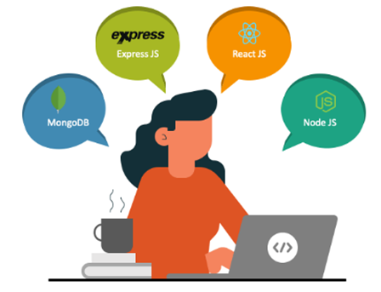
Tech Stack
Front-End
React JS
Back-End
Node JS
Database
MongoDB

Slide 5
Sprint 1
FronT-END
The team worked on implementing Google Authentication and creating a homepage for the frontend. They also created user stories.
Back-end
Worked on our login feature for backend as well as register

Slide 6
Sprint 2
Front-END
The team worked on several components of the project including Google Authentication, homepage, register and login functionality for both customers and admins, as well as the admin dashboard layout and database integration.
Back-end
The team worked on implementing Facebook authentication, forgot password, login and register functionality for both frontend and backend, update password feature for backend, management login for backend, and login for customers and admins on both frontend and backend.

Slide 7
Sprint 3
Front-END
The team integrated data for the management dashboard, added a search feature for the frontend, updated the UI for login and registration, ensured users were directed to the home page upon login, and implemented seat selection and availability.
Back-end
The team worked on database schema search functionality, AWS deployment, Facebook authentication, forgot password, and seat selection.

Slide 8
Sprint 4
Front-END
The team made UI changes, implemented error messages and routing, updated the login page, and worked on the forgot password feature. They also worked on the search bar and movie display for the customer homepage, and revamped the dashboard.
Back-end
The team worked on populating data for the admin dashboard, fetching booking details, implementing a search function for the database, and integrating a payment gateway. They also worked on implementing the forgot password feature for both mobile and email.

Slide 9
Sprint 5
Front-END
The team worked on developing the customer dashboard, implementing a chatbot and customer support dashboard, and integrating a filter. They also worked on adding various features to the chatbot.
Back-end
The team worked on adding movies to the database, developing the backend for the admin dashboard and integrating the payment gateway. They also worked on AWS solutioning, payment testing, and implementing promotional offers.

Slide 10


Challenges
Communication due to busy schedules
Learning everything with such a time crunch
Making time
Integration issues
Project deployment

Slide 11

Solutions
Made front and backend GitHub repositories so they could communicate better
Watched YouTube videos and shared together
Used when2meet for scheduling meetings
Used GitHub to address merge requests to fix integration issues
Followed Iterative development approach

Slide 12
Things Learned
Software Project
Teamwork
Time
How a software project is executed
Communication and reliability
How to manage and make time
Backend & Frontend
Documentation
Technologies
How backend and frontend work
How important it is to document
How to use GitHub and JIRA

Slide 13

Future Changes
Some things we would change are having a group with similar schedules so communication is easier.
Not adding deliverables that couldn't be completed by the end of the sprint
Clearer communication at the beginning of each week.
Follow a burn-down chart for better tracking of progress.

Slide 14
Do you have any questions?
Reach us out?
Thanks!
Watchaflicks@gmail.com
FILMS INSPIRING HOPE
RETRO CINEMA
18543

