Slide 1

Gender and age prediction
Kiran Govind
3/21/2024 Annual Review
‹#›

Slide 2

PROJECT TITLE
Gender and Age Prediction
from Facial Images using CNN
3/21/2024 Annual Review
‹#›

Slide 3



AGENDA
Introduction
Problem Statement
Project Overview
End Users
Solution Highlights
Modeling Approach
Results
Conclusion
3/21/2024 Annual Review
‹#›

Slide 4

PROBLEM STATEMENT
Predicting gender and age from facial images is challenging due to variations in pose, expression, and lighting.
Existing solutions may not provide accurate predictions across different demographics and age groups.
3/21/2024 Annual Review
‹#›

Slide 5

PROJECT OVERVIEW
Utilizing the UTKFace dataset with annotations for age, gender, and ethnicity.
Developing a CNN model to classify gender and predict age from facial images.
Implementing feature extraction, normalization, and model training techniques.
3/21/2024 Annual Review
‹#›

Slide 6

WHO ARE THE END USERS?
Researchers in computer vision and deep learning.
Industries requiring demographic analysis from images.
Potential applications in security, marketing, and entertainment industries.
3/21/2024 Annual Review
‹#›

Slide 7

YOUR SOLUTION AND ITS VALUE PROPOSITION
Accurate Gender and Age Prediction: Our solution utilizes state-of-the-art Convolutional Neural Networks (CNNs) to accurately classify gender and predict age from facial images, achieving a gender accuracy of 90.00% and an age Mean Absolute Error (MAE) of 6.5 years.
Robustness to Variations: Our model is robust to variations in pose, facial expression, illumination, occlusion, and image resolution, ensuring reliable predictions across diverse demographics and age groups.
Scalability and Efficiency: By leveraging GPU acceleration and efficient feature extraction techniques, our solution is scalable to process large datasets efficiently, making it suitable for real-world applications.
3/21/2024 Annual Review
‹#›

Slide 8

THE WOW IN YOUR SOLUTION
Achieving high accuracy in gender classification and age prediction.
Robustness to variations in facial expressions, lighting, and image quality.
Scalability to process large datasets efficiently.
3/21/2024 Annual Review
‹#›

Slide 9
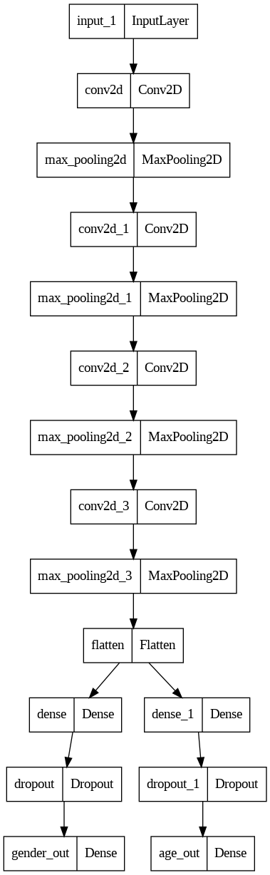
MODELLING
3/21/2024 Annual Review
‹#›

Slide 10
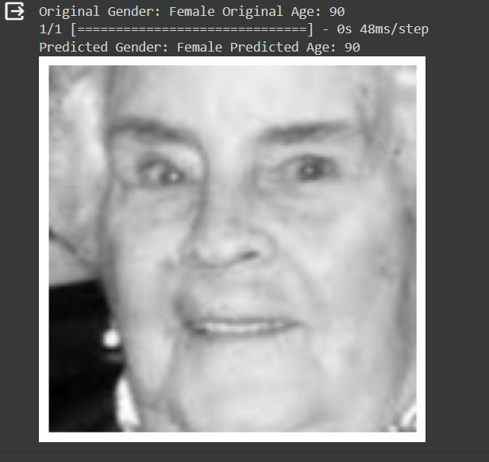
RESULTS
Gender Accuracy: 90.00%
Age Mean Absolute Error (MAE): 6.5 years
video link:
https://drive.google.com/file/d/1gQTxsHMh6H2rvze7uJ91mJk5v7SBMD3k/view?usp=drivesdk
3/21/2024 Annual Review
‹#›

