Slide 1
Rossmann Store Sales Forecasting
Task 1 — Exploration of Customer Purchasing Behaviour
Exploratory Data Analysis (EDA)
NextHikes IT Solutions
Presented by: Kiran Jadoun
ROSSMANN STORE SALES FORECASTING | TASK 1: EDA
01

Slide 2
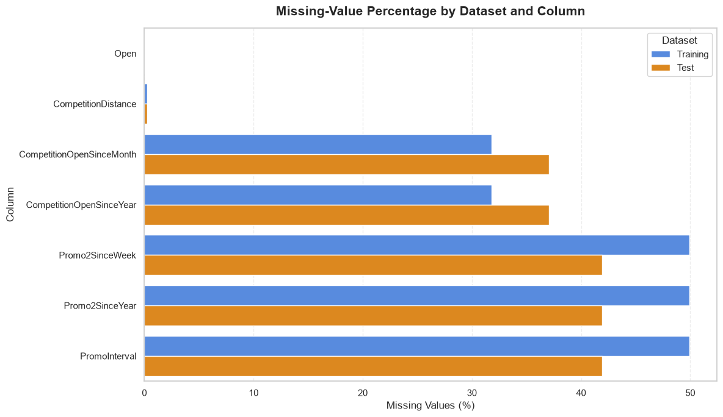
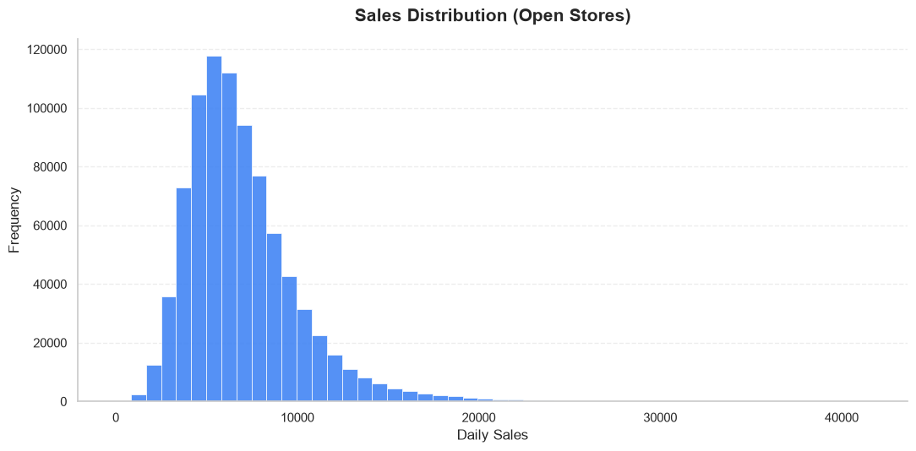
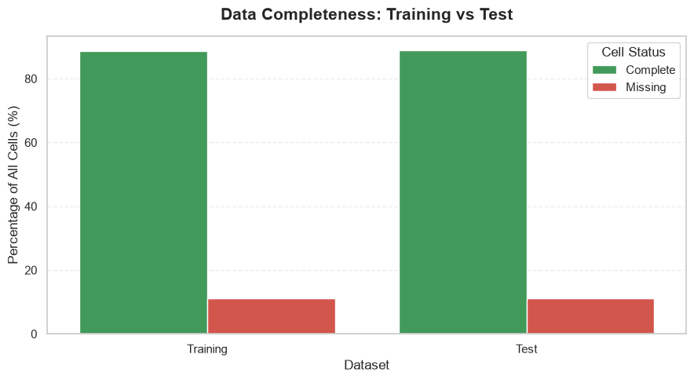
01 | DATASET & DATA QUALITY
Data coverage and quality checks
The EDA notebook checks dataset structure, missing values, duplicates and numerical outliers before interpretation.
Missing-value percentage by feature
Sales distribution: numerical outlier investigation
Data completeness: training vs test
TRAINING DATA
TEST DATA
DATA COMPLETENESS
1,017,209 records
41,088 records
≈88.75% / ≈88.88%
Historical records containing Sales and Customers.
Test records do not provide Sales or Customers.
Training / test; percentages cover all dataset cells.
Notebook findings: missing values are concentrated in CompetitionDistance and Promo2-related metadata. Promo2 metadata is missing when Promo2 = 0 and is generally structurally non-applicable. No exact duplicate rows or duplicate Store–Date combinations were detected in either dataset. Outliers were investigated using the IQR method; original values were preserved and no observations were deleted or modified. Missing Open values in the test data require careful treatment before forecasting.
ROSSMANN STORE SALES FORECASTING | TASK 1: EDA
02

Slide 3
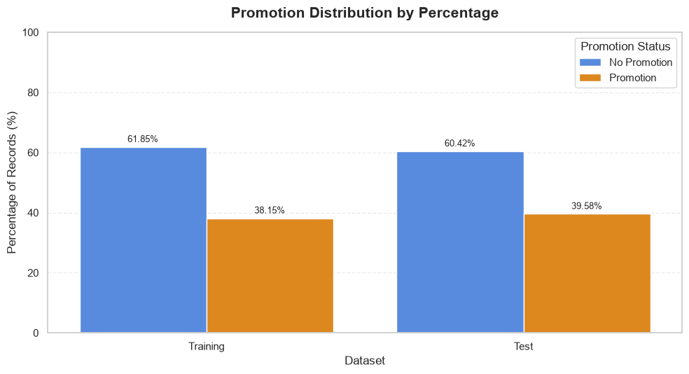
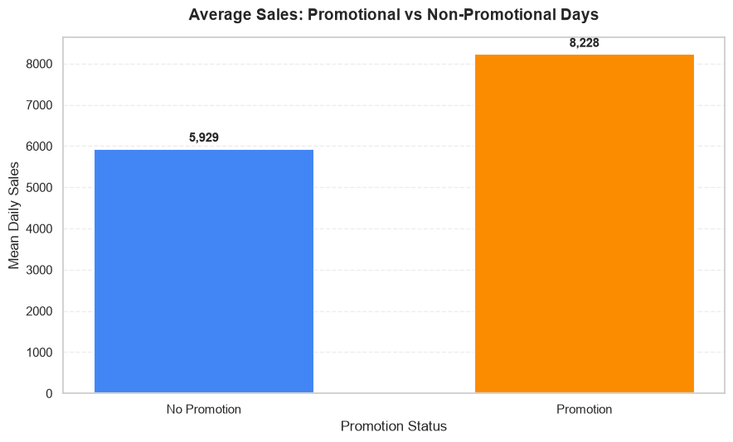
02 | PROMOTION DISTRIBUTION & IMPACT
Promotion frequency is similar in training and test data
The notebook separates promotion frequency from the observed association between promotions, Sales and Customers.
Promotion distribution by dataset (%)
Mean Sales: non-promotional vs promotional records
PROMO SHARE
MEAN SALES
MEAN CUSTOMERS
38.15% / 39.58%
8,228.28 vs 5,929.41
844.43 vs 696.86
Training / test; difference = 1.43 percentage points.
Promo vs non-promo; observed increase ≈38.77%.
Promo vs non-promo; observed increase ≈21.18%.
Exact counts: training — 629,129 non-promo (61.85%) and 388,080 promo (38.15%); test — 24,824 non-promo (60.42%) and 16,264 promo (39.58%). Median Sales: 7,649 promo vs 5,459 non-promo; median Customers: 757 vs 610. Store-level paired analysis: all 1,115 stores had both conditions; mean store-level Sales uplift 41.43% (median 40.56%), Customers uplift 23.84% (median 22.66%); positive uplift in Sales 1,114/1,115 stores and Customers 1,101/1,115. Descriptive, not causal.
ROSSMANN STORE SALES FORECASTING | TASK 1: EDA
03

Slide 4
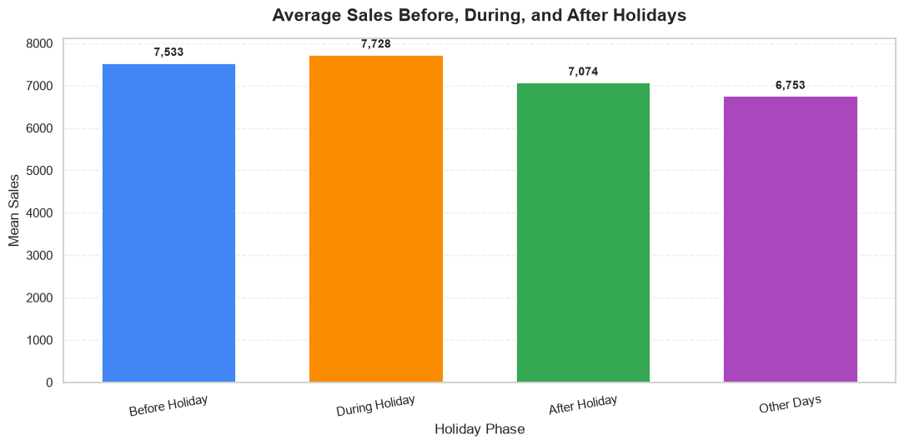
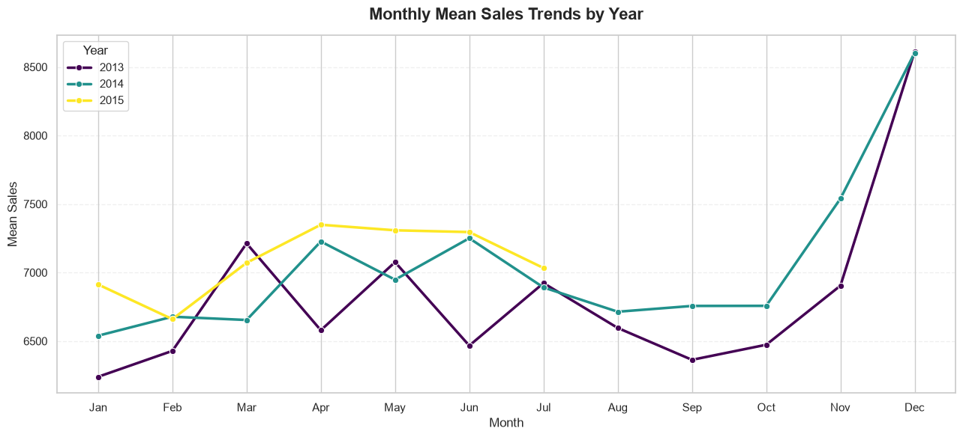
03 | HOLIDAY & SEASONAL BEHAVIOUR
Observed demand is higher around holidays and key seasonal periods
Comparisons use open-store training records; group sizes and calendar composition differ.
Mean Sales before, during and after state holidays
Monthly mean Sales trend by year
STATE HOLIDAY
CHRISTMAS (DEC 20–31)
EASTER WINDOW
7,728.29 vs 6,752.60
7,977.34 vs 6,904.41
7,654.74 mean Sales
Mean Sales during holiday vs other days (+14.45%).
Mean Sales during Christmas vs other days (+15.54%).
7 days before through 7 days after Easter (+10.87%).
Before holidays: mean Sales 7,533.11 (+11.56%); after holidays: 7,074.08 (+4.76%). Mean Customers: holidays 893.80, before 807.54, after 773.79, other days 745.18. December had highest monthly mean Sales in 2013 (8,613.46) and 2014 (8,603.81); 2015 covers Jan–Jul only. Christmas Customers: 861.90 vs 758.00 (+13.71%); Easter Customers: 825.13 (+8.86%).
ROSSMANN STORE SALES FORECASTING | TASK 1: EDA
04

Slide 5
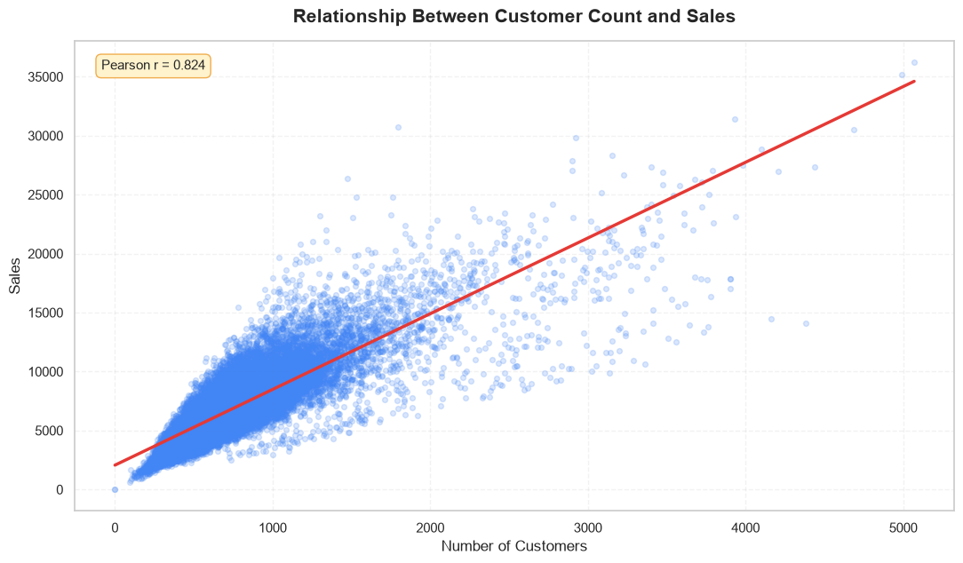
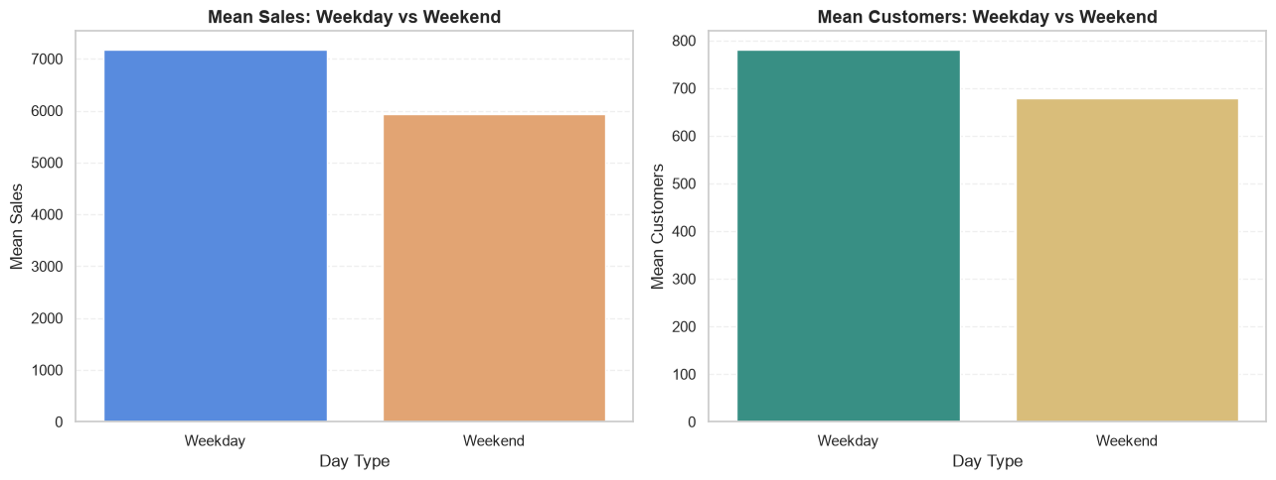
04 | CUSTOMER TRAFFIC & WEEKLY PATTERNS
Sales are strongly associated with Customers; weekday averages are higher
The correlation analysis and weekday/weekend comparison use 844,392 valid open-store records.
Sales vs Customers: historical open-store observations
Mean Sales by day of week
CORRELATION
WEEKDAY vs WEEKEND SALES
WEEKDAY vs WEEKEND CUSTOMERS
0.8236 / 0.8319
7,172.41 vs 5,932.02
780.43 vs 679.19
Pearson / Spearman between Sales and Customers.
Weekend mean Sales ≈17.29% lower.
Weekend mean Customers ≈12.97% lower.
Monday mean Sales: 8,216.07; Saturday: 5,874.84; Sunday: 8,224.72 from only 3,593 open-store records (interpret cautiously). Only 10/1,115 stores were open on every observed Monday–Friday. Their weekend mean Sales was 11,627.11 vs 5,826.74; Customers 2,215.32 vs 650.79; weekend opening rates 100.00% vs 50.55%. Small group size limits generalisation. Daily data has no exact intraday opening/closing times. Future test Customers are unavailable and cannot be used as direct future Sales inputs.
ROSSMANN STORE SALES FORECASTING | TASK 1: EDA
05

Slide 6
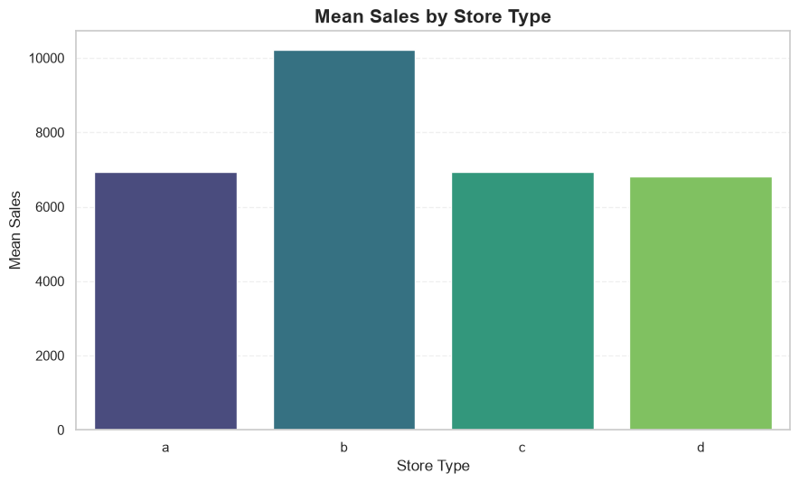
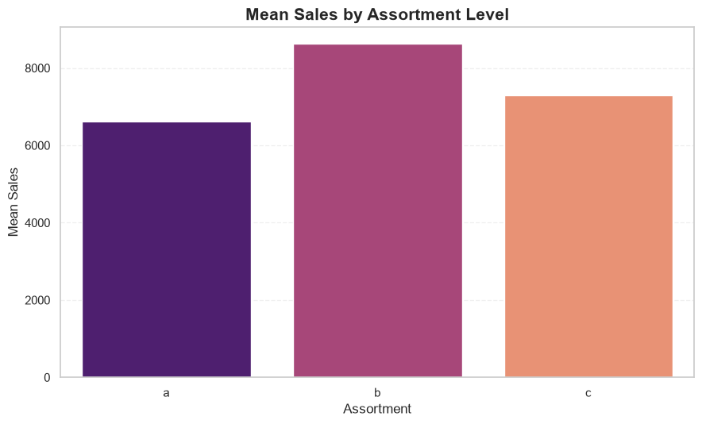
05 | STORE TYPE & ASSORTMENT
Sales averages differ across store types and assortment levels
Interpret averages alongside the number of stores represented in each group.
Mean Sales by Store Type
Mean Sales by Assortment Level
STORE TYPE B
ASSORTMENT C
ASSORTMENT B
10,231.41 mean Sales
7,300.53 mean Sales
8,639.35 mean Sales
Highest store-type average; 17 stores, 15,563 open-store records.
Highest mean among assortment groups with broad coverage.
Highest assortment mean; only 9 stores.
Store Type means: B 10,231.41; C 6,932.51; A 6,925.17; D 6,822.14. Type B mean Customers: 2,021.82. Assortment A mean Sales: 6,621.02. Store Type B + Assortment C: 17,969.56 across 1 store; Type A + Assortment C: 7,573.38 across 221 stores; Type D + Assortment C: 7,043.36 across 220 stores. Small groups limit generalisation.
ROSSMANN STORE SALES FORECASTING | TASK 1: EDA
06

Slide 7
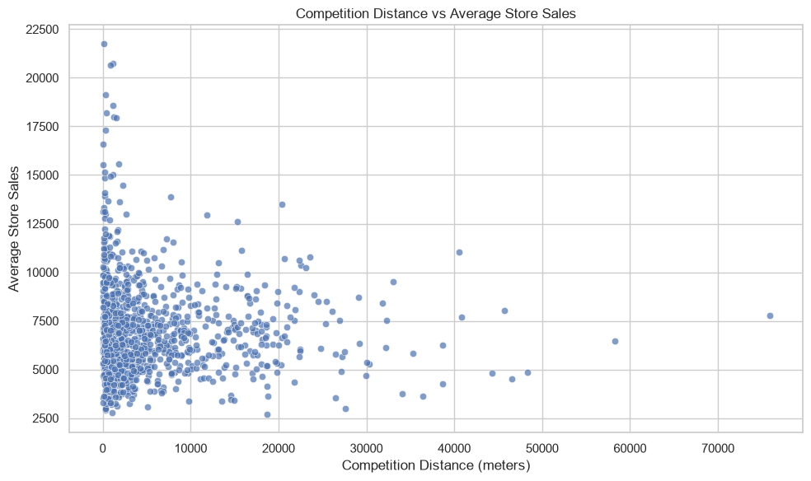
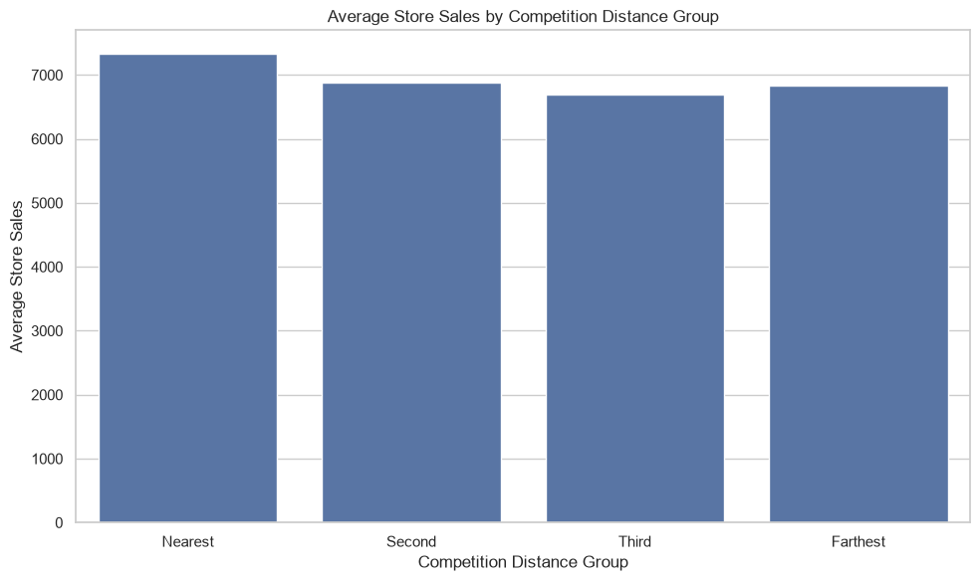
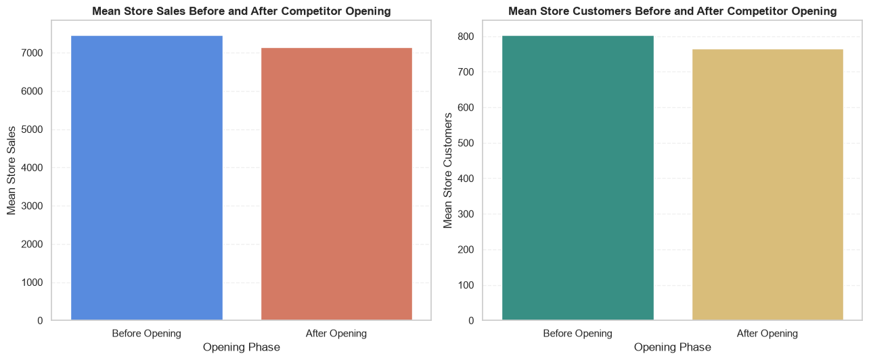
06 | COMPETITION DISTANCE & COMPETITOR OPENING
Competition distance is weakly related to Sales; competitor-opening evidence is limited
Store-level averages and approximate competitor opening month/year are used in this exploratory analysis.
Competition Distance vs average store Sales
Mean Sales by Competition Distance group
Mean Sales & Customers before/after competitor opening
DISTANCE CORRELATION
COMPETITION DISTANCE
COMPETITOR OPENING
−0.0424 / −0.0280
1,112 / 1,115 stores
188 paired stores
Pearson / Spearman with average store Sales.
3 stores missing: 291, 622 and 879.
Sales 7,466.30 → 7,137.26 (−4.41%).
Competition-distance groups: Nearest mean Sales 7,331.50; Second 6,881.74; Third 6,698.75; Farthest 6,841.75 (no consistent increasing/decreasing pattern). Competitor-opening comparison: mean Sales 7,466.30 → 7,137.26 (−4.41%); Customers 803.87 → 764.33 (−4.92%). Of 1,115 stores, 761 had opening month/year data and 354 did not; only 188 had both 12-month windows. No missing-to-available distance transition was found; Stores 291, 622 and 879 were missing throughout. No reopening date or city-centre coordinates/indicator are supplied. Findings are descriptive, not causal.
ROSSMANN STORE SALES FORECASTING | TASK 1: EDA
07

Slide 8
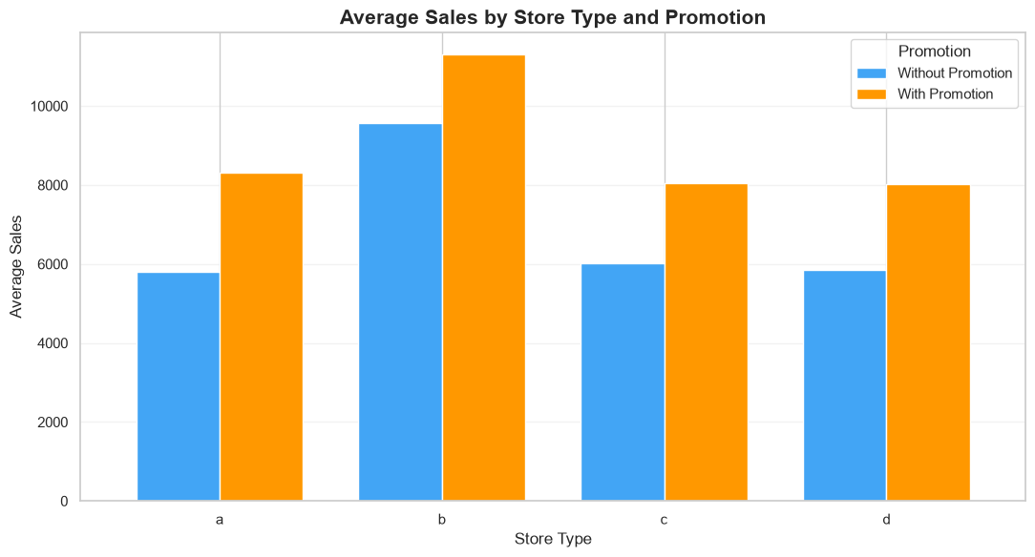
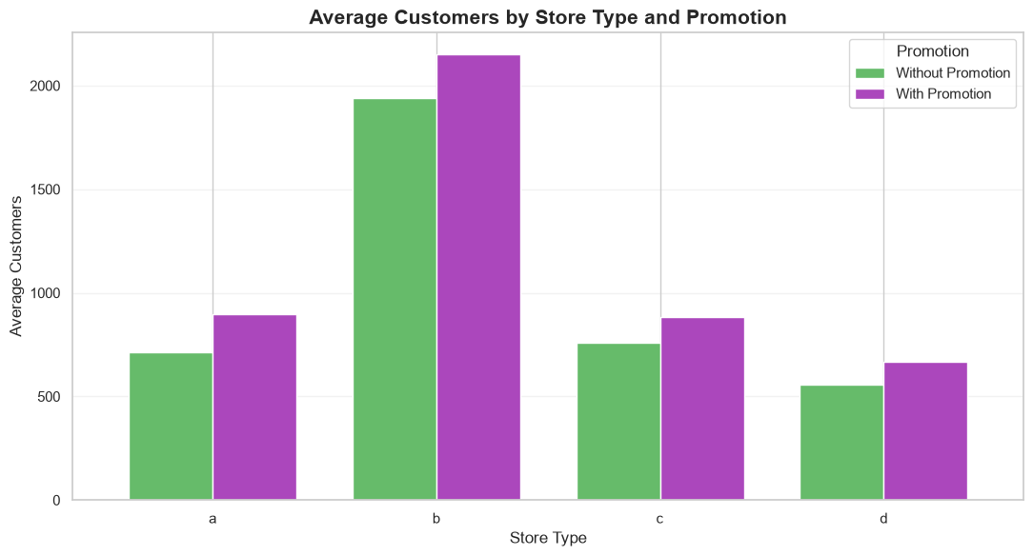
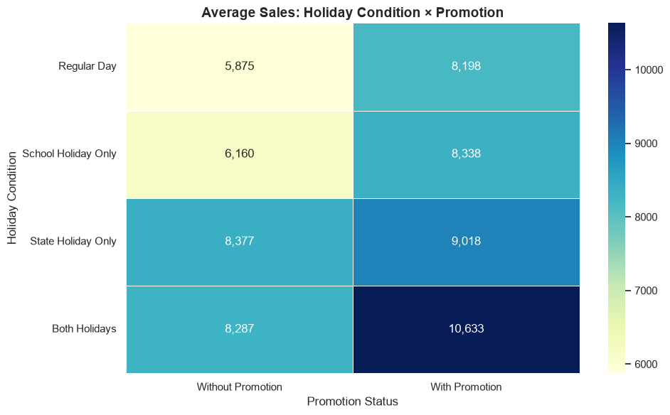
07 | PROMOTION SEGMENTATION & COMBINED ANALYSIS
Promotional uplift varies by store type and business conditions
The notebook also examines correlations and combined promotion, holiday and customer-traffic patterns.
Mean Sales by Store Type and Promotion
Mean Customers by Store Type and Promotion
Mean Sales: Holiday Condition × Promotion
Store-type uplift (Sales / Customers): A +42.96% / +25.53%; B +18.20% / +10.80%; C +33.41% / +16.66%; D +36.93% / +20.12%. Type B had the highest average Sales both without promotions (9,566.86) and with promotions (11,307.99), but the lowest percentage uplift.
Correlation with Sales (Pearson / Spearman): Customers +0.8236 / +0.8319; Promo +0.3681 / +0.4204; Promo2 −0.1276 / −0.1166; SchoolHoliday +0.0386 / +0.0382; CompetitionDistance −0.0364 / −0.0352; CompetitionDistance_missing −0.0242 / −0.0296. Correlation indicates association, not causation.
Combined analysis: 844,392 open-store observations — Regular Day 680,339; School Holiday Only 163,143; State Holiday Only 596; Both Holidays 314. Customer quartile groups: Low 211,939; Medium 211,208; High 211,005; Very High 210,240. Promo uplift is descriptive; promotional costs/profit margins are unavailable. Actual Customers-based groups are historical EDA only, not future forecast inputs.
ROSSMANN STORE SALES FORECASTING | TASK 1: EDA
08

Slide 9
Thank You
ROSSMANN STORE SALES FORECASTING | TASK 1: EDA
09

