Slide 1

Debt simplification CS 512 - FINAL PROJECT GROUP – 31
Submitted by:
DHRUVI LALIT JAIN DJ470
KANCHU KIRAN KK1219
SIDDHARTH DEVENDRA GUPTA SDG141
SHRADDHA SANJEEV PATTANSHETTI SP2304

Slide 2
PROBLEM STATEMENT
One of the main reasons to implement debt simplification is to reduce the tedious task of splitting the dues.
Moreover, the system reduces the number of transactions, making it more efficient to interpret while keeping the total amount intact.
They store and maintain user data and transaction details.

Slide 3
Algorithm used
The algorithm used to implement the debt simplification Project is Dinic’s Algorithm. It is a Maximum Flow Algorithm. Its run time is independent of the flow graph’s capacity value, which could be very large. It has a runtime of O (V² E). It tremendously increases the performance of bipartite graphs giving a time complexity of O((√VE)).
We perform BFS on the source and obtain a level graph. An edge is a part of the level graph if it follows the path to the sink. This means it must advance from one level to another after omitting back and side edges.

Slide 4
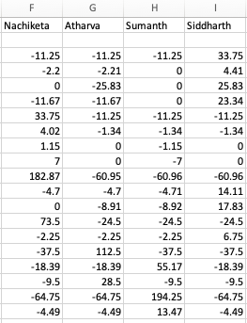
IMPLEMENTATION
Stepwise Procedure to minimize transactions:
STEP 1: The file is parsed a 3-tuple is created, which contains information regarding (the debtor, creditor, and amount). A directed edge is created from the debtor to the creditor, and a weight is assigned to it, equal to the amount owed by the debtor to the creditor, and graph G is generated.

Slide 5
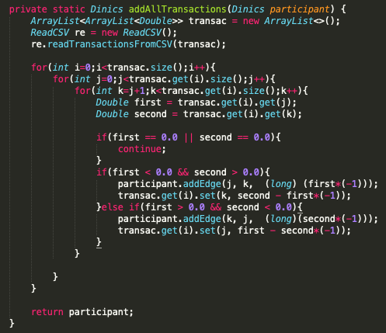
STEP 2: Initialize residual graph G as generated graph from the data parsed from a CSV file.

Slide 6
IMPLEMENTATION CONTINUED..
Step 3: Call Dinics for all pairs of vertices. Do BFS of G to construct a level graph (or assign levels to vertices) and check if more flow is possible.
Step 4: If more flow is not possible, then return
Step 5: Send multiple flows in G using a level graph until blocking flow is reached

Slide 7
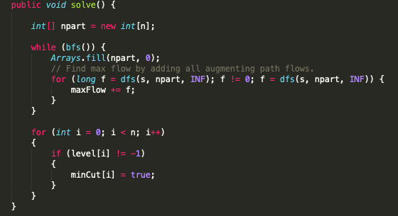
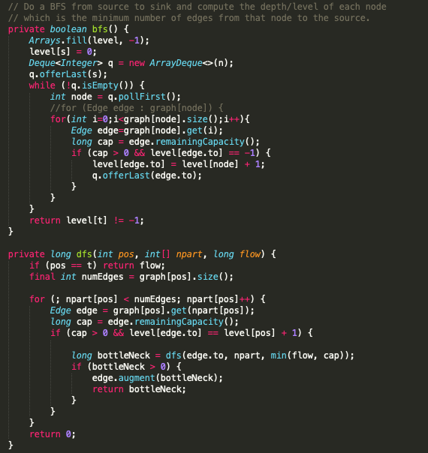
IMPLEMENTATION CONTINUED..
Dinic network solver code, which calls BFS from source to sink and computes the depth/level of each node:

Slide 8
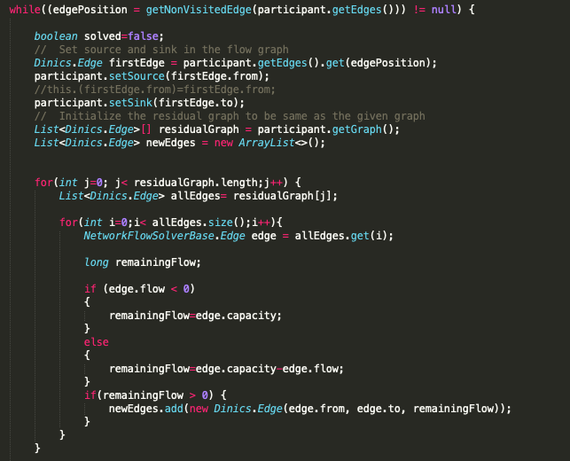
IMPLEMENTATION CONTINUED..
Here, using a level graph means, in every flow, levels of path nodes should be 0, 1, 2… (in order) from s to t.
A flow is Blocking Flow if no more flow can be sent using a level graph, i.e., no more s-t path exists such that path vertices have current levels 0, 1, 2… in order.

Slide 9
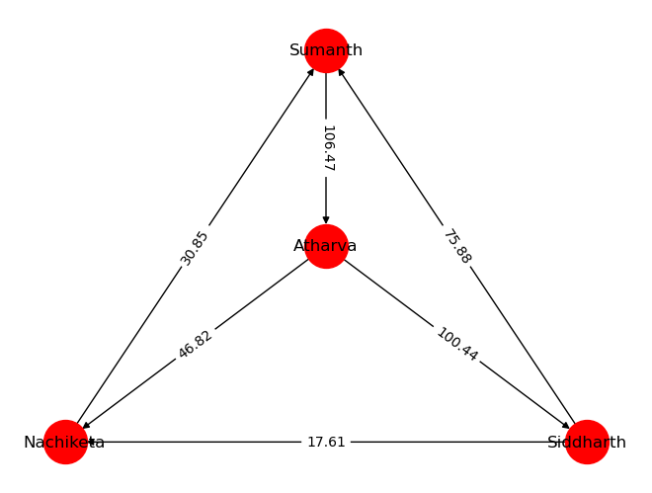
GRAPH CREATION
Graph is created with one directed edge for each transaction mentioned above. If there are multiple transactions from the same creditor to the same debtor, the weight is updated by adding the new amount.
We can see that vertices in the below graph denote the people involved in the transactions, and there is one vertex created for every person in the group.
A directed edge is created for each effective transition from the above transaction tuples, and the weight is updated accordingly.

Slide 10
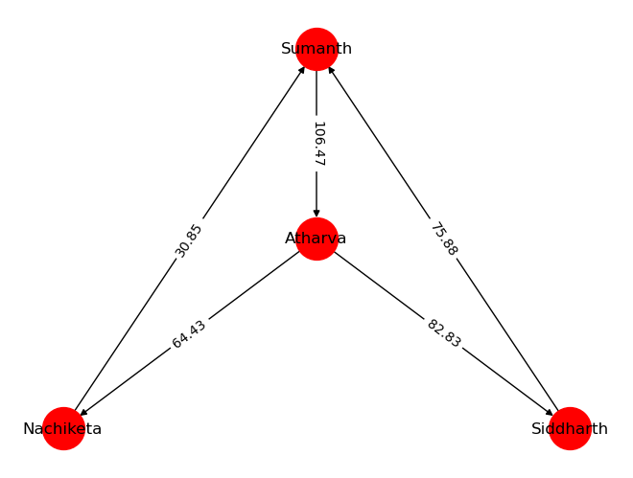
Transaction simplification using the Dinic Algorithm
After adjusting [‘Nachiketa’, ‘Atharva’, ‘Siddharth’] by -17.61

Slide 11
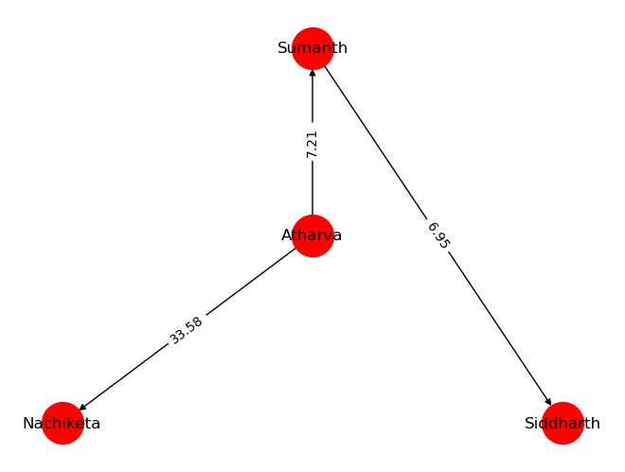
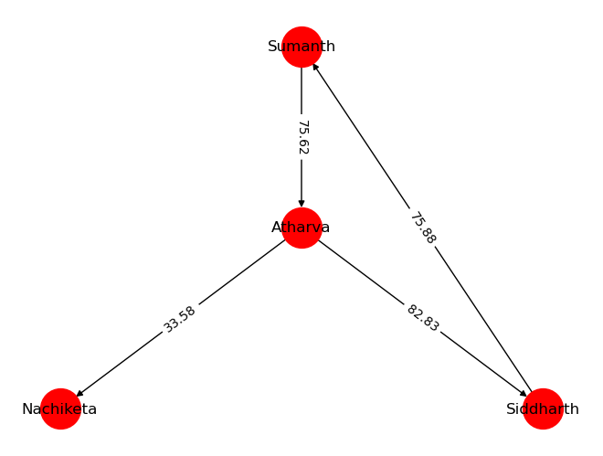
After adjusting [‘Nachiketa,’ ‘Sumanth,’ ‘Atharva'] by 30.85
After adjusting [‘Atharva,’ ‘Siddharth,’ ‘Sumanth'] by 82.83

Slide 12
FINAL OUTPUT
Atharva owes Nachiketa Prasad $ 33.58
Atharva owes Sumanth Tangirala $ 7.21
Sumanth Tangirala owes Siddharth Gupta $ 6.95

Slide 13
TIME COMPLEXITY OF ALGORITHM
Doing a BFS to construct a level graph takes O(E) time.
Sending multiple more flows until a blocking flow is reached takes O(VE) time.
The outer loop runs at-most O(V) time.
In each iteration, we construct a new level graph and find blocking flow. It can be proved that the number of levels increases at least by one in every iteration. So, the outer loop runs at most O(V) times.
Therefore, the overall time complexity is O(EV2)

Slide 14
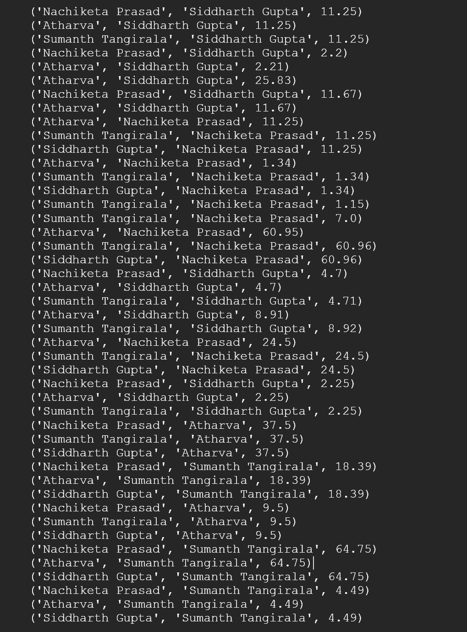
RESULTS AND ANALYSIS
The file is read and parsed, and (the debtor, creditor, and amount) are created and stored for graph edge creation. Below is a sample file read and tuple values:

Slide 15
CONCLUSION
People foot the bill for different expenses and need to get paid back later. Debt Simplification does all the bookkeeping for you, which helps you keep track of your debits and credits. Furthermore, it assists people in narrowing the complex task of splitting the bill among several people.
Many algorithms can be used to accomplish the task of implementing the application. A few are Karzanov, Galil, Tarjan, Bertsekas, Edmonds and Karp, Dinics, and many more. Of these, the Dinics algorithm is one of the best options in terms of Time complexity which is O(n²m).

