Slide 1

Kiran Kumar Reddy K
@kiranreddykasa

Slide 2
Agenda
Web Development and SPA
Intro to AngularJS
Getting Started with AngularJS
Directives, Filters and Data Binding
View, Controllers and Scope
Modules, Routes, Services
Integration with RESTful web service

Slide 3
Single-page Applications (SPA)
Web app that fits on a single web page
Fluid UX, like desktop app
Examples like Gmail, Google maps
Html page contains mini-views (HTML Fragments) that can be loaded in the background
No reloading of the page, better UX
Requires handling of browser history, navigation and bookmarks

Slide 4
Challenges in SPA
DOM Manipulation
How to manipulate the view efficiently?
History
What happens when pressing back button?
Routing
Readable URLs?
Data Binding
How bind data from model to view?
View Loading
How to load the view?
Lot of coding! You could use a framework instead ...

Slide 5
Enter Angularjs

Slide 6
Angular JS
Single Page App Framework for JavaScript
Implements client-side MVC pattern
Separation of presentation from business logic and presentation state
No direct DOM manipulation, less code
Support for all major browsers
Supported by Google
Large and fast growing community

Slide 7
Getting Started

Slide 8
Hello World
<html ng-app> <body> <div> <input type="text" ng-model="name" /> Hello {{name}} </div> </body> <script src="angular.min.js"></script> </html>
Directive
Directive
Expression
Loading angularjs script

Slide 9
Basic Concepts
1) Templates
HTML with additional markup, directives, expressions, filters ...
2) Directives
Extend HTML : ng-app, ng-bind, ng-model
3) Filters
Filter the output: filter, orderBy, uppercase
4) Data Binding
Bind model to view using expressions {{ }}

Slide 10
Directives
Directives apply special behaviour to attributes or elements in HTML
Attach behaviour, transform the DOM
Some directives
ng-app
Initializes the app
ng-model
Stores/updates the value of the input field into a variable
ng-repeat
Iterates over a collection of objects

Slide 11
ng-init & ng-repeat directives
<!DOCTYPE html> <html ng-app> <body> <div ng-init="names=['Rachel Green','Ross Geller','Monica Geller','Chandler Bing','Phoebe Buffay','Joey Tribbiani']"> <h3>List of names</h3> <ul> <li ng-repeat="name in names"> {{name}} </li> </ul> </div> </body> <script src="angular.min.js" ></script> </html>

Slide 12
Filter
With filter, you can format or filter the output
Formatting
currency, number, date, lowercase, uppercase
Filtering
filter, limitTo
Others
orderBy

Slide 13
Filter Example
<!DOCTYPE html> <html ng-app> <body> <div ng-init="characters=[{screenName:'Rachel Green',realName:'Jennifer Anniston'}, {screenName:'Ross Geller',realName:'David Schwimmer'}, {screenName:'Monica Geller',realName:'Courteney Cox'}, {screenName:'Chandler Bing',realName:'Matthew Perry'}, {screenName:'Phoebe Buffay',realName:'Lisa Kudrow'}, {screenName:'Joey Tribbiani',realName:'Matt LeBlanc'}]"> <h3>List of characters</h3> <ul ng-repeat="character in characters | orderBy:'realName'"> <li>{{character.screenName | uppercase}} - {{character.realName | lowercase}}</li> </ul> </div> </body> <script src="angular.min.js" ></script> </html>
Filter
Filter

Slide 14
Filter Example 2
<!DOCTYPE html> <html ng-app> <body> <div ng-init="characters=[{screenName:'Rachel Green',realName:'Jennifer Anniston'}, {screenName:'Ross Geller',realName:'David Schwimmer'}, {screenName:'Monica Geller',realName:'Courteney Cox'}, {screenName:'Chandler Bing',realName:'Matthew Perry'}, {screenName:'Phoebe Buffay',realName:'Lisa Kudrow'}, {screenName:'Joey Tribbiani',realName:'Matt LeBlanc'}]"> <input type="text" ng-model="searchBy"/> <h3>List of characters</h3> <ul ng-repeat="character in characters | filter:searchBy |orderBy:'realName'"> <li>{{character.screenName | uppercase}} - {{character.realName | lowercase}}</li> </ul> </div> </body> <script src="angular.min.js" ></script> </html>
Chaining Filters

Slide 15
Model – View - Controllers
Controllers provide the logic behind your app.
So use controller when you need logic behind your UI
AngularJS apps are controlled by controllers
Use ng-controller to define the controller
Controller is a JavaScript Object, created by standard JS object constructor

Slide 16
View, Controller and Scope
View(HTML)
Controller
$Scope
$scope is an object that can be used to communicate between View and Controller

Slide 17
Controller Example
var myApp = angular.module('myApp',[]); myApp.controller('CharacterController', CharacterController); //here $scope object gets injected by angular function CharacterController($scope) { //adding an array to access in view $scope.characters=[{screenName:'Rachel Green',realName:'Jennifer Anniston'}, {screenName:'Ross Geller',realName:'David Schwimmer'}, {screenName:'Monica Geller',realName:'Courteney Cox'}, {screenName:'Chandler Bing',realName:'Matthew Perry'}, {screenName:'Phoebe Buffay',realName:'Lisa Kudrow'}, {screenName:'Joey Tribbiani',realName:'Matt LeBlanc'} ]; //adding a property to access in view $scope.sortBy='screenName'; }
$scope gets injected

Slide 18
Controller Example Contd
Define the controller name
<!DOCTYPE html> <html ng-app="myApp"> <body> <div ng-controller="CharacterController"> <input type="text" ng-model="searchBy"/> <select ng-model="sortBy"> <option value="screenName">Screen Name</option> <option value="realName">Real Name</option> </select> <h3>List of characters</h3> <ul ng-repeat="character in characters | filter:searchBy | orderBy:sortBy"> <li>{{character.screenName | uppercase}} - {{character.realName | lowercase}}</li> </ul> </div> </body> <script type="text/javascript" src="angular.min.js"></script> <script type="text/javascript" src="app.js"></script> </html>
Access $scope.characters

Slide 19
Adding functions to scope
var myApp = angular.module('myApp',[]); myApp.controller('EmployeeController', EmployeeController); function EmployeeController($scope) { var employees=[{firstName:'kiran',lastName:'kasa'}, {firstName:'arun',lastName:'kumar'} ]; $scope.employees=employees; $scope.addEmployee= function(employee){ employees.push(employee); $scope.employee={}; } $scope.removeEmployee= function(employee){ var index = employees.indexOf(employee); employees.splice(index, 1); } }
Assigning function to $scope

Slide 20
Form
<form ng-submit="addEmployee(employee)"> <div> <label for="firstName">First Name</label> <div> <input type="text" id="firstName" ng-model="employee.firstName" placeholder="First Name" required> </div> </div> <div> <label for="lastName">Last Name</label> <div> <input type="text" id="lastName" ng-model="employee.lastName" placeholder="Last Name" required> </div> </div> <div> <div> <button type="submit" >Save</button> </div> </div> </form>
Accessing function defined on $scope

Slide 21
MODULES, ROUTES, SERVICES

Slide 22
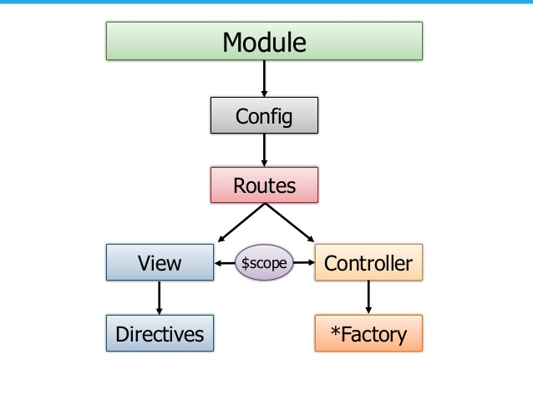
Big Picture

Slide 23
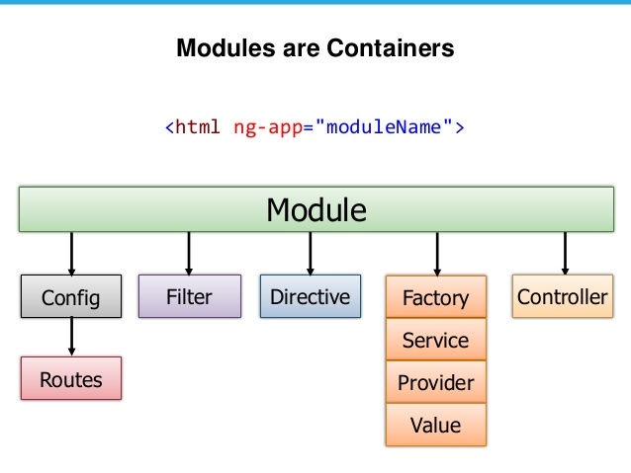
Module

Slide 24
Routing
Since we are building a SPA app, everything happens in one page.
How should back-button work?
How should linking between "pages" work?
How about URLs?
Routing comes to rescue!

Slide 25
Route Configuration
//this module is dependent on ngRoute module, // so we should load it first var myApp = angular.module('myApp',['ngRoute']); myApp.config(['$routeProvider', function ($routeProvider) { $routeProvider.when('/employee', { templateUrl: 'employee.html', controller: EmployeeController }); $routeProvider.when('/student', { templateUrl: 'student.html', controller: StudentController }); $routeProvider.otherwise({redirectTo: '/employee'}); }]);

Slide 26
Route Configuration
<div class="container"> <div class="masthead"> <h3 class="muted">Angularjs demo</h3> <div class="navbar" ng-controller="HeaderController"> <div class="navbar-inner"> <div class="container"> <ul class="nav"> <li ng-class="{ active: isActive('/employee')}"><a href="#/employee">Employee</a></li> <li ng-class="{ active: isActive('/student')}"><a href="#/student">Student</a></li> </ul> </div> </div> </div><!-- /.navbar --> </div> <hr/> <div ng-view></div> </div>
This div is replaced dynamically based on the url

Slide 27
Services
View-independent business logic should not be in a controller
Logic should be in a service component
Controllers are view specific, services are app-specific
Controller's responsibility is to bind model to view. Model can be fetched from service!
Controller is not responsible for manipulating (create, destroy, update) the data. Use Services instead!
AngularJS has many built-in services, see
https://docs.angularjs.org/api/ng/service
Example $http

Slide 28
Service Example
myApp.controller('EmployeeController', EmployeeController); function EmployeeController($scope,$http) { $scope.fetchEmployee= function(){ $http.get('employee').success(function(employeeList){ $scope.employees = employeeList; }); } $scope.addEmployee= function(newEmployee){ $http.post('employee',newEmployee).success(function() { $scope.fetchEmployee(); }); $scope.employee={}; } $scope.removeEmployee= function(employee){ $http.delete('employee/'+employee.id).success(function() { $scope.fetchEmployee(); }); } $scope.fetchEmployee(); }
$http service is injected

Slide 29
Links
Angularjs - https://angularjs.org/
Video tutorials : https://egghead.io/technologies/angularjs
Samples shown in this session can be downloaded from here:
https://github.com/kiranreddykasa/angularjs-samples
Spring & Angularjs app:
https://github.com/kiranreddykasa/spring-angularjs

Slide 30
Q&A

Slide 31
Thank You

