Slide 1
Agile-Git-Maven
Sunil Nagaraj , 21/10/21

Slide 2
Introduction to Agile
Software Development

Slide 3
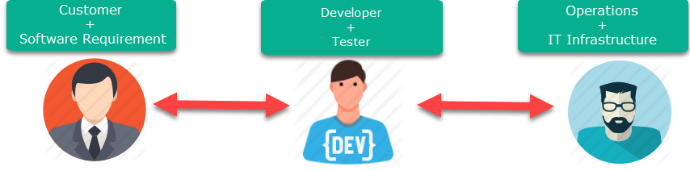
Software Development

Slide 4
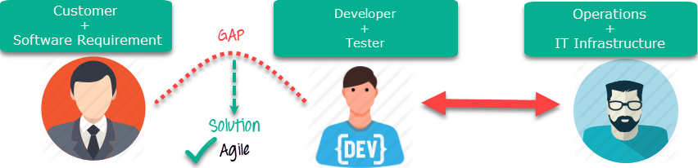
Agile Advantage

Slide 5
Scrum Basics

Slide 6
What is Scrum?
Scrum refers to a holistic or “rugby” approach— where teams go the distance as a unit, passing the ball back and forth—as opposed to the traditional sequential or “relay race” approach for managing new product development.
It is not individual effort but the best coordination of the team that will determine success.

Slide 7
User Stories: Components
A User Story describes functionality that will be useful to a stakeholder of the system.
1 2 3
User Stories consists of three things
A brief description of the story used for planning
Tests that convey and document details
Conversations about the story
4
5
Estimating elements
IBM Customized
Additional Elements
Assumptions

Slide 8
An example of user stories
Success would be …
Acceptance Test #1
Acceptance Test #2
User Story
As a system admin at Wal*Mart, I want to configure WAS so I can manage my applications
Success would be …
WAS is configured
No critical errors occurred in the process
No data was lost

Slide 9
What is an Epic?
As a premium site member, I want to cancel a reservation on the last minute with no cancellation fee so that I am not charged for a travel arrangement I no longer need.
As an user, I want to cancel a reservation so that I am not charged for a travel arrangement I no longer need.
EPIC
User Story
As a premium site member, I want to cancel a reservation on the last minute with no cancellation fee so that I am not charged for a travel arrangement I no longer need.
As a non-premium member, I want to cancel 24 hours in advance so that I am not charged for a travel arrangement I no longer need.
As a site visitor,
I want to receive a confirmation of any cancelled reservation so that I can have proof of cancellations.

Slide 10
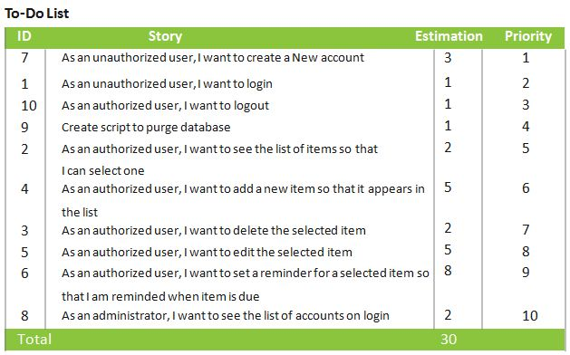
Product Backlog

Slide 11





Scrum roles and responsibilities
Scrum Meeting
Review
Scrum Master
2- WEEK SPRINT
Product Owner
The Team
Commitment
Potentially Shippable product
No Changes (In Duration or Deliverable)
Retrospective

Slide 12
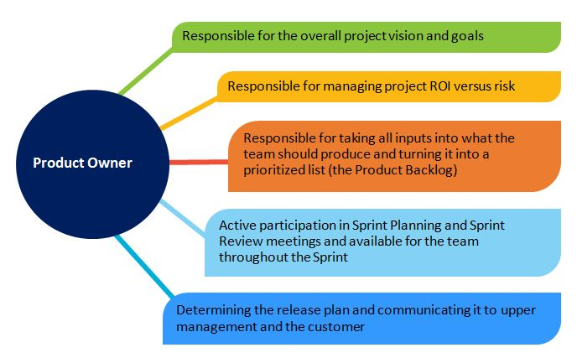
Scrum roles and responsibilities—product owner

Slide 13
Scrum roles and responsibilities—the team
7 people +
or – 2
Can be shared with other teams (but it is better when not)
Can change between Sprints (but better when they don’t)
Can be distributed (but better when collocated)
Cross- functional
Possesses all the skills necessary to produce an increment of potentially shippable product
Team takes on tasks based on skills, not just the official “role”.
Self-managing
Team manages itself to achieve the Sprint commitment.

Slide 14
Scrum Master Roles
Scrum Master
Guides the team’s use of
Scrum
Serves the team
Protects the Team
Guides the team’s use of
Scrum
Teaches Scrum to the team and organization
The Scrum Master takes action to help remove impediments to the team’s effectiveness.
The Scrum Master facilitates the team’s group interactions to help the team achieve its full potential.
The Scrum Master protects the team from anything that threatens its effectiveness, such as outside interference or disruption.
The Scrum Master will need to confront uncomfortable issues, both inside and outside the team.
The Scrum Master ensures that all standard Scrum rules and practices are followed.
The Scrum Master organizes all Scrum- related practices.

Slide 15
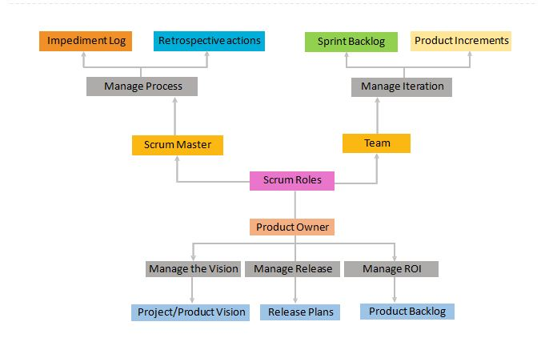
Scrum project roles in a nutshell

Slide 16
Sprint planning
What is on the Product Owner’s “shopping list”?
Team understands details of what Product Owner has prioritized on Product Backlog.
How much “money” do we have in our bank account?
Team decides how much productive time is available during the Sprint.
How many items on the shopping list can we afford to “buy” with that “money”?
Team decides how many Product Backlog items can be committed for completion during the Sprint.

Slide 17
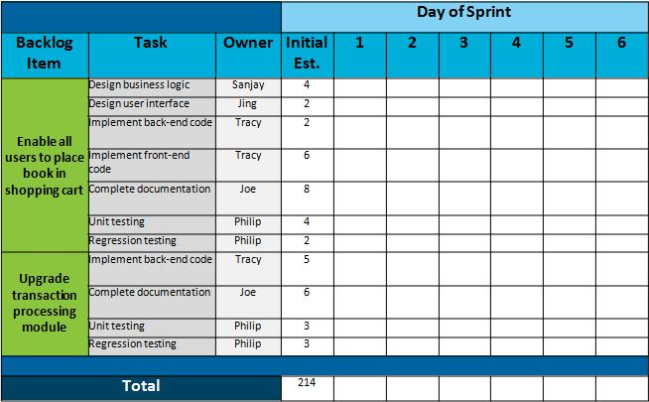
Sprint Backlog

Slide 18
Definition of Done
In Scrum, “Done” is defined as “Potentially Shippable”.
RELEASE
RELEASE
RELEASE
RELEASE
RELEASE
RELEASE
S P R I N T
S P R I N T
S P R I N T
S P R I N T
S P R I N T
S P R I N T
RELEASE
S P R I N T
S P R I N T
S P R I N T
S P R I N T
S P R I N T
PRE-RELEASE
S P R I N T

Slide 19
Scrum Execution

Slide 20
Daily Scrum Meeting
Every weekday
Whole team attends
Everyone stands
Lasts 15 minutes or less
Product Owner can attend and report
Update of artifacts after standup-Sprint backlog, Task board, and so on

Slide 21
Daily Scrum Meeting (continued)
Every Developer / Tester reports the following three things:
What task was I able to accomplish since yesterday?
What task will I try to accomplish for the day?
Any issues blocking my work?
No discussions or conversations until meeting ends

Slide 22
Conduct Daily Scrum Meeting in the following scenario:
There are three developers and two testers working on building a product that will automate the Bank Transactions.
One person is working on Creating new accounts.
Sub-tasks:
Create a Registration/login page.
Add options for User to select Creating new account.
Add all the mandatory / optional fields as text box or combo boxes.
Validate the data entered and the formats and save the data in the database.
Generate the account number and display. One person is working on Creating Fixed Deposit.
Sub-tasks
Provide the user list of FD plans and the rates.
Check if User is already an account holder. If yes, then display a webpage which will get the User account details so that FD account to be linked with S/B account.
One person is working on Generating Reports.
Sub-tasks:

Slide 23
Conduct Daily Scrum Meeting in the following scenario:
Design a screen/page to provide the Report generating options.
Create the tables and views.
Design the report layout for different queries (ex: fetch all the details of Customer XYZ like account summary, FD details, Home loan details and so on.
2 Testers testing first 2 scenarios.

Slide 24
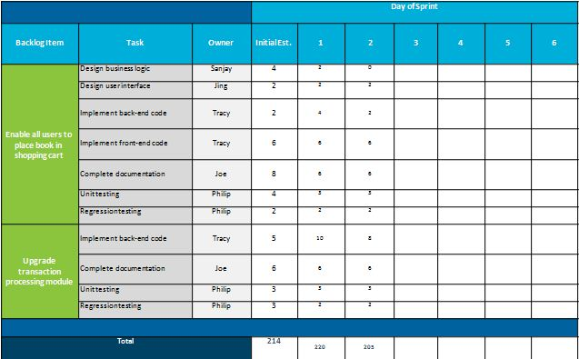
Sprint Backlog Updation

Slide 25
Kanban Task Board (1 of 4)
A Kanban board is a work and workflow visualization tool that enables you to
optimize the flow of your work. Physical Kanban boards, like the one
pictured below, typically use sticky notes on a whiteboard to
communicate status, progress, and issues.
TO DO
IN PROGRESS
DONE

Slide 26
Kanban Task Board (2 of 4)
TO DO
IN PROGRESS
DONE

Slide 27
Kanban Task Board (3 of 4)
TO DO
IN PROGRESS
DONE

Slide 28
Kanban Task Board (4 of 4)
TO DO
IN PROGRESS
DONE

Slide 29
Sprint Review and Retrospective

Slide 30
Sprint Review
The purpose of the Sprint Review is:
Demo what the team has built
Generate feedback which the Product Owner can incorporate in the Product Backlog
Attended by Team, Product Owner, ScrumMaster, functional managers, and any other stakeholders
A demo of what’s been built and not a presentation about what’s been built:
No Power Points allowed!
Usually lasts 1-2 hours
Followed by Sprint Retrospective

Slide 31
Sprint Retrospective
What is it?
1-2 hour meeting following each Sprint Demo
Attended by Product Owner, Team, and ScrumMaster
Usually a neutral person will be invited in to facilitate
Presents what is working and what could work better
Why does the Retrospective matter?
Accelerates visibility
Accelerates action to improve

Slide 32
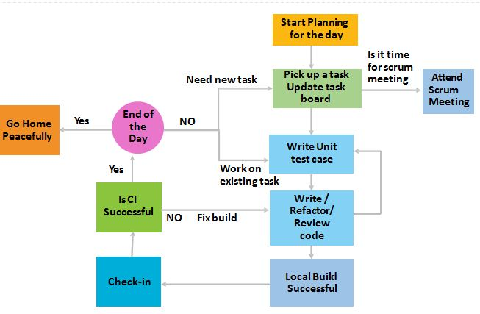
A typical day in the life of a developer

Slide 33
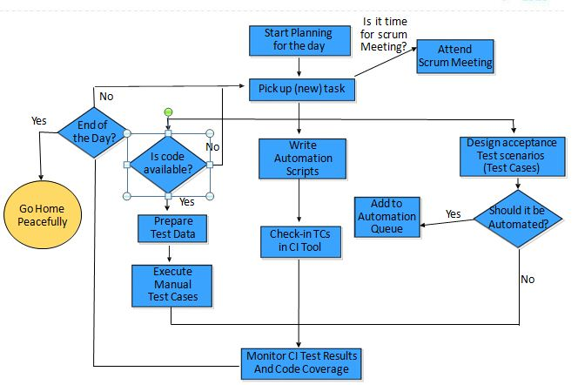
A typical day in the life of a tester

Slide 34
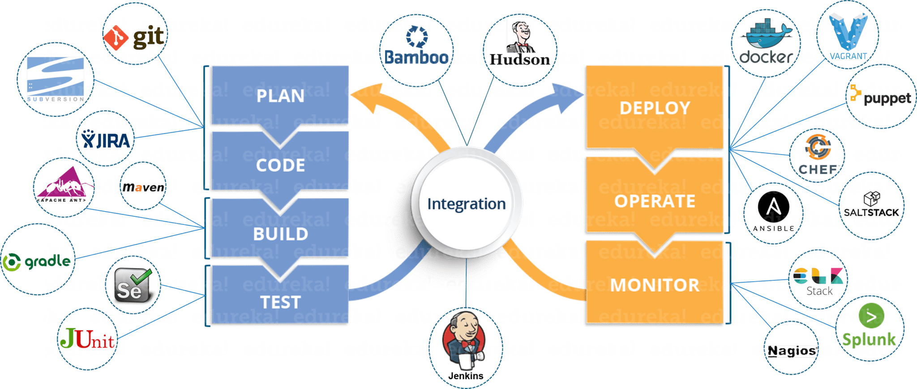
DevOps Tools

Slide 35
Agile & DevOps
Agile | DevOps
Emphasize breaking down barriers between developers and management. | DevOps is about software deployment and operation teams.
Addresses gap between customer requirements and development teams. | Addresses the gap between development and Operation team
Focuses more on functional and non-functional readiness | It focuses operational and business readiness.
Agile development pertains mainly to the way development is thought out by the company. | DevOps emphases on deploying software in the most reliable and safest ways which aren't necessarily always the fastest.
Agile development puts a huge emphasis on training all team members to have varieties of similar and equal skills. So that, when something goes wrong, any team member can get assistance from any member in the absence of the team leader. | DevOps, likes to divide and conquer, spreading the skill set between the development and operation teams. It also maintains consistent communication.
Agile development manages on "sprints. It means that the time table is much shorter (less than a month) and several features are to be produced and released in that period. | DevOps strives for consolidated deadlines and benchmarks with major releases, rather than smaller and more frequent ones.

Slide 36
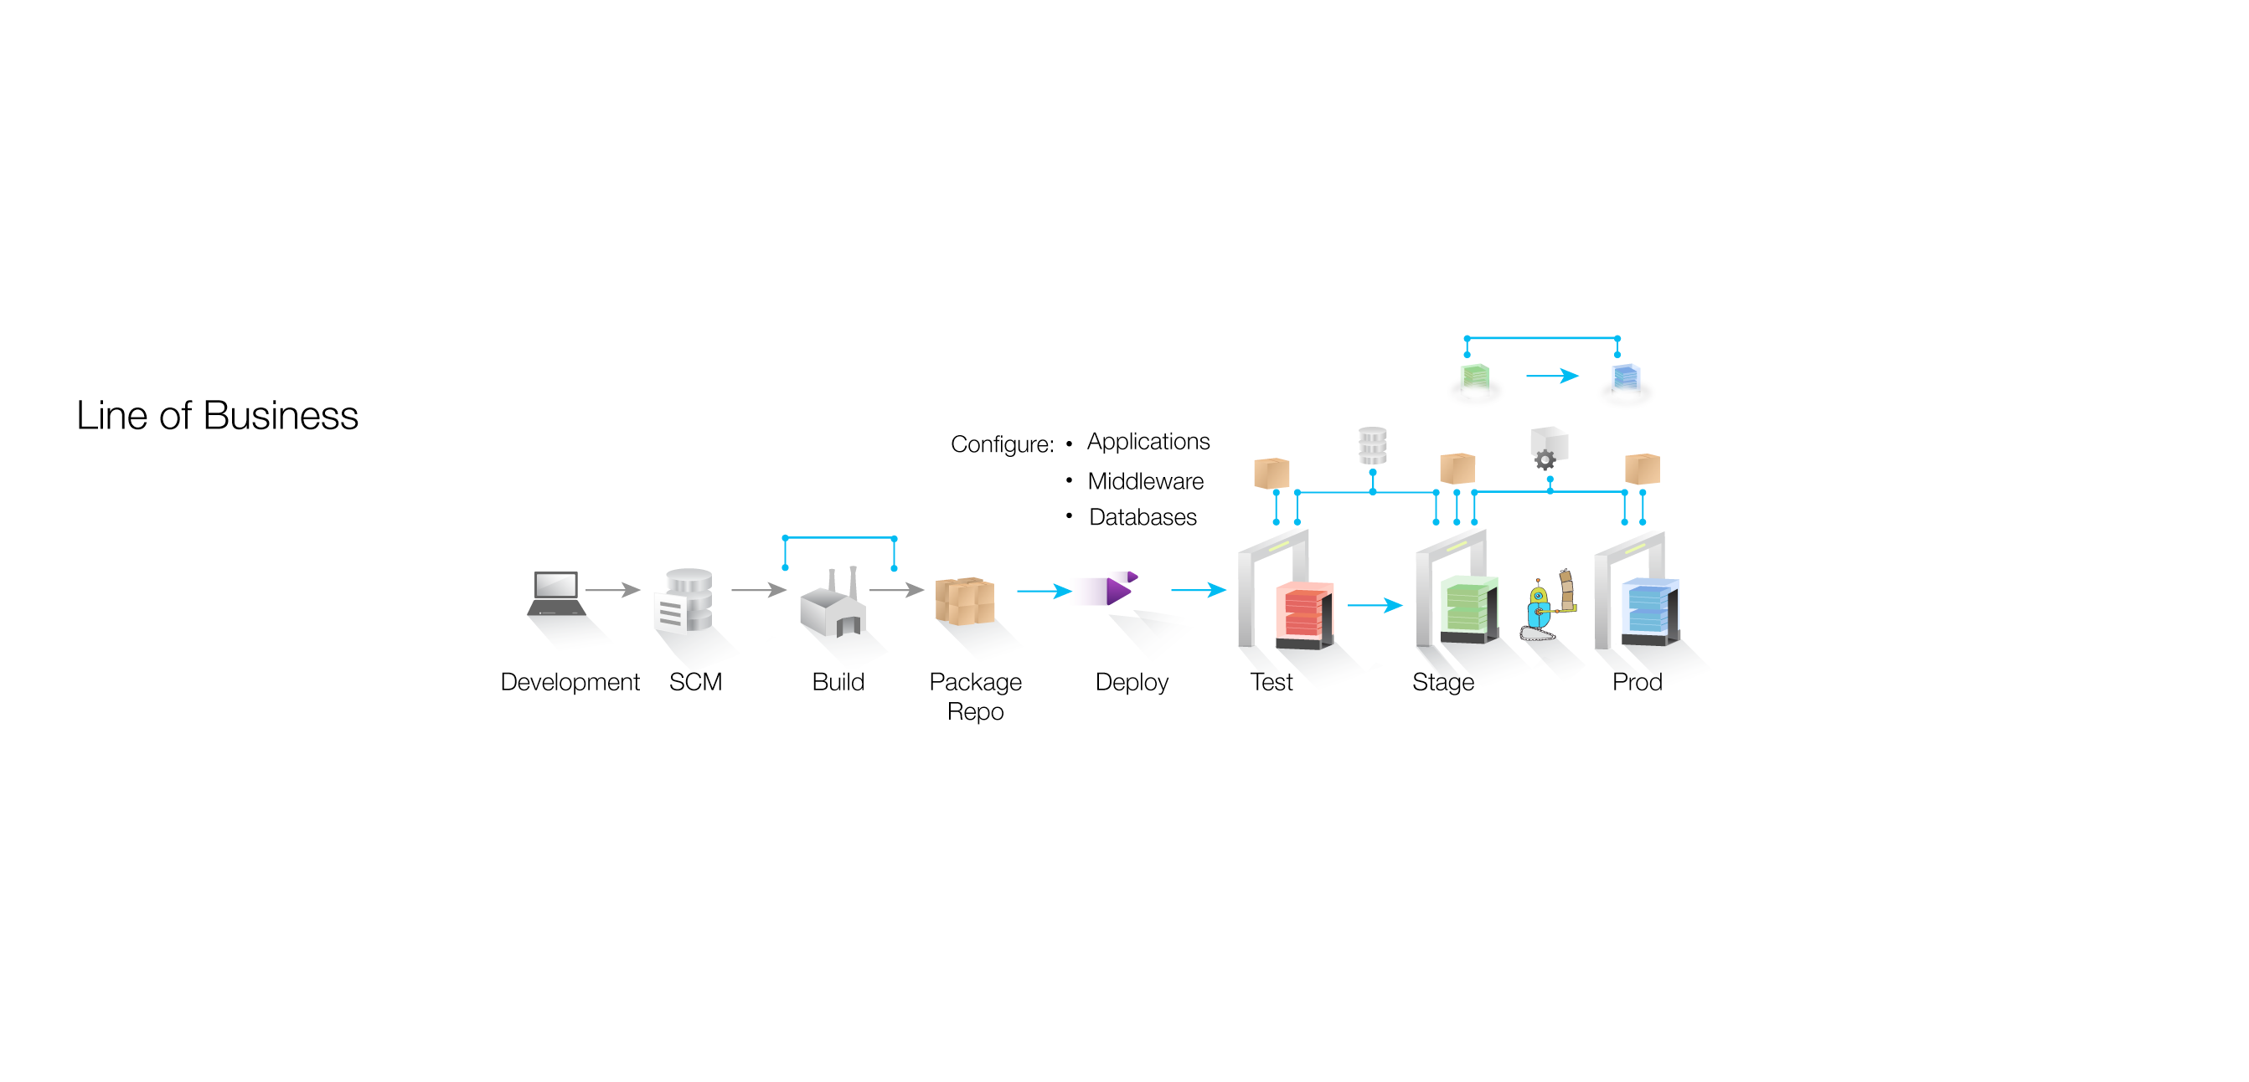
VIEW OF TOOLS IN A DEVELOPMENT PIPELINE
Ant,
Gradle,
Make,
Maven
jUnit,
Selenium,
AntUnit
DbUnit
INFRASTRUCTURE
Chef,
Puppet
Dockers, Vagrant
Git,
SVN
Continuous Integration
Continuous Deployment and Delivery
Jenkins for CI and CD
Notes:
A picture depicting a typical Development pipeline. The tools which assist in each stage of development process is also indicated.

Slide 37
Introduction to DevOps
Software Development

