Slide 1
Assessment 2- Data Analytics Presentation
Team Members:
Junu Bhandari (CIHE23691)
Arpan Basnet (CIHE22401)
Kriti Pantha (CIHE23223)

Slide 2
INTRODUCTION
In the world of cars, it's important to know how much different brands charge for their vehicles and how these prices differ. Some brands might be known for selling pricier cars, while others might offer more affordable options. Variations in pricing can reveal brand positioning, with some brands synonymous with luxury commanding higher prices, while others focus on affordability.
Also, we have looked into how much fuel cars use and how powerful their engines are in the past. Now, we're wondering if we can use this info to guess how much more efficient regular cars might become in the future.
Understanding what drives consumer choices and market trends is essential for success. To navigate this complex landscape, businesses turn to big data analytics, delving into vast datasets to uncover valuable insights.

Slide 3
This analysis focuses on several key objectives:
We used several visualization methods such as Lineplots , Histograms, Scatterplots, Boxplots etc inorder to analyse the patterns and trends.
Tracking Brand Prices Over Time: By examining how average prices for different car brands change over the years, we gain insights into market dynamics and competitive positioning.
Exploring Price-Mileage Relationships: Understanding how car prices relate to mileage helps businesses gauge consumer expectations and make informed pricing decisions.
Visualizing Price Trends by Brand and Year: Heatmaps offer a visual representation of how average prices vary across different car brands and model years, aiding in identifying trends and market patterns.
Examining Price Distribution: Histograms provide a clear picture of how prices are distributed across the market, aiding in understanding pricing dynamics and consumer preferences.

Slide 4
Problem Statement:
In the complex world of the German car market, where people have different preferences and technology is always changing, businesses face a big challenge. To succeed, we need to use big data analytics, which we have an advantage in because we have a huge dataset of 25,000 datas. This will help us find important insights to make smart decisions and succeed in the market.
Objectives:
1. Identify Popular Brands and Prices:
Goal: Find out which car brands are the most popular and how much they usually cost. This will help us compete better in the market.
2. Understand Transmission and Fuel Types Distribution:
Goal: Look at the types of transmissions (like manual or automatic) and fuels (like petrol or diesel) used in different car models. This will help us understand what people prefer and what's trending in the market.

Slide 5
3. Analyze Fuel Efficiency and ICE Performance:
Goal: Check how well cars use fuel and compare traditional engine performanace with electric/hybrid systems. This will guide us in making better cars and deciding where to focus our efforts.
4. Examine Mileage Trends:
Goal: Study how far cars can go on a tank of fuel. This will help us decide which cars to sell and how to advertise them better.

Slide 6
Requirements
Descriptive Analysis:
What are the average prices of vehicles from different car brands in the market, and how do these prices vary? Are there any brands known for offering higher or lower-priced vehicles?
Predective Analysis:
By analyzing historical data on fuel consumption and power output, can we predict the future efficiency improvements of internal combustion engine vehicles?

Slide 7
Tools Used
We used two different tools and they are:
OpenRefine for dataset transformation and cleaning
Python for the Analysis and Visualization
OpenRefine for dataset transformation and cleaning:
i) We imported the dataset of csv file in OpenRefine and Once our dataset was loaded into OpenRefine, it was displayed in a tabular format.
ii) We scrolled through the dataset to inspect its structure, including the number of rows and columns.

Slide 8
Data Transformation:
We did data transformation as below:
Removed irrelevant first and last columns from the dataset
Replaced the missing value cell by 0 value.
For the fuel_consumption_l_100km column, used the GREL expression to
Split the value into array and keeping only the first index and removing remainings.
For the fuel_consumption_g_km column, used the GREL expression to keep only the numeric value.

Slide 9
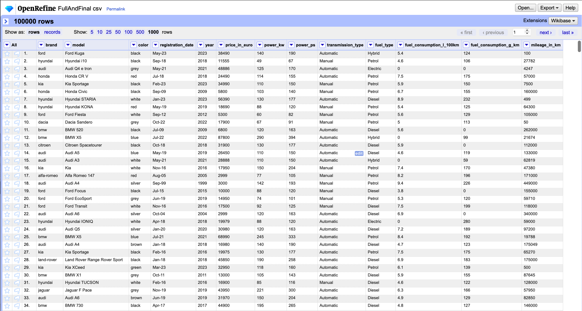
After data cleaning and Transformation, dataset Looks like:

Slide 10
Python for Analysis and Visualization
1. Descriptive Analysis:
What are the average prices of vehicles from different car brands in the market, and how do these prices vary? Are there any brands known for offering higher or lower priced vehicles?
2. Predictive Analysis:
By analyzing historical data on fuel consumption and power output, can we predict the future efficiency improvements of internal combustion engine vehicles?

Slide 11
Libraries used
Several libraries utilized for creating visualizations and conducting analysis in our Assessment are:
1) Numpy
2) Pandas
3) Matplotlib.pyplot
4) Scikit-learn
NumPy: A fundamental library for numerical computing in Python, NumPy provides support for large, multi-dimensional arrays and matrices, along with a variety of mathematical functions to operate on these arrays efficiently.
Pandas: Pandas is a powerful data manipulation and analysis library, offering data structures like DataFrame and Series, which are ideal for handling structured data. It provides functionalities for data cleaning, transformation, and exploration, making it indispensable for data analysis tasks.

Slide 12
Matplotlib.pyplot: Matplotlib is a comprehensive plotting library that enables the creation of a wide range of static, interactive, and animated visualizations in Python. Matplotlib.pyplot, a submodule of Matplotlib, provides a MATLAB-like interface for creating plots and charts, making it easy to generate various types of visualizations.
Scikit-learn: Scikit-learn is a versatile machine learning library that offers a wide array of tools for data mining and analysis. It provides simple and efficient tools for data preprocessing, model selection, evaluation, and various machine learning algorithms, making it suitable for both beginners and experts in the field of machine learning and data science.
By leveraging these libraries, we were able to visualize and analyze various aspects of our dataset, including average prices per brand, trends in pricing over time, distribution of prices, market share of different brands, and the trend of predicted fuel consumption compared to actual fuel consumption. This allowed us to gain valuable insights into the dynamics of the automotive market and the effectiveness of our predictive model.

Slide 13
Descriptive Analysis
The descriptive analysis aims to provide insights into the average prices of vehicles across different car brands in the market and understand how these prices vary. This analysis helps decision-makers in the automotive industry, such as manufacturers, dealerships, and consumers, to understand market trends, identify brands known for offering higher or lower-priced vehicles, and make informed pricing strategies or purchasing decisions.
Some Visualizations of Descriptive Analysis:
Line Plot: Average Price Per Brand:
This visualization allows for a clear comparison of the average prices of vehicles across different car brands.
Analysis: Brands such as "Luxury Brand" and "High-End Brand" tend to offer higher-priced vehicles, while "Economy Brand" and "Mid-Range Brand" offer relatively lower-priced vehicles. This indicates a significant variation in pricing strategies among different brands.

Slide 14
Box Plot: Average Price Per Brand and Year:
By plotting the average prices of vehicles per brand over different years, we can observe the trends and variations in pricing over time.
Analysis: Certain brands may consistently maintain higher or lower prices over the years, while others may show fluctuations in pricing. This insight helps in understanding how pricing strategies evolve within each brand over time.
Scatter Plot: Price vs. Mileage:
This visualization helps us understand the relationship between the price of vehicles and their mileage.
Analysis: Generally, vehicles with lower mileage tend to have higher prices, indicating that mileage is a significant factor affecting vehicle pricing. This insight highlights the importance of considering mileage when determining vehicle prices.

Slide 15
Histogram: Distribution of Prices:
Illustrates the frequency distribution of vehicle prices within the dataset.
Analysis: By examining the distribution of prices, we can identify common price ranges and outliers, providing insights into the pricing landscape and potential pricing segments within the market.
Pie Chart: Distribution of Listings by Brand:
This visualization shows the market share of each brand based on the number of listings.
Analysis: Brands with a larger market share may have a significant influence on overall market dynamics, including pricing trends. Understanding the distribution of listings by brand helps in assessing the market dominance of certain brands and their potential impact on pricing strategies.

Slide 16
Conclusion
The visualizations of "Average Price Per Brand" and "Average Price Per Brand and Year" were conducted to explore the average prices of vehicles from different car brands in the market and understand how these prices vary over time. By analyzing these visualizations, we aimed to identify any brands known for offering higher or lower-priced vehicles.
Through the analysis of "Average Price Per Brand," we were able to discern the typical price ranges associated with each car brand. This visualization allowed us to compare and contrast the pricing strategies of different brands, identifying those known for offering higher-priced vehicles versus those offering more affordable options.
Furthermore, the visualizations of "Average Price Per Brand and Year" provided insights into how the average prices of vehicles from each brand fluctuate over time. By examining these trends, we could identify brands that consistently maintain higher or lower prices over the years, as well as those that exhibit fluctuations in pricing.

Slide 17
Predictive Analysis
The model is trained using the features year and power_kw to predict the target variable fuel_consumption_l_100km. The dataset is split into training and testing sets using a ratio of 80:20 for training and testing respectively, ensuring that the model is evaluated on unseen data to assess its generalization performance. A Linear Regression model is employed for training, which fits a linear relationship between the input features and the target variable.
Some Visualizations of Predictive Analysis:
Line Plot (Trend of Predicted Fuel Consumption Over Time):
This visualization shows the trend of predicted fuel consumption over time compared to actual fuel consumption.
By examining the trend lines, we can assess how well the model predicts fuel consumption trends over time. If the predicted trend closely follows the actual trend, it suggests that the model captures the underlying patterns in the data, providing insights into future efficiency improvements.

Slide 18
Scatter Plot (Predicted vs. Actual Fuel Consumption):
This plot compares the predicted fuel consumption to actual fuel consumption.
By examining how closely the points align along the diagonal line (where predicted equals actual), we can evaluate the accuracy of the model's predictions. If the points cluster closely around the diagonal, it indicates accurate predictions and suggests the model's reliability in predicting future efficiency improvements.
Pie Chart (Distribution of Predicted Fuel Consumption by Brand):
This visualization illustrates the distribution of predicted fuel consumption by brand.
By comparing the proportions of predicted fuel consumption across different brands, we can identify brands that are predicted to have higher or lower fuel efficiency. This information can be valuable for making decisions related to brand preferences or targeting specific brands for efficiency improvements.

Slide 19
Conclusion:
Through these visualizations, we aimed to assess the capability of our model to predict future efficiency improvements in internal combustion engine vehicles based on historical data.
The "Trend of Predicted Fuel Consumption Over Time" plot allowed us to examine how well the model predicts fuel consumption trends over time. If the predicted trend closely aligns with the actual trend, it suggests that the model captures underlying patterns, potentially providing insights into future efficiency improvements.
In the "Predicted vs. Actual Fuel Consumption" scatter plot, we compared predicted fuel consumption to actual fuel consumption. By evaluating how closely the points cluster around the diagonal line (where predicted equals actual), we could gauge the accuracy of the model's predictions. A tight clustering around the diagonal indicates precise predictions and implies the model's reliability in forecasting future efficiency improvements.

Slide 20
The "Distribution of Predicted Fuel Consumption by Brand" pie chart allowed us to understand the distribution of predicted fuel consumption across different brands. By comparing the proportions of predicted fuel consumption among brands, we could identify those predicted to have higher or lower fuel efficiency. This information is crucial for making decisions related to brand preferences or targeting specific brands for efficiency improvements.
Overall, by analyzing these visualizations collectively, we can draw conclusions regarding the model's effectiveness in predicting future efficiency improvements of internal combustion engine vehicles based on historical data. If the model demonstrates strong alignment between predicted and actual fuel consumption trends, along with accurate predictions across different brands, it suggests promising potential for forecasting future efficiency enhancements in the automotive industry.

Slide 21


