Slide 1
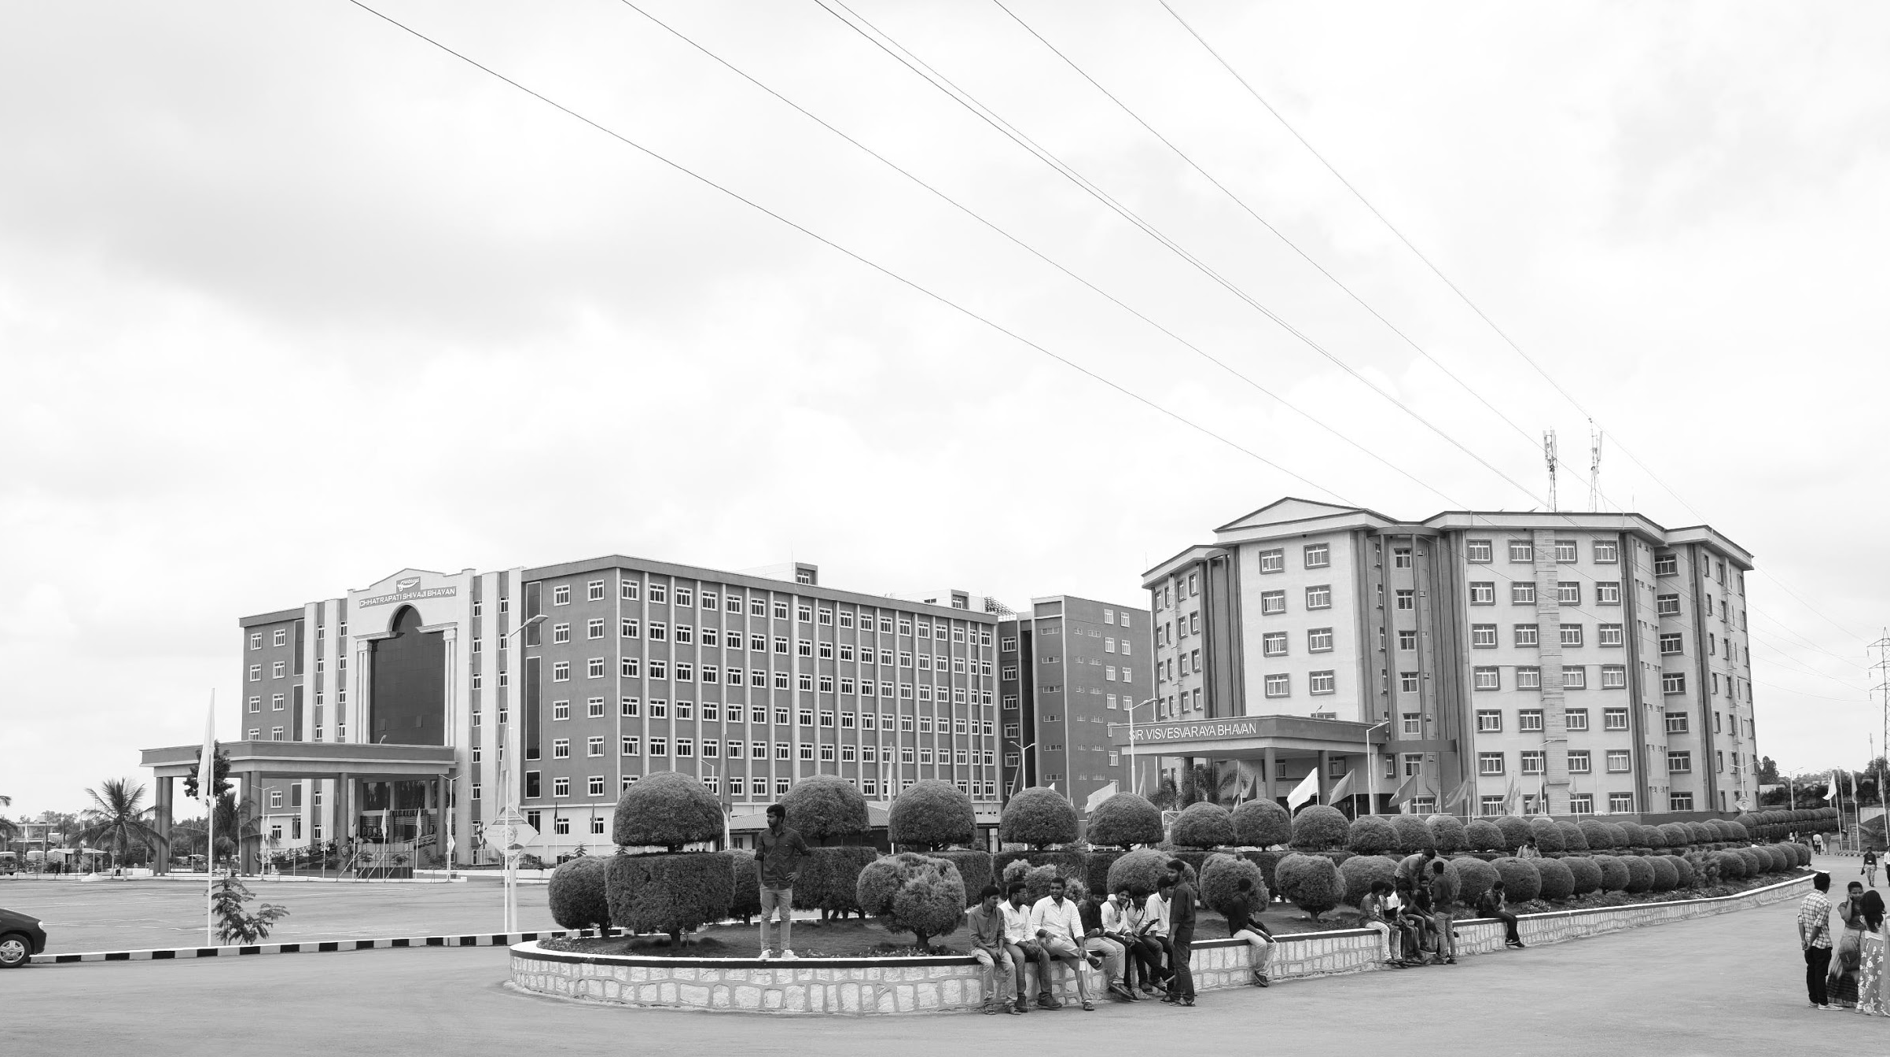

OFDM Transceiver using GNU Radio and SDR
AY 2021-2025
GITAM UNIVERSITY
Major Project
Project ID: XX
A University should be a place of light, of liberty, and of learning.
Department of Electrical Electronics and Communication Engineering
Project Team: ALPHA 16
KIRAN P S BU21EECE0100564
HARIPRIYA RAO M BU21EECE0100567
HAMSINI REDDY K S BU21EECE0100546
Project Mentor:
RAMESHA M
www.gitamedu.com

Slide 2




Project Group – ALPHA 16
Photo
Track
Roll No
Name
EECE
BU21EECE0100564
KIRAN P S
EECE
BU21EECE0100567
HARIPRIYA RAO M
EECE
BU21EECE0100546
HAMSINI REDDY K S

Slide 3
Objective and Goals
Objective
Brief Description :
An OFDM transceiver using GNU Radio and SDR (Software-Defined Radio) enables the transmission and reception of data across multiple subcarriers, providing robustness against interference.
The transmitter modulates data, applies IFFT, adds a cyclic prefix, and transmits via SDR hardware. The receiver captures the signal, removes the cyclic prefix, applies FFT, and demodulates the data.
GNU Radio facilitates the design and simulation of the transceiver, while SDR hardware handles the actual signal transmission and reception.
Goals
Main Goals
Understand and Apply OFDM Principles: Develop a practical understanding of OFDM, including its advantages in wireless communications, such as efficient bandwidth utilization and resistance to multipath interference.
Utilize GNU Radio for Signal Processing: Leverage GNU Radio, an open-source software toolkit, to build and simulate the OFDM transceiver, enabling flexible and rapid prototyping of the communication system.
Implement Real-Time Wireless Communication: Deploy the OFDM transceiver using SDR hardware, enabling real-time transmission and reception of data over a wireless channel.

Slide 4
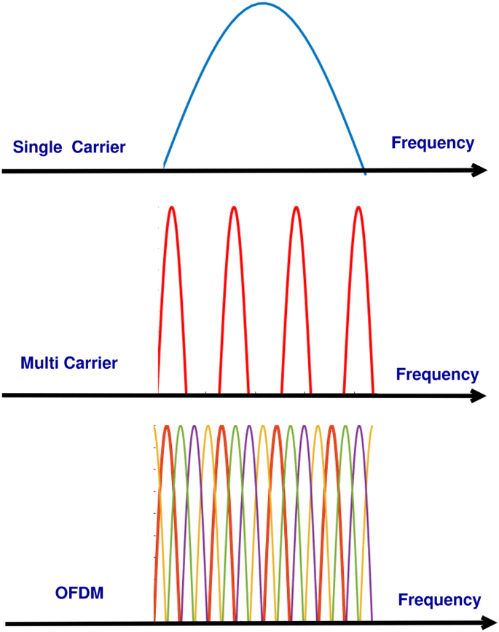
INTRODUCTION
Frequency is the rate at which a wave oscillates, or completes a cycle, per second, measured in Hertz (Hz).
For example, a frequency of 1 Hz means one complete cycle per second, while a frequency of 1 GHz (gigahertz) means one billion cycles per second.
Orthogonal Frequencies refer to frequencies that are mathematically spaced so that they don’t interfere with each other, even if they are closely packed together.
In OFDM, subcarriers are chosen so that each frequency’s peak aligns with the null points of others. This orthogonality minimizes interference and allows the subcarriers to be very close, maximizing spectrum efficiency while avoiding signal overlap.

Slide 5
FDM AND OFDM
FDM (Frequency Division Multiplexing) and OFDM (Orthogonal Frequency Division Multiplexing) are two techniques used for transmitting multiple signals over a single communication channel by dividing the available bandwidth.
1. FDM (Frequency Division Multiplexing)
FDM is a multiplexing technique where multiple signals are transmitted simultaneously over different frequencies within the same communication medium. Each signal is allocated a specific frequency band within the overall bandwidth.
How it works: The available bandwidth is divided into non-overlapping frequency bands. Each user or signal is assigned a unique frequency band, and all signals are transmitted simultaneously over different carriers.
2.OFDM (Orthogonal Frequency Division Multiplexing)
OFDM is a more advanced version of FDM, where multiple closely spaced subcarriers are used to transmit data in parallel. The key difference is that the subcarriers in OFDM are mathematically orthogonal to each other, allowing them to overlap without causing interference.
How it works: The available bandwidth is divided into many closely spaced, orthogonal subcarriers, and each subcarrier carries part of the data. By ensuring that the subcarriers are orthogonal, it prevents interference, even though the frequency bands overlap.

Slide 6
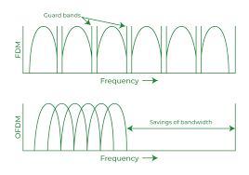
Difference between FDM and OFDM
Spacing of frequencies: In FDM, frequencies are separated by guard bands to avoid interference, while in OFDM, subcarriers overlap but do not interfere due to orthogonality.
Efficiency: OFDM is more spectrally efficient and better suited for modern digital communication systems (e.g., Wi-Fi, LTE).
Applications:
FDM: Used in traditional analog broadcasting (radio, TV).
OFDM: Used in digital communication systems (4G, 5G, Wi-Fi, DSL).

Slide 7
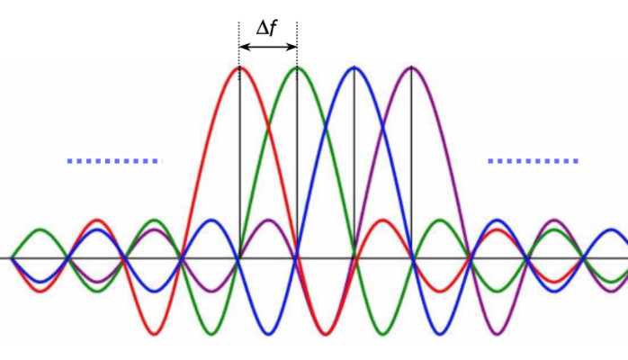
OFDM TRANSCEIVER
A transceiver is a device that combines both a transmitter and a receiver in a single unit, allowing it to send and receive data over the same communication channel.
It’s widely used in various communication systems, including radios, telecommunication networks, and wireless systems, to enable two-way communication.
By integrating both functions, a transceiver simplifies design, reduces cost, and is essential in systems like Wi-Fi routers, smartphones, and Bluetooth devices.

Slide 8

OFDM TRANSCEIVER BLOCK DIAGRAM
Cyclic prefix
Ofdm signal
C(t)
Serial to parallel
Constelation mapper
(Bpsk , Qpsk, Qam)
Cloud
IFFT
Parallel to series
Input
R(t)
Constelation demapper
(Bpsk , Qpsk, Qam)
Freq domain equilizer
FFT
delete cyclic prefix
Serial to parallel
Parallel to serial
Output

Slide 9

OFDM TRANSCEIVER USING GNU RADIO AND SDR
GNU RADIO
GNU Radio is an open-source software toolkit for building software-defined radios (SDRs) and signal processing applications through modular, block-based development in Python and C++.
Here’s a brief introduction to GNU Radio:
- Open-Source Software Toolkit: GNU Radio is a free, open-source software toolkit for building software-defined radios (SDRs) and signal processing applications.
- Flexible and Modular: It provides a modular, block-based interface for combining signal processing blocks to create custom radio and signal processing workflows.
- Cross-Platform: Compatible with Linux, Windows, and macOS, making it accessible across different operating systems.
- Wide Range of Applications: Used in communication systems, spectrum sensing, radio astronomy, and research in wireless networks.
- Python and C++ Integration: Allows for development primarily in Python, with performance-critical code written in C++.
- Hardware and Software Support: Compatible with various SDR hardware like USRP, HackRF, and RTL-SDR, but can also simulate radio applications without hardware.

Slide 10
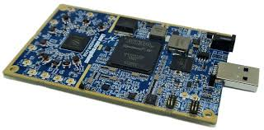
OFDM TRANSCEIVER USING GNU RADIO AND SDR
SDR
Software-Defined Radio (SDR) is a radio communication system that uses software to perform functions typically handled by hardware, offering flexibility and adaptability across a wide range of frequencies and applications.
Here’s a quick introduction to Software-Defined Radio (SDR):
Radio Communication System: SDR is a radio communication system where components like filters, mixers, and amplifiers are implemented through software rather than hardware.
Flexibility and Reconfigurability: It allows for flexible modification of radio functions via software updates without changing physical hardware.
Wide Range of Frequencies: Capable of operating over various frequencies, making it adaptable to multiple radio standards and protocols.
Broad Applications: Used in military, cellular networks, satellite communications, and amateur radio for diverse signal processing tasks.
Accessible for Experimentation: Often used with tools like GNU Radio for prototyping and educational purposes, making it popular in research and hobbyist communities.

Slide 11
OFDM TRANSCEIVER USING GNU RADIO AND SDR
OFDM TRANSCEIVER USING GNU RADIO AND SDR
Building an OFDM transceiver using GNU Radio and SDR (Software-Defined Radio) involves creating a system that can modulate, transmit, receive, and demodulate data using the OFDM technique. GNU Radio is an open-source platform that provides signal processing blocks, while SDR allows you to transmit and receive radio signals using software, making it a flexible tool for prototyping communication systems.
ADVANTAGES:
1. High Spectral Efficiency: OFDM's close-packed, orthogonal subcarriers make the best use of available bandwidth for higher data rates.
2. Robustness to Multipath Interference: Handles reflections and interference well, making it ideal for complex environments.
3. Flexibility and Customizability: With GNU Radio and SDR, easily modify parameters for different applications and testing scenarios.
4. Resilience to Noise and Interference: OFDM minimizes inter-symbol interference, improving data reliability in noisy channels.
5. Cost-Effective Development: Open-source GNU Radio and affordable SDR hardware make it accessible for learning and prototyping.

Slide 12
Analysis - SWOT
Weaknesses
W1. Complexity and Learning Curve
W2. Limited Performance
W3. Synchronization and Stability Issues
Strengths
S1. Flexibility and Customization
S2. Real-Time Processing
S3. Educational and Research Value
Opportunities
Threats
O1. Innovation and Research
02. Prototyping and Testing
O3. Educational Use and Skill Development
T1. Security Vulnerabilities
T2. Interference and Spectrum Regulation
T3. Hardware Limitations

Slide 13
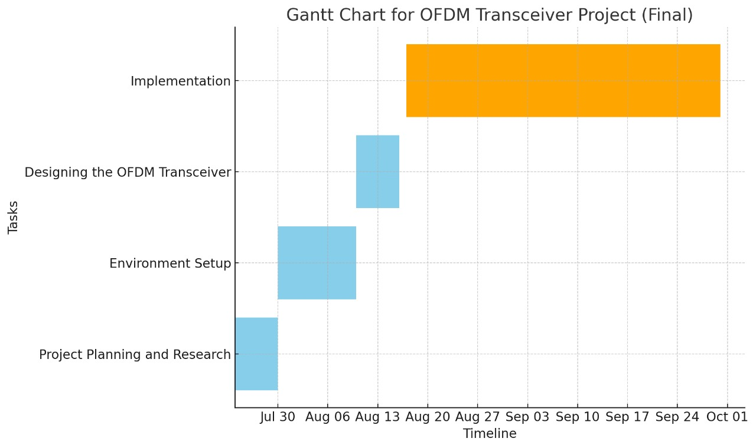
Project Plan
Gant Chart - Milestones and Activities
Resources : https://www.officetimeline.com/gantt-chart/how-to-make/excel & https://www.teamgantt.com/

Slide 14
Literature Survey
Ref No. | Title of paper | Abstract | Outcome | Methodology | Research gap
01 | "An IEEE 802.11a/g/p OFDM Receiver for GNU Radio" | The paper presents an OFDM receiver in GNU Radio for Ettus USRP N210, supporting IEEE 802.11a/g/p with 20 MHz and 10 MHz bandwidths. It's the first of its kind to handle both physical and MAC layers, | The receiver was built using GNU Radio, with steps for frame detection, frequency offset correction , symbol alignment, and full payload decoding. It was tested on Ettus USRP N210 for compatibility and performance. | The project successfully created a GNU Radio OFDM receiver that supports IEEE 802.11a/g/p, with performance comparable to consumer hardware. The receiver is open-source, facilitating further wireless communication research. | This work addresses the lack of accessible OFDM receivers for IEEE 802.11a/g/p in GNU Radio, providing a platform for real-time experimentation and research at the physical layer.
02 | "OFDM Simulation Using GNU Radio on Dynamic Channels | The paper simulates OFDM systems using GNU Radio across different channel conditions (AWGN, NLOS, and LOS). BPSK modulation was used to evaluate signal performance, with results showing how noise impacts SNR across these channels. | The study implements an OFDM transceiver in GNU Radio, testing it under AWGN, NLOS, and LOS conditions. The simulation uses BPSK modulation. | The results indicate that SNR decreases as noise increases across all channels. The study provides insight into the performance of OFDM systems in dynamic channel conditions, highlighting the significant impact of noise on signal quality. | The research addresses the need for practical simulations of OFDM systems in varying channel conditions using GNU Radio, providing a framework for further studies on signal processing and communication systems in dynamic environments.

Slide 15
Literature Survey
Ref No. | Title of paper | Abstract | Outcome | Methodology | Research gap
03 | Implementation of OFDM systems using GNU Radio and USRP | The project developed a Software Defined Radio (SDR) testbed using GNU Radio and USRP2 to evaluate the practical error performance of OFDM systems in different environments. | The successful creation of the OFDM testbed, comprehensive technical documentation, error performance analyses, and insights into SDR limitations provide a foundation for future research | The study involved building a testbed using GNU Radio and USRP2, simulating OFDM systems with channel estimation, implementing them in hardware, and analyzing their performance. | Prior research primarily focused on simulated results, whereas this study addresses the gap by implementing and analyzing OFDM systems in actual hardware using SDR technology
04 | "GNU Radio and USRP B210 based Software Defined Radio for OFDM Data Transmission." | The paper presents a practical implementation of an OFDM-based software-defined radio (SDR) system using GNU Radio and USRP B210, focusing on performance evaluation in various environments. | The study successfully demonstrated an OFDM system with BPSK and QPSK modulations, highlighting its performance under different conditions, including the presence of obstructions. | The research utilized GNU Radio and USRP B210 to implement and test an OFDM system, analyzing its bit error rate (BER) and spectrum efficiency through experiments and simulations. | Previous studies on OFDM implementation with SDR have primarily focused on simulations, whereas this study addresses the gap by experimentally evaluating performance in real-world conditions, including obstructions.

Slide 16
Literature Survey
Ref No. | Title of paper | Abstract | Outcome | Methodology | Research gap
05 | OFDM: Today and in the Future of Next Generation Wireless Communications" | OFDM is a key technology in modern communication systems, providing high data rates and robustness against channel impairments. This paper reviews OFDM's history, its role in 4G, and its potential future applications in 5G networks. | The paper analyzes the development and features of OFDM, comparing it with other technologies like CDMA and FBMC. | OFDM has proven to be superior in handling multipath fading and achieving high data rates, making it the foundation for current and future wireless systems | The paper identifies the need for further exploration of OFDM's capabilities in complex networks, particularly in overcoming synchronization challenges and out-of-band noise issues, to ensure its continued relevance in future communication systems.
06 | "A Review Paper on Implementation of OFDM Transceiver using Mixed Radix 8-2 Algorithm" | The paper explores the implementation of an OFDM transceiver using the Mixed Radix 8-2 algorithm, emphasizing the need for high-speed data transmission in wireless communication. | The implementation achieved an efficient and faster OFDM transceiver with reduced power consumption using the Mixed Radix 8-2 algorithm. | The research employed the Mixed Radix 8-2 algorithm for FFT and IFFT computations, which were coded in Verilog and synthesized using Xilinx ISE software, and then implemented on an FPGA Spartan 3E device. | Previous works focused on Radix-2 algorithms for FFT/IFFT, but this study addresses the gap by using the Mixed Radix 8-2 algorithm to improve processing time and power efficiency in OFDM systems.

Slide 17
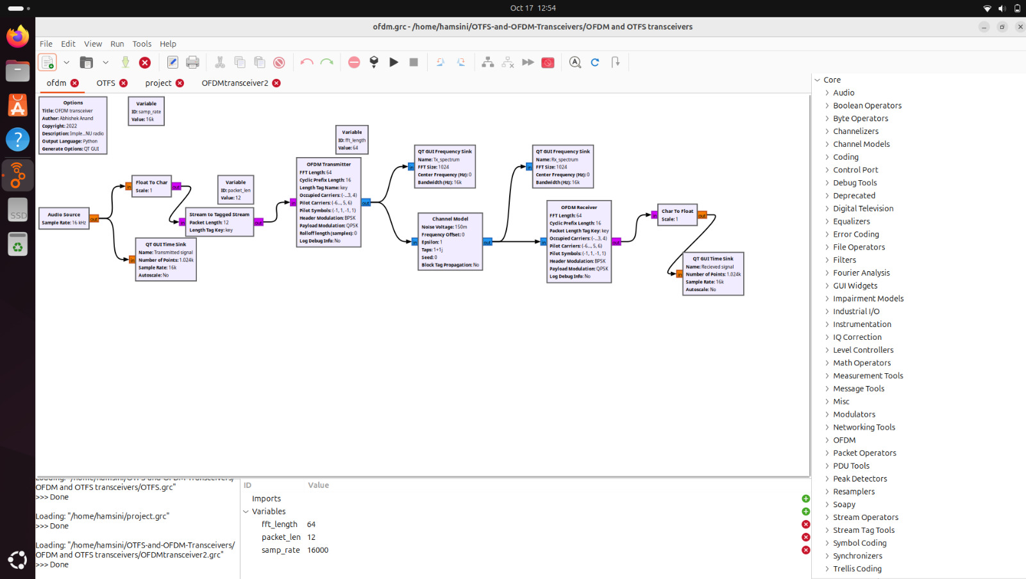
OFDM TRANSCEIVER BLOCK DIAGRAM

Slide 18
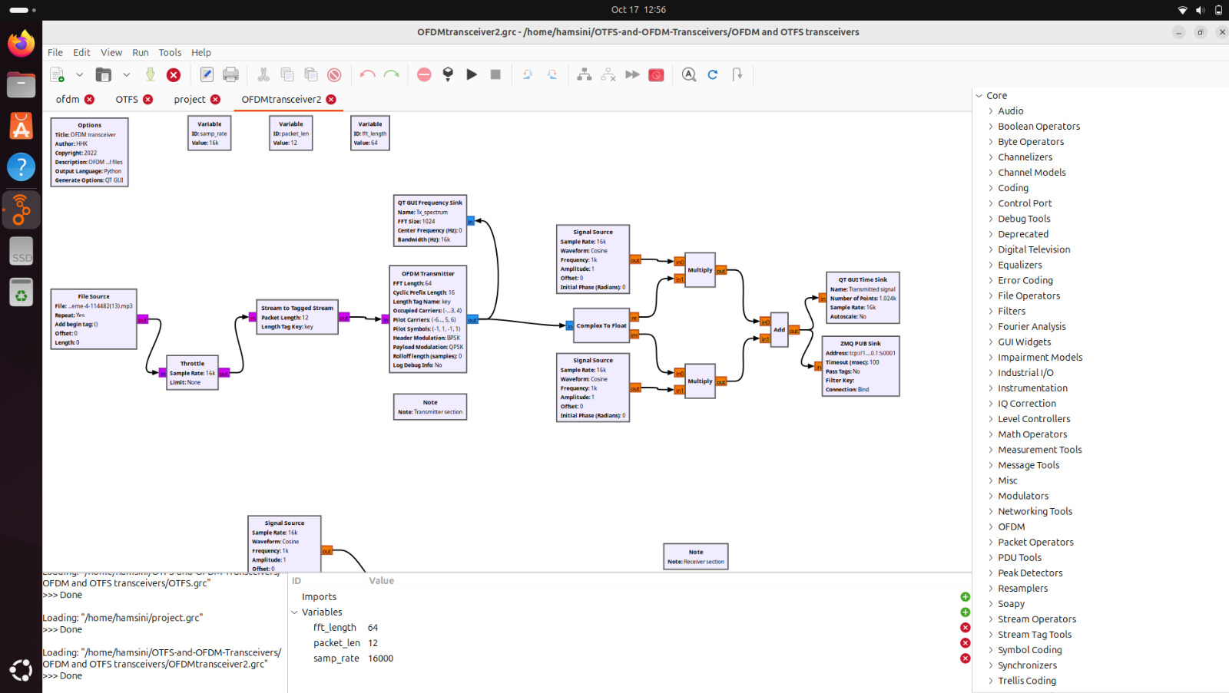
OFDM TRANSCEIVER BLOCK DIAGRAM

Slide 19
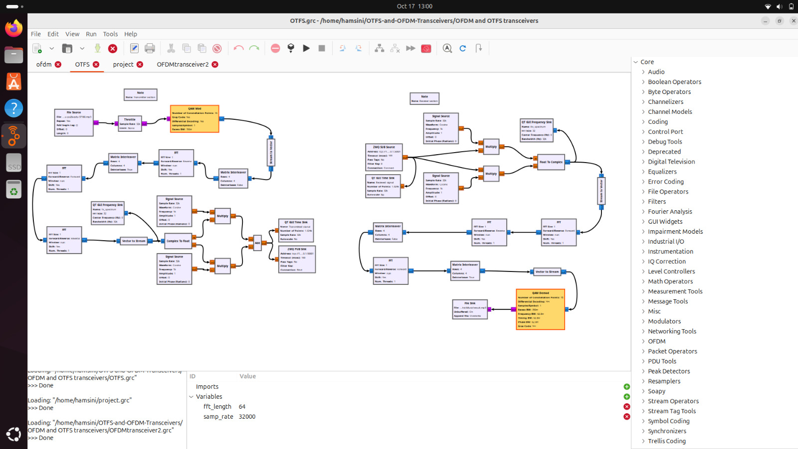
OFDM TRANSCEIVER BLOCK DIAGRAM

Slide 20
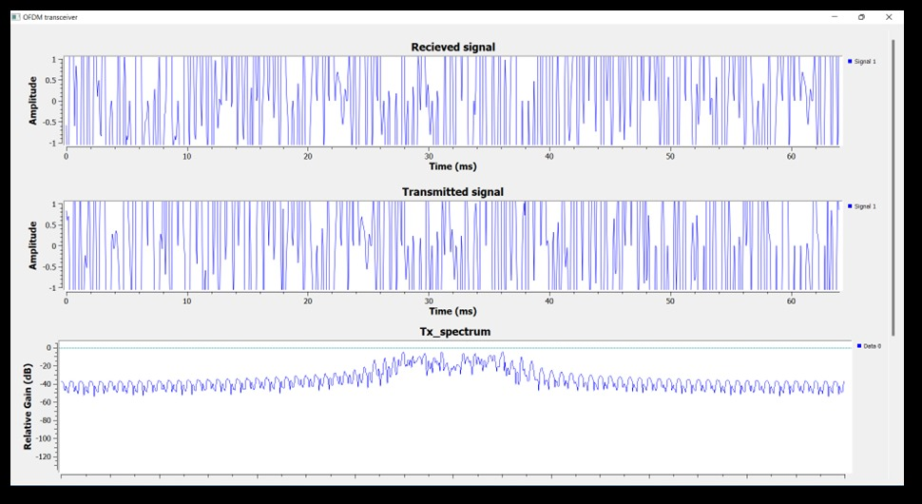
RESULT

Slide 21
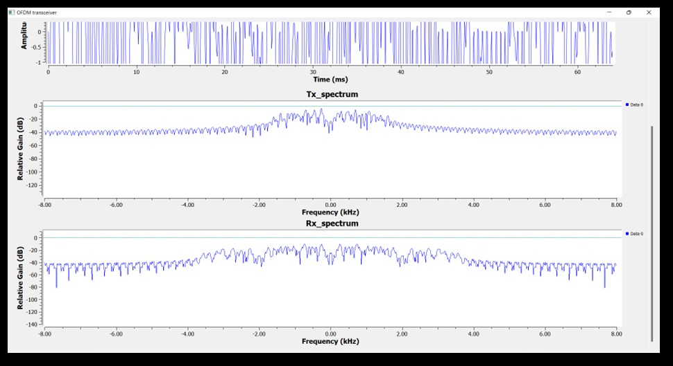
RESULT

Slide 22
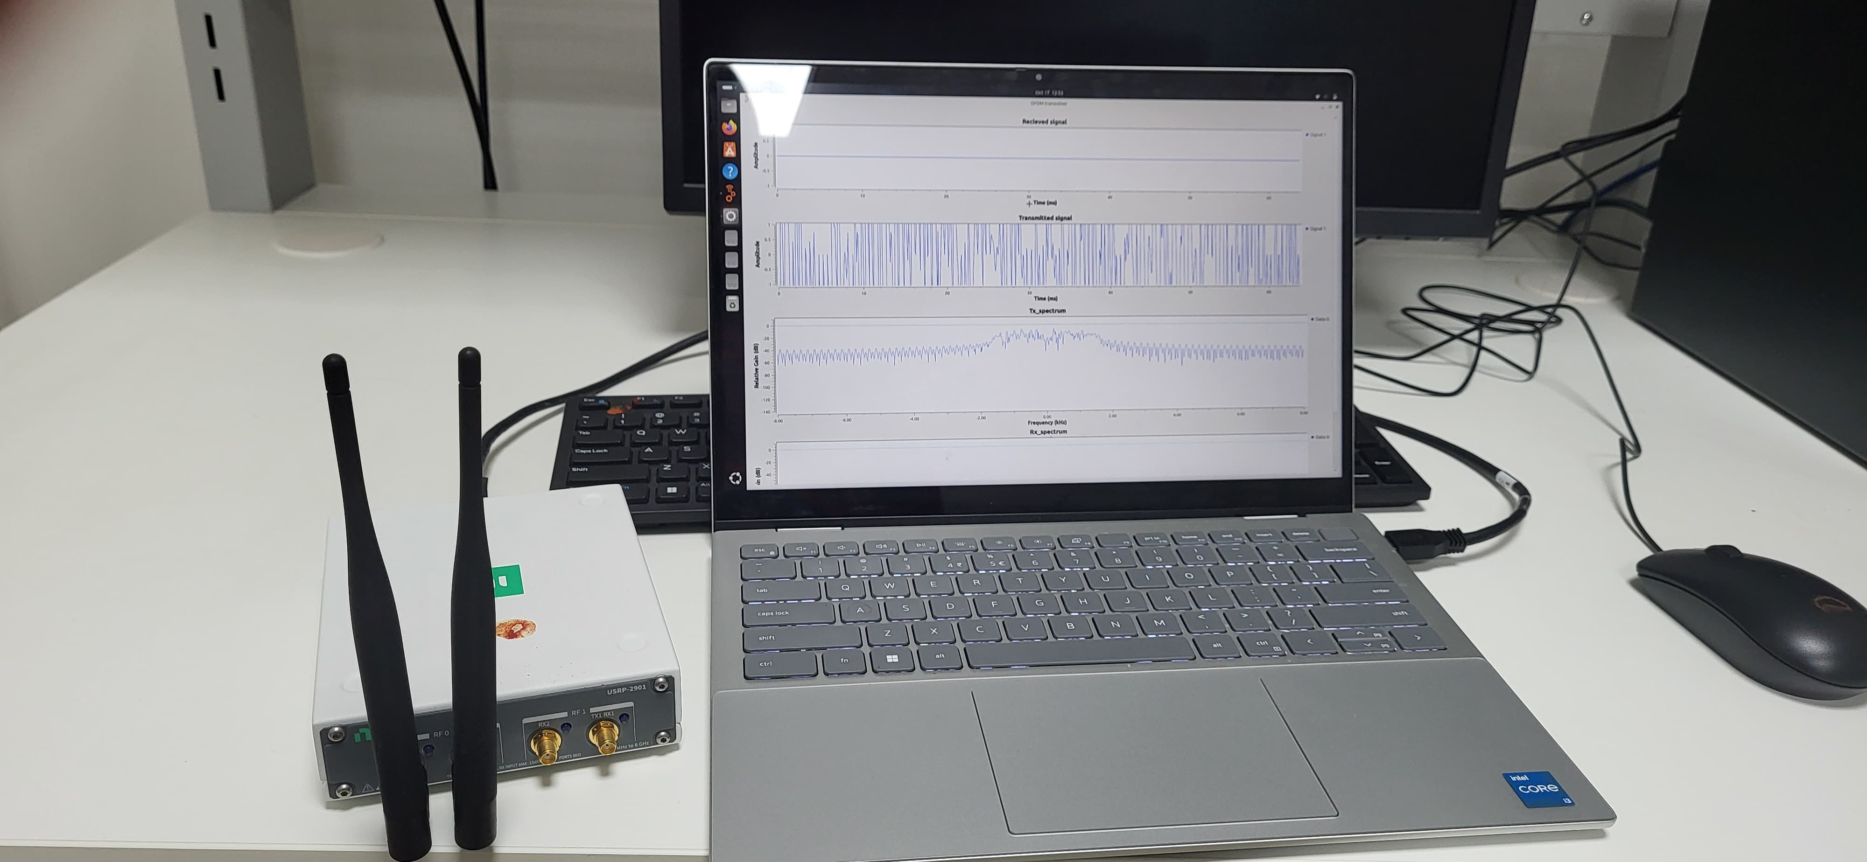
RESULT

Slide 23

THANK YOU

