Slide 1
OOPS Through JAVA WEEK 2 -Orientation
-MSIT

Slide 2
Mini Project : PayPal Software System
In this project we will Design a PayPal Software System Using Object Oriented Design paradigm and Implement it Using Java Programming Language.

Slide 3
Main Objectives
Design PayPal Software System
Implement PayPal Software System
Development Environment : Eclipse IDE
Using JAVA Language with OOPS concepts

Slide 4
What is PayPal System
PayPal is an e-commerce business allowing payments and money transfers to be made through the Internet.
PayPal serves as an electronic alternative to traditional paper methods such as cheques and money orders.
A PayPal account can be funded with an electronic debit from a bank account or by a credit card.
The recipient of a PayPal transfer can request a check from PayPal, establish their own PayPal deposit account or request a transfer to their bank account.

Slide 5
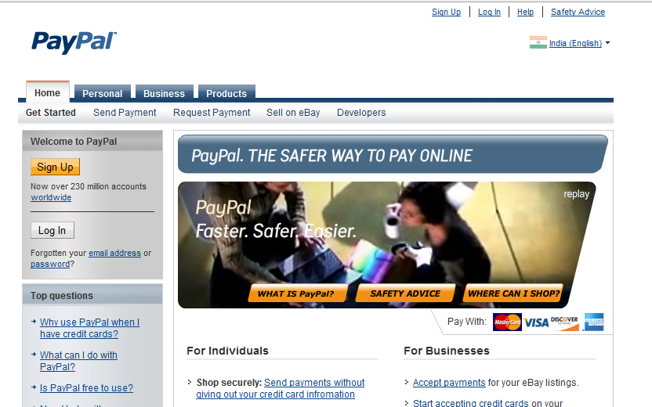
PayPal and Access

Slide 6
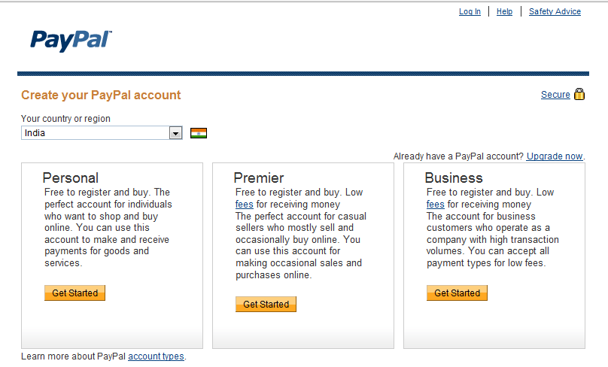
Types of Accounts

Slide 7
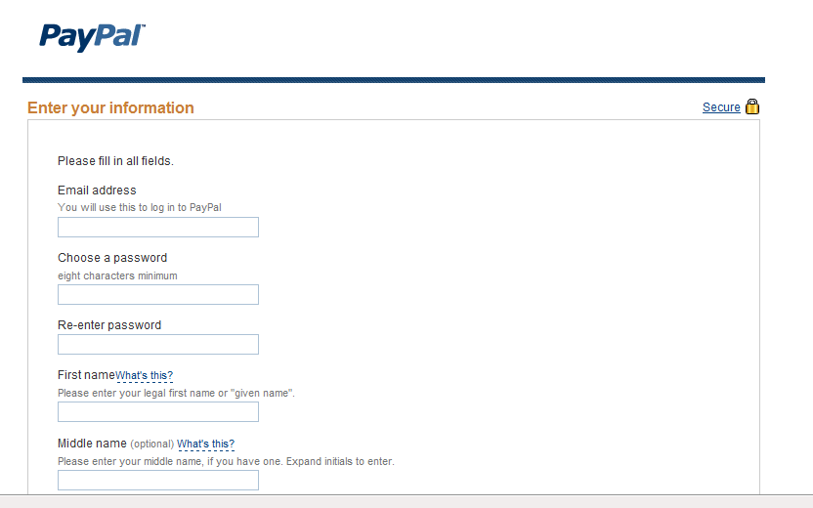
PayPal Registration form

Slide 8
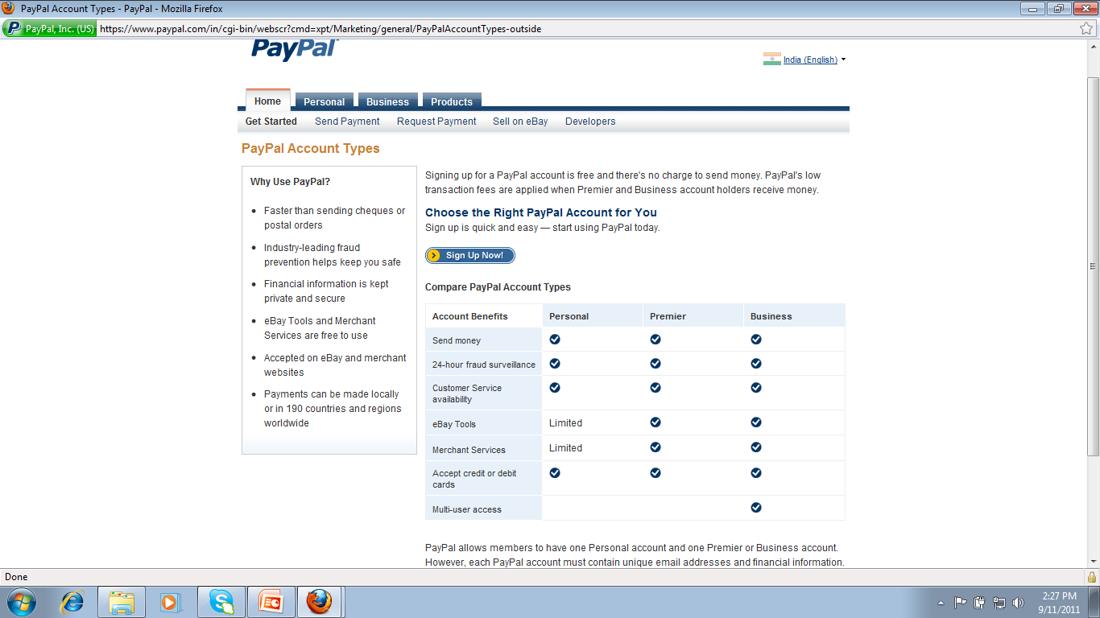
PayPal accounts and Properties

Slide 9
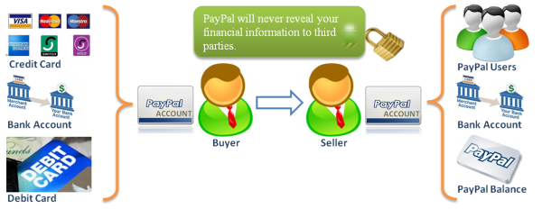
PayPal is safe and secure

Slide 10
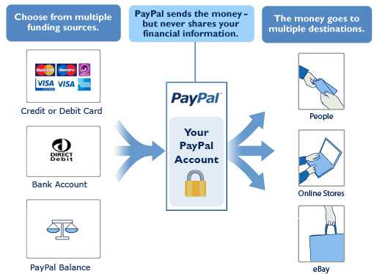
PayPal process

Slide 11
Project Description
PayPal is the safer, easier way to pay.
PayPal users can use their credit card or bank account without exposing their account numbers.
They can link credit card or bank account to their PayPal account.
PayPal users can open 3 types of accounts, Personal, Student and Business.

Slide 12
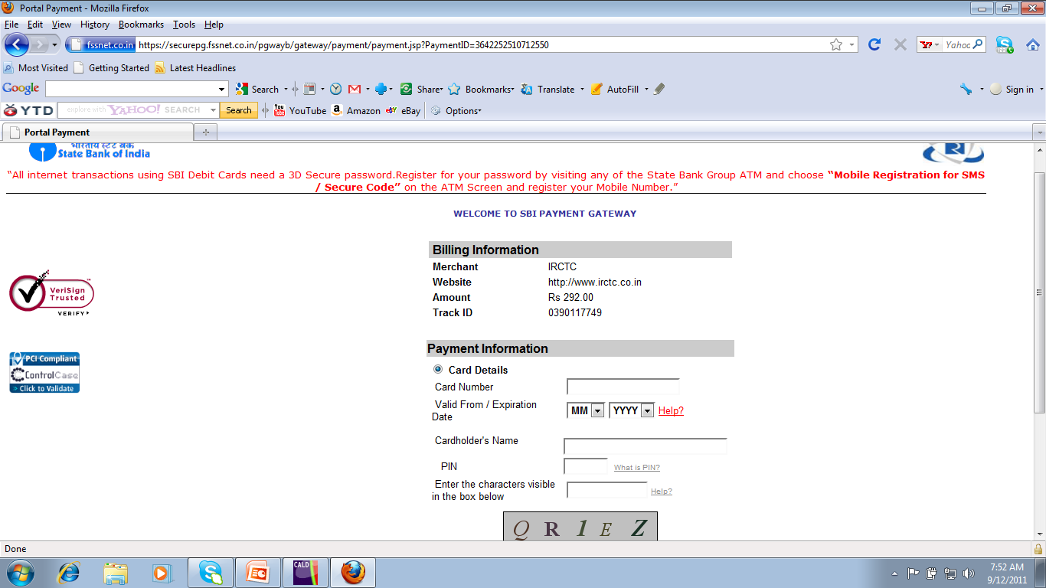
Typical online transaction

Slide 13
Contd..
In order to open a PayPal account users need an email address and a funds source.
Funds source, in case of personal and business accounts, can either be a bank account and/or credit/debit card.
Funds will be added to the PayPal account as authorized by the user of the account.

Slide 14
Contd..
Student account fund source can only be another PayPal account (usually the account holders are parents of students).
A user of the PayPal account can add funds into his/her account from a bank account or debit/credit card and vice versa.
They can send money to anyone who has an email address and request for money from anyone .

Slide 15
Contd…
Invoice can be created and sent as a payment request against to the email address.
In this Project We need to use Files for Information Storage Purpose.
Data should be stored in terms of Objects into a file Using Object serialization .
It’s Purely Console Based Project .
Finally This Project Should Simulates the PayPal System.

Slide 16
Basic Functionalities of PPS
Create PayPal Account
Activate/Suspend/Respond SMS a PayPal Account
Add/Withdraw Funds
Send /Request Money

Slide 17
Project Plan –Week2 Schedule
Module 1: OO Analysis & OO Design of the PayPal Console
Module 2: Skeleton code and Test cases of Pay Pal Console
Implementation & Testing
Module 3: Create a new PayPal account
Module 4 &5: Account home screen and Account Activation
Module 6: Add and Withdraw funds
Module 7: Send and Request funds
Module 8: Improving the PPAccountScreen
Module 9: Generate System Status Reports
Module 10: Integration followed by Project DEMO’s
Saturday : Project DEMO’s and End Exam

Slide 18
Thank you

