Slide 1

READER 9
Version 1.0.2 α
Gowtham Ganguri- 201285087
Santosh Kiran-201285088
Venkata Praveen-201285100

Slide 2
INTRODUCTION
About e-book reader
Use case models
Story board
Client perspective
Life cycle models
Project plan
Resources

Slide 3
ABOUT EBOOK
One click access
Sequential access
Personalized reading
Tag, highlight, note in pages
Search, read, delete, update
Shelf arrangement
Download

Slide 4
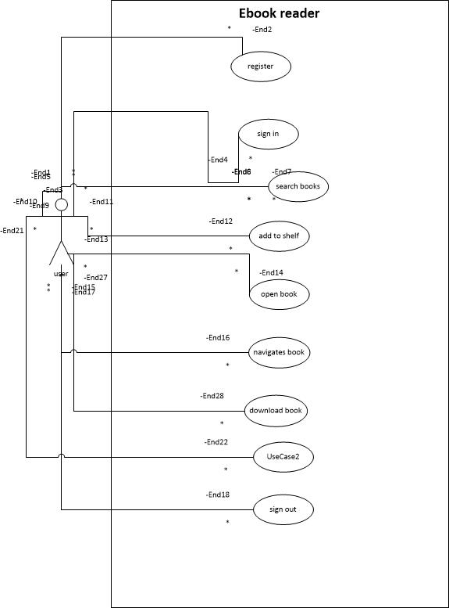
USE CASE MODEL

Slide 5
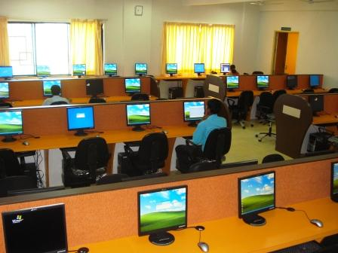

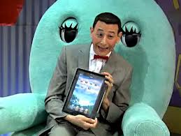
BACK STORY
Students cannot carry all books to where ever they want.
Digitization swept into every aspect of learning.
Books are digitized and stored in huge databases and are made available to the student at all time.
Student can download those books and use it as they wish.

Slide 6

SEQUENCE FLOW

Slide 7
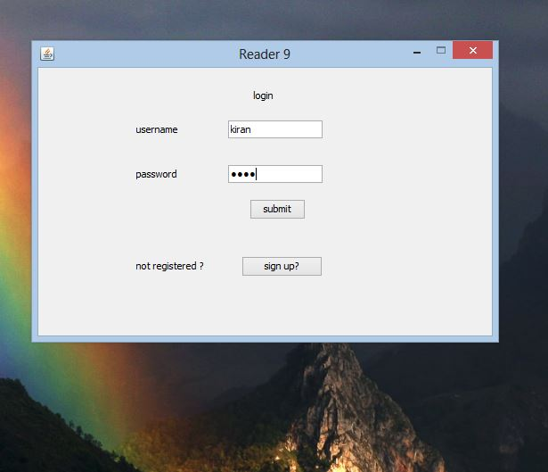
SIGN IN

Slide 8
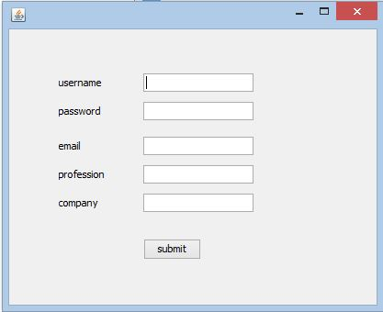
REGISTRATION

Slide 9
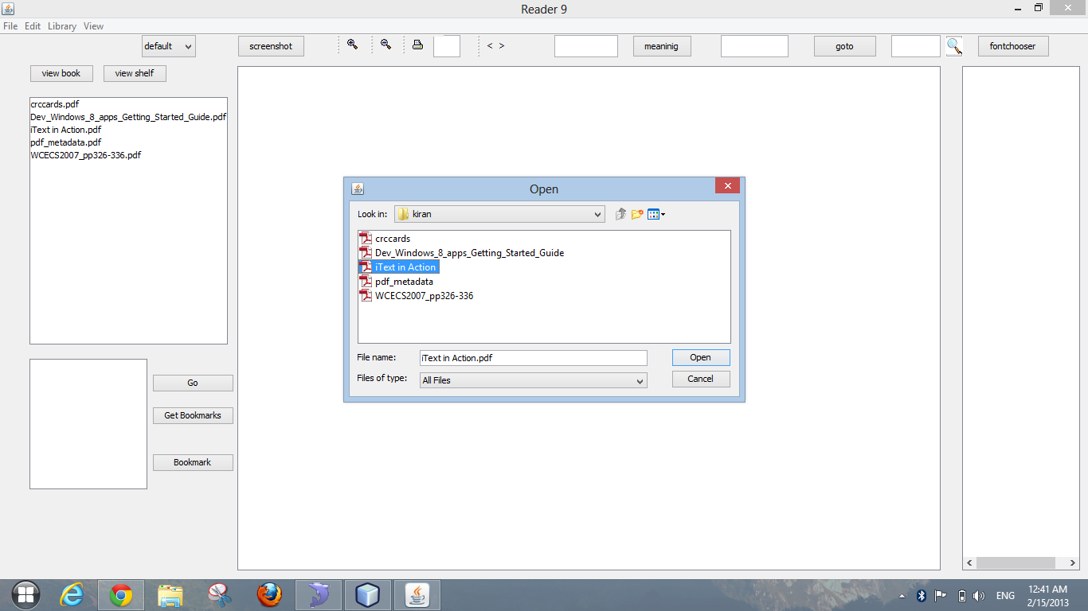
OPEN & DELETE BOOK

Slide 10
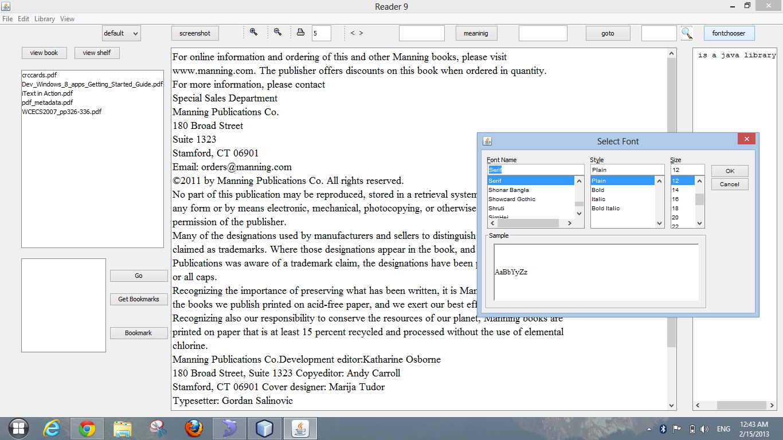
TEXT MENU

Slide 11
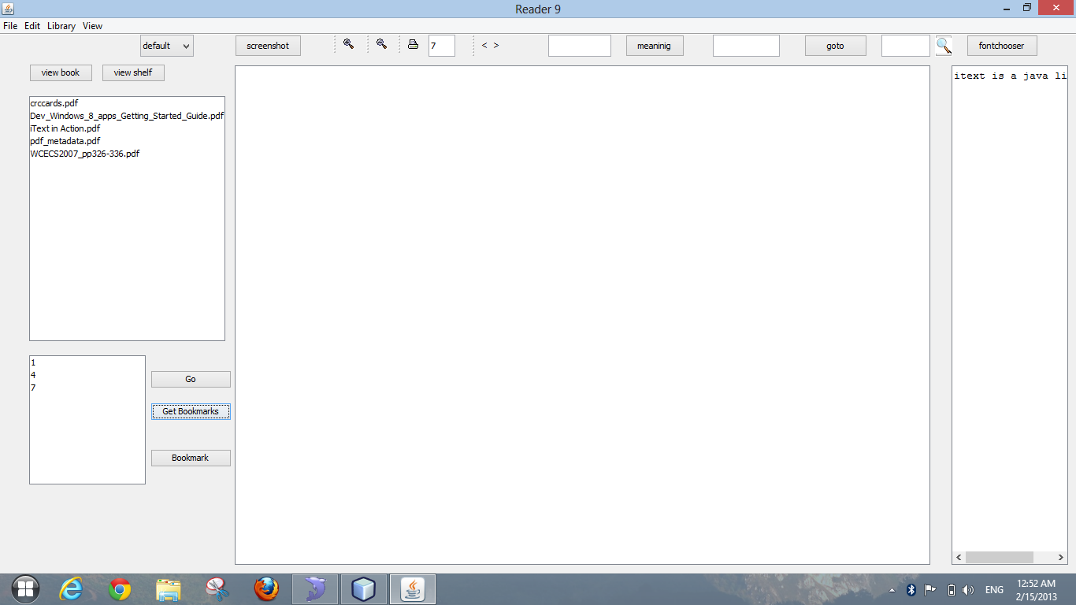
BOOKMARKS & NOTES

Slide 12
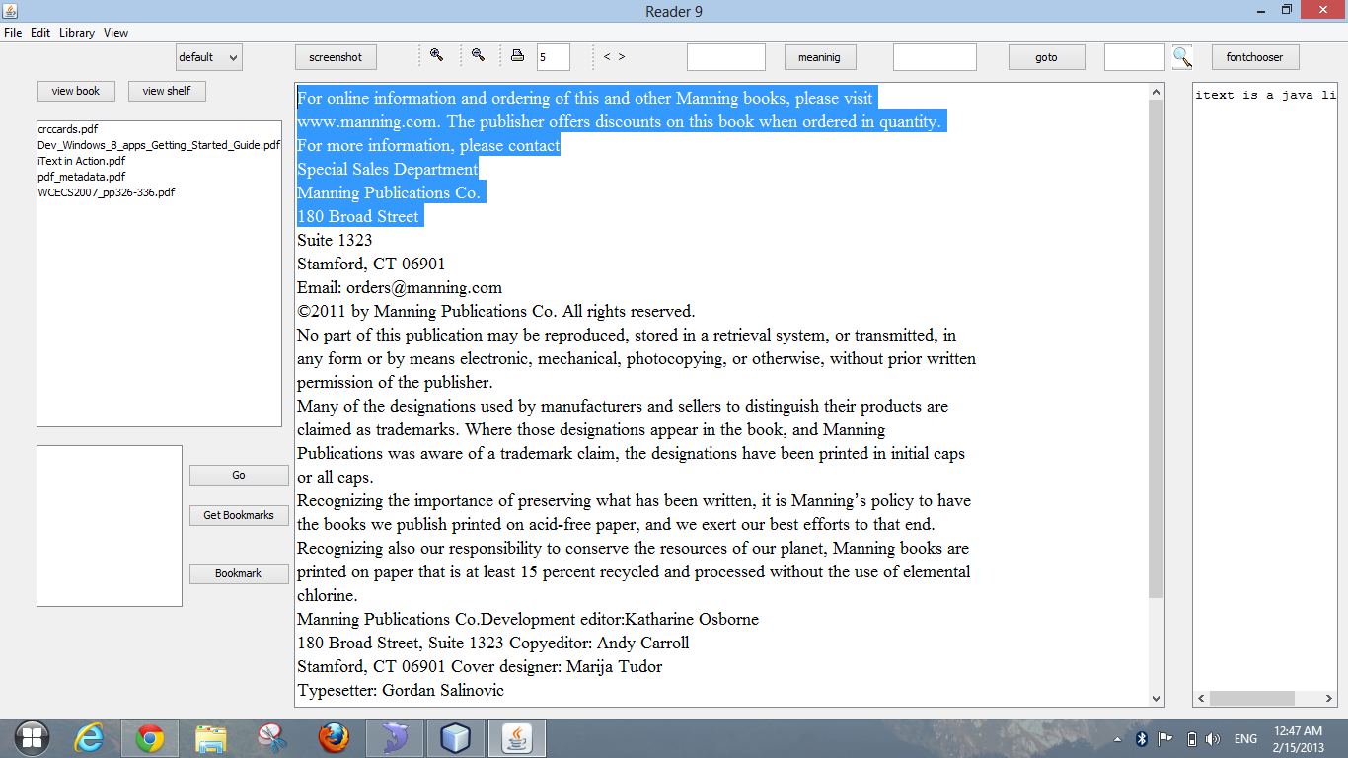
HIGHLIGHT

Slide 13
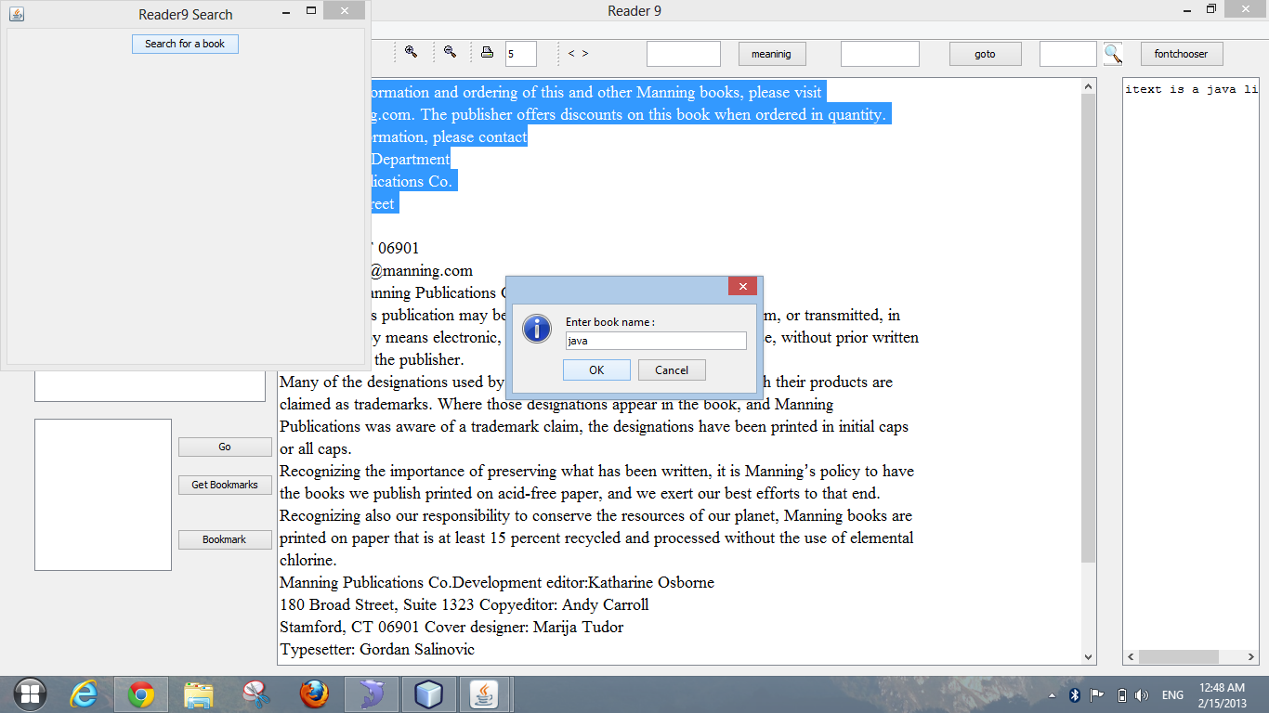
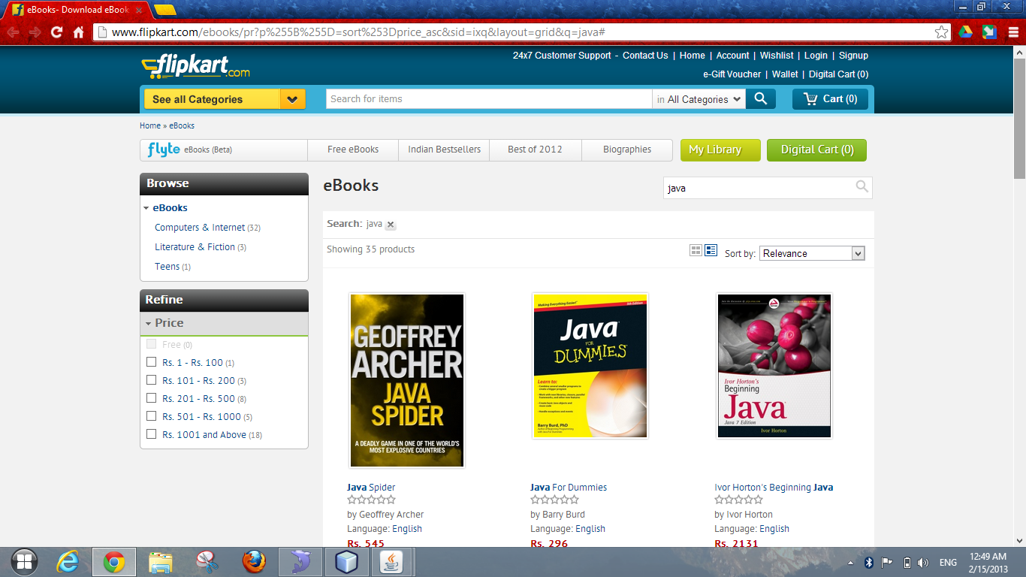
BUY BOOK

Slide 14
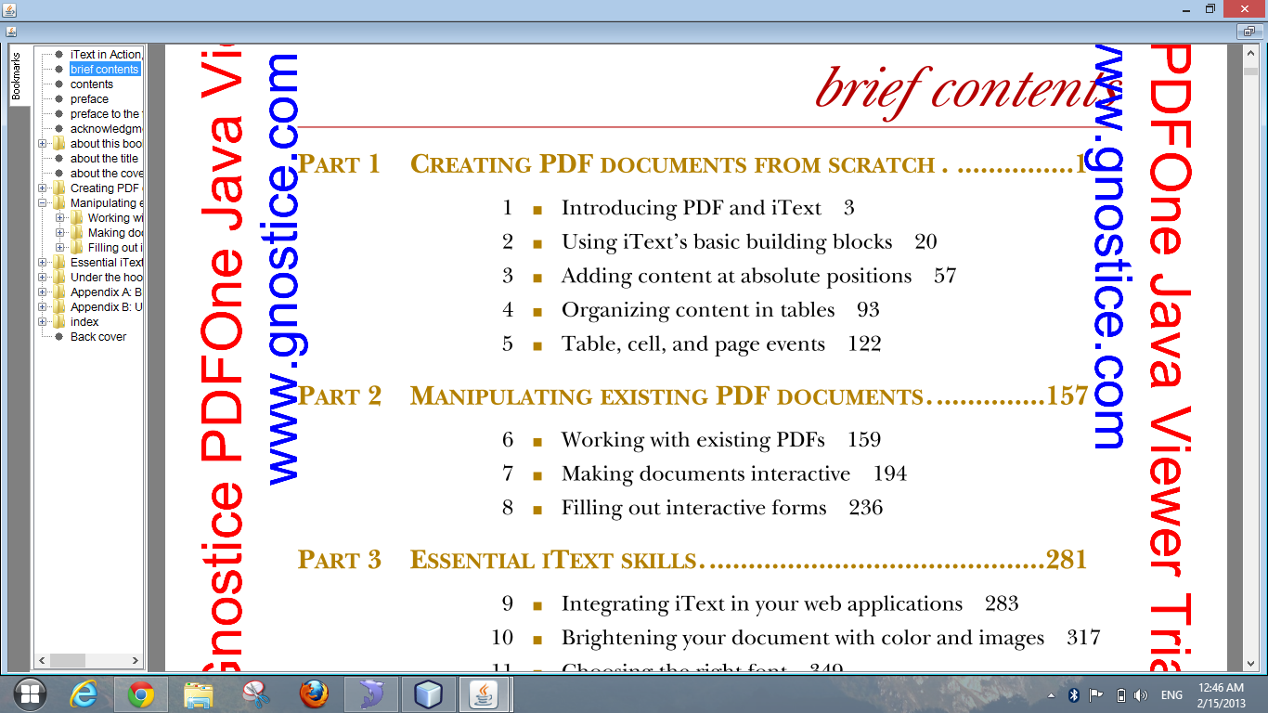
VIEW MODE

Slide 15
LIBRARY
*
*graphical representation ,original may vary

Slide 16

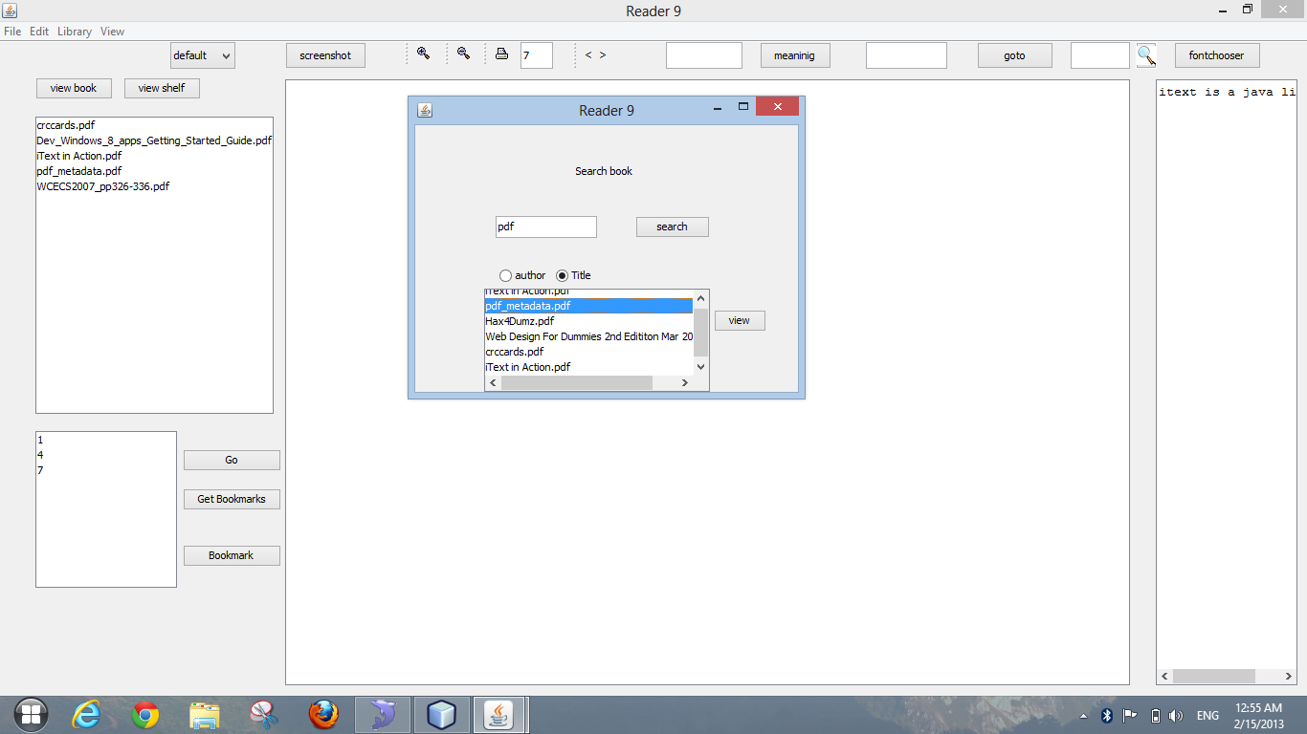
BOOK SEARCH

Slide 17
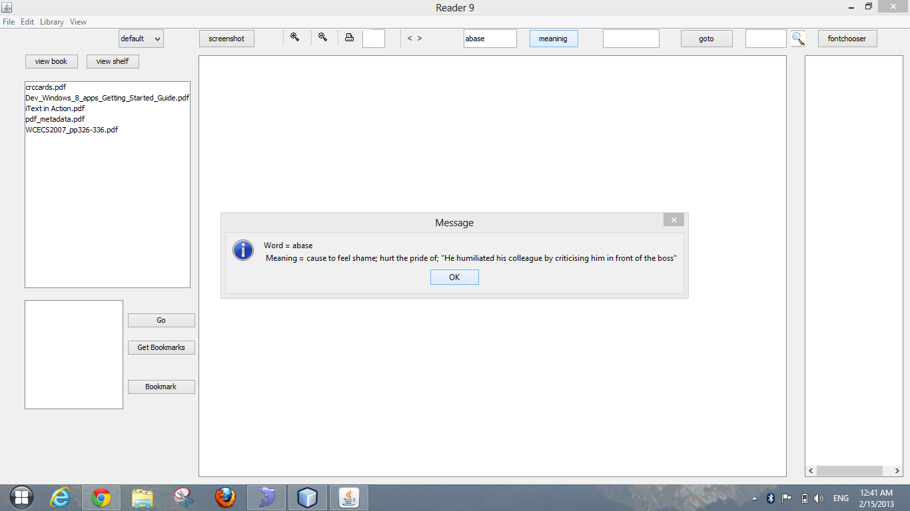
OTHER FEATURES

Slide 18
LIFE CYCLE MODEL UNIFIED PROCESS- ITERATION & INCREMENT
CLIENT’S PERCEPECTIVE
 | Inception | Elaboration | Construction |  | Transition
Requirements Analysis AND Design Implementation Testing Deployment | Iteration 0 | Iteration 1 | Iteration 2 | Iteration 3 | Iteration 4

Slide 19
Till now phases completed are
Inception
Elaboration 1
So, we now finally gathered requirements and designed the models by analyzing.
If client is satisfied with the progress implementation for first iteration could be started

Slide 20
Assumptions
Client should have computer system with minimum 1 gb ram and 500 mb of free storage space
For online e book search, the computer should be connected to internet

Slide 21
PROJECT PLAN
The plan is to implement the product using the above requirements as beta version
Client reviews the product and specifies additional requirements.
Again these requirements are updated in next iterations.
Thus gradual increment of the project is done
This iteration continues till client is satisfied

Slide 22
RESOURCES
Several high level tasks like arranging book shelf and download book from internet is major part of development
Resources like
Internet
Java
Tools

Slide 23
THANK YOU

Slide 24
Contirbutions
201285088,201285087,201285100 - contributed for inception ,elaboration, and design including project plan,sdlc reference, back story

