Slide 1

READER 9
Version 1.0.2 β
Gowtham Ganguri- 201285087
Santosh Kiran-201285088
Venkata Praveen-201285100

Slide 2
INTRODUCTION
Problem Specification
About e-book reader
Uml Diagrams
Screenshots
Technical Specifications
Future enhancements

Slide 3
Problem specification
Display the contents of a pdf file into digital format and facilitate with following features:
Displaying the contents of book
Ease of Navigation
One click access
Ability to read pdf files

Slide 4
ABOUT EBOOK
One click access
Sequential access
Personalized reading
Highlight, note in pages
Search, read, delete
Download

Slide 5
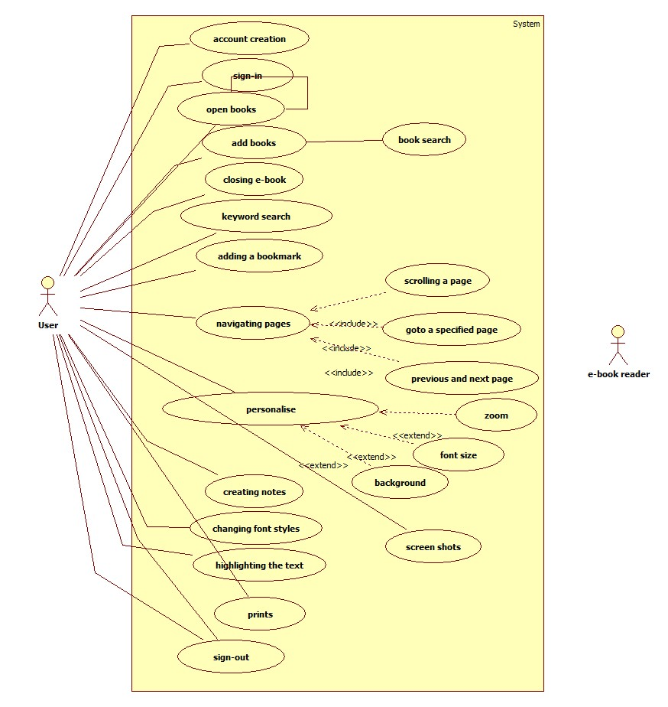
USE CASE MODEL

Slide 6
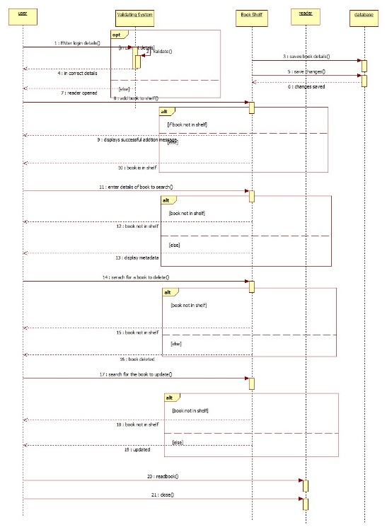
Sequence diagram

Slide 7
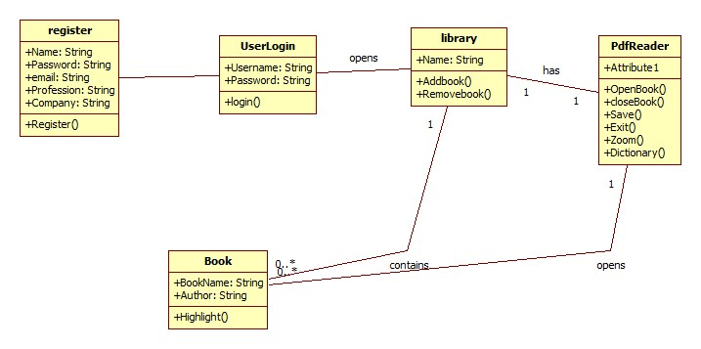
Class diagram

Slide 8

SEQUENCE FLOW

Slide 9
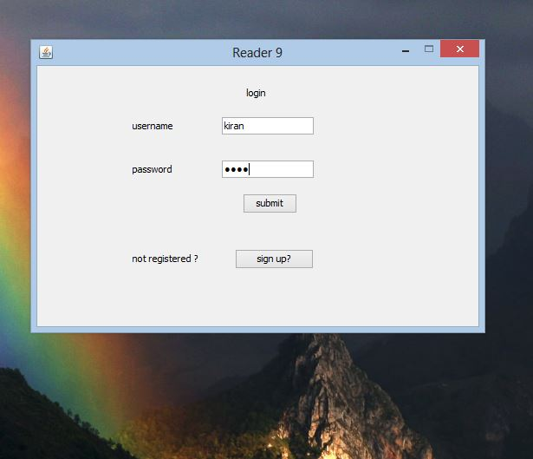
SIGN IN

Slide 10
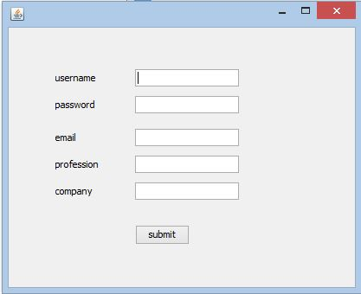
REGISTRATION

Slide 11
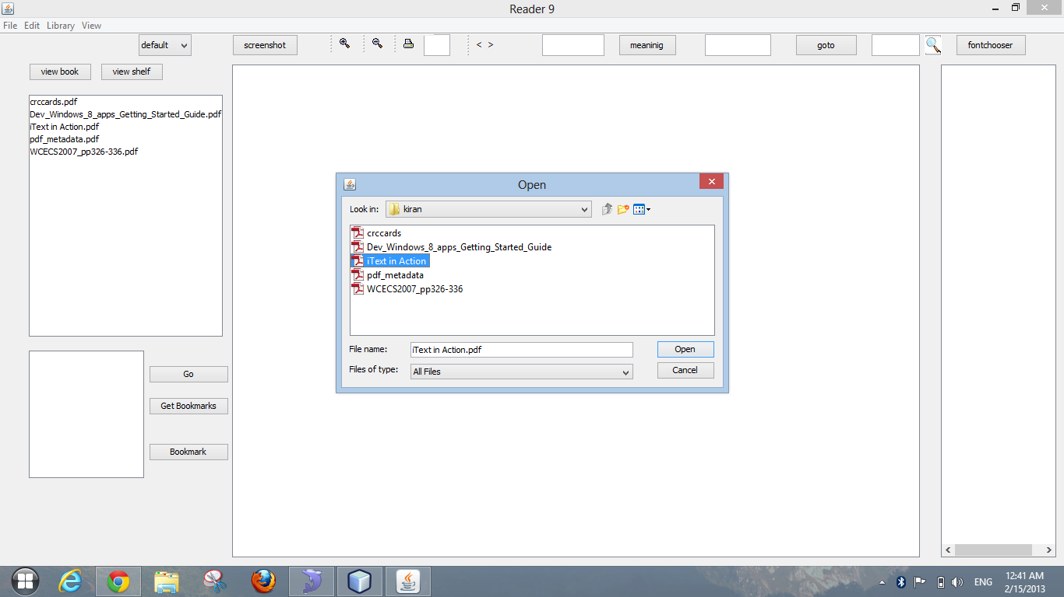
OPEN & DELETE BOOK

Slide 12
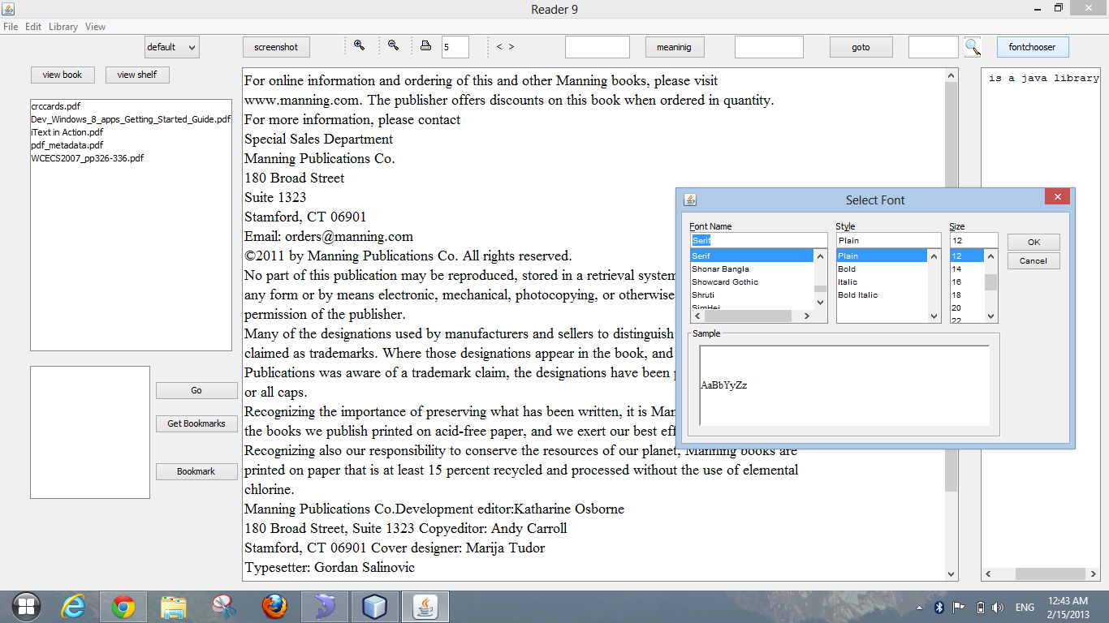
TEXT MENU

Slide 13
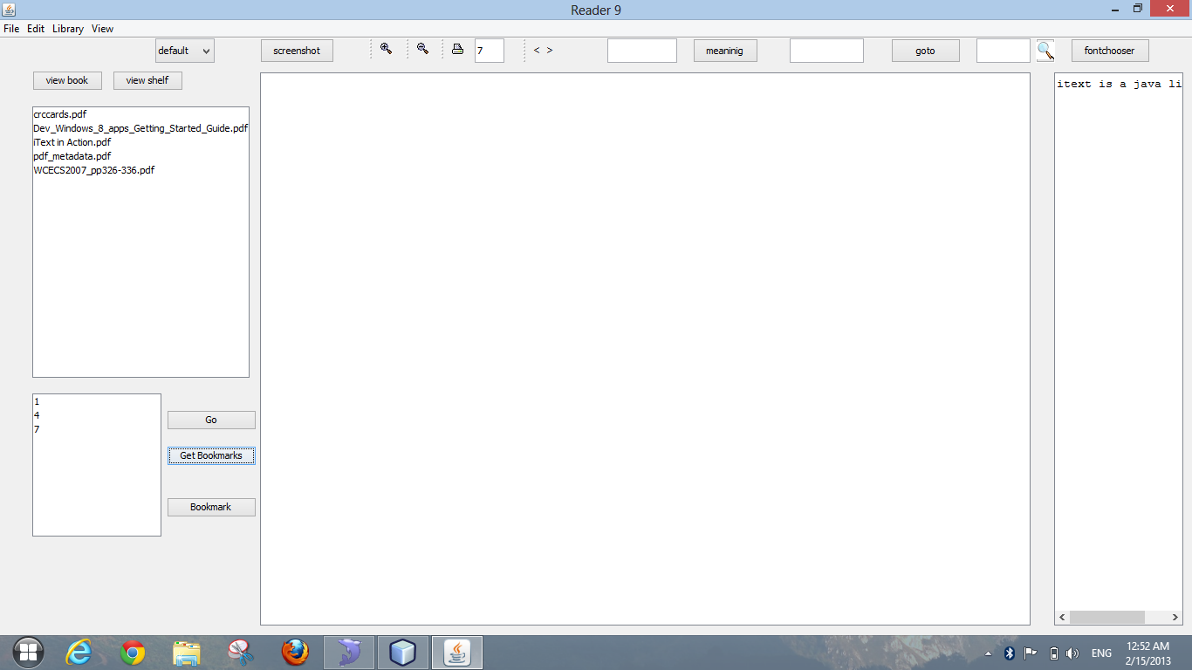
BOOKMARKS & NOTES

Slide 14
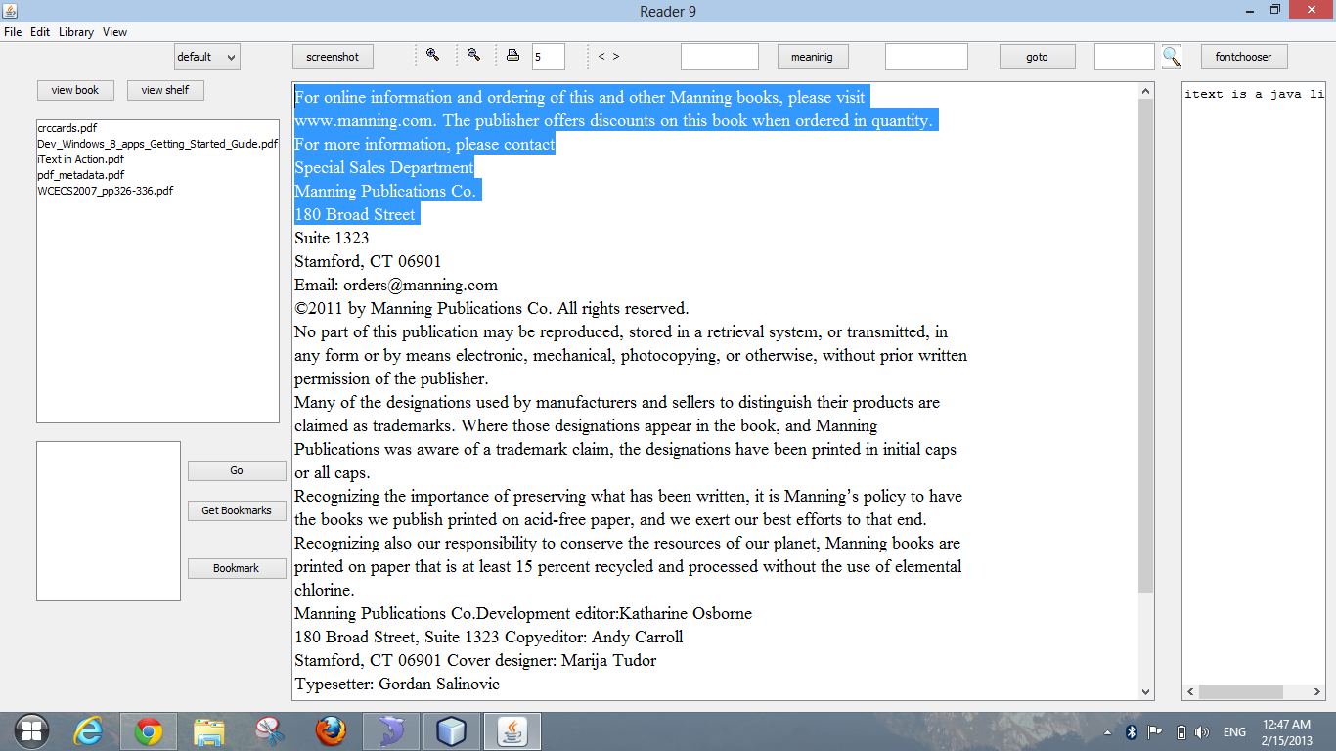
HIGHLIGHT

Slide 15
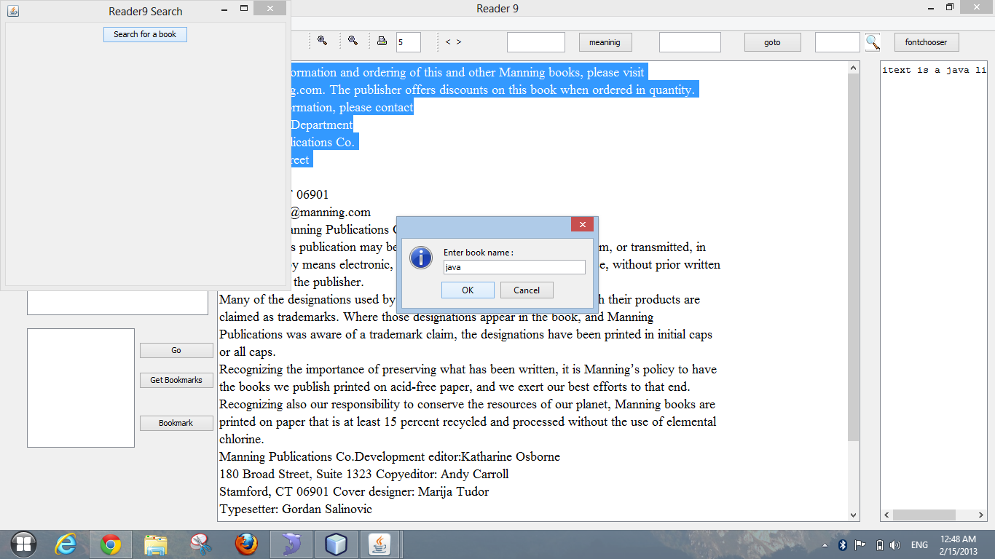
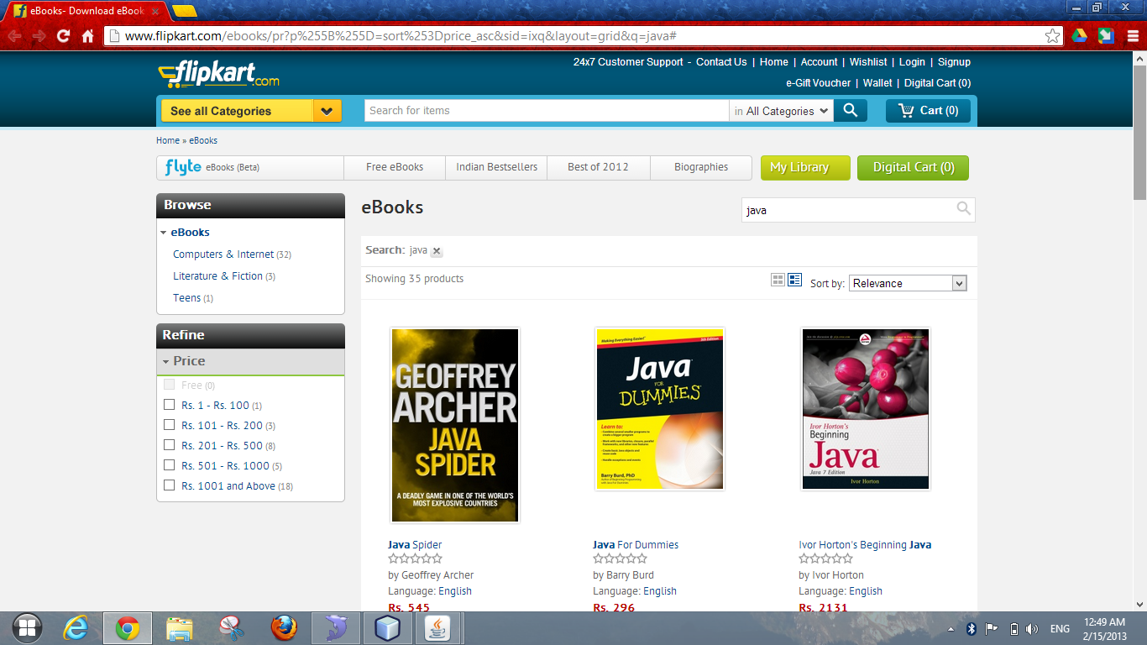
BUY BOOK

Slide 16
LIBRARY
*
*graphical representation ,original may vary

Slide 17
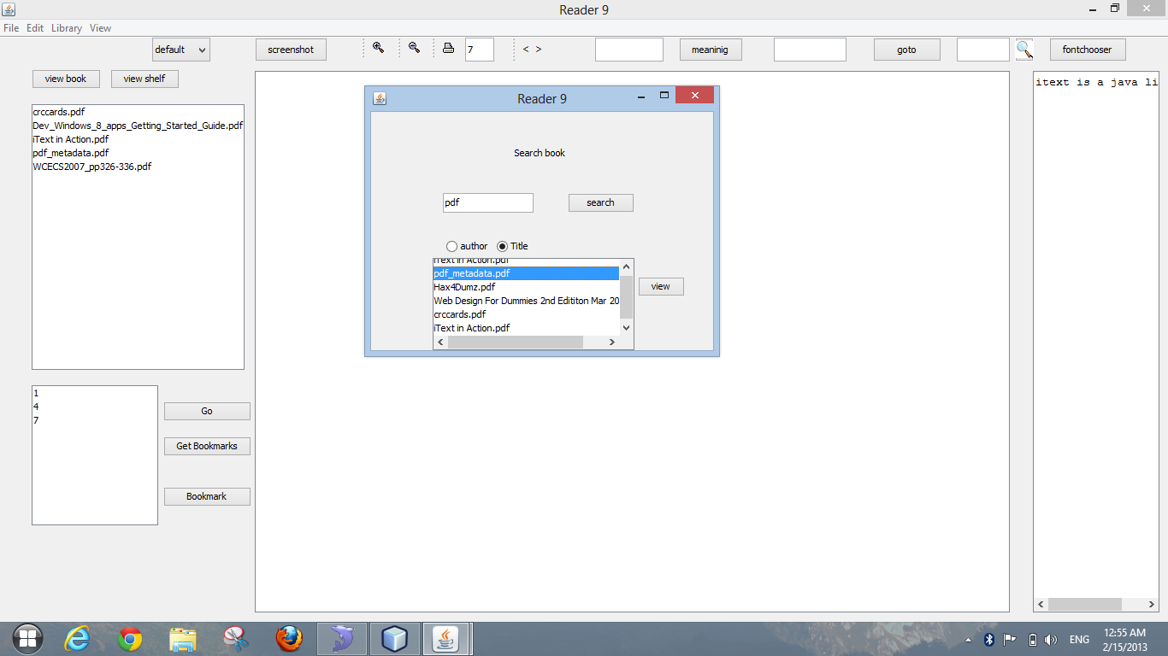

BOOK SEARCH

Slide 18
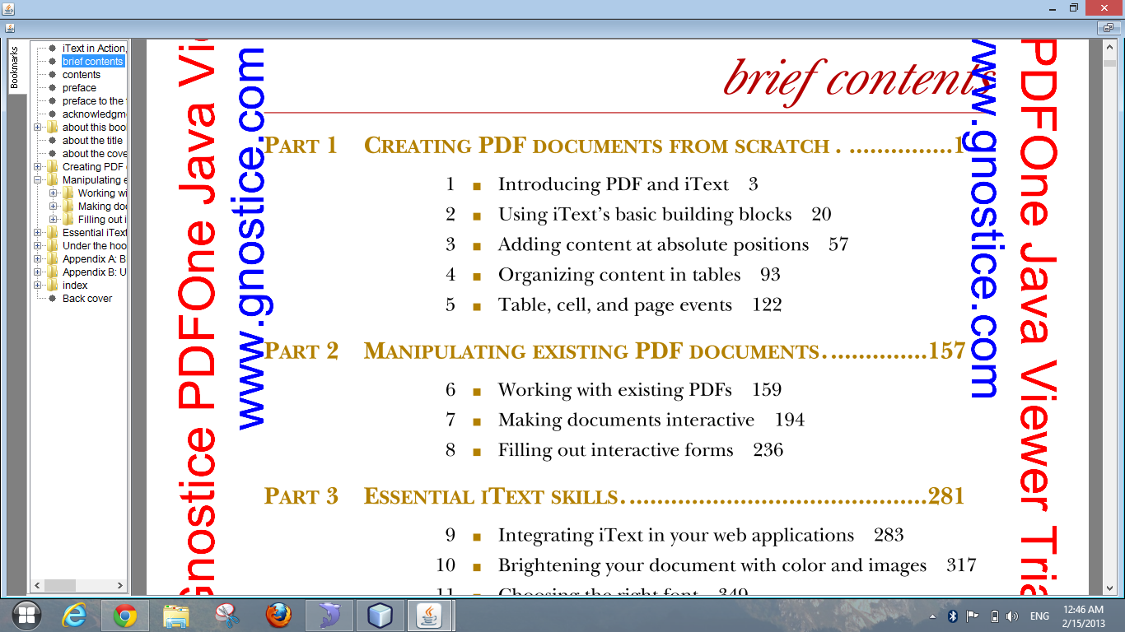
VIEW MODE

Slide 19
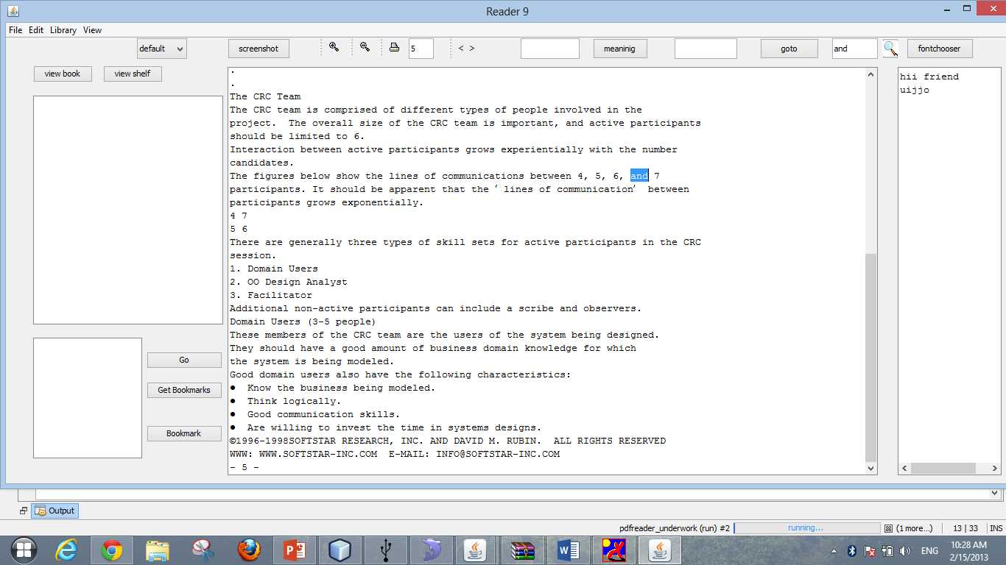
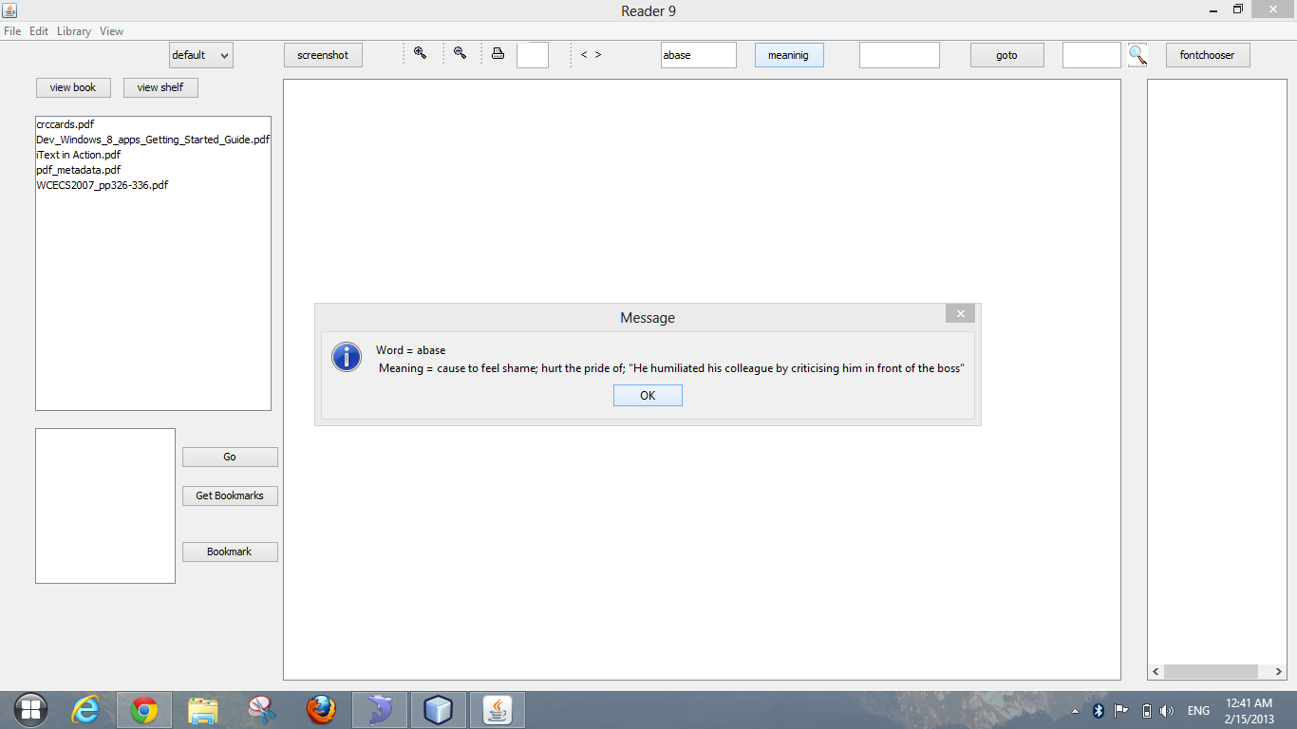
OTHER FEATURES

Slide 20
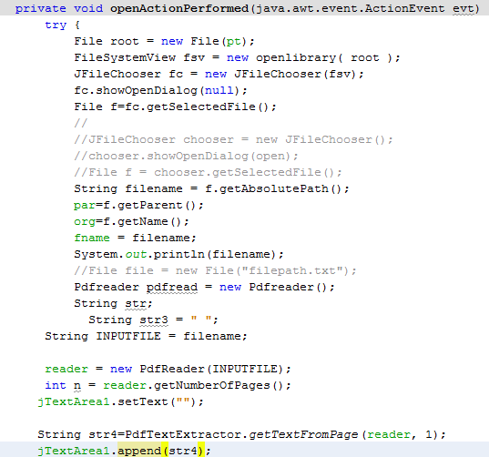
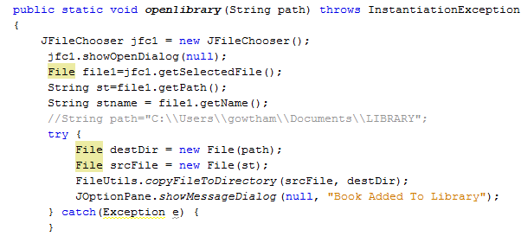
Code snippets
Opening book
Adding books

Slide 21
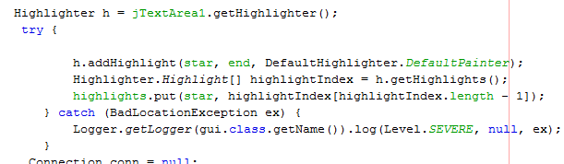
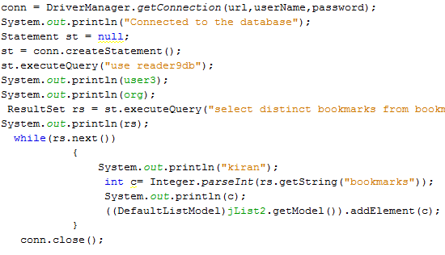
Code snippets
Highlighting
Book marks

Slide 22
Technical specifications
Tool used : Netbeans IDE 7.3 RC2
Language : JAVA
Libraries : itext pdf library ,pdfone

Slide 23
Future enhancements
Complete support for pdf files
Creating pdf along with reading
Grid view

Slide 24
THANK YOU

Slide 25
Contirbutions
201285088,201285087,201285100 - contributed for inception ,elaboration, and design including project plan,sdlc reference, back story

