Slide 1
SECURE DATA HIDING IN IMAGES USING STEGNOGRAPHY
SECURE THE DATA TO PREVENT HACKER.
Presented By:
KIRAN K.M
MCA
JSS COLLAGE OF ARTS SCIENCE AND COMMERCE OOTY ROAD MYSORE

Slide 2
OUTLINE
Problem Statement
Technology used
Wow factor
End users
Result
Conclusion
Git-hub Link
Future scope

Slide 3
Problem Statement
Hide messages inside images securely
Encrypt messages with a password
Decrypt hidden messages if the correct password is provided
User-friendly GUI built with Tkinter
Supports PNG image format

Slide 4
Technology used
Python 3
OpenCV (cv2) for image processing
Tkinter for GUI
Cryptography module (Fernet) for encryption
NumPy for handling image arrays
Base64 for encoding and decoding binary data and form base64 strings
Hashlib for efficient hashing of a file

Slide 5
Wow factors
Tkinter-based interface
Input fields for secret message and password
Buttons for encoding and decoding messages
File selection dialog for choosing images

Slide 6
End users
Cybersecurity Professionals
Journalists & Whistleblowers
Government & Intelligence Agencies
Corporate Organizations
Military & Defense
Forensic Investigators
Privacy Advocates
Hackers & Cybercriminals

Slide 7
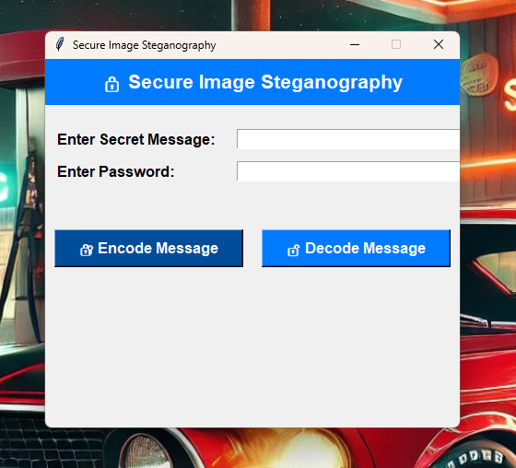
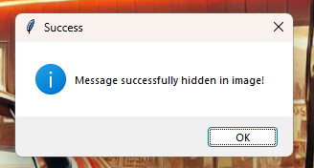
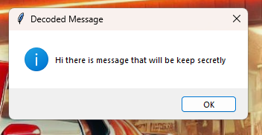
Results

Slide 8
Conclusion
Provides a secure way to hide messages in images.
Successfully implemented image steganography with encryption.
Password protection ensures security.

Slide 9
GitHub Link
https://github.com/kirankm0215/kiran-project.git

Slide 10
Support for different image formats.
Mobile app version.
Advanced encryption techniques.
Future scope(optional)

Slide 11
THANK YOU

