Slide 1
MSc Data Science
Energy Consumption Analysis and Optimizations for Scottish Councils Name: Kirankumar Chaudhary
Matriculation number : 2120051
Course: MSc Data Science
School : School of Computing

Slide 2
Motivation, Aims and Objectives
The motivation behind this project is to leverage advanced data analytics and machine learning to provide a comprehensive understanding of energy consumption patterns and energy type is consumed in the Scottish council area. By conducting exploratory data analysis (EDA) and developing predictive models, we can facilitate informed decision-making by various stakeholders, including government authorities, utility companies, and end-users.
Collect energy consumption data for Scottish council area spanning over 2005- 2020 from open-source websites. Perform exploratory data analysis to gain insights into the data, identify patterns, correlations, and anomalies. Develop business intelligence dashboard to effectively visualize the data. Develop machine learning models to predict energy consumption accurately. Deploy the machine learning models and the algorithms for optimization of energy consumption.

Slide 3
Design / Project Plan
A well-structured project plan is essential to ensure the successful completion of any project. Here is a detailed project plan for my project:
Data Collection: Collect energy consumption data for Scottish council areas from 2005-2020 from the Scottish government website. Review and validate the data to ensure its quality and relevance.
Exploratory Data Analysis (EDA): Perform EDA using Python and Jupyter Notebook. Conduct data inspection, univariate and bivariate analyses Create charts to visualize findings and gain insights.
Dashboard Development: Develop a Business Intelligence (BI) dashboard using Power BI. Incorporate interactive visualizations to allow users to explore the data and discover insights.
Machine Learning Model Development: Label encoding of categorical values as machine learning algorithms takes only numerical input. Split the data into training, validation, and testing sets. Develop multiple machine learning models, including Linear Regression, SVM, ANN, and XGBoost. Train, validate, and test each model.
Model Selection: Measuring their performance using metrics such as R- squared (R2) score, Mean Absolute Error (MAE), and Mean Squared Error (MSE). and evaluate the performance of the developed models. Select the best-performing model for deployment.
Model Deployment: The best model will be deployed using Flask, a lightweight Python web framework, and tested using Postman, an API testing tool.
Documentation and Reporting: Document the entire project, including methodology, code, results, and insights. Create a final report summarizing the project findings, key insights, and model performance.

Slide 4
EDA
The analysis of energy consumption in Scotland between 2005 and 2020 reveals several important insights.
There has been a general downward trend in total energy consumption, possibly attributable to increased energy efficiency measures, a shift towards cleaner energy sources, and changes in the economy or industrial activities during this period.
Regional disparities in energy consumption across different council areas were observed, with Falkirk, Fife, and Glasgow City having the highest energy consumption levels, and Orkney Islands, Na h-Eileanan Siar, and Shetland Islands having the lowest. Understanding these regional patterns is crucial for developing targeted policies and resource allocation strategies to promote sustainable development.
The regional analysis of energy consumption shows that there are substantial differences in consumption patterns among the council areas. Glasgow City and Edinburgh consistently appear as top consumers in several sectors and energy types, likely due to their large populations and industrial presence. The data also highlights specific regions with high consumption within certain energy-consuming sectors, such as agriculture in Dumfries & Galloway or industrial activity in Falkirk.
Energy consumption varied across different energy-consuming sectors, with the Industrial, Domestic, and Road Transport sectors accounting for the most significant energy use. Additionally, it was found that Petroleum Products, Gas, and Electricity were the primary energy types used in these sectors. Therefore, promoting cleaner energy alternatives and improving energy efficiency should be targeted, especially in the most energy-consuming sectors.
Overall, the visualizations and observations from this analysis can serve as a valuable resource for policymakers, businesses, and communities in Scotland. By identifying the key trends and regional differences, targeted interventions can be implemented to further promote energy efficiency, adopt cleaner energy sources, and work towards a more sustainable energy future.

Slide 5

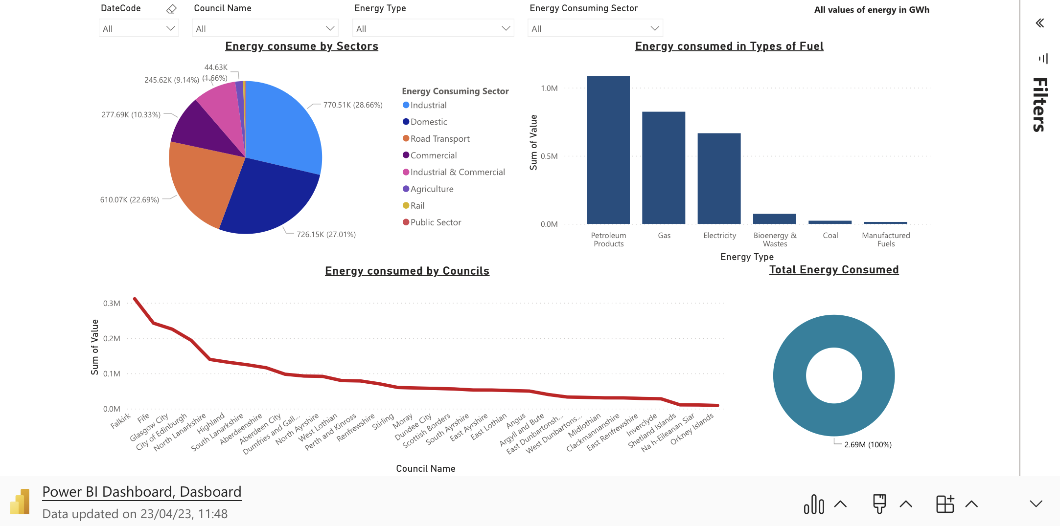
Microsoft Power BI

Slide 6
Machine Learning and Deployment
Four machine learning models will be developed for predicting energy consumption: Linear Regression, Support Vector Machines (SVM), Artificial Neural Networks (ANN), and XGBoost. Each model will be trained and evaluated using cross-validation, and their performance will be compared using R-squared (R2) score, Mean Absolute Error (MAE), and Mean Squared Error (MSE).
The best-performing model will be selected and deployed using Flask, a lightweight Python web framework.

Slide 7
Conclusion and future work
In conclusion, the project effectively addressed its primary aim of collecting and analyzing energy consumption data for Scottish council areas, developing an interactive dashboard to visualize the data, and deploying a predictive model for optimized energy consumption. Through this work, we have demonstrated the potential for data-driven decision-making in the realm of energy management and sustainability.
Looking forward, there are several opportunities to expand and improve upon the project. Additional data sources could be incorporated to provide a more comprehensive understanding of energy consumption patterns and the factors influencing them. Furthermore, the inclusion of other advanced machine learning techniques, such as deep learning, could potentially enhance the predictive model's accuracy.
Another direction for future work could involve exploring energy consumption patterns at a more granular level, examining individual households or buildings, and identifying potential inefficiencies or areas for improvement. This could aid in the development of targeted interventions and policies aimed at reducing energy consumption and promoting sustainable practices.
Lastly, the deployment of the predictive model as a web service could be enhanced to ensure scalability and improved user experience. Integrating the model with other web applications or services could extend its utility, allowing for broader access and impact on energy management and sustainability initiatives.

Slide 8
Thank You Very Much

