Slide 1
Final Project
KIRANKUMAR M,
2021503024,
Department of Computer Technology,
Madras Institute of Technology, Anna University

Slide 2
PROJECT TITLE
HYDROSAFE: ENHANCING WATER POTABILITY THROUGH PREDICTIVE ANALYTICS

Slide 3


AGENDA
Welcome to our journey through water potability prediction and public health enhancement. We begin with an Introduction, outlining the Problem Statement and Project Overview.
Transitioning to our Solution, we explore the predictive modeling approach, discussing methodologies and algorithms.
In the Model Building section, we uncover the neural network architectures and optimization techniques used to train our models.
Finally, in the Implementation segment, we showcase the real-world application of our solution in enhancing public health and water safety initiatives. Join us as we navigate towards a future of accessible and safe drinking water, guided by data-driven insights.
3/21/2024 Annual Review

Slide 4

PROBLEM STATEMENT
In the realm of public health and environmental safety, ensuring access to clean and potable water is paramount. However, conventional methods of water quality assessment often rely on labor-intensive and time-consuming manual inspections, leading to inefficiencies and potential oversights.
Developing an automated solution for water potability prediction is imperative to streamline the monitoring process, mitigate risks, and safeguard public health. By harnessing advanced analytics and predictive modeling techniques, we aim to create a system capable of accurately assessing water quality, enabling timely interventions, and facilitating informed decision-making for water treatment facilities and public health authorities

Slide 5

PROJECT OVERVIEW
Our project aims to innovate water safety monitoring by constructing an intelligent predictive system for water potability assessment. Leveraging advanced data analytics and machine learning techniques, we aspire to develop a solution that not only ensures the accuracy of water quality evaluation but also facilitates proactive interventions and strategic resource management.
Through this endeavor, we seek to enhance public health initiatives, streamline water treatment processes, and contribute to the broader goal of ensuring access to clean and safe drinking water for all.

Slide 6

WHO ARE THE END USERS?
Water Quality Testing Laboratories: Laboratories specializing in water quality analysis can utilize our solution to streamline the testing process and ensure accurate and timely assessments.
Industrial Facilities: Manufacturing plants, refineries, and industrial sites that rely on water for their operations can implement our system to monitor water quality and compliance with environmental regulations.
Agricultural Sector: Farms and agricultural enterprises can benefit from our solution to assess the quality of irrigation water and prevent contamination of crops and livestock.
Residential Consumers: Individuals and households concerned about the quality of their drinking water can access our solution to monitor water safety and make informed decisions about filtration and purification systems.

Slide 7

YOUR SOLUTION AND ITS VALUE PROPOSITION
Solution:
Our solution employs machine learning algorithms, including Random Forest, XGBoost, and neural networks, to analyze water quality data and predict water potability. By training on a diverse dataset containing various water parameters, our model can effectively classify water samples as potable or non-potable based on their characteristics.
Value Proposition:
Accuracy: High accuracy rates ensure reliable predictions of water potability.
Efficiency: Automated assessment saves time and resources for water treatment facilities.
Adaptability: Versatile and applicable across different water sources and treatment processes.
Early Detection: Enables proactive measures by detecting water contamination early.
Public Health: Enhances public health outcomes by ensuring safe drinking water and reducing waterborne diseases.

Slide 8

THE WOW IN YOUR SOLUTION
Our solution excels in employing cutting-edge machine learning techniques to predict water potability with exceptional accuracy and efficiency. Here's why it stands out:
Advanced Technology: Leveraging state-of-the-art algorithms and neural networks, our model delivers precise predictions of water quality.
Robust Data Analysis: Thorough data preprocessing ensures dataset integrity, enabling reliable predictions across diverse water sources.
Adaptability: Our solution seamlessly adjusts to different treatment processes, making it versatile and applicable in various contexts.
Real-Time Monitoring: With real-time analysis capabilities, our solution enables proactive measures to address water contamination swiftly.
Public Health Impact: By ensuring safe drinking water and reducing waterborne diseases, our solution significantly improves public health outcomes.

Slide 9
MODELLING
Data Preparation:
Utilize a comprehensive dataset containing water quality parameters and corresponding potability labels.
Perform data preprocessing, including handling missing values, scaling features, and splitting data into training and validation sets.
Model Architecture:
Construct a predictive model using machine learning algorithms such as Random Forest, XGBoost, and neural networks.
Implement ensemble methods to combine the strengths of multiple models and improve predictive performance.
Training and Evaluation:
Compile each model with appropriate hyperparameters, optimizer, and loss function.
Train the models on the training data and evaluate their performance using metrics like accuracy, precision, recall, and F1-score.
Fine-tune the models using techniques like grid search or randomized search to optimize performance further.

Slide 10
MODELLING
Predictive System Development:
Develop a robust system for predicting water potability based on input water quality parameters.
Implement preprocessing steps to handle incoming data and prepare it for prediction.
Deploy the predictive system to enable real-time monitoring of water quality and potability.
Technology Used:
TensorFlow and Keras for implementing neural networks and deep learning models.
Scikit-learn for implementing machine learning algorithms and model evaluation.
NumPy and pandas for data manipulation and handling.
Matplotlib and Seaborn for data visualization and result interpretation.

Slide 11
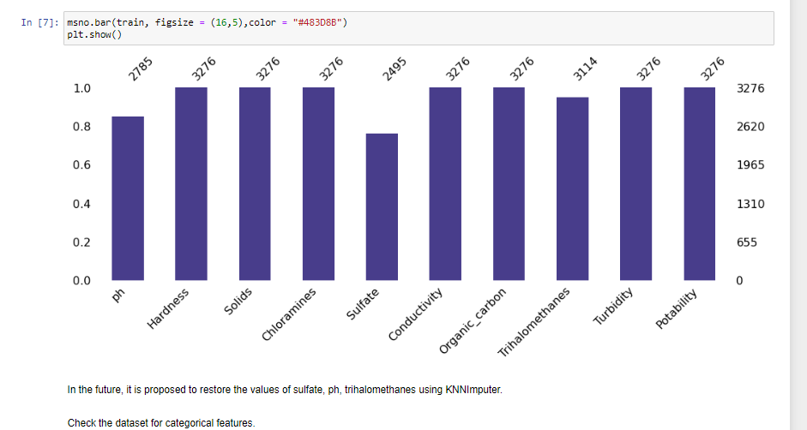
RESULTS
Demo Link

Slide 12
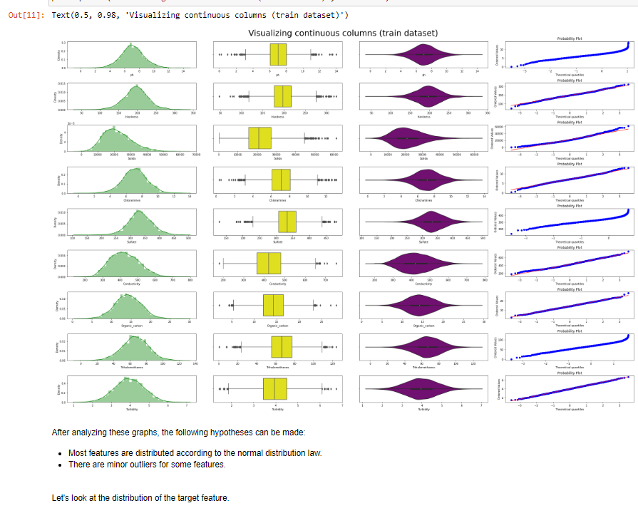
RESULTS
Demo Link

Slide 13
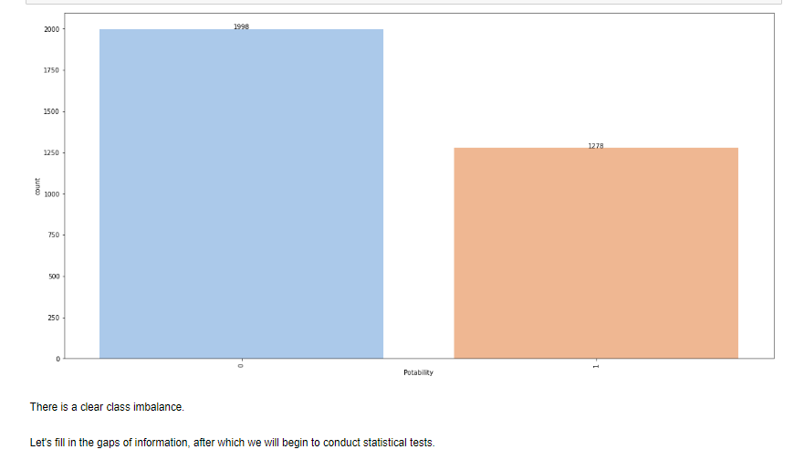
RESULTS
Demo Link

Slide 14
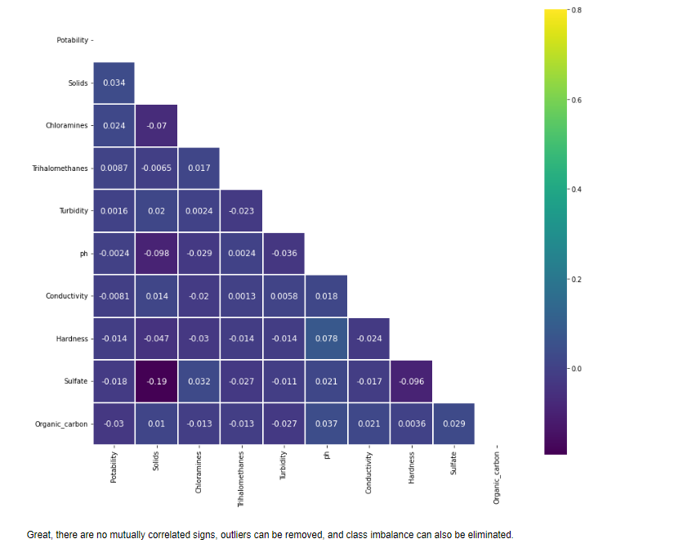
RESULTS
Demo Link

Slide 15
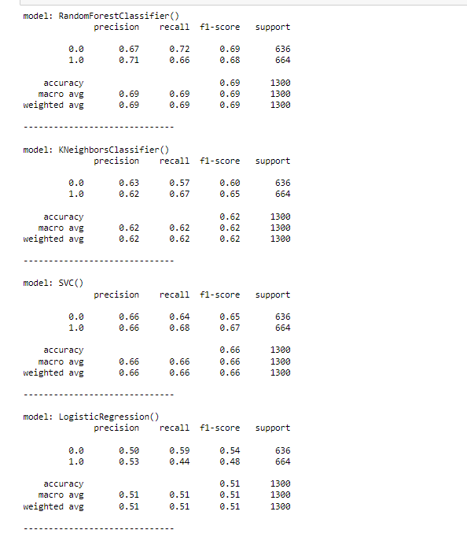
RESULTS
Machine learning model:
Demo Link

Slide 16
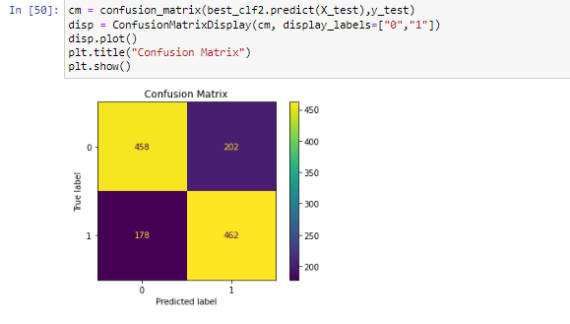
RESULTS
Demo Link

Slide 17
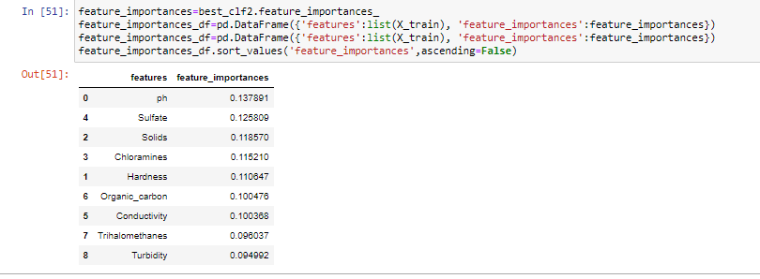
RESULTS
Demo Link

