Slide 1
Sauce Demo Automation Framework
Selenium | Java | Maven | TestNG | Jenkins
Presented By: Kiran Kumar
Batch-3 (Java Selenium)

Slide 2
Project Overview: Web Application
The project focuses on testing a sample web application with multiple user roles.
Website Under Test: https://www.saucedemo.com
Objective: Automate end-to-end login and purchase flow
Why SauceDemo?
Simple & UI-driven test cases
Good for demonstrating automation framework design
Benefits:
Faster feedback through automation
CI/CD ready
Reusable and scalable codebase

Slide 3
Project Structure
src/main/java – Page Object Model (POM) classes
src/test/java – TestNG test classes
testng.xml – Suite configuration
pom.xml – Maven dependency file
resources/ – Test data, config files

Slide 4
Key Test Scenarios
Valid Login
Invalid Login (wrong username/password)
Add Item to Cart
Remove Item from Cart
Checkout Flow (from cart to confirmation)

Slide 5
Types of Testing
Manual Testing:
Functional testing
Regression testing
Exploratory testing
Automation Testing:
Selenium WebDriver with Java
Maven for build management
Jenkins for CI/CD

Slide 6
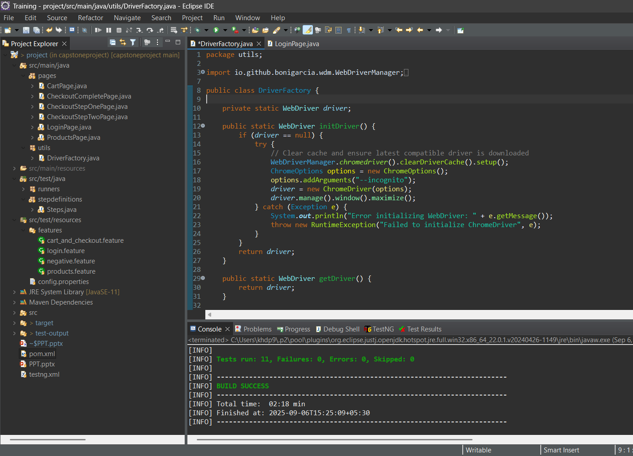
Automation Framework
Our automation framework was designed using:
Selenium WebDriver with Java
Page Object Model for maintainability
Maven for build execution

Slide 7
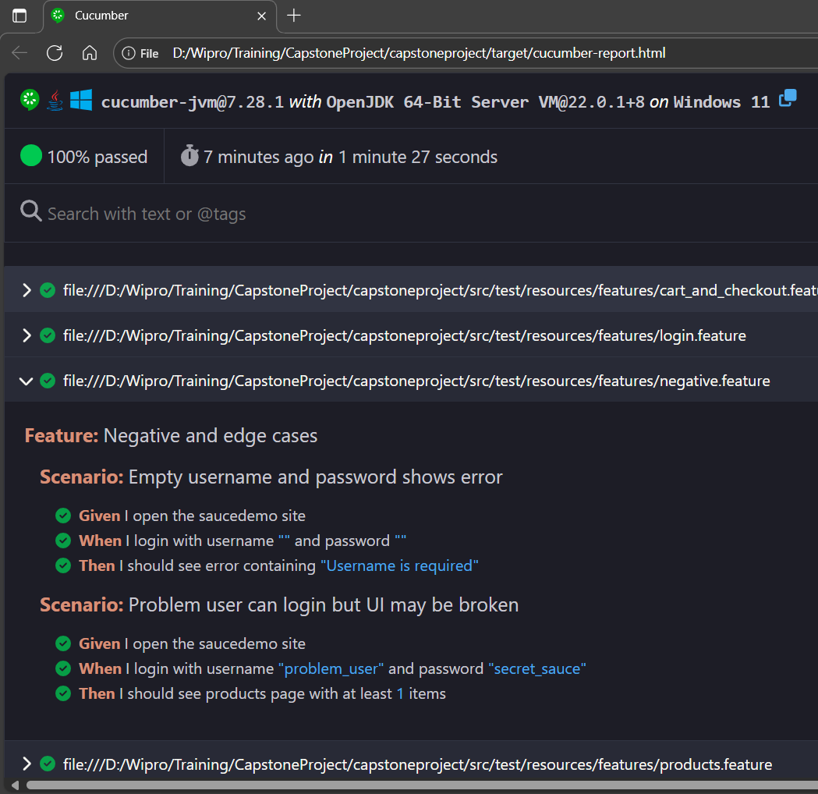
Automation Approach
Followed a structured automation approach:
Page Object Model for modular design
Data Driven Testing for scalability
Cross Browser Testing (Chrome, Firefox, Edge)
Integrated reporting and logging for execution results

Slide 8
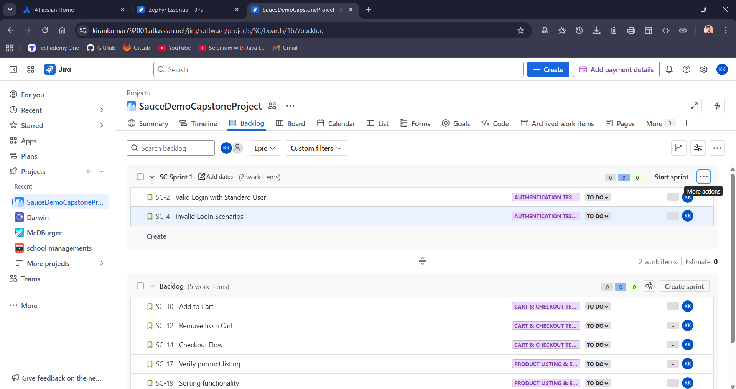
Agile & Jira Backlog
Used Jira for Agile project management:
Backlog managed with user stories and tasks.
Sprint planning and tracking.
Screenshots from Jira backlog highlight sprint-based tracking.

Slide 9
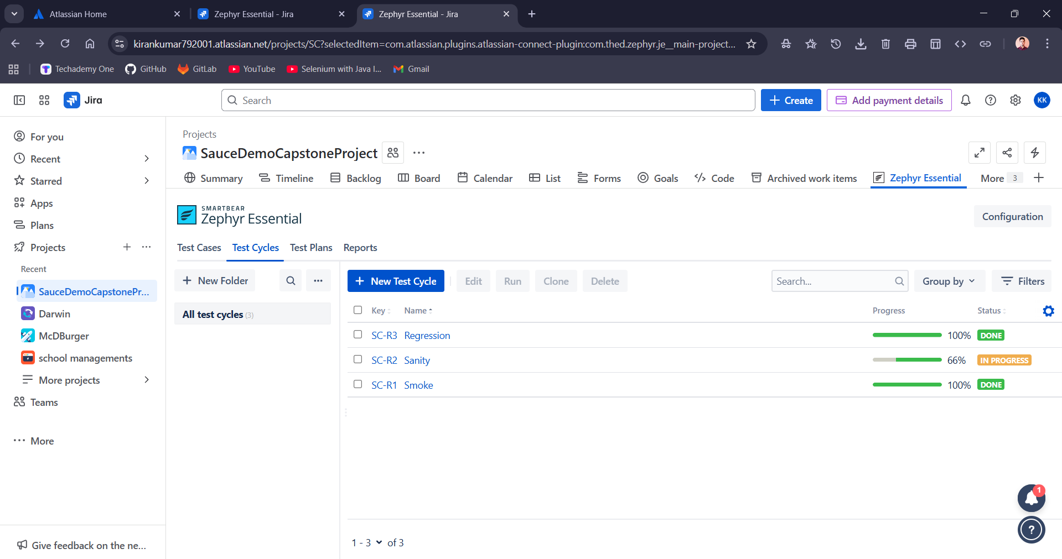
Zephyr Board & Test Management
Test case management was handled in Zephyr:
Organized into Smoke, Sanity, and Regression test cycles.
Clear traceability between requirements, test cases, and execution.
Improved visibility for stakeholders.

Slide 10
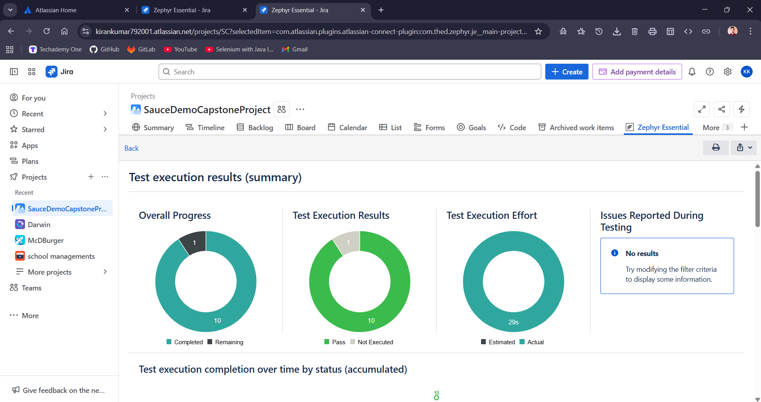
Test Reports
Test execution reports from Zephyr included:
Pass/Fail status of test cases
Execution trends over sprints
Defect mapping with Jira.
Reports helped stakeholders review quality metrics efficiently.

Slide 11
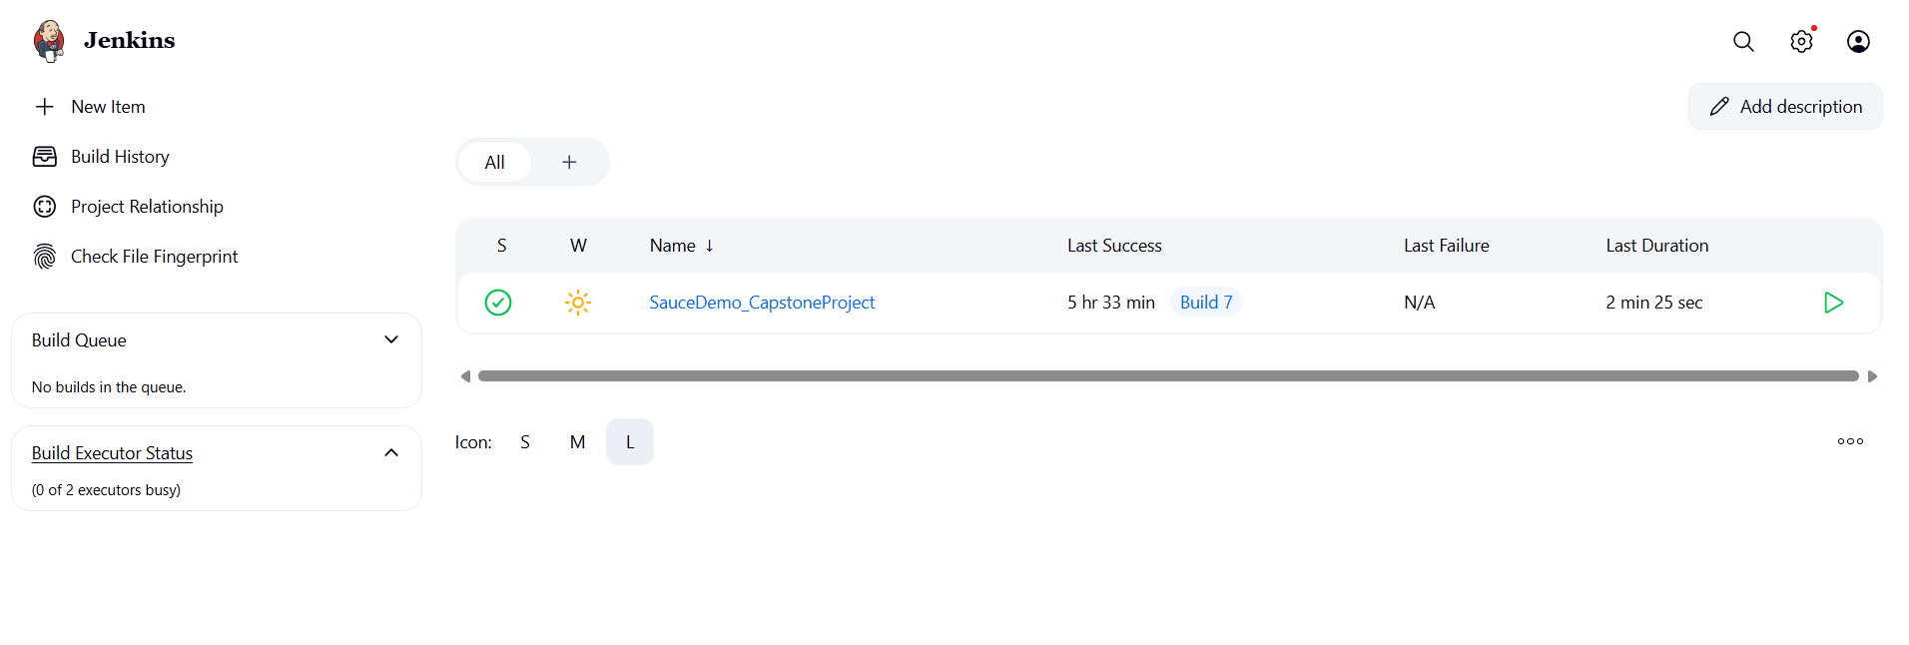
Jenkins – Continuous Integration and Delivery
Open-source automation server for CI/CD.
Automates building, testing, and deploying software.

Slide 12
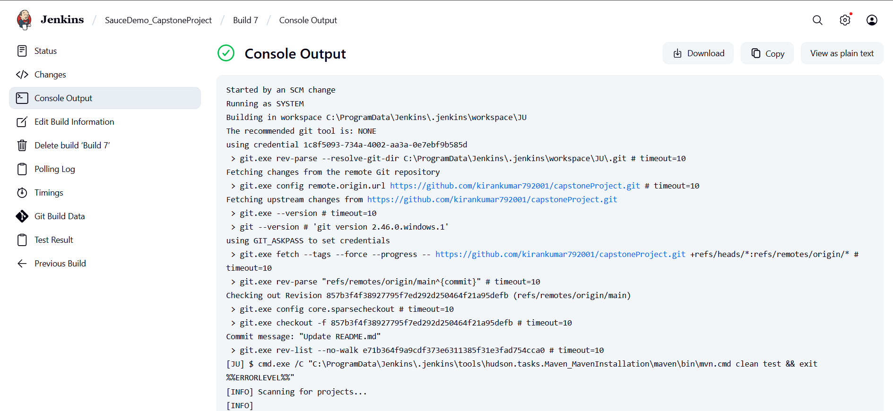
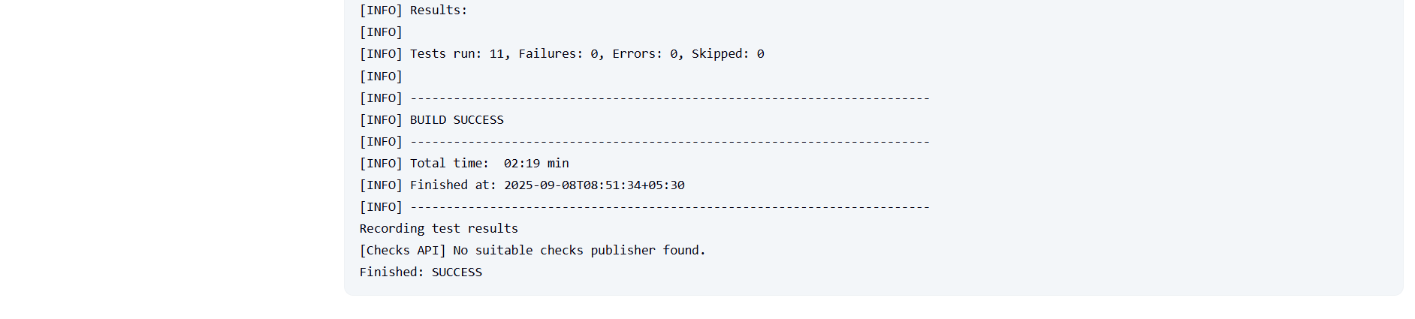

Slide 13
Work Summary
Manual test cases executed in Zephyr integrated with Jira Scrum board.
Automation scripts developed for regression testing.
Defects logged and tracked in Jira.
Faster feedback ensured within sprint cycles

Slide 14
Conclusion
Manual & Automation Testing.
CI/CD integration with Jenkins.
Agile tracking with Jira & Zephyr.
Scalable automation framework in Java & Selenium.

Slide 15
Thank You

