Slide 1
Sauce Demo Automation Framework
Selenium | Java | Maven | TestNG | Jenkins
Presented By: Kiran Kumar
Batch-3 (Java Selenium)

Slide 2
Agenda
Project Overview
Tools & Technologies Used
Project Structure
Key Test Scenarios
Maven Setup
Selenium + TestNG Integration
Jenkins CI/CD Pipeline
Demo & Output
Challenges & Solutions
Conclusion

Slide 3
Project Overview
Website Under Test: https://www.saucedemo.com
Objective: Automate end-to-end login and purchase flow
Why SauceDemo?
Simple & UI-driven test cases
Good for demonstrating automation framework design
Benefits:
Faster feedback through automation
CI/CD ready
Reusable and scalable codebase

Slide 4
Tools & Technologies
Tools | Purpose
Java | Programming Language
Selenium | Web Automation Framework
Maven | Build and Dependency Manager
TestNG | Test Framework
Jenkins | CI/CD Automation

Slide 5
Project Structure
src/main/java – Page Object Model (POM) classes
src/test/java – TestNG test classes
testng.xml – Suite configuration
pom.xml – Maven dependency file
Jenkinsfile (Optional) – Jenkins pipeline script
resources/ – Test data, config files

Slide 6
Key Test Scenarios
Valid Login
Invalid Login (wrong username/password)
Add Item to Cart
Checkout Flow (from cart to confirmation)
Logout Functionality
Page Title & Element Verification

Slide 7
Maven Setup(pom.xml)
<dependencies>
<dependency>
<groupId>org.seleniumhq.selenium</groupId>
<artifactId>selenium-java</artifactId>
<version>4.x.x</version>
</dependency>
<dependency>
<groupId>org.testng</groupId>
<artifactId>testng</artifactId>
<version>7.x.x</version>
</dependency>
</dependencies>

Slide 8
Selenium + TestNG Integration
Design Pattern Used: Page Object Model (POM)
TestNG Annotations:
@BeforeClass – Setup browser
@Test – Test cases
@AfterClass – Teardown
Example Test Case:
@Test
public void validLoginTest() {
loginPage.login("standard_user", "secret_sauce");
Assert.assertTrue(inventoryPage.isLoaded());
}

Slide 9
Jenkins CI/CD Pipeline
Version Control: GitHub Integration
Trigger: Webhook for every commit
Build Step:
mvn clean test
Post-build Actions:
TestNG reports (XML/HTML)
Optional: Allure reporting
Benefits:
Continuous Testing
Fast feedback for every push

Slide 10
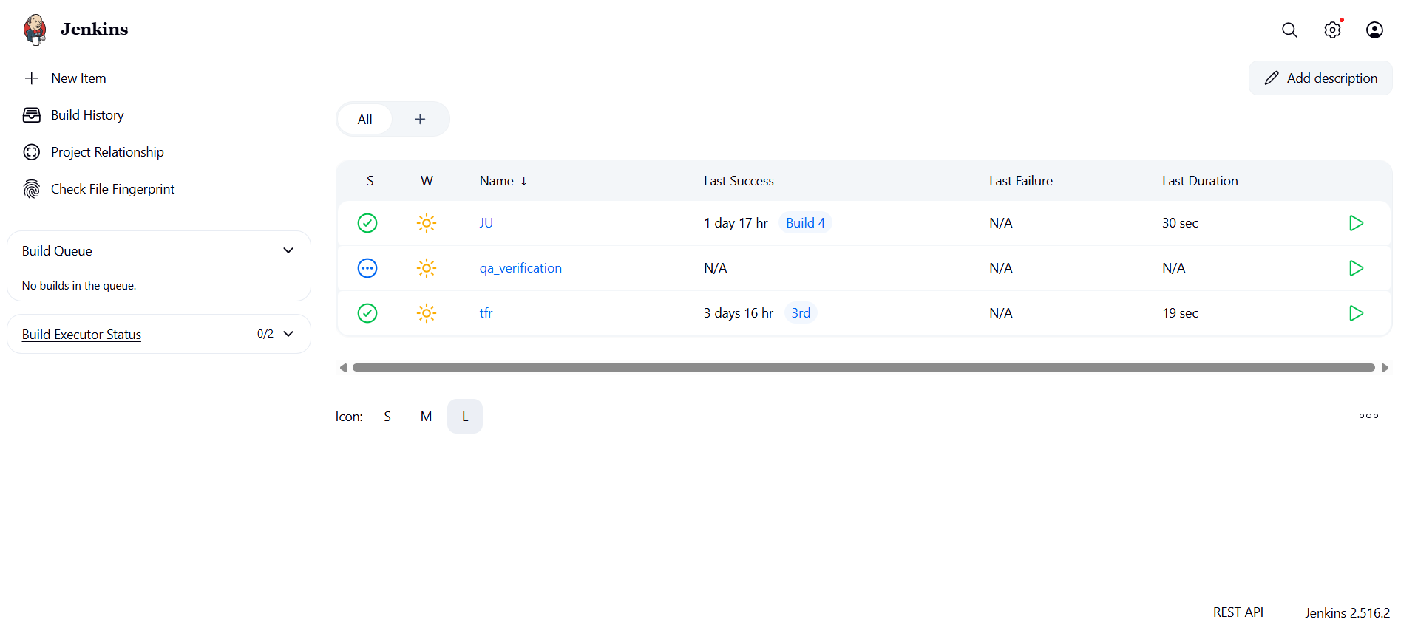
Output

Slide 11
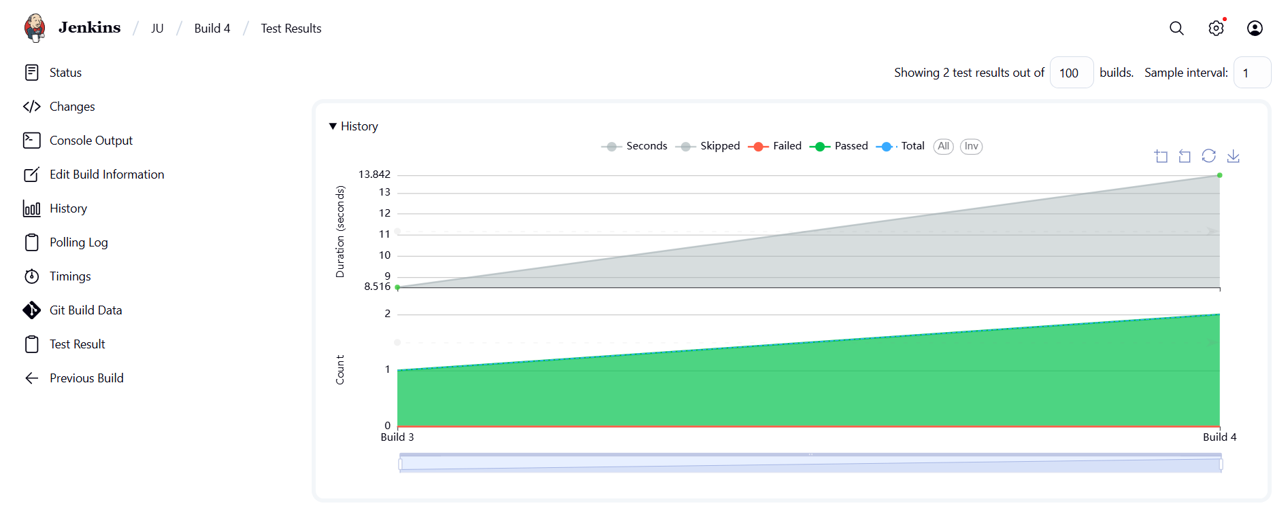

Slide 12
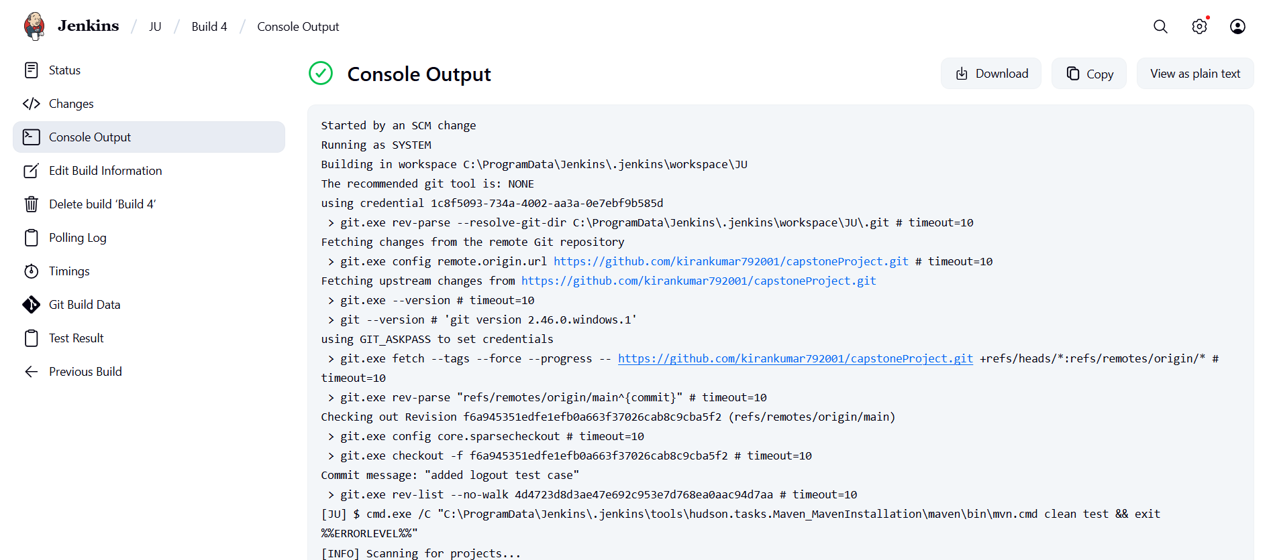

Slide 13
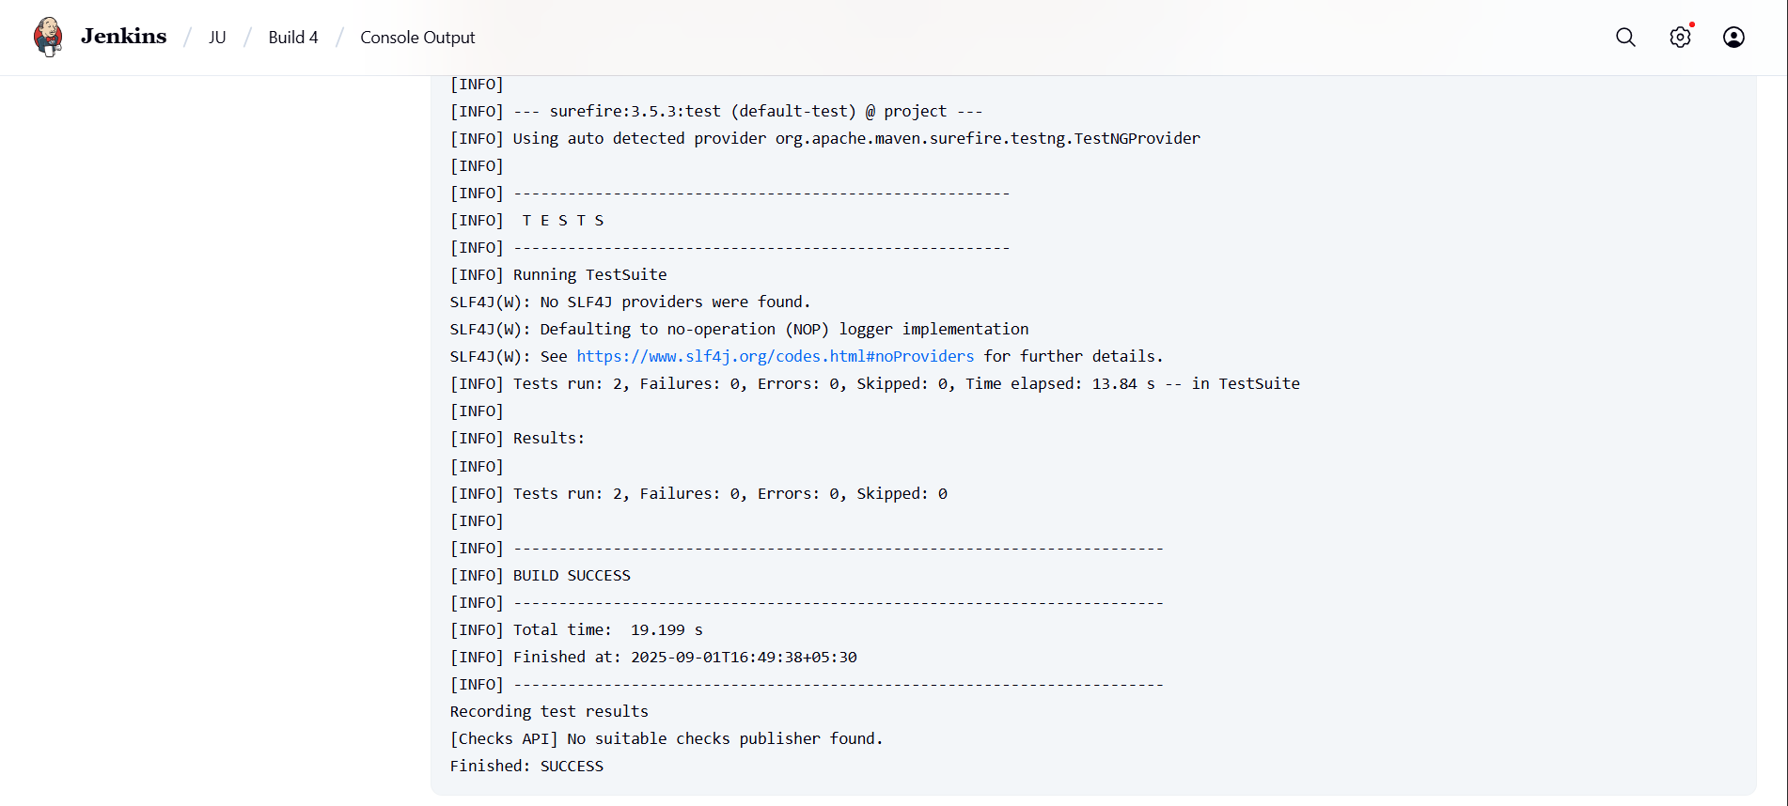

Slide 14
Challenges & Solutions
Challenges | Solution
Dynamic Web Elements | Use Explicit Waits
Data Management | TestNG DataProviders or JSON
Browser Compatibility | Selenium Grid or Selenoid
Build Failures in CI | Use RetryAnalyzer in TestNG

Slide 15
Conclusion
Successfully built an automation framework using:
Java, Selenium, Maven, TestNG & Jenkins
Achieved:
Reliable and repeatable testing
Full CI pipeline using Jenkins
Ready for real-world scaling and modularization

