Slide 1

Versions
Current Version: 2.1.0 (Dec 28, 2016)
Version Used: 1.6

Slide 2
Agenda
Introduction to Apache Spark
History of Spark
Limitations of MapReduce in Hadoop
Batch vs. Real-Time Processing
In-Memory processing
MapReduce vs. Spark
Spark Features
Spark Eco System
Components of Spark
RDD
Spark Context
Transformations and Actions
Spark Cluster Types

Slide 3





























Big Data Ecosystem
Streaming Engines
Data Store
Data Processing
Peripherals
Data Services
Distributions
Cloud Exposure

Slide 4
Introduction to Apache Spark
Spark was introduced by Apache Software Foundation for speeding up the Hadoop computational computing software process
Apache Spark is a fast and general engine for large-scale data processing
General Purpose distributed system
The main feature of Spark is its in-memory cluster computing that increases the processing speed of an application
Up to 100 times faster than MapReduce
Spark is designed to cover a wide range of workloads such as batch applications, iterative algorithms, interactive queries and streaming
Written in Scala, Functional programming language
Provides APIs in Scala, Java and Python

Slide 5
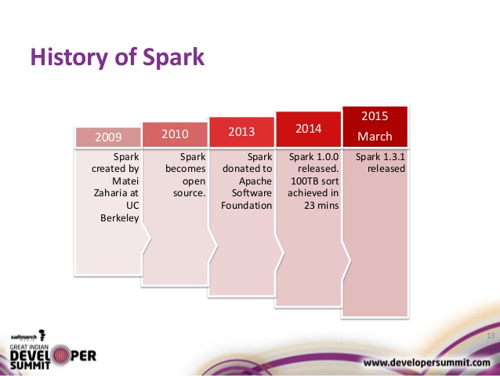
History of Spark

Slide 6
Limitations of MapReduce in Hadoop
Unsuitable in real-time processing
Being batch oriented, it takes minutes to execute jobs depending upon the amount of date and number of nodes in the cluster.
Unsuitable for trivial operations
For operations like Filter and Joins, you might need to rewrite the jobs, which becomes complex because of the key-value pattern.
Unfit for large data on network
However, it works on the data locality principle, it cannot process a lot of data requiring shuffling over the network well.
Unfit for iterative execution
Being a state-less execution, MapReduce doesn’t fit with use cases that need iterative execution.

Slide 7
Batch vs. Real-Time Processing
The features below show a comparison of batch and real-time analytics in the enterprise user cases:
Batch Processing
Real-Time Processing
Large group of data/transaction is processed in a single run.
Jobs run without any manual intervention.
The entire data is pre-selected and fed using command-line parameters and scripts.
It is used to execute multiple operations, handle heavy data load, reporting and offline data workflow.
Example: Regular reports requiring decision making
Data processing takes place upon data entry or aommand receipt instantaneously.
It must execute on response tome within stringent constraints.
Example: Fraud detection

Slide 8
In-Memory Processing
The working of in-memory processing can be explained as below:
The entire information is loaded into memory, eliminating the need of indexes, aggregates, optimized databases, start schemas and cubes.
Compression algorithms are used by most of the in-memory tools, thereby reducing the in-memory size.
With in-memory tools, the analysis of data can be flexible in size and can be accessed within seconds by concurrent users with an excellent analytics potential.
It is possible to access visually rich dashboards and existing data sources.

Slide 9





MapReduce vs. Spark
MapReduce
Spark

Slide 10
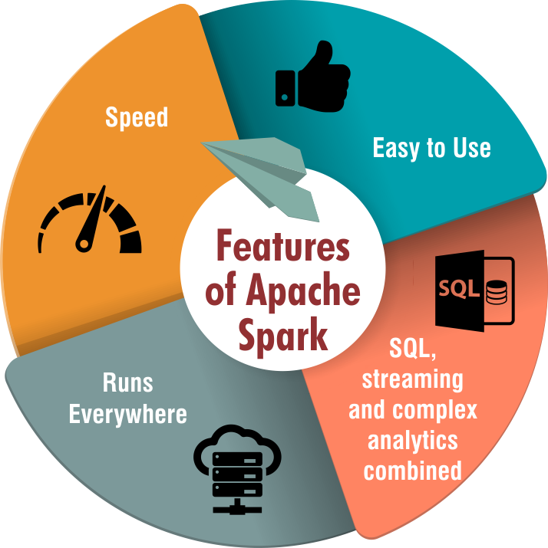
Spark Features
Spark enables applications in Hadoop clusters to run up to 100x faster in memory, and 10x faster even when running on disk.
Spark supports SQL queries, streaming data, and complex analytics such as machine learning and graph algorithms out-of-the-box.
Spark can handle real time streaming.
Spark can run independently.
Active and Expanding Community

Slide 11
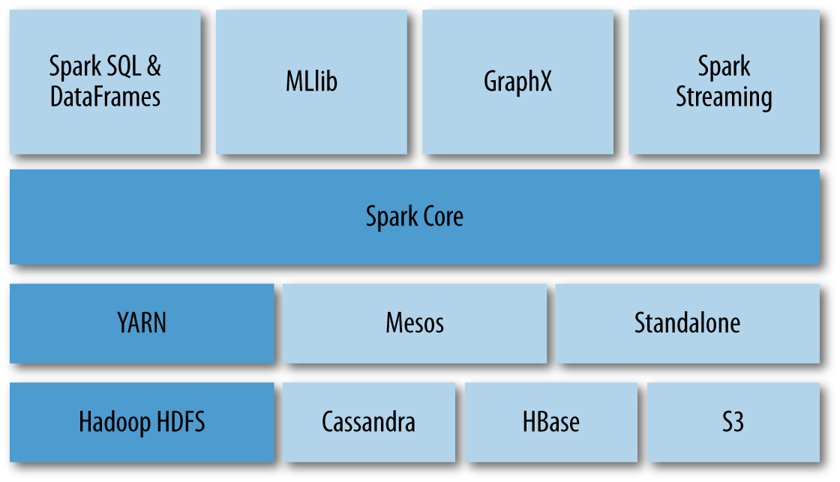
Spark Eco System
Components
Cluster Modes
Data Sources

Slide 12
Components of Spark
Spark Core
As the foundation, it provides basic I/O, distributed task dispatching and scheduling. RDDs can be created by applying coarse-gained transformations of referencing external datasets.
Spark SQL
As a component lying on the top of Spark Core, it introduces SchemaRDD, which can be manipulated. It supports SQL with ODBC/JDBC server and command-line interfaces.
Spark Streaming
It leverages the fast scheduling capability of Spark Core, ingests data in small batches, and performs RDD transformations on them.
MLlib
As a distributed machine learning framework on top of Spark, it is nine times faster then the Hadoop disk-based versions of Apache Mahout.
GraphX
Being a distributed graph processing framework on top of Spark, it gives an API and provides an optimized runtime for the Pregel abstraction.

Slide 13
Resilient Distributed Datasets (RDDs)
Allow apps to keep working sets in memory for efficient reuse
Retain the attractive properties of Map Reduce
Fault tolerance, data locality, scalability
Support a wide range of application
RDD Characteristics:
Hold references to partition objects
Each partition object references a subset of your data
Partitions are assigned to nodes on your cluster
Each partition/split will be in RAM (by default)
RDDs are immutable

Slide 14
Spark Context
Every Spark application requires a Spark Context
Main entry point for Spark application
Interact with Cluster Manager
Specify Spark how to access the cluster
RDDs are created using Spark Context
Worker Node
Executor
Cache
Task
Task
Worker Node
Spark Context
Cluster Manager
Executor
Cache
Driver Program
Task
Task

Slide 15
Transformations
Transformations are functions that take a RDD as the input and produce one or many RDDs as the output.
map()
flatMap()
filter()
mapPartitions()
mapPartitionsWithIndex()
sample()
union()
intersection()
distinct()
groupByKey()
reduceByKey()
sortByKey()
join()
cogroup()
cartesion()
pipe()
coalesce()
repartition()
partitionBy()
…

Slide 16
Actions
An action helps in bringing back the data from RDD to the local machine. An action’s execution is the result of all previously created transformations.
reduce()
collect()
count()
first()
take()
takeSample()
saveToCassandra()
takeOrdered()
saveAsTextFile()
saveAsSequenceFile()
saveAsObjectFile()
countByKey()
foreach()
…

Slide 17
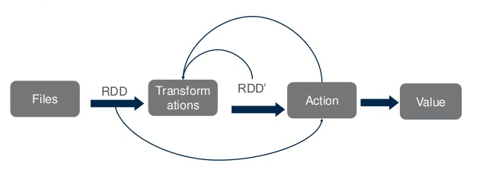
Spark General Flow

Slide 18
Spark Execution Modes
Local Mode – Client Mode
Standalone Cluster – Master-Worker
Hadoop YARN – Hadoop Cluster
Apache Mesos

Slide 19
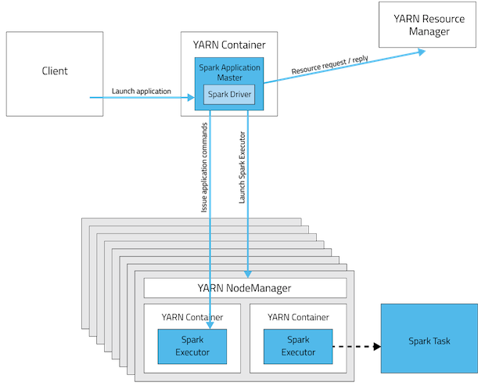
Spark YARN Mode

Slide 20
Questions?

Slide 21


Test Yourself
Answer the following questions:
What operations RDD support?
Define functions of SparkCore.
What is Spark Driver?
What is Spark Executor?
Transformations, Actions
Executors are Spark processes that run computations and store the data on the worker node.
Name types of Cluster Managers in Spark.
Serving as the base engine, SparkCore performs various important functions like memory management, monitoring jobs, fault-tolerance, job scheduling and interaction with storage systems.
Standalone, Apache Mesos, Yarn
Name commonly-used Spark Ecosystems.
Spark Driver is the program that runs on the master node of the machine and declares transformations and actions on data RDDs.
Spark Streaming, Spark SQL, Spark MLlib, Spark GraphX

