Slide 1

ELE Management System
A system designing project in
Visual Basic . Net

Slide 2

Our Team
Kiran lama
Jangbu Sherpa
Sujan Shrestha

Slide 3
Introduction to the system
We have built a system that handles the tasks of managing the ELE (Extracurricular Learning Experience) points.
We used Visual Studio Code as our IDE and SQL Server as our database to create this system.
Our system consists of user friendly interfaces which helps the user to easily interact with the system.
Our system helps and guides the users through different processes.

Slide 4
Why this System
In our college, there are many events frequently being conducted and this system can help in the marking process.
The file-oriented method can have many chances of loss and misplacement of data.
By the use of this system, both the students and the Instructors will be benefited as it will help to reduce the mistakes and increase the efficiency of the process.

Slide 5
Objectives of the System
To make user friendly interfaces which helps the user to easily interact with the system.
To make the process cost and time effective.
To build a reliable data recording system to record the information about the students for the course securely.
To decrease the errors which come through the file-based system and make data recording process more effective.

Slide 6
Connection to the Database
We have connected our system to a database (SQL Server) through the help of the features in Visual Studio Code.
The database is only present in the user’s computer so the user can only get access to the database through that specific computer.

Slide 7
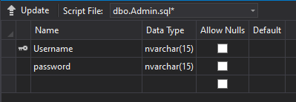
Designing the Database Data Dictionary
The three Main schemas in the database are:
ADMIN Table
In the Admin Table, we have used the admin’s Username as the Primary key
Figure 1: Meta-data of Admin Table

Slide 8
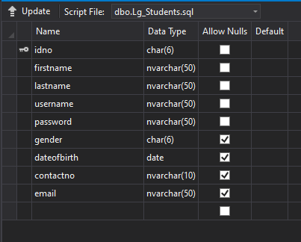
STUDENTS Table
In the Student Table, we have used the student’s ID number as the Primary key
Figure 2: Meta-data of Student Table

Slide 9
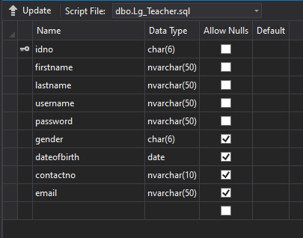
TEACHERS Table
In the Teachers Table, we have used the Teacher’s ID number as the Primary key
Figure 3: Meta-data of Teacher Table

Slide 10
Designing the Database Relationships
One to One Relationship (1:1)
One student receives ELE points once after taking part in an event.
After the occurrence of One event, One report should be submitted in order to gain ELE points
Figure 4 : ER diagram showing 1:1 relationship between Students and ELE points
Figure 5: ER diagram showing 1:1 relationship between Events and Reports

Slide 11
Designing the Database Relationships
After submitting One ELE report the students secure ELE points for one time.
The Admin assigns new Course instructor when the teacher is changed or on when required.
Figure 6: ER diagram showing 1:1 relationship between Reports and ELE points
Figure 7: ER diagram showing 1:1 relationship between Admin and course Instructor

Slide 12
Designing the Database Relationships
One to Many Relationship (1:m)
At the beginning of each year, the Admin adds a list of students to the system.
The course instructor validates the reports that many students submit after the events.
Figure 8: ER diagram showing 1:m relationship between Admin and Students
Figure 9: ER diagram showing 1:m relationship between Course instructor and Reports

Slide 13

Designing the Database Relationships
The Course instructor uploads the ELE points of many students involved in event in the system.
After the completion of the events, students submit their different reports.
Figure 10: ER diagram showing 1:m relationship between Course Instructor and ELE points
Figure 11: ER diagram showing m:n relationship between Students and Reports

Slide 14
Designing the Database Relationships
Many to One Relationship (m:1)
There are many students attending a single event.
Figure 12: ER diagram showing m:1 relationship between Students and Events

Slide 15
Designing the Database E-R Diagram
Figure 13: ER diagram for the system

Slide 16
Assumptions
The reports are submitted by the students in a physical form.
The Attendance of students are taken after the completion of events.
The Admin of the system adds newly enrolled students every year.
The Admin of the system mostly remains same.
There can be only one event in a day.

Slide 17
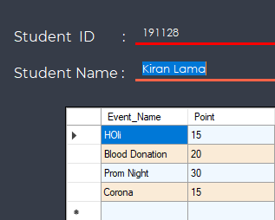
System Generated Report
Student’s ELE Points Details
This view is generated by the form in student’s view when the student tries to see his/her ELE points.
Figure 14: ELE Detail page on student’s Panel

Slide 18
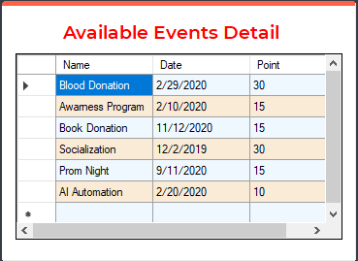
Event Details in student’s Panel
The information about the events are posted by the teacher through his/her panel and this is the view that is generated in the user’s panel when they login through their account. It shows the information about the events that have occurred or can be participated in.
Figure 15: Event details in Student’s Panel

Slide 19
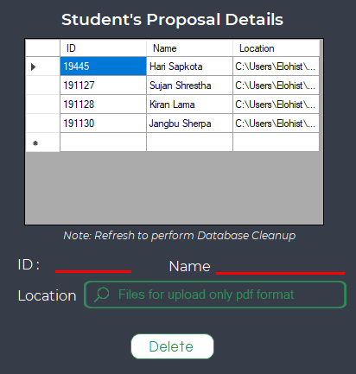
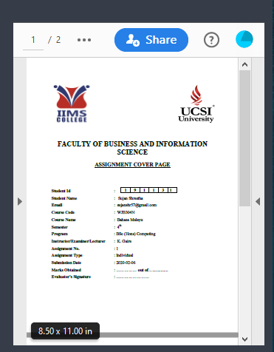
Student’s Proposal Details
This view is shown in the teacher’s panel which shows the number of proposals that have been submitted by the students along with their names. We can get the view of the PDF document by clicking on the proposal name which is right next to the grid in the panel.
Figure 16: Proposal details on Teacher’s Panel

Slide 20
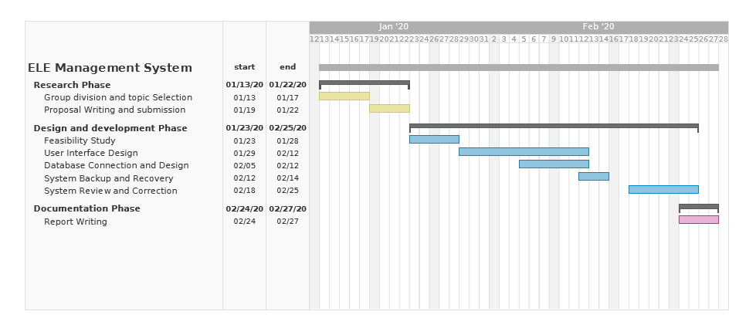
Time Schedule
Figure 17: Timeline of the project shown in a Gantt Chart

Slide 21
Limitations of the System
This system cannot be used online.
Because it can be only accessed offline, it does not have automation features and requires manual action to perform operations.
Unlike online systems that utilize cloud computing, this system stores data on computer's hard drive which increases the risk of data loss.
Additional hardware and software can make it more expensive.
Upgrading the system can be very tough.

Slide 22
Future Works
Further functions such as submission of report, attendance can be added in the system.
The application can be re-designed for online use.
The build and the server can be changed so it can handle and store large amount of data.

Slide 23

Thank You

