Slide 1


Cash Register
Kevin Chancey and Kiran Limbu
IS312 Web Design
School of Technology & Computing (STC)

Slide 2
Agenda
Introduction
Planning
Requirements
Design
Application Development
Testing
Summary
Q&A

Slide 3
Introduction
Teamwork and collaboration are important
Even if 2 programmers are equal in experience, they can both still teach each other new things as no one has the same experiences
This paper will get more into depth on how we overcame technical problems, maintained virtual communication as a team, created working functions, made a visually pleasing user interface, debugged our way through issues, and came together as a team to produce a working cash register application
We will discuss how we were able to create this functional application using only HTML, CSS and JavaScript

Slide 4
Planning
We used Microsoft Teams as our main communication hub
In our initial chat we discussed our goals, deadlines, schedule, and what we want our final product to look like
Our first major step was to code a working calculator since the functions are the same as a cash register
The application should show the numbers that was clicked
The application should perform calculation with the information that was provided to it
The application should display the result

Slide 5
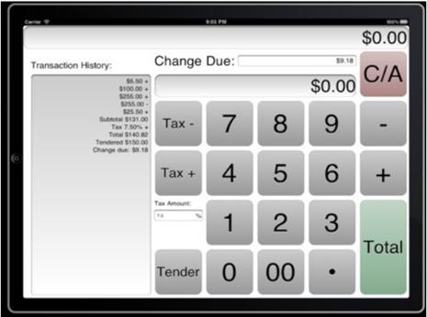
Planning
Image of generic cash register application

Slide 6
Requirements
User Interface
Number pads (0 - 9)
Operator buttons (-, +, x)
Equation buttons that calculates (Total, Cash, Credit Card)
Key Butttons (Clear, backspace)
Display screens (Top, Bottom, Left)
Functions
Total
Change
Credit Card
Calculator
Display Clicked Number
Display total and subtotal
Transaction Entry
Display Transaction History

Slide 7
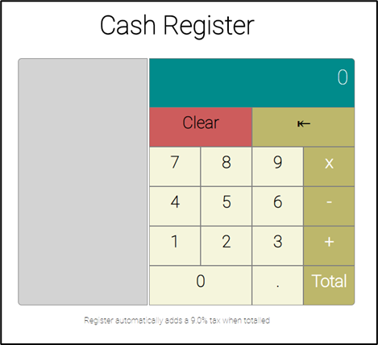
Design and Prototype
Screenshot of user interface design

Slide 8
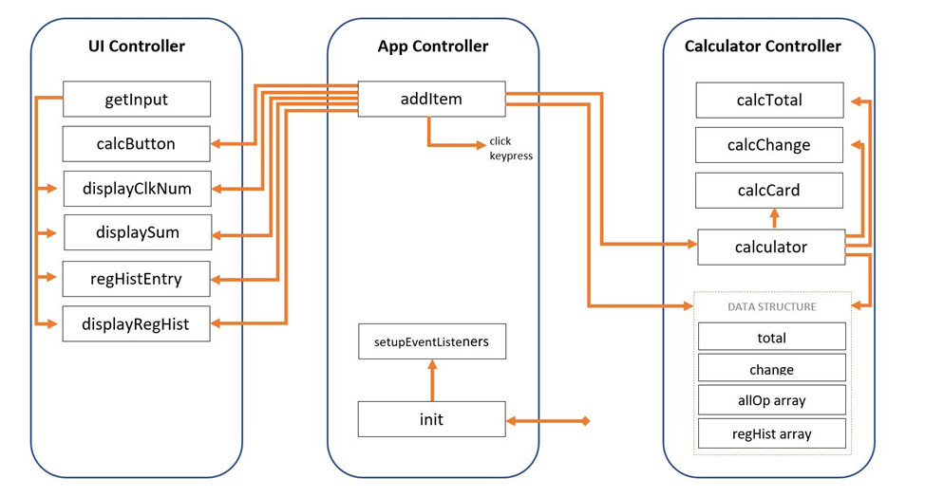
Problem Statement
Low Level Architecture Design

Slide 9
Application Development
This was the longest phase of our SDLC model
The first thing we did was create the user interface to build a simple calculator image with div tags as buttons separated by rows
Next, to test the capabilities of the team, we first started with a simple calculator
After that, as planned, we separated all codes into three modules: Interface Module, Data Module and Controller Module
Controller Module is a delegator that tells Data Module (calcCtrl Module) to execute some function and update Data Structure. It also tells Interface Module (uiCtrl Module) to display information on the screens

Slide 10
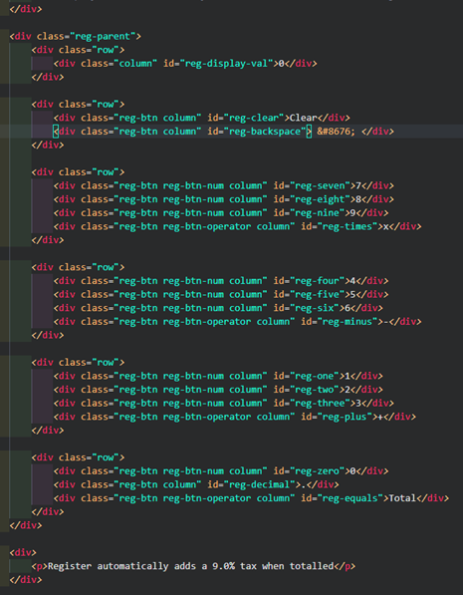
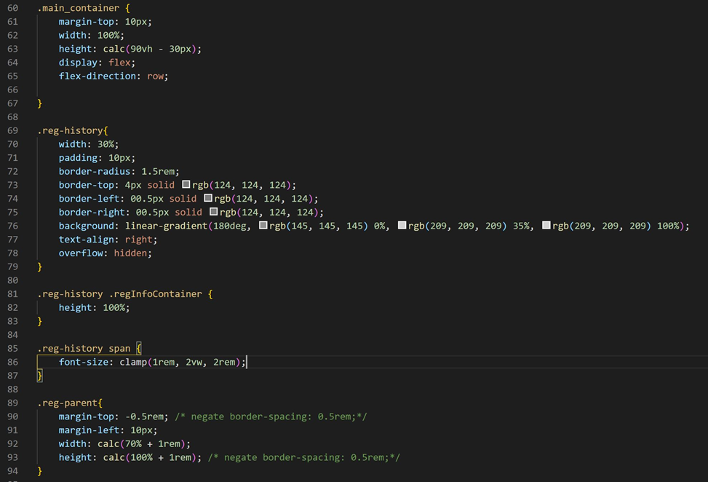
Application Development
Screenshot of HTML and CSS

Slide 11
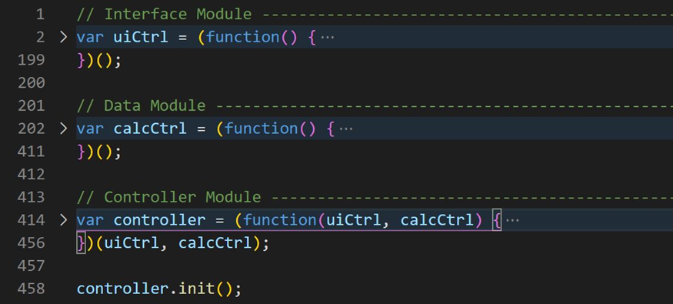
Application Development
Screenshot shows how Interface Module and Data Module communicates through Controller Module

Slide 12
Application Development
Controller Module
Controller Module contains two functions: addItem and setupEventListerners
addItem
Designed to call Data Module and tell the module to take user input calculate them and update the data structure
It also calls Interface Module, supplies the module with data structure and tells the module to display the information on the screen
setupEventListerners
Contains the event listener method that tracks clicked button and provides that information to function addItem

Slide 13
Application Development
Data Module
It is designed for two main purpose, host a data structure, and do all the heavy calculation of a calculator
Functions
Calculate Total
Calculate Change
Calculate Credit Card
Calculator: Execute a certain task depending on the user input types.
There are four different types and they are number, operator, equation and key.

Slide 14
Application Development
Interface Module
Interface Module (uiCtrl Module) deals with getting the current value and updating the interface
It contains functions and objects
Objects
calcButton contains properties like name, type and formula
getInput grabs DOM elements which is used to manipulate HTML content
Functions
Display clicked Number
Display sum
Push all transaction into array
Display register History

Slide 15
Testing
Testing was performed at various phases of the application development lifecycle
Unit testing verifies the functionality of a unit of code
Integration testing assesses the interface between application components
System testing is the overall testing of the application system
Regression testing assures that each new fix does not break anything that was previously working
Acceptance testing is often performed by the customers themselves but in our case team member tested each others code

Slide 16
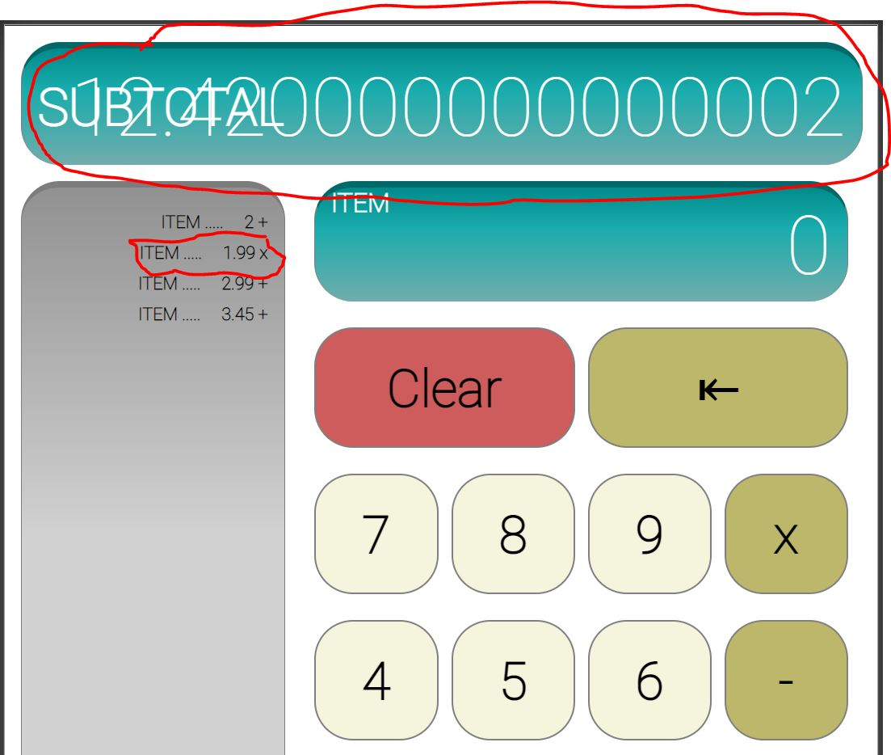
Testing
Unit Testing
Integration Testing
Unit testing Solution
toFixed() method was used
Integration testing Solution
Correct information was fed to Interface Module

Slide 17
Summary
This project was a great learning experience and will help us with our careers in computer science
Reading other’s code, debugging, teaching others, and collaborating are great experience that one can only get from team/pair programming
The cash register application project pushed us to learn new concepts, techniques, and different ways of coding
Our team used HTML to create the static page, added CSS to produce a great visual design, and finally added the JavaScript to bring it all to life
Our team went through learning process of struggles, frustration and collaboration to produce our final product

Slide 18
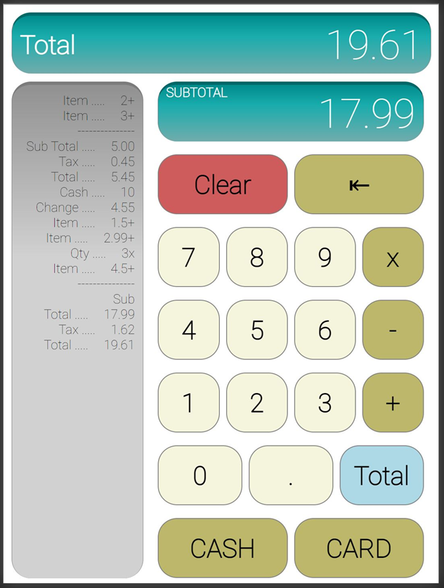
Summary
Screenshot of Final working Cash Register Application

Slide 19


Q&A

