Slide 1
FOOD FOR NEEDY
Under the guidance of:
Mr. G Anil Kumar, M.Tech
Asst.prof., Dept. of cse,
CIT, Gubbi, Tumakuru
PRESENTED BY:
KIRAN M [1CG17CS044]
LOKESH K [1CG17CS047]

Slide 2
CONTENTS:
Introduction
Aim of the project
Implementation
Modules
services
Benefits
Conclusion

Slide 3
INTRODUCTION:
Food For Needy is an web based project which aims to redistribute excess food from weddings, parties, events to those who are hungry. The project objective is to bring benefits across the spectrum of society and help provide access to food to those who don’t have adequate means to access it.
This project mainly useful to, those who are daily sleeping empty stomach in our surrounding. We collect the excess food from weddings, parties and events then distribute the food to those who are hungry. The donor’s can easily contact us using this website through online.

Slide 4
AIM OF THE PROJECT:
Our main aim of this project to feed the needy and hungry with untouchable edible surplus food. To raise awareness about food loss and food waste amongst citizens and bring about behavioral change in them to prevent food waste at home, school or at workplace through guidance and sharing of good practices.

Slide 5
IMPLIMENTATION:
The term project is to design and implement for, feed the needy and hungry with untouchable edible surplus food. To raise awareness about food loss and food waste amongst citizens and bring about behavioral change in them to prevent food waste at home, school or at workplace through guidance and sharing of good practices. To raise awareness among Food businesses by encouraging them to adopt good practices to reduce food loss and food waste in their supply chains and sharing good practices.

Slide 6
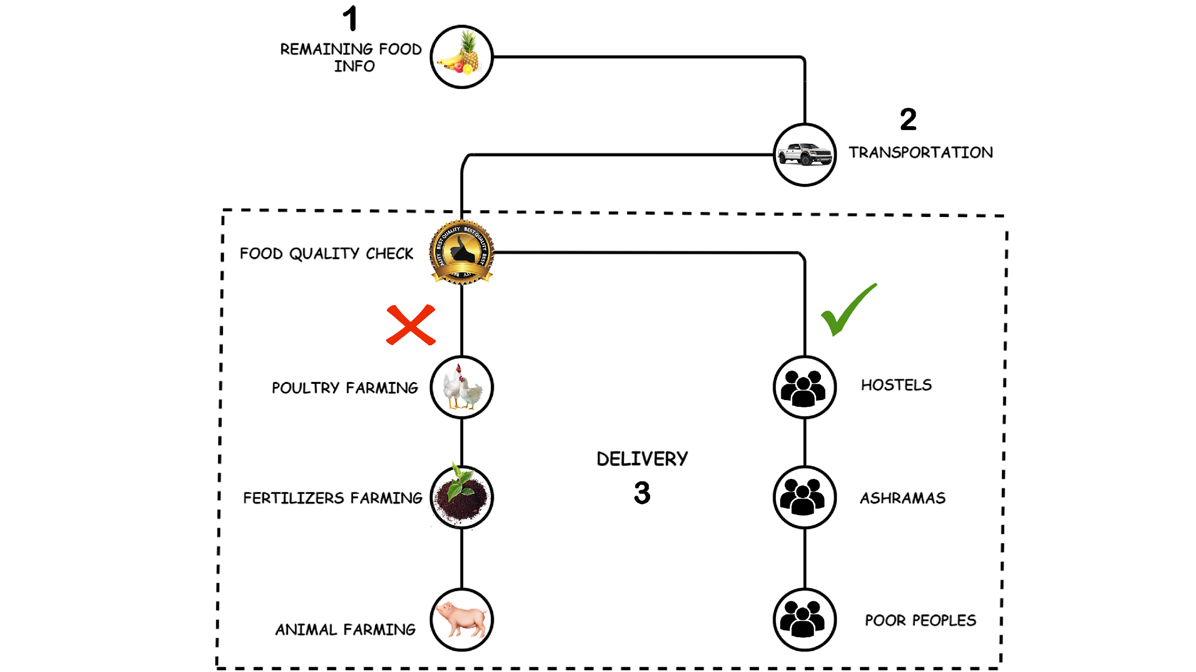
SERVICES:

Slide 7
BENIFITS:
*To feed the needy and hungry with untouchable edible surplus food.
*To reduce hunger people in our country.
*To raise awareness about food loss and food waste amongst citizens and bring about behavioral change in them to prevent food waste at home, school or at workplace through guidance and sharing of good practices.

Slide 8
CONCLUSION:
There is a scope for further development in our project to a great extent. A number of features can be added to this system in future like building an application and reaching each and every corner of our country to remove the hunger. And inspiring more young volunteers who involves in the welfare of social activities.

Slide 9
THANK YOU

