Slide 1

USED CARS PRICE PREDICTION USING MACHINE LEARNING
Presented By:
Kiran M
(1CG17CS044)
Manoj G S
(1CG17CS052)
Manoj Kumar D
(1CG17CS053)
Nandan Kumar T N
(1CG17CS060)
Under the Guidance of :
Mr. Suhas K C ,M.tech
Asst. Prof., Dept. of CSE
CIT, Gubbi, Tumkur.

Slide 2
CONTENTS
1. Introduction
2. Business Understanding
3. Methodology
4. Implementation
5. Results
6. Conclusion
7. Future Work
8. References

Slide 3
INTRODUCTION
The prices of new cars in the industry is fixed by the manufacturer with some additional costs incurred by the Government in the form of taxes.
But due to the increased price of new cars and the incapability of customers to buy new cars due to the lack of funds, used cars sales are on a global increase.
There is a need for a used car price prediction system to effectively determine the worthiness of the car using a variety of features. Even though there are websites that offers this service, their prediction method may not be the best.
Besides, different models and systems may contribute on predicting power for a used car’s actual market value. It is important to know their actual market value while both buying and selling.

Slide 4
BUSINESS UNDERSTANDING
Companies can restrict the selling price of the used car being posted by the customer in their respective websites.
Companies can provide a visualization to customers for a better understanding of their car selling price.
Companies can have Fraud Customers who are posting cars for higher prices.
Companies can expand their network based on the number of cars being sold the next year by prediction.

Slide 5
METHODOLOGY
There are two primary phases in the system:
Training phase: The system is trained by using the data in the data set and fits a model (line/curve) based on the algorithm chosen accordingly.
Testing phase: the system is provided with the inputs and is tested for its working. The accuracy is checked. And therefore, the data that is used to train the model or test it, has to be appropriate.
The system is designed to detect and predict price of used car and hence appropriate algorithms must be used to do the two different tasks. Before the algorithms are selected for further use, different algorithms were compared for its accuracy. The well-suited one for the task was chosen.

Slide 6
TECHNOLOGY USED
Libraries used:
NumPy (for Numerical Analysis)
Pandas (for handling data files)
Matplotlib (for visualizations inline & figure settings)
Seabon (for better relational visualization)
Scikit Learn (for model building & data pre-processing)
Algorithm Used:
Linear Regression
K- Neighbours Regression

Slide 7
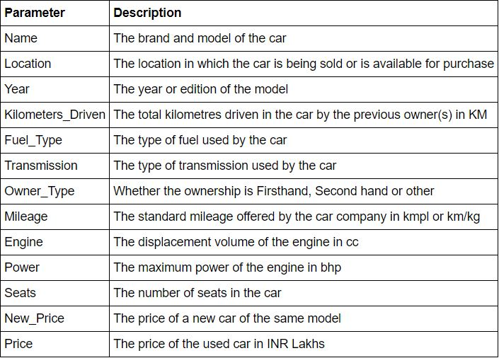
DATA

Slide 8
DATA CLEANING
Data cleaning is the process of ensuring data is correct, consistent and usable. You can clean data by identifying errors or corruptions, correcting or deleting them, or manually processing data as needed to prevent the same errors from occurring.
Remove Irrelevant Values
Get Rid of Duplicate Values
Convert Data Types
Take Care of Missing Values
Removing outliers

Slide 9
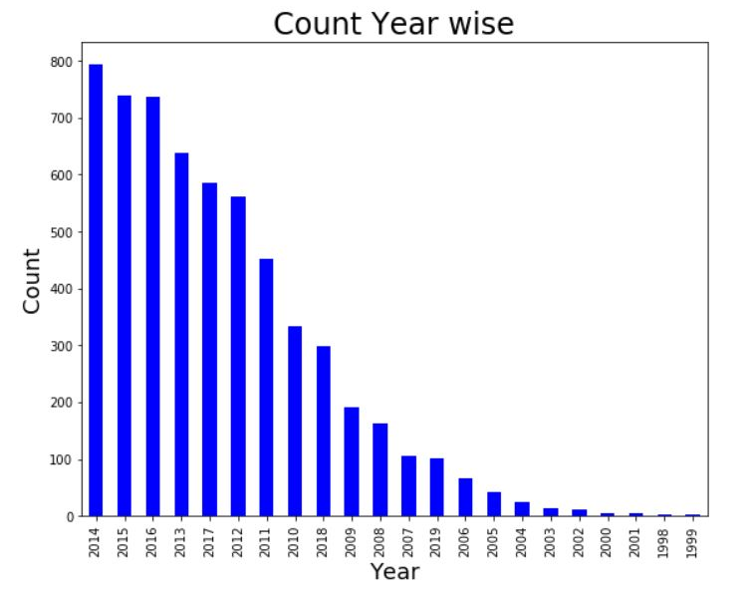
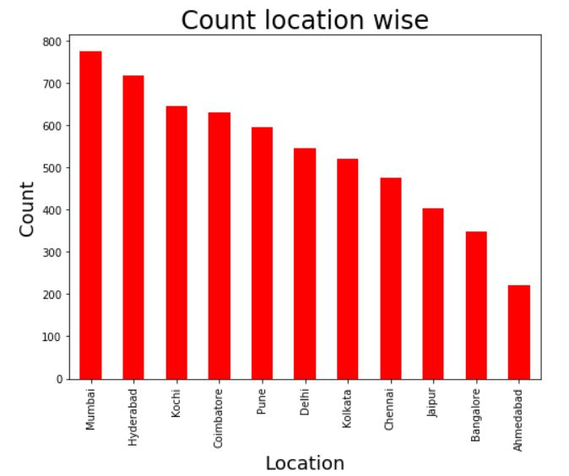
DATA VISUALIZATION

Slide 10
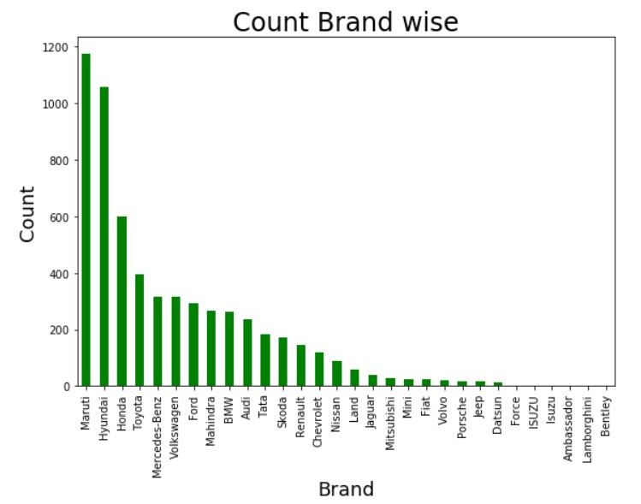
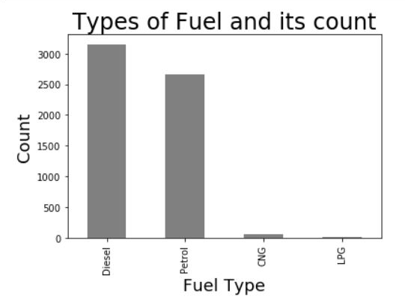
DATA VISUALIZATION

Slide 11
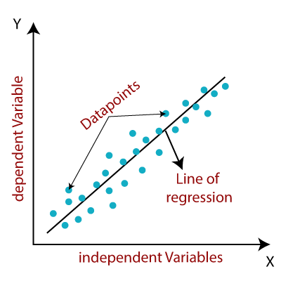
IMPLEMENTATION
Linear Regression:
Linear regression is one of the easiest and most popular Machine Learning algorithms. It is a statistical method that is used for predictive analysis.
Linear regression algorithm shows a linear relationship between a dependent (y) and one or more independent (y) variables, hence called as linear regression.
Since linear regression shows the linear relationship, which means it finds how the value of the dependent variable is changing according to the value of the independent variable.
y= a₀+a₁x+ ε
y = dependent variable (target variable)
x = Independent Variable (predictor variable)
a0= intercept of the line (Gives an additional degree of freedom)
a1= Linear regression coefficient (scale factor to each input value).

Slide 12
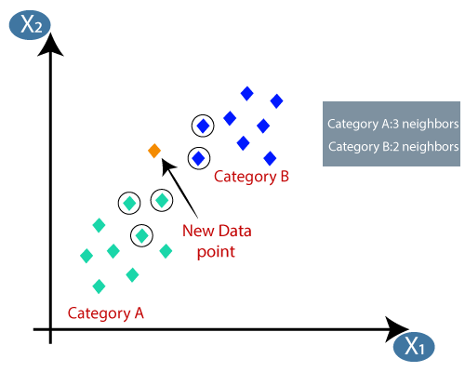
IMPLEMENTATION
K-Nearest Neighbors
K-Nearest Neighbour is one of the simplest Machine Learning algorithms based on Supervised Learning technique.
K-NN algorithm assumes the similarity between the new case/data and available cases and put the new case into the category that is most similar to the available categories.
K-NN algorithm stores all the available data and classifies a new data point based on the similarity. This means when new data appears then it can be easily classified into a well suite category by using K- NN algorithm.
K-NN algorithm can be used for Regression as well as for Classification but mostly it is used for the Classification problems.

Slide 13
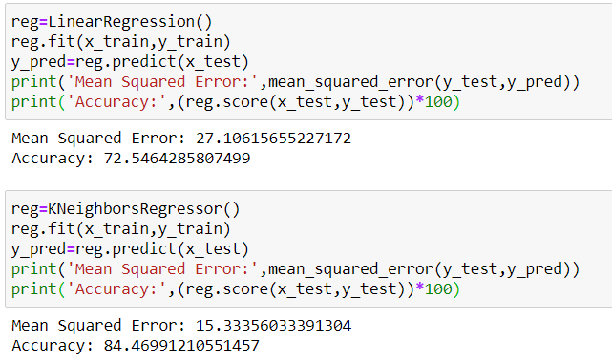
RESULTS
Linear Regression
K-Neighbours Regression

Slide 14
CONCLUSION
The increased prices of new cars and the financial incapability of the customers to buy them, Used Car sales are on a global increase. Therefore, there is an urgent need for a Used Car Price Prediction system which effectively determines the worthiness of the car using a variety of features. The proposed system will help to determine the accurate price of used car price prediction
K-Neighbors Regressor gives best accurate model when compared with Linear regression. Here you have a list of items
Data Cleaning played a major role in achieving better accuracy and Visualizing Data helped us a lot to identify the patterns of data .
Removing the outliers increased the model accuracy, which is a huge improvement
Successfully obtained a K-Neighbors regressor model with 84.4% of accuracy from the data given.

Slide 15
FUTURE WORK
In future this machine learning model may bind with various website which can provide real time data for price prediction. Also we may add large historical data of car price which can help to improve accuracy of the machine learning model.
We can build an android app as user interface for interacting with user. For better performance, we plan to judiciously design deep learning network structures, use adaptive learning rates and train on clusters of data rather than the whole dataset.

Slide 16
THANK YOU !

